Slide 1
Employee Burnout Analysis
Kotla Satya Vardhan Reddy

Slide 2
Agenda
Data Loading
Data Visualization
Data Pre-Processing
Linear Regression

Slide 3


Introduction
Employee Burnout Analysis with multi linear regression. Employee burnout has become a prevalent issue in today's fast-paced and demanding work environments. It is characterized by physical and emotional exhaustion, cynicism, and reduced personal accomplishment, leading to decreased productivity and increased turnover rates.

Slide 4
Data Loading

Slide 5
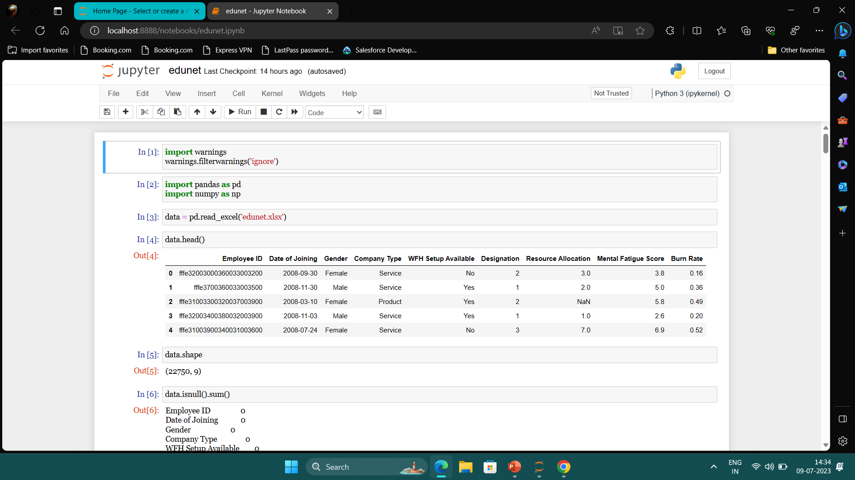

Slide 6
Data Visualization

Slide 7
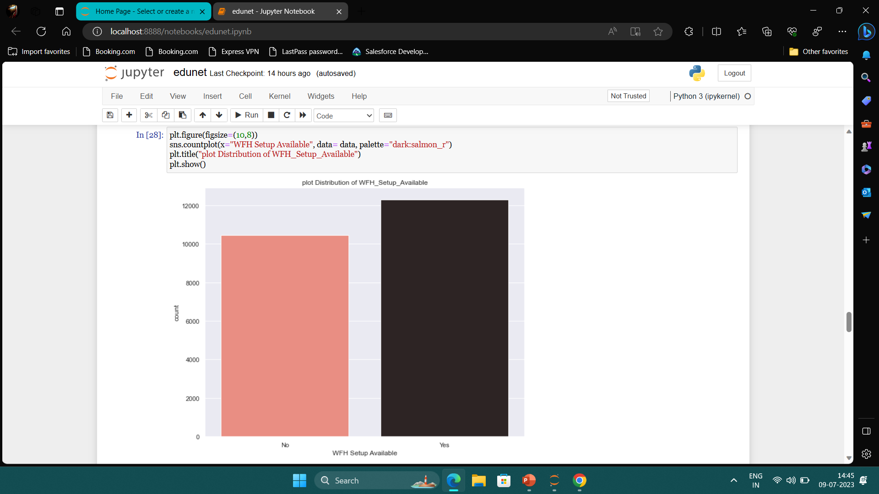
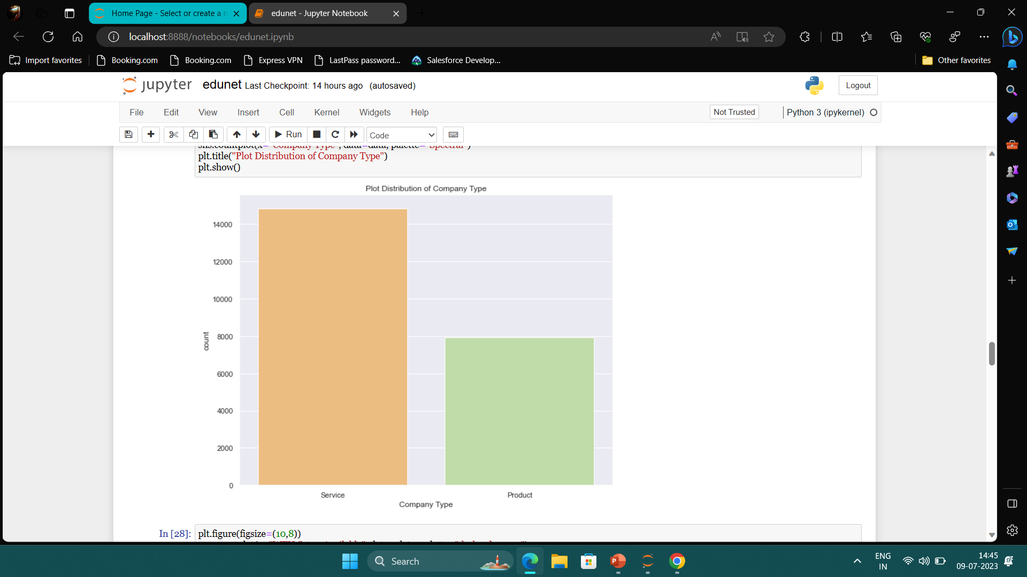
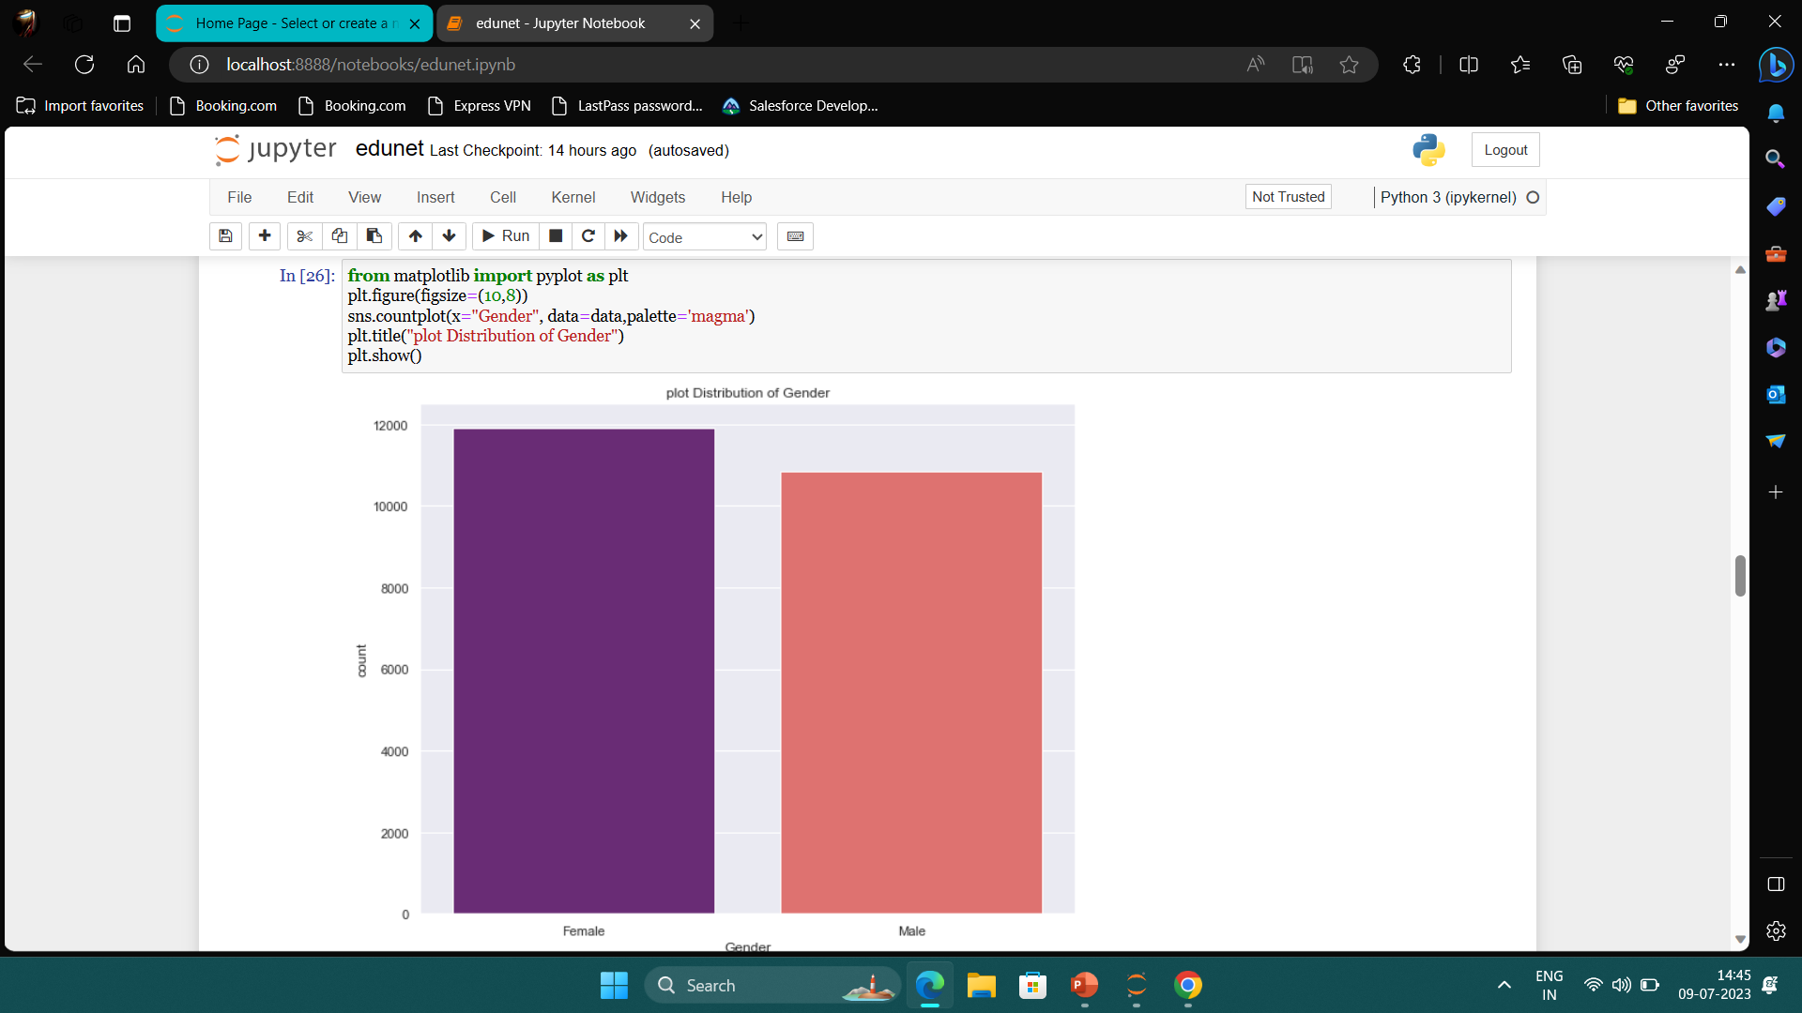
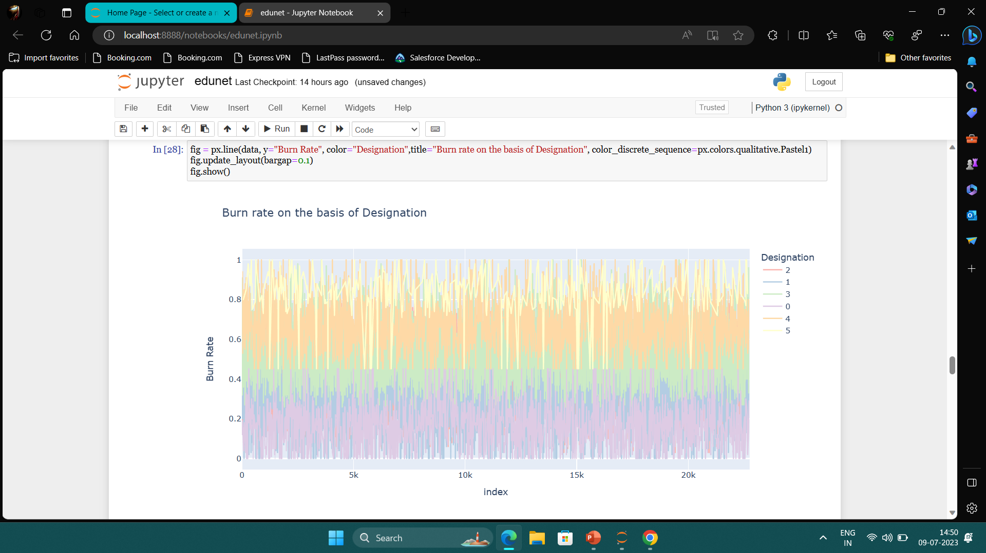

Slide 8
Data Pre-Processing

Slide 9
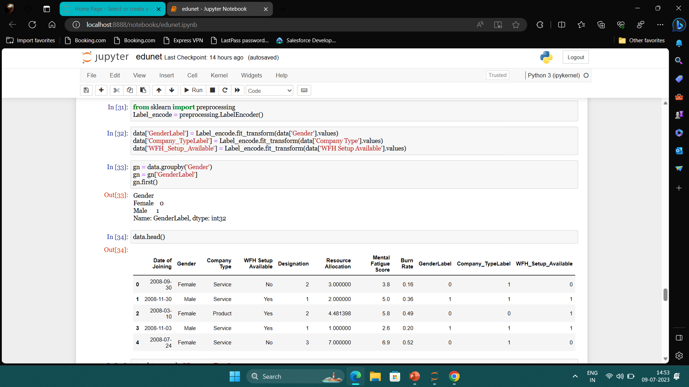

Slide 10
Linear Regression

Slide 11
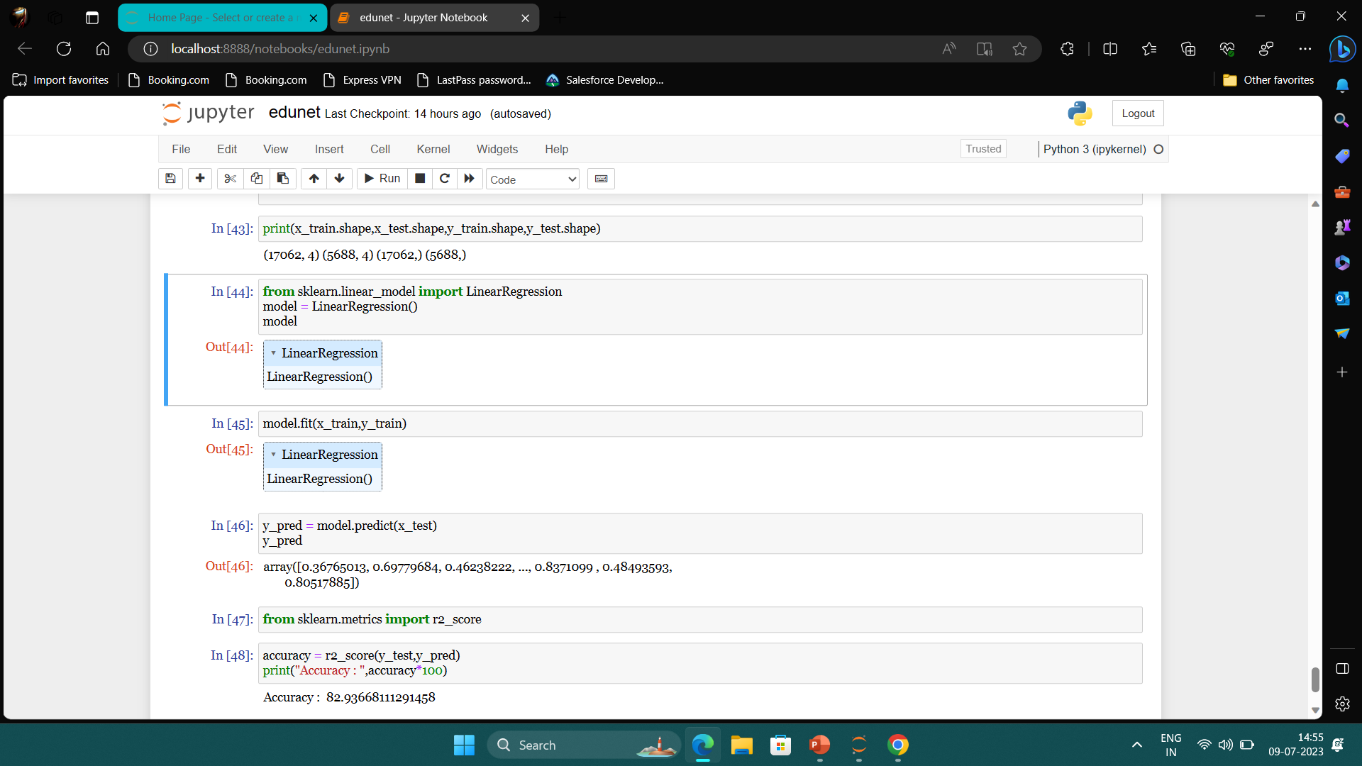

Slide 12
Thank you
Kotla Satya Vardhan Reddy
Email : satyakotla398@gmail.com
LinkedIn : https://www.linkedin.com/in/kotla-satya-vardhan-reddy-161289226/

