Slide 1


Mobile Back-end Development with
Ktor
Kotlin Everywhere
Sina Rezaei
Android & Back-End Developer at Kappa Technologies
20 June 2019

Slide 2
Kotlin Hype
Kotlin Everywhere
Back-End Developers
Android Developers
Front-End Developers
Love Kotlin
Data Engineers
All Programmers
What is Ktor?
Yet another back-end framework (with Kotlin)
Yet another back-end framework (with Kotlin)
Framework for quickly creating web applications with Kotlin

Slide 3
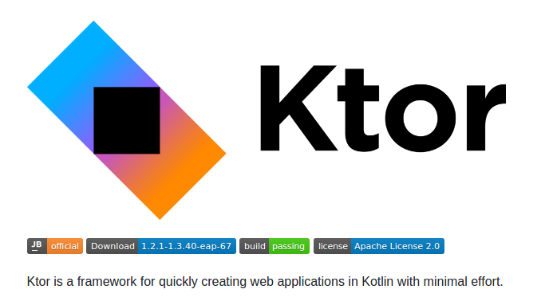
What is Ktor?
From Github Page of Ktor:
https://github.com/ktorio/ktor
Mobile Back-End Development with Ktor

Slide 4
What is Ktor?
Based on ktor.io, Ktor is a:
Pure Kotlin
Unopinionated
  Logging, Templating, Messaging, Persistence, Serializing, DI, etc.
  Any servlet container (Servlet 3.0+ API), standalone with Netty or Jetty
  Application composition
Asynchronous
Server development framework
By JetBrains
Started on Nov. 2015
First Released on Jan. 2018 (0.9.0)
Mobile Back-End Development with Ktor

Slide 5
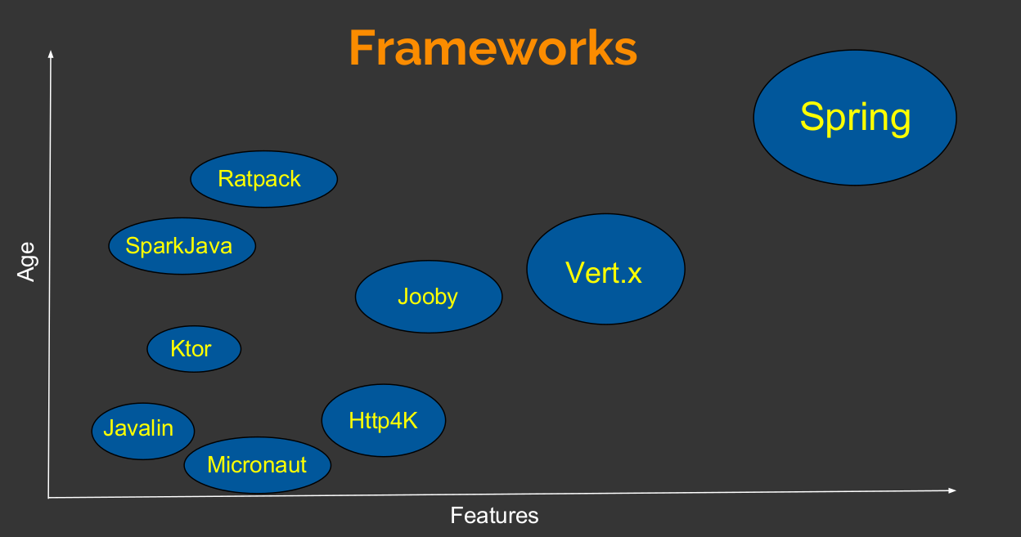
Ktor vs. Kotlin Frameworks
Source: Komparing Kotlin Server-Side Frameworks
KotlinConf 2018
Mobile Back-End Development with Ktor

Slide 6
Ktor vs. Kotlin Frameworks
Ktor | Http4K | Spring
Pure Kotlin | Pure Kotlin | Needs plug-ins
Kotlin Coroutine Support | No Kotlin Coroutine Support | 3rd Party Coroutine Support
No Opentracing or Micrometer | Micrometer | Opentracing + Micrometer
3rd Party Swagger Support | Swagger Support | Swagger Support
Free-marker & Velocity | 5 Template Engines | Over 7 Template Engines
Supports WebSockets | Supports WebSockets | Supports WebSockets
Very fast | Moderate Speed | Slowest Kotlin framework
Google App Engine | AWS Lambda Deployment | AWS Lambda & App Engine
Mobile Back-End Development with Ktor

Slide 7
Ktor vs. Non Kotlin Frameworks
Ktor | Web.Go | Tornado
Super Fast | Very Fast | Fast
Statically Typed (Kotlin) | Statically Typed (Go) | Dynamically Typed (Python)
Kotlin Coroutines | Goroutines | No Coroutines
3rd Party (Exposed, JDBC, etc.) | 3rd Party (GORM, Sql packge, etc.) | 3rd Party
Supports WebSockets | No WebSockets | Supports WebSockets
Mobile Back-End Development with Ktor

Slide 8
Why Back-Ends welcome Ktor
High Performance (Using Coroutines + Thread Pooling)
Fast & Easy Implementation
Strong Runtime Environment
Statically Typed Language
Includes multi-platform clients (Android/iOS/JavaScript)
Suitable for creating RESTful apis and websockets
Can help Android developers with creating mobile back-end easily with Kotlin
Mobile Back-End Development with Ktor

Slide 9
Mobile Back-End
Some examples:
User Registration/Verification
Subscription and In-App billing
Chat
Mobile Back-End Development with Ktor

Slide 10
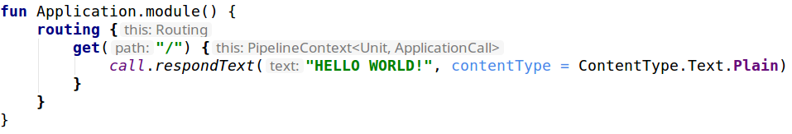
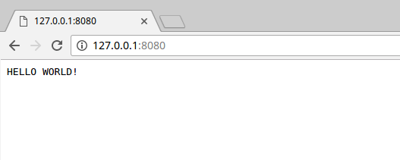
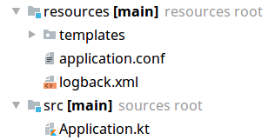
How Ktor code looks like...
Mobile Back-End Development with Ktor

Slide 11
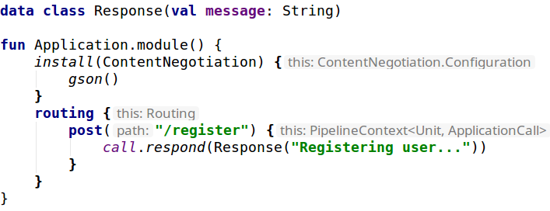
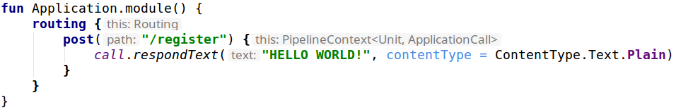
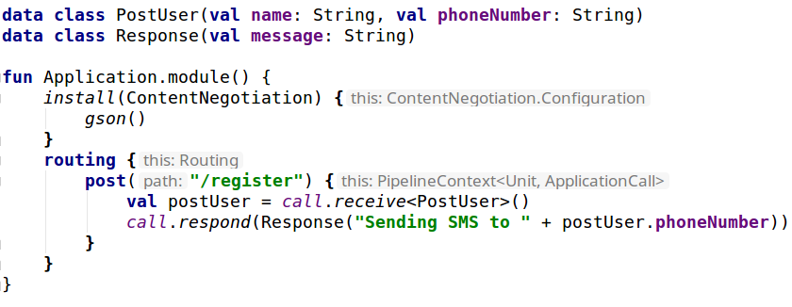
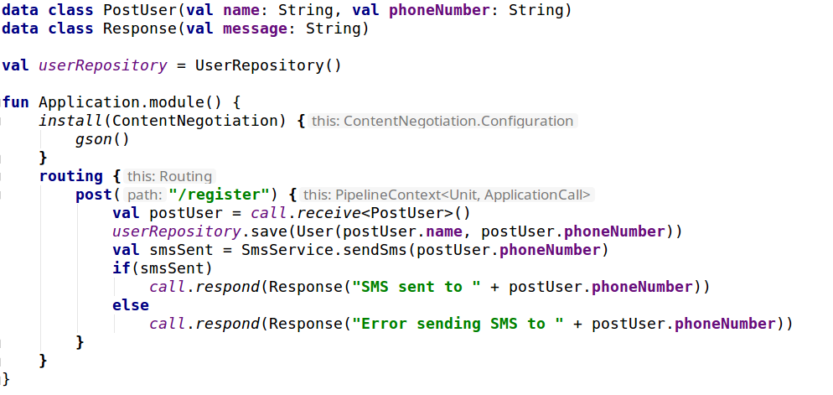
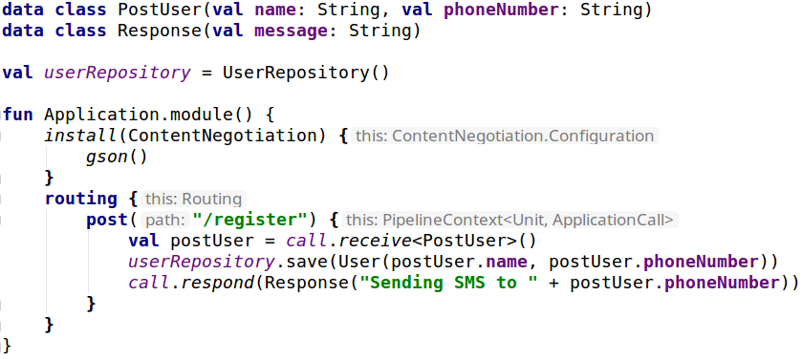
User Registration
RESTful service with Ktor
Mobile Back-End Development with Ktor

Slide 12
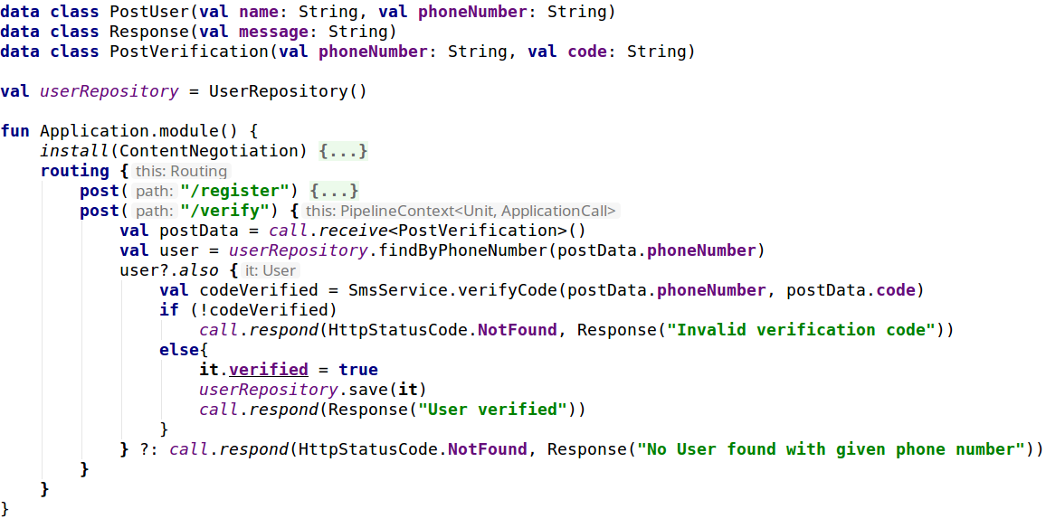
User Verification
Mobile Back-End Development with Ktor

Slide 13
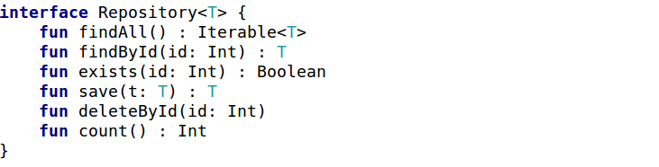
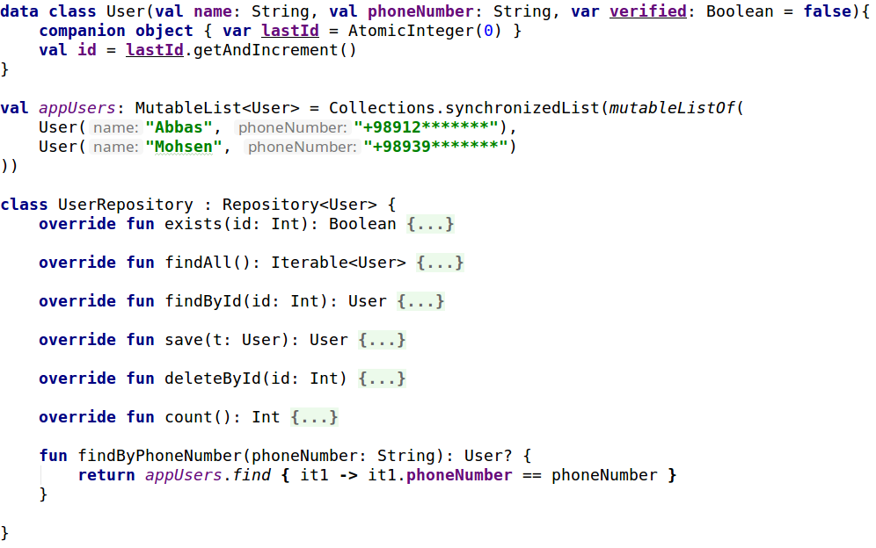
Data Persistence (Repository)
Mobile Back-End Development with Ktor

Slide 14
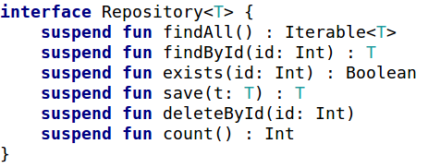
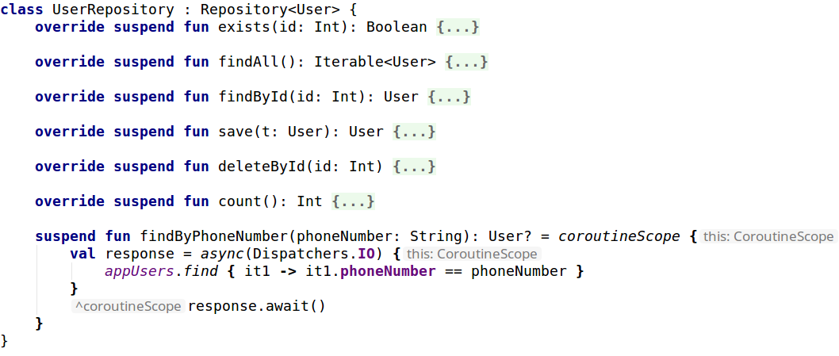
Data Persistence - Coroutines
Mobile Back-End Development with Ktor

Slide 15
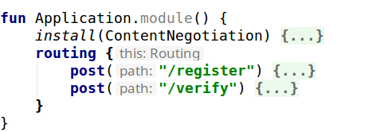
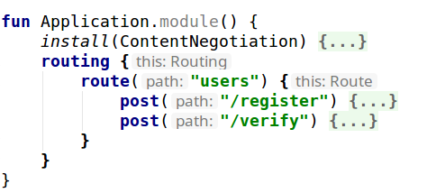
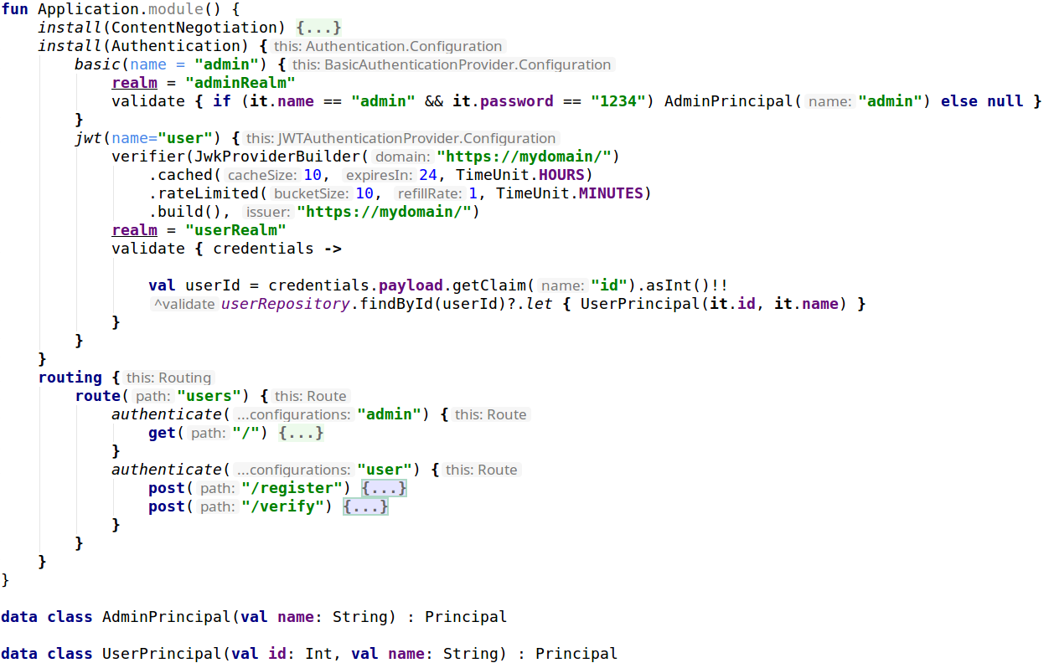
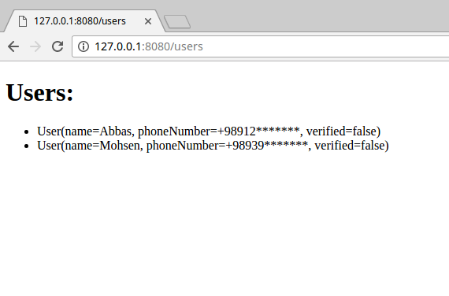
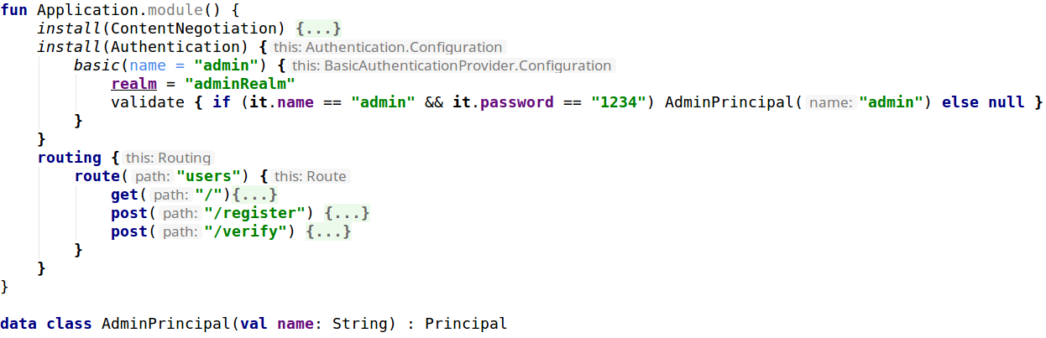
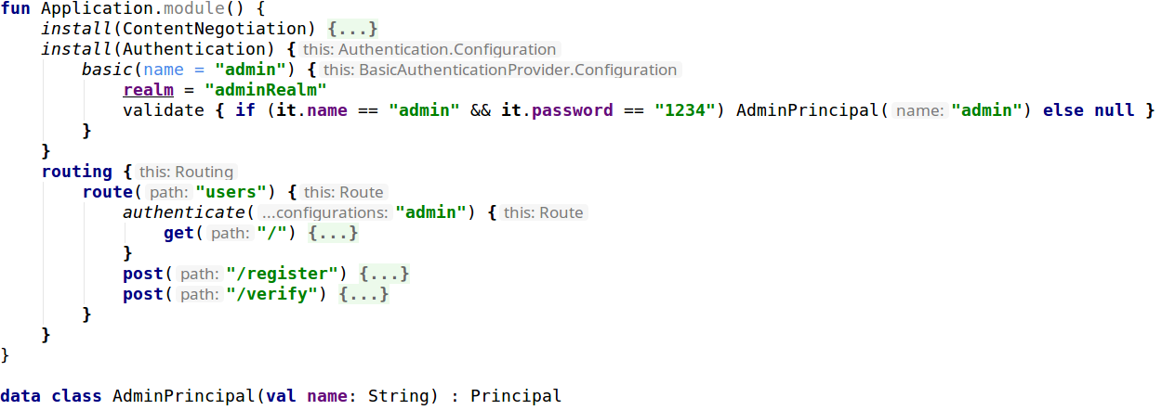
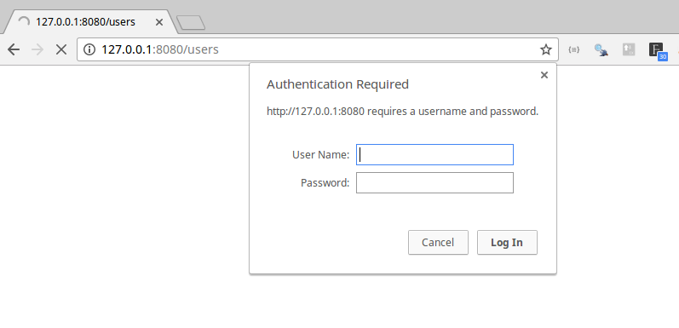
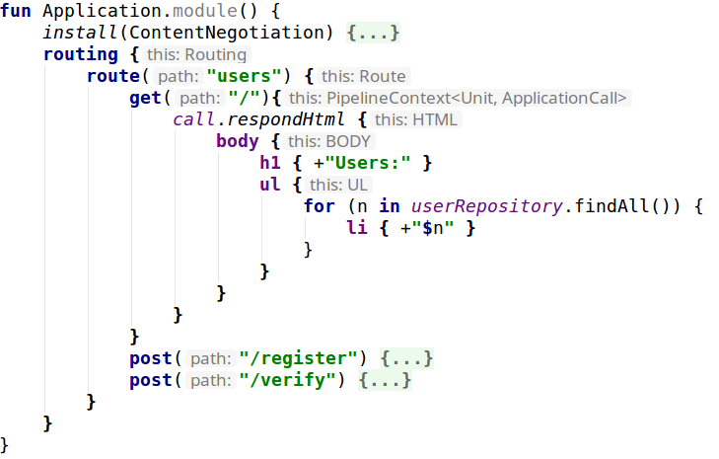
Users Admin
Mobile Back-End Development with Ktor

Slide 16
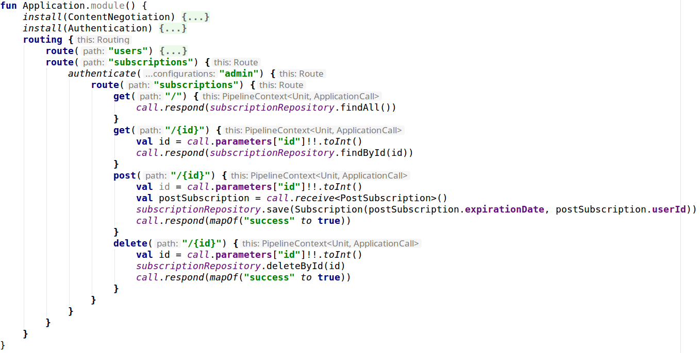
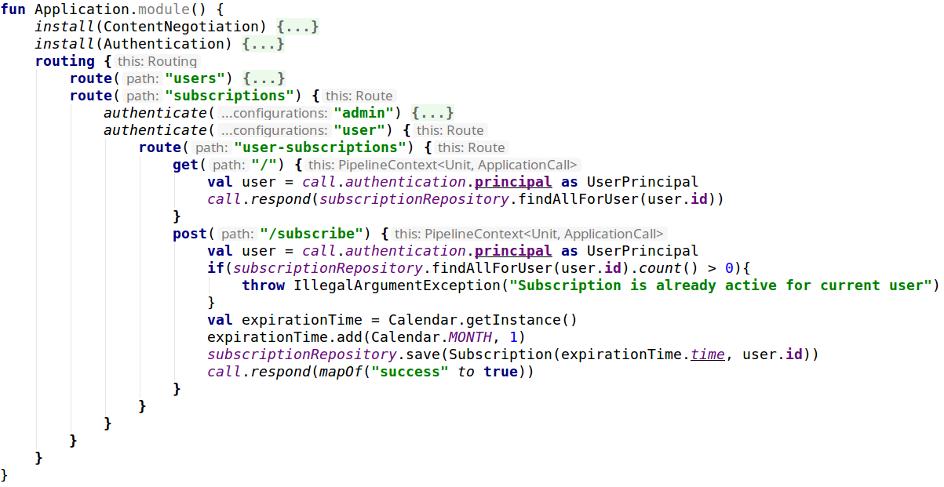
Subscription
Mobile Back-End Development with Ktor

Slide 17
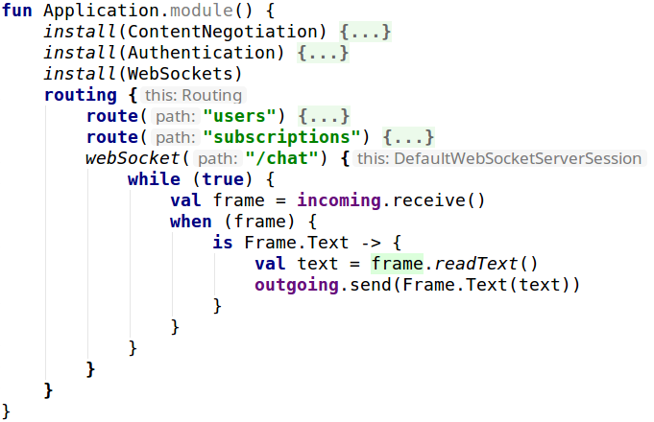
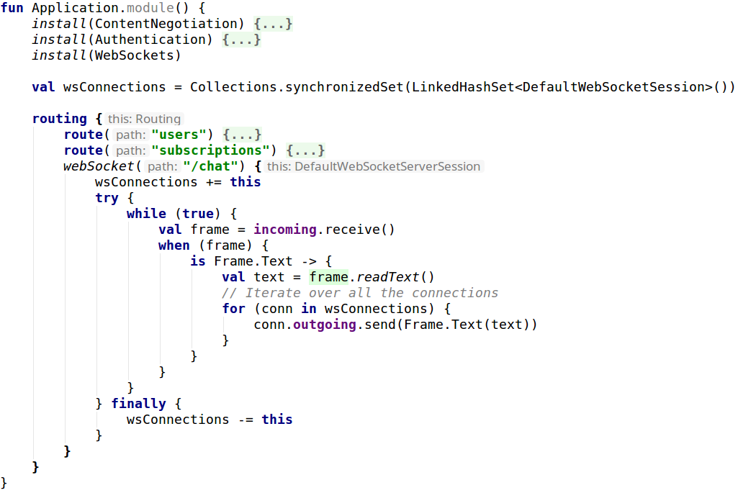
Chat with WebSockets
Mobile Back-End Development with Ktor

Slide 18
Ktor Cons
Small Community
Not even in stackoverflow trends
Low search popularity in Google trends
Mobile Back-End Development with Ktor

Slide 19
Hope you’ve enjoyed the presentation!
Kotlin Everywhere
Questions

