Slide 1

Project 1 Team 3 Analyzing the Effects of World Events on Prices
Notes:
Opening:
Kevin will intro

Slide 2

Hypothesis: World Events have significant affects on prices of products and goods.
Notes:
Kevin

Slide 3
Primary Questions: * Which world events are heavily visible in a variety of commodity prices? * Do prices decrease to normal after world events? * Are there any items that appear to have been affected uniquely by one major event?
Notes:
Kevin

Slide 4
Major World Events in question: Oil Crash: 2014-2016 Covid 19: March 2020 Ever Given: March 2021 Ukraine/Russian War: March 2021 Avian Flu: 2016 & February 2022
Notes:
Kevin

Slide 5
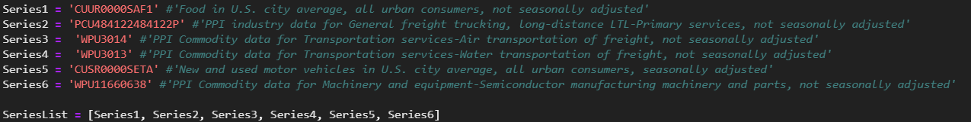
Import of API and CSV data Source: US Bureau of Labor Statistics
Notes:
Kevin
-Where from
Ryan
-define BLS, PPI, CPI

Slide 6
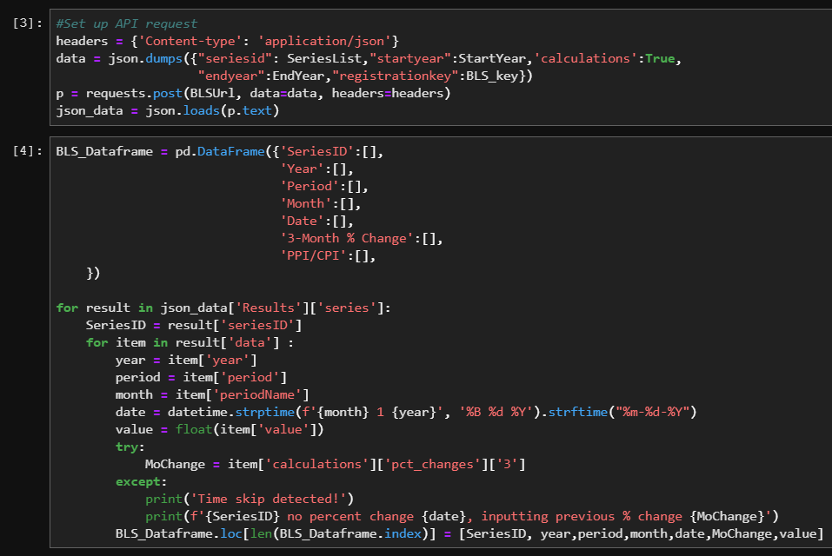
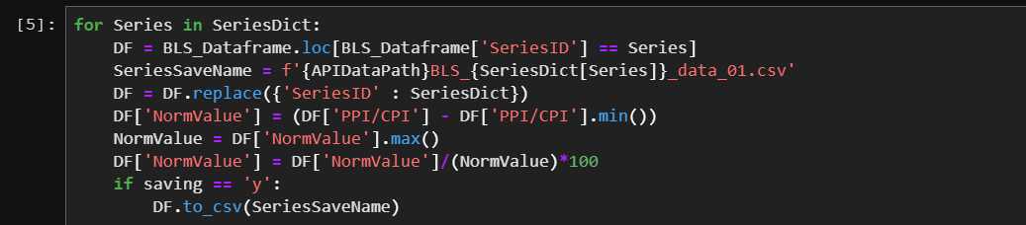
Import of API and CSV data
Notes:
Ryan
Data includes series ID, price, 3-Month % Change, Date
Data is normalized

Slide 7
Collected Datasets Air freight prices Water freight prices Land freight prices Electricity prices Gasoline prices New and used automobile prices General food prices Banana prices Egg prices Shelter (rent) prices Toilet paper prices Television prices Semiconductor manufacturing machinery prices
Notes:
Ryan

Slide 8
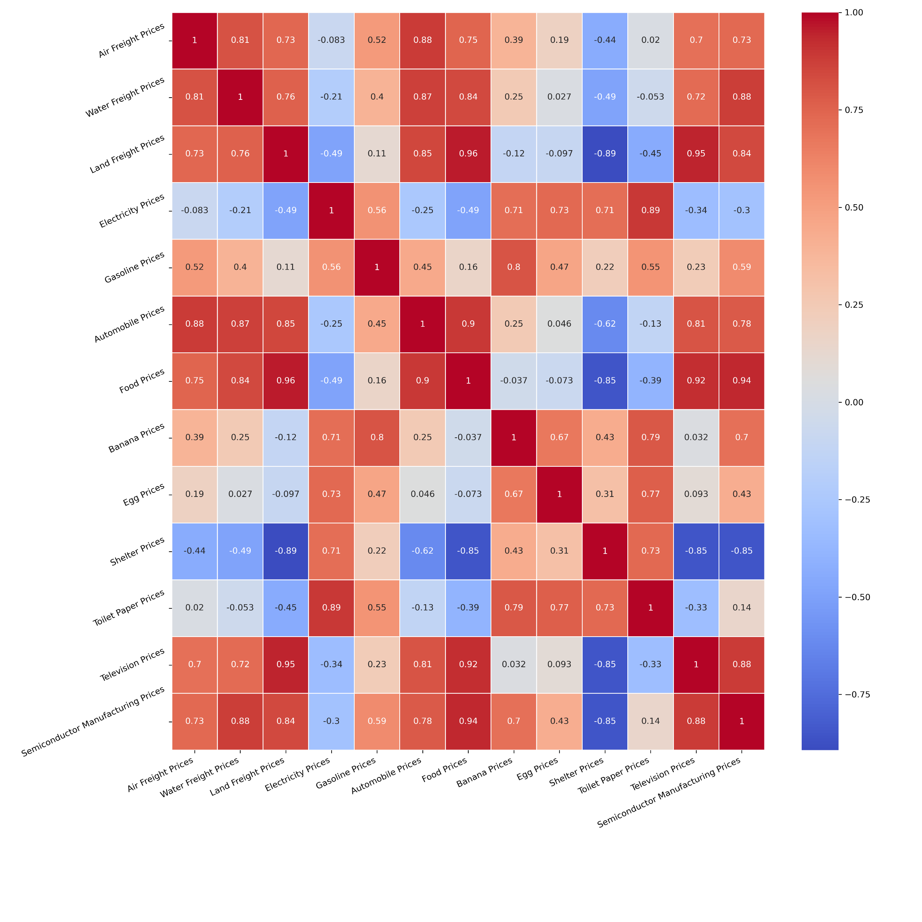
All correlation Matrix
Notes:
Ryan

Slide 9
Datasets
Discuss major events for the dataset
Unique trends
Did prices return to normal for past events?
Notes:
Jo Ann
* Which world events are heavily visible in a variety of commodity prices? * Do prices decrease to normal after world events? * Are there any items that appear to have been affected uniquely by one major event? * How does each items price increase compare to yearly inflation?

Slide 10
Major influences
1. COVID-19 Pandemic (2019-present): The coronavirus disease pandemic caused by the novel coronavirus (SARS-CoV-2) has had a significant global impact, resulting in millions of infections and deaths, as well as widespread social and economic disruptions.
2. Oil Price Crash (2014-2016): In mid-2014, global oil prices began a steep decline. The price drop was attributed to a combination of factors, including a surge in global oil production, particularly from U.S. shale oil, slowing global economic growth, and a decision by OPEC (Organization of the Petroleum Exporting Countries) to maintain production levels rather than cut them. This led to an oversupply of oil in the market. As a result, oil prices fell from over $100 per barrel in mid-2014 to around $30 per barrel in early 2016.
Minor influences
3. Russia-Ukraine conflict (February 2022-present): On 24 February 2022, Russia invaded and occupied parts of Ukraine in a major escalation of the Russo-Ukrainian War, which had begun in 2014.
Notes:
Jo Ann
Automobile Prices Food Prices Electricity Prices Gasoline Prices Toilet Paper Prices
Affect most americans / daily life
Covid, oil crash (2014-2016)
* Which world events are heavily visible in a variety of commodity prices? * Do prices decrease to normal after world events? * Are there any items that appear to have been affected uniquely by one major event? * How does each items price increase compare to yearly inflation?

Slide 11
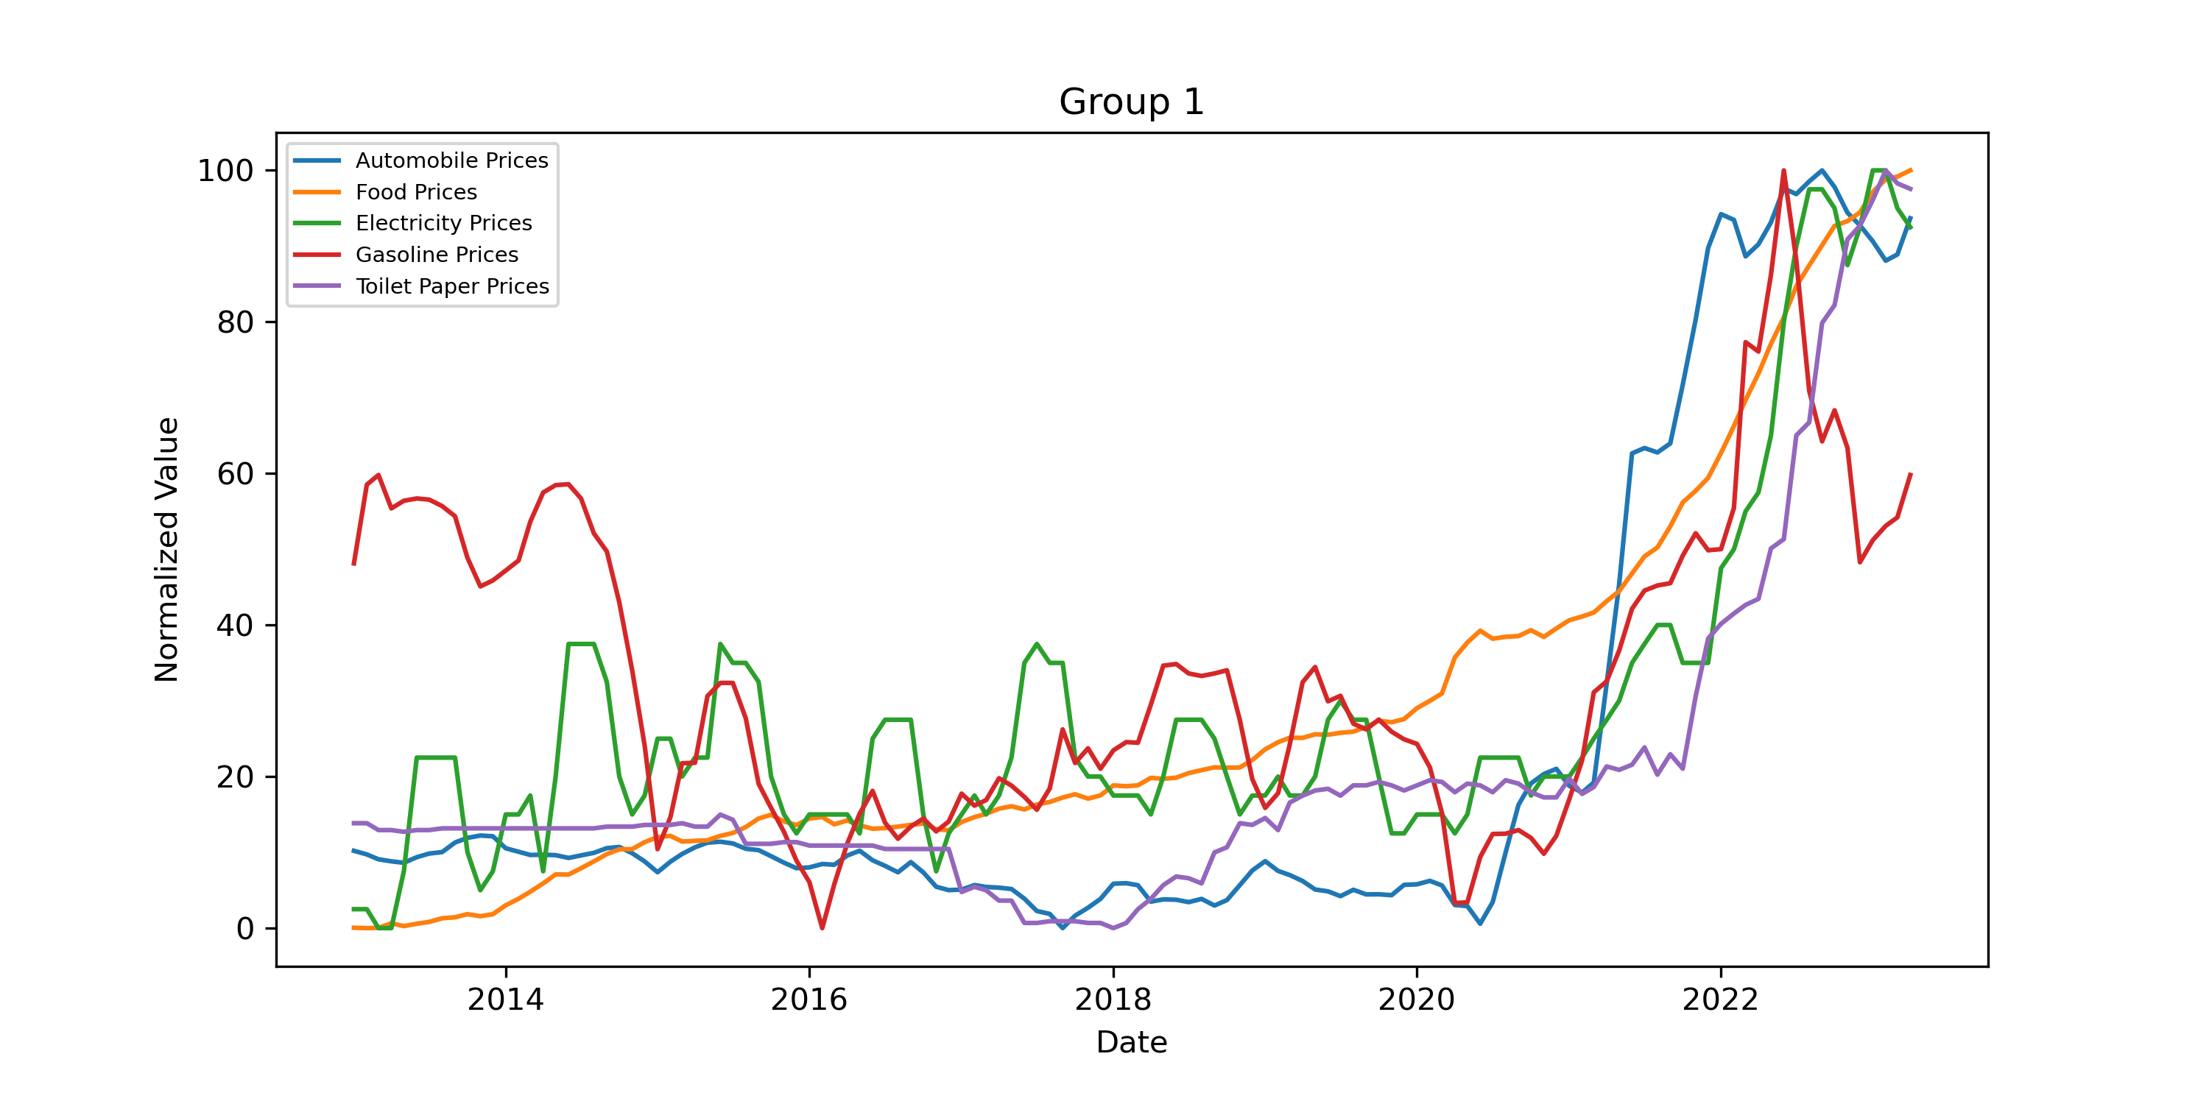
Automobile Prices Food Prices Electricity Prices Gasoline Prices Toilet Paper Prices
Notes:
Jo Ann
Automobile Prices, Food Prices, Electricity Prices, Gasoline Prices, Toilet Paper Prices
Covid, oil crash (2014-2016)
-Covid peaked all of these
-Many of these were affected mainly by covid
-gasoline is an example that was affected previously (was high and dropped)
Which world events are heavily visible in a variety of commodity prices?
* Are there any items that appear to have been affected uniquely by one major event? * How does each items price increase compare to yearly inflation?

Slide 12
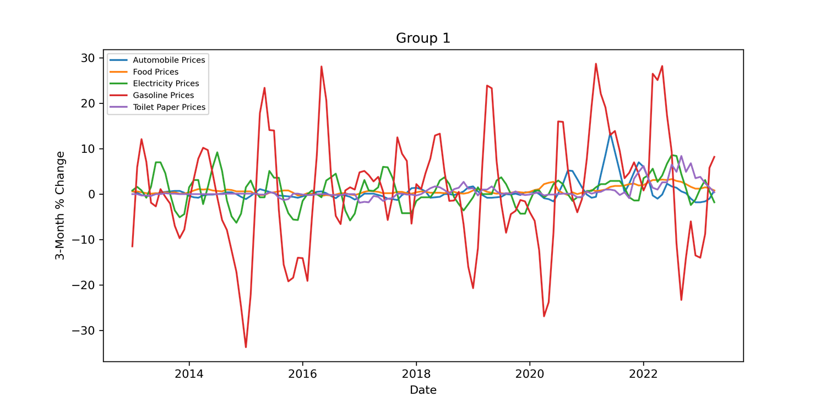
3 Month Percent Change
Notes:
Jo Ann
Gasoline prices you can really see the volatility

Slide 13
Major influences
1. COVID-19 Pandemic (2019-present): The coronavirus disease pandemic caused by the novel coronavirus (SARS-CoV-2) has had a significant global impact, resulting in millions of infections and deaths, as well as widespread social and economic disruptions.
2. Oil Price Crash (2014-2016): In mid-2014, global oil prices began a steep decline. The price drop was attributed to a combination of factors, including a surge in global oil production, particularly from U.S. shale oil, slowing global economic growth, and a decision by OPEC (Organization of the Petroleum Exporting Countries) to maintain production levels rather than cut them. This led to an oversupply of oil in the market. As a result, oil prices fell from over $100 per barrel in mid-2014 to around $30 per barrel in early 2016.
3. Ever Given (March 2021): While traveling from Tanjung Pelepas in Malaysia[9] to Rotterdam in the Netherlands under Captain Krishnan Kanthavel, the ship ran aground in the Suez Canal, blocking the channel. The Suez canal handles approximately 12% of global trade.
Minor influences
4. Russia-Ukraine conflict (February 2022-present): On 24 February 2022, Russia invaded and occupied parts of Ukraine in a major escalation of the Russo-Ukrainian War, which had begun in 2014.
Notes:
Navya
Banana Air Freight Prices Water Freight Prices Land Freight Prices Gasoline Prices
Ever Given (Evergreen was the company)
Mostly affected by crude oil price – decreased 2014-2016
Banana and gasoline line up / correlate
Land freight less affected by Ever Given
* Which world events are heavily visible in a variety of commodity prices? * Do prices decrease to normal after world events? * Are there any items that appear to have been affected uniquely by one major event? * How does each items price increase compare to yearly inflation?

Slide 14
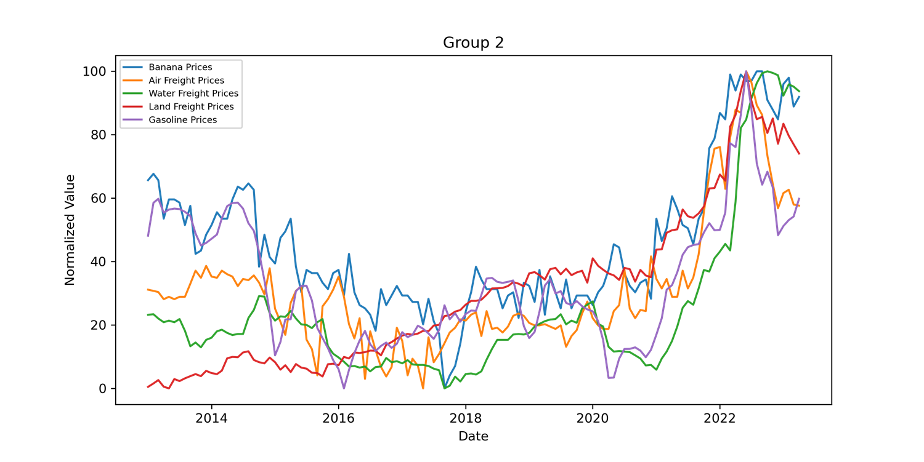
Banana Air Freight Prices Water Freight Prices Land Freight Prices Gasoline Prices
Notes:
Navya
Banana Air Freight Prices Water Freight Prices Land Freight Prices Gasoline Prices
Ever Given (Evergreen was the company)
Mostly affected by crude oil price – decreased 2014-2016
Banana and gasoline line up / correlate
Land freight less affected by Ever Given
* Which world events are heavily visible in a variety of commodity prices? * Do prices decrease to normal after world events? * Are there any items that appear to have been affected uniquely by one major event? * How does each items price increase compare to yearly inflation?

Slide 15
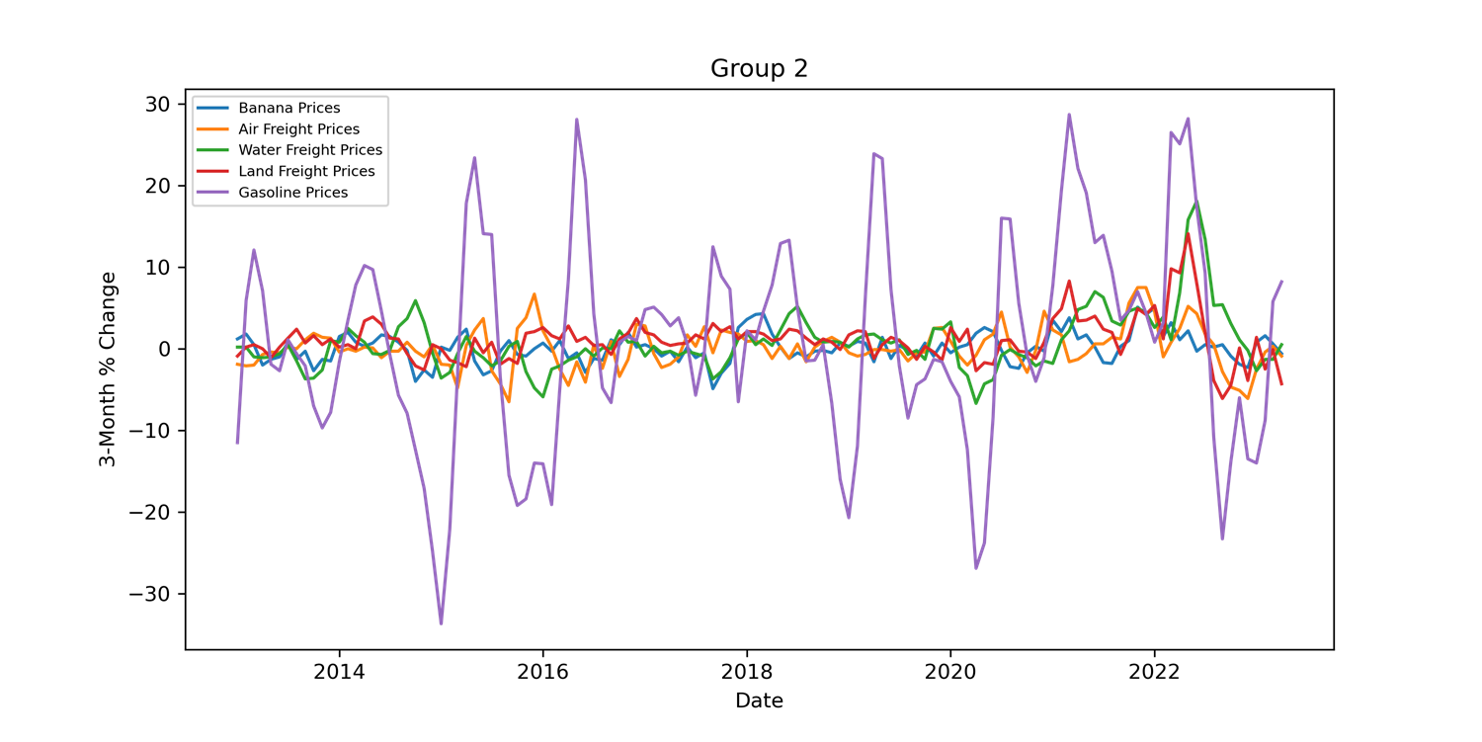
3 Month Percent Change
Notes:
Navya
3% change – gasoline again has a lot of variance.
Others are steady other than a 2022 peak near the Ever Given
2019 peak is covid
Banana Air Freight Prices Water Freight Prices Land Freight Prices Gasoline Prices
Ever Given (Evergreen was the company)
Mostly affected by crude oil price – decreased 2014-2016
Banana and gasoline line up / correlate
Land freight less affected by Ever Given
* Which world events are heavily visible in a variety of commodity prices? * Do prices decrease to normal after world events? * Are there any items that appear to have been affected uniquely by one major event? * How does each items price increase compare to yearly inflation?

Slide 16
Major influences
1. Russia-Ukraine conflict (February 2022-present): On 24 February 2022, Russia invaded and occupied parts of Ukraine in a major escalation of the Russo-Ukrainian War, which had begun in 2014.
2. Ever Given (March 2021): While traveling from Tanjung Pelepas in Malaysia[9] to Rotterdam in the Netherlands under Captain Krishnan Kanthavel, the ship ran aground in the Suez Canal, blocking the channel. The Suez canal handles approximately 12% of global trade.
3. Oil Price Crash (2014-2016): In mid-2014, global oil prices began a steep decline. The price drop was attributed to a combination of factors, including a surge in global oil production, particularly from U.S. shale oil, slowing global economic growth, and a decision by OPEC (Organization of the Petroleum Exporting Countries) to maintain production levels rather than cut them. This led to an oversupply of oil in the market. As a result, oil prices fell from over $100 per barrel in mid-2014 to around $30 per barrel in early 2016.
4. COVID-19 Pandemic (2019-present): The coronavirus disease pandemic caused by the novel coronavirus (SARS-CoV-2) has had a significant global impact, resulting in millions of infections and deaths, as well as widespread social and economic disruptions.
Notes:
Nelson
Semiconductor Manufacturing Machinery Prices - Russia Ukraine – Neon is primarily sourced from Ukraine and is used in chip manufacturing
Also peak in 2018 – probably a bit of Covid and trade tension Water Freight Prices – appear to correlate with the semiconductor price data – points to affects by the Russia Ukraine confict Food Prices – also appear to correlate with the semiconductor price data – points to affects by the Russia Ukraine confict
Water freight prices returned to normal post 2020
* Which world events are heavily visible in a variety of commodity prices? * Do prices decrease to normal after world events? * Are there any items that appear to have been affected uniquely by one major event? * How does each items price increase compare to yearly inflation?

Slide 17
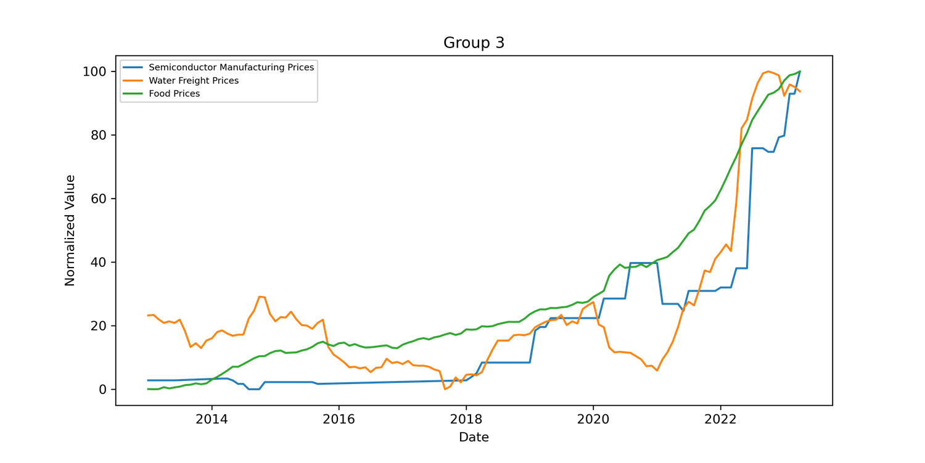
Semiconductor Manufacturing Machinery Prices Water Freight Prices Food Prices
Notes:
Nelson
Semiconductor Manufacturing Machinery Prices - Russia Ukraine – Neon is primarily sourced from Ukraine and is used in chip manufacturing
Also peak in 2018 – probably a bit of Covid and trade tension Water Freight Prices – appear to correlate with the semiconductor price data – points to affects by the Russia Ukraine confict Food Prices – also appear to correlate with the semiconductor price data – points to affects by the Russia Ukraine confict
Water freight prices returned to normal post 2020
* Which world events are heavily visible in a variety of commodity prices? * Do prices decrease to normal after world events? * Are there any items that appear to have been affected uniquely by one major event? * How does each items price increase compare to yearly inflation?

Slide 18
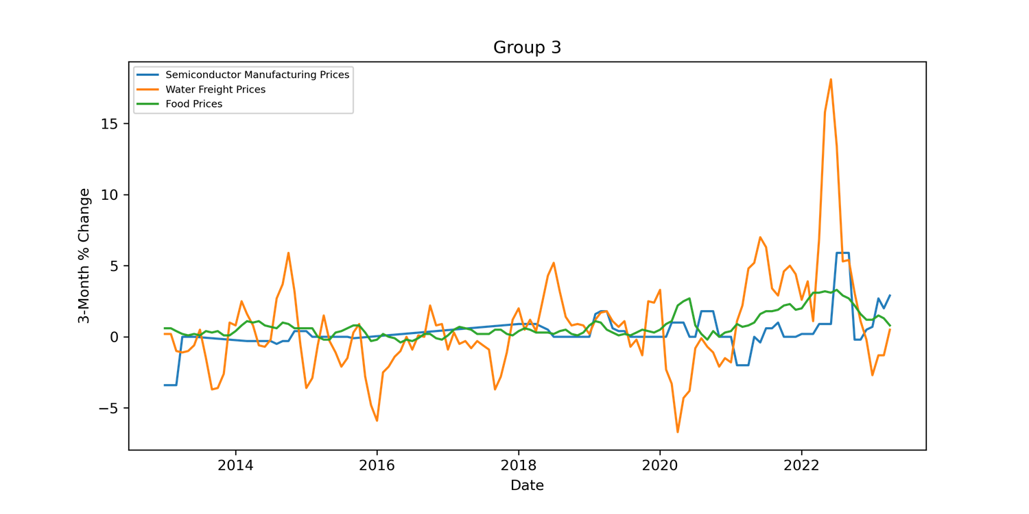
3 Month Percent Change
Notes:
Nelson
Semiconductor Manufacturing Machinery Prices - Russia Ukraine – Neon is primarily sourced from Ukraine and is used in chip manufacturing
Also peak in 2018 – probably a bit of Covid and trade tension Water Freight Prices – appear to correlate with the semiconductor price data – points to affects by the Russia Ukraine confict Food Prices – also appear to correlate with the semiconductor price data – points to affects by the Russia Ukraine confict
Water freight prices returned to normal post 2020
* Which world events are heavily visible in a variety of commodity prices? * Do prices decrease to normal after world events? * Are there any items that appear to have been affected uniquely by one major event? * How does each items price increase compare to yearly inflation?

Slide 19
Major influences
1. Avian Flu (2014-2015)(2022-2023)
2. Ever Given (March 2021): While traveling from Tanjung Pelepas in Malaysia[9] to Rotterdam in the Netherlands under Captain Krishnan Kanthavel, the ship ran aground in the Suez Canal, blocking the channel. The Suez canal handles approximately 12% of global trade.
3. COVID-19 Pandemic (2019-present): The coronavirus disease pandemic caused by the novel coronavirus (SARS-CoV-2) has had a significant global impact, resulting in millions of infections and deaths, as well as widespread social and economic disruptions.
Other datasets are surprisingly consistent (such as shelter).
Notes:
Kevin

Slide 20
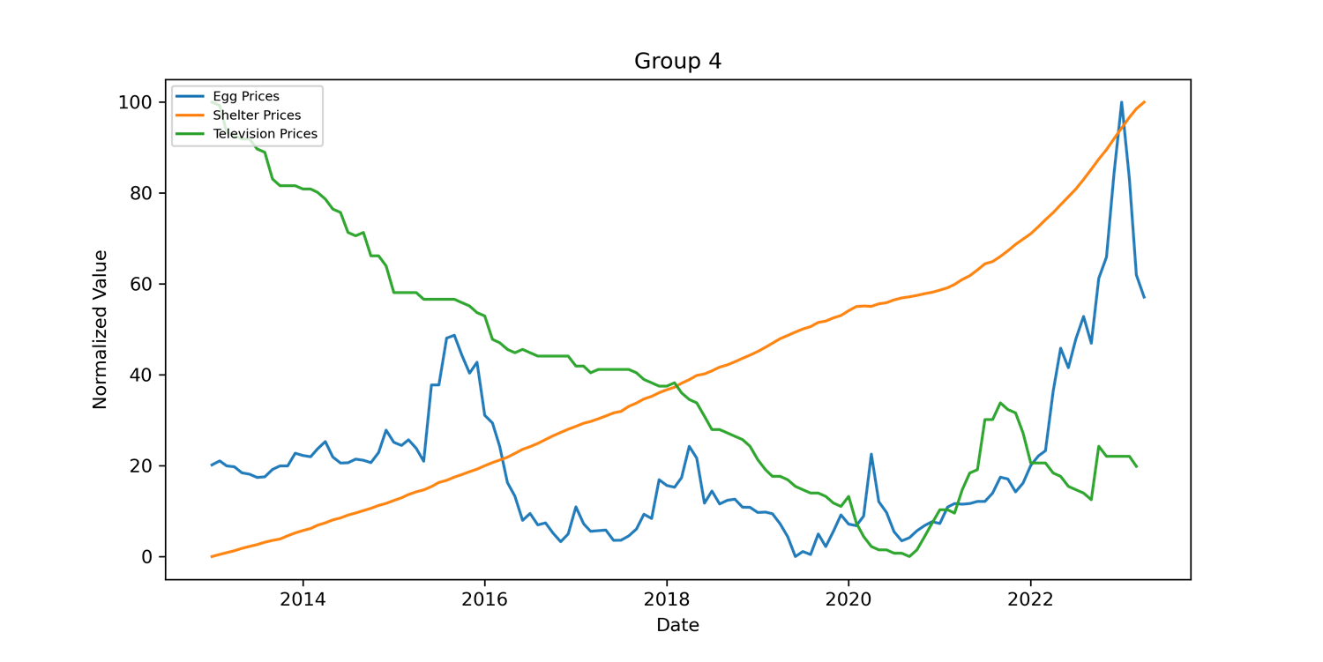
Egg Prices Shelter (rent) Prices Television Prices
Notes:
Kevin
Egg Prices Shelter (rent) Prices Television Prices

Slide 21

3 Month Percent Change
Notes:
Kevin
Egg Prices Shelter (rent) Prices Television Prices

Slide 22
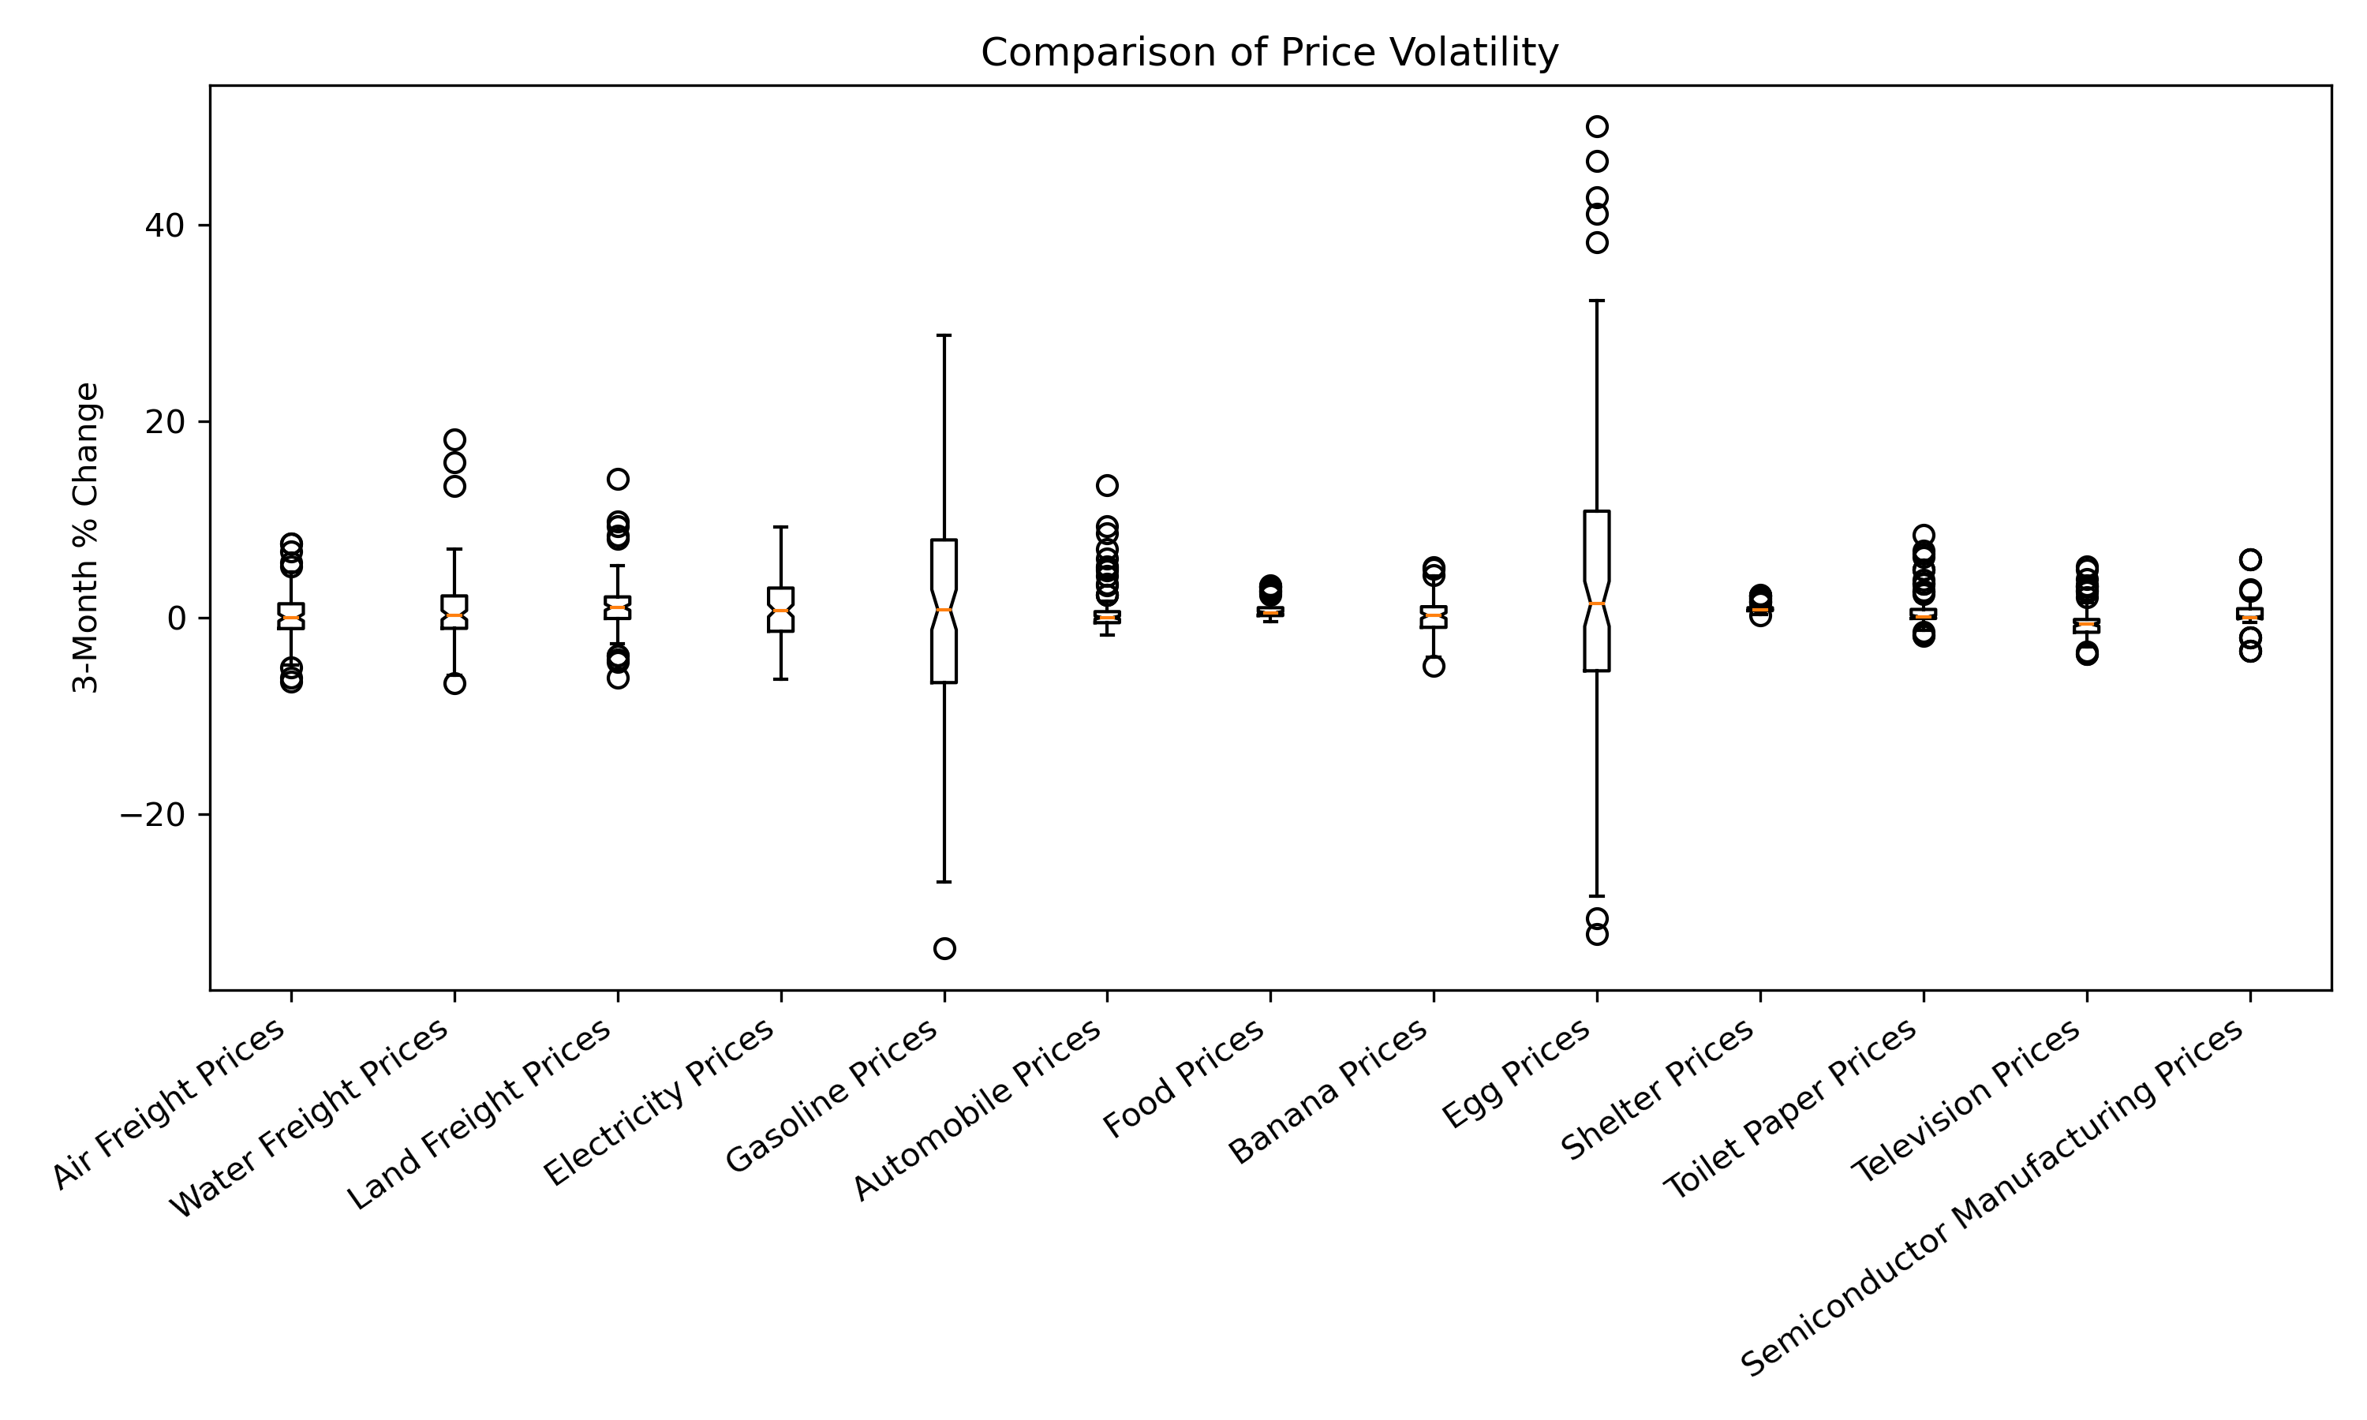
Volatility Comparison
Notes:
Ryan

Slide 23
World Events we considered
Syrian Civil War (2011-present): The conflict in Syria escalated in 2013 and has resulted in a devastating humanitarian crisis and regional instability.
Ukraine Crisis (2013-2014): Protests erupted in Ukraine after the government rejected closer ties with the European Union, leading to political turmoil and the eventual annexation of Crimea by Russia.
Ebola Outbreak (2014-2016): The Ebola virus outbreak in West Africa resulted in thousands of deaths and raised global concerns about public health preparedness.
Bird Flu (2014-2015)(2022-2023):
Oil Price Crash (2014-2016): In mid-2014, global oil prices began a steep decline. The price drop was attributed to a combination of factors, including a surge in global oil production, particularly from U.S. shale oil, slowing global economic growth, and a decision by OPEC (Organization of the Petroleum Exporting Countries) to maintain production levels rather than cut them. This led to an oversupply of oil in the market. As a result, oil prices fell from over $100 per barrel in mid-2014 to around $30 per barrel in early 2016.
Russia-Ukraine conflict (February 2022-present): On 24 February 2022, Russia invaded and occupied parts of Ukraine in a major escalation of the Russo-Ukrainian War, which had begun in 2014.
Ever Given (March 2021): While traveling from Tanjung Pelepas in Malaysia[9] to Rotterdam in the Netherlands under Captain Krishnan Kanthavel, the ship ran aground in the Suez Canal, blocking the channel. The Suez canal handles approximately 12% of global trade.
*Results from history.com, theceomagazine.com, and Wikipedia
Notes:
Ryan

Slide 24
World Events we considered
Paris Climate Agreement (2015): The international climate agreement was adopted by nearly 200 countries, aiming to combat climate change and limit global warming.
Brexit Referendum (2016): The United Kingdom held a referendum on leaving the European Union, resulting in a majority vote in favor of Brexit.
U.S. Presidential Election (2016): Donald Trump, a Republican candidate, was elected as the 45th President of the United States, defeating Hillary Clinton.
Rohingya Crisis (2017-present): The persecution of Rohingya Muslims in Myanmar led to a massive refugee crisis, with thousands fleeing to neighboring Bangladesh.
North Korea Nuclear Crisis (2017-2018): North Korea conducted several missile tests and engaged in a war of words with the United States, raising concerns about nuclear weapons proliferation.
COVID-19 Pandemic (2019-present): The coronavirus disease pandemic caused by the novel coronavirus (SARS-CoV-2) has had a significant global impact, resulting in millions of infections and deaths, as well as widespread social and economic disruptions.
Black Lives Matter Protests (2020-present): Following the killing of George Floyd by a police officer in Minneapolis, protests against racial inequality and police brutality spread across the United States and around the world.
*Results from history.com, theceomagazine.com, and Wikipedia
Notes:
Ryan

Slide 25
Conclusions: Which world events are heavily visible in a variety of commodity prices? Oil Crash in trade, Covid 19, Ever Given, Ukraine/Russian War, Avian Flu Do prices decrease to normal after world events? Gasoline, toilet paper, water freight, eggs have all in the past increased and returned to a normal price Are there any items that appear to have been affected uniquely by one major event? Many items are affected by many world events, but shelter pricing was unique in being affected by legislation during covid.
Notes:
Jo Ann

