Slide 1
SAIL-RISCV Memory Model Refactor
Mingzhu Yan，Shuo Huang，Jian Guan，Yunxiang Luo
2025-2-27

Slide 2
CATALOGUE
01.
Introduction
02.
Motivation
03.
Implement
04.
Future plan

Slide 3
01.
Introduction

Slide 4
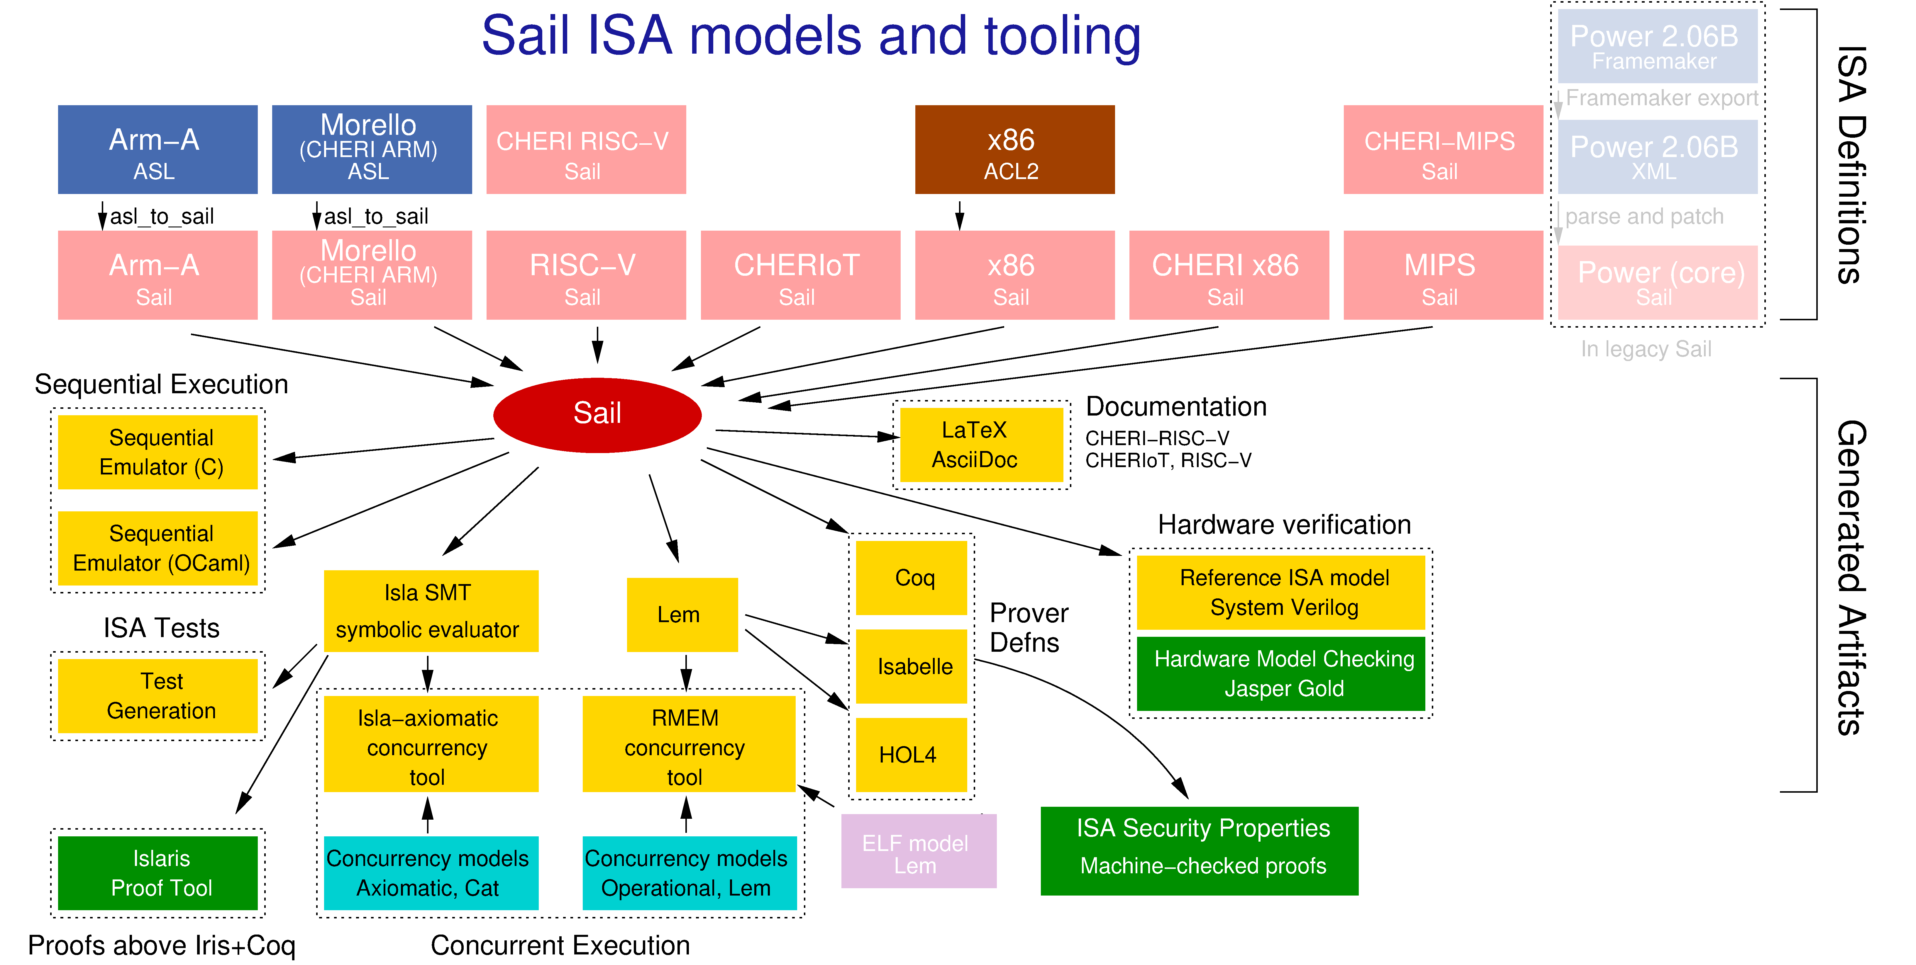
Introduction: Sail-RISCV
Sail-RISCV is a formal specification of the RISC-V architecture, written in Sail, which has been adopted by the RISC-V Foundation.
It specifies assembly language
formats of the instructions, the
corresponding encoders and
decoders, and the instruction
semantics.

Slide 5
02.
Motivation

Slide 6
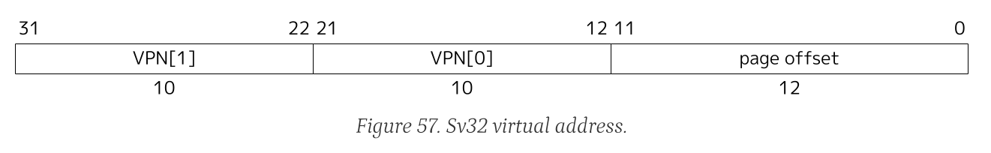
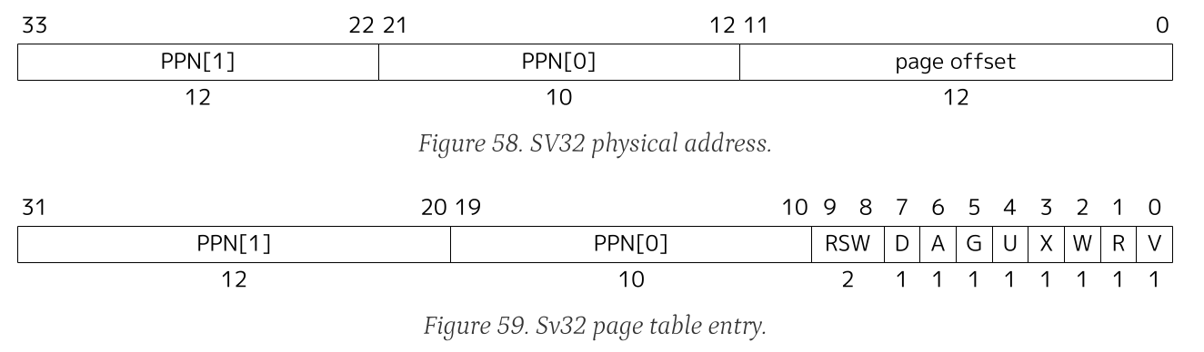
Motivation: Problem
The existing Sail-RISC-V memory model exhibits several limitations.
lacks native support for 34-bit physical addresses within the RV32 specification
conflates the concepts of physical and virtual memory,

Slide 7
03.
Implements

Slide 8
Implements
Our approach to reconstructing the Sail-RISC-V memory model centers on the explicit separation of physical and virtual memory representations and the provision of native support for 34-bit physical addresses within RV32 contexts.
To achieve this, we leveraged the newtype keyword within the Sail language.
virtaddrs
xlenbits
newtype
physaddrs

Slide 9
Implements
For both virtual and physical memory addresses, we then introduced new, distinct types using newtype, such that a given type may now have an explicit meaning representing either the virtual or physical memory space.
PC Fetch
sail backend
physaddrs
translate
virtaddrs
PC Control
Data access
This allows for type-safe handling and prevents accidental use of one type where another is expected.

Slide 10
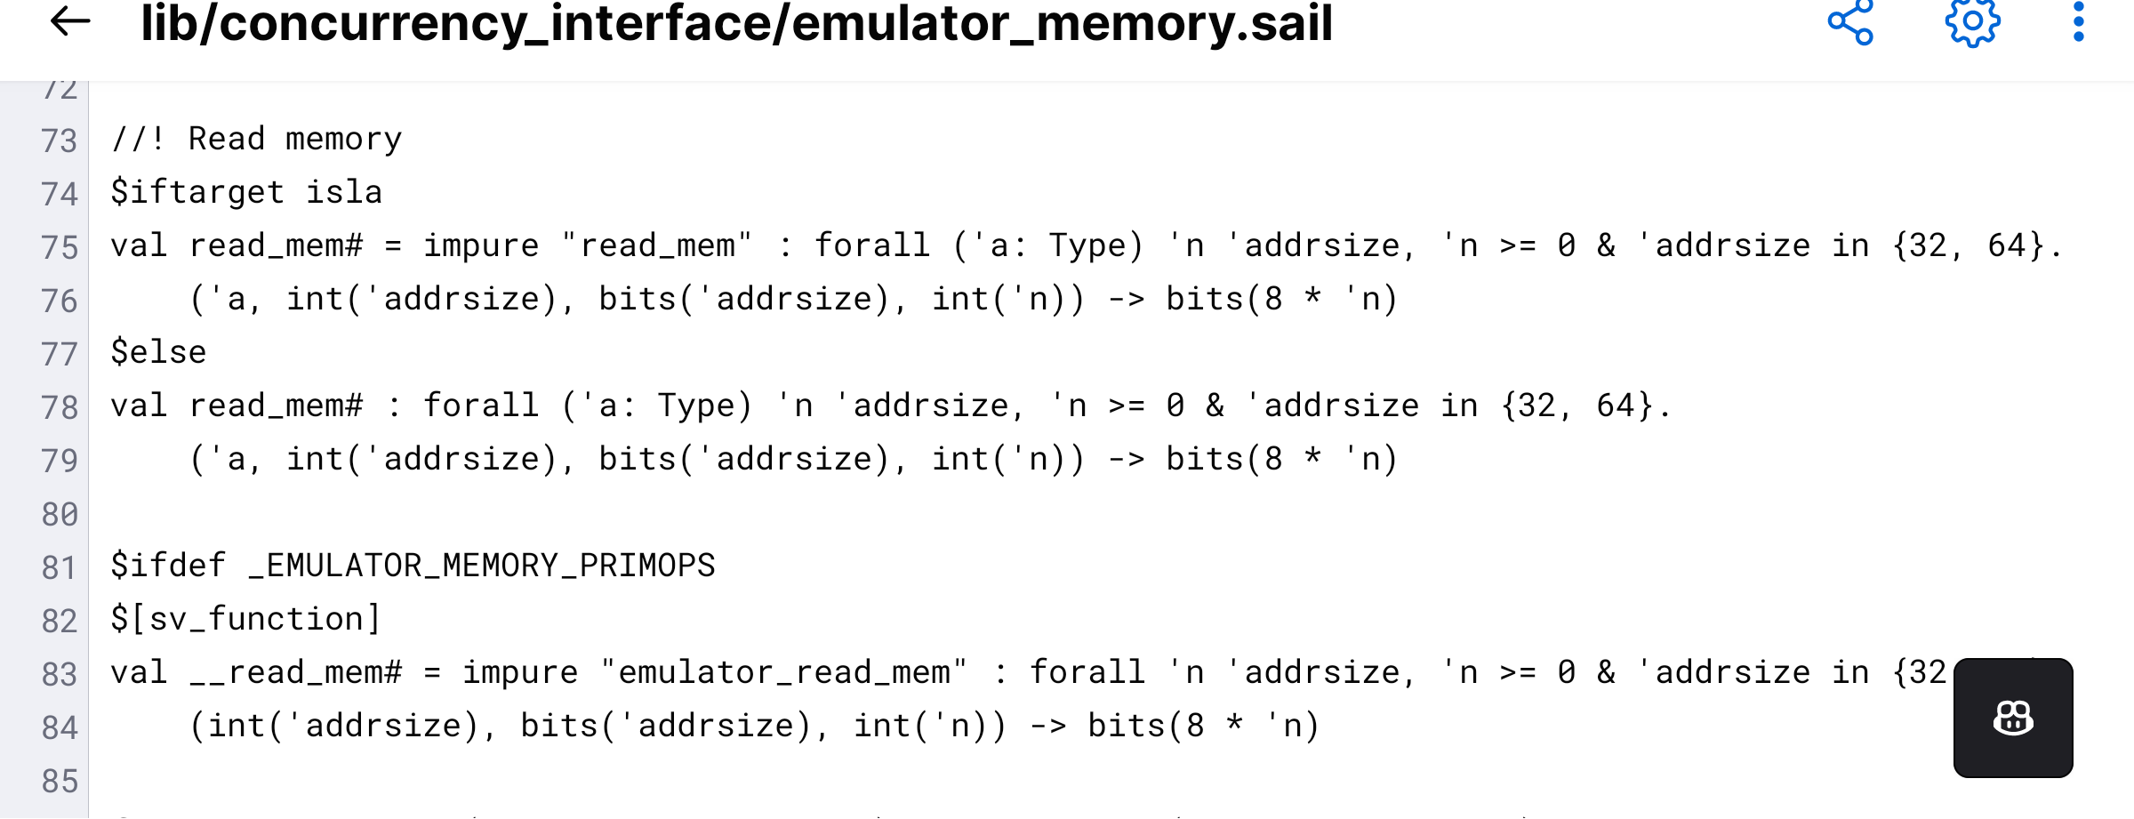
Implements
Sail, being a type-safe language, enforces strict checks on the bit-width of addresses during data transfer. This
restriction limits the address width to 32-bit or 64-bit, creating a limitation for models that need to handle physical address widths beyond these boundaries.

Slide 11
Implements
To address the limitation of existing upstream Sail models, we employed a mapping strategy that leverages the larger 64-bit address space. This approach involves mapping 34-bit physical addresses into a 64-bit representation using zeroextend
34-bits physaddr
Zeroextend
64-bits physaddr
Send to
Sail memory backend

Slide 12
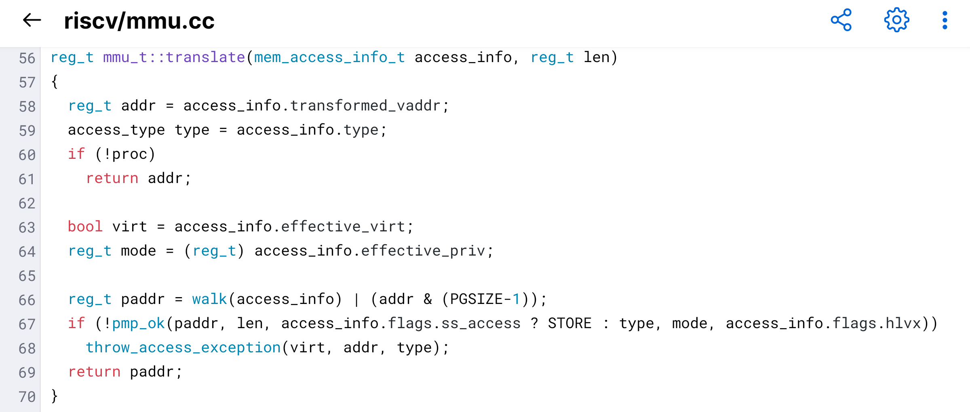
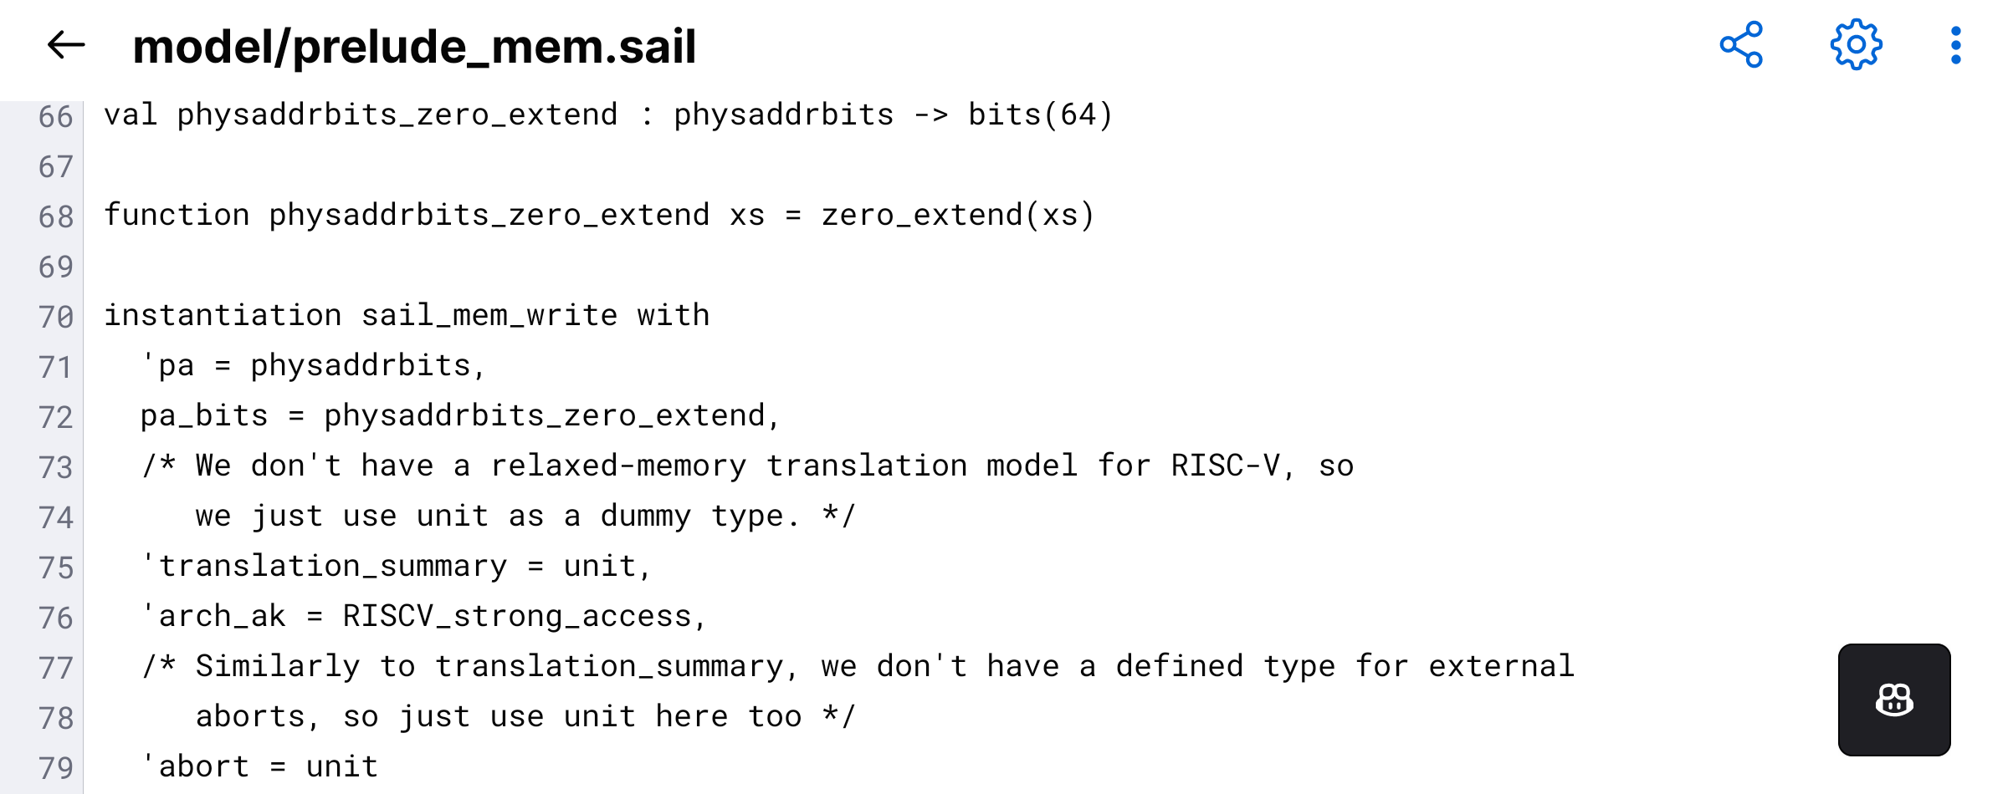
Implements
Mirroring Spike's implementation of reg_t (uint64) for representing and passing physaddrs, our design also ensures that physaddrs are not subject to value corruption during simulator execution, thus guaranteeing the fidelity of address transmission.

Slide 13
04.
Future plan

Slide 14
Future plan
In the future, we will continue to develop Sail-RISCV with a strong emphasis on optimizing its performance and ensuring its robustness. This will involve implementing the ratified extension to identify and eliminate potential vulnerabilities and edge cases that could compromise the reliability of the simulator. We also plan to improve documentation and add support for more RISC-V extensions.

Slide 15
Thanks for watching

