Slide 1
Analog Avengers
Data Analysis
Fabian Eingang, BSc Thomas Kotschnig, BSc Ing. Matthias Krenn, BSc
Notes:
.

Slide 2
Dataset description
Notes:
.

Slide 3

Bike sales in Europe
From Kaggle
> 100k entries
18 columns
Ranging from 2011 to 2016
6 different countries

Slide 4
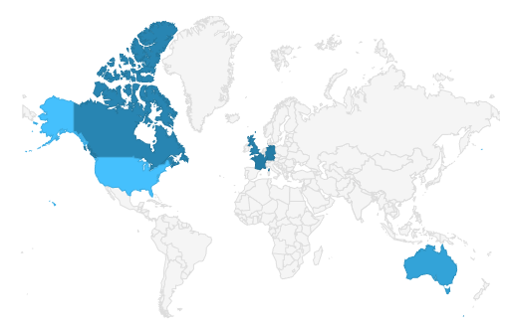
Basic Analysis
Date
Day
Month
Year
Customer_Age
Age_Group
Customer_Gender
Country
State
Product_Category
Sub_Category
Product
Order_Quantity
Unit_Cost
Unit_Price
Profit
Cost
Revenue

Slide 5
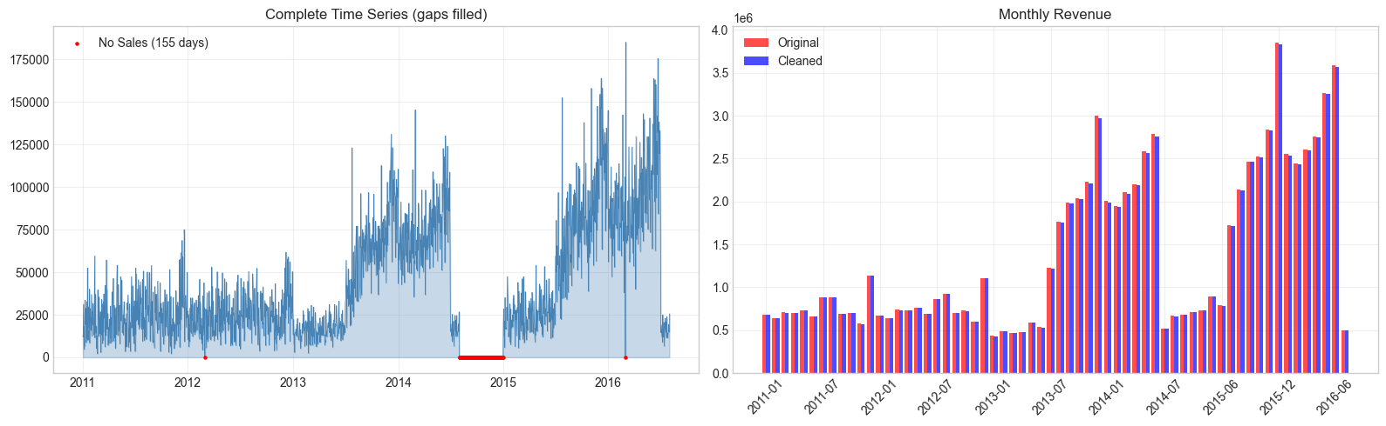
Data Quality
Missing entries, but no missing data

Slide 6
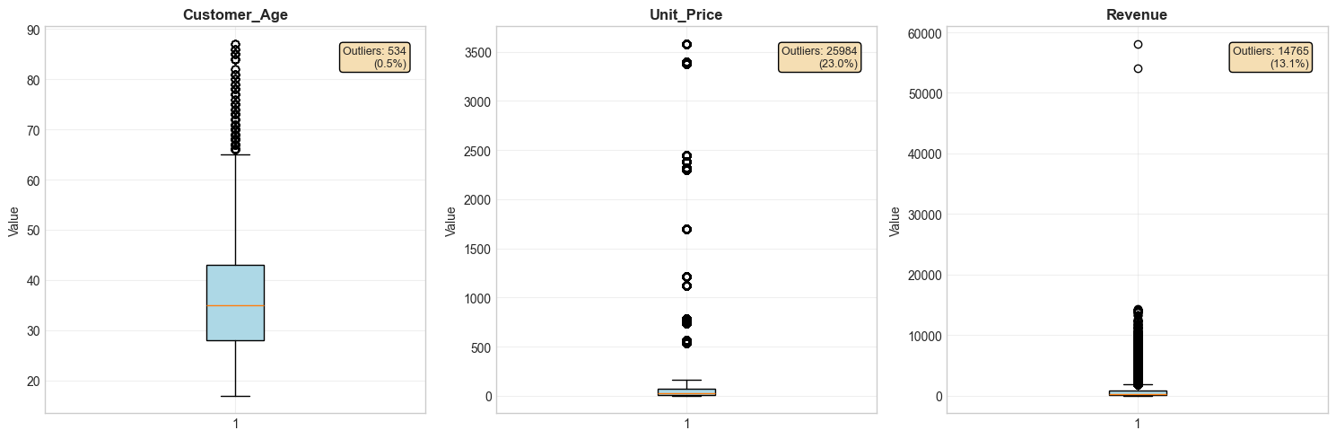
Data Quality
Outliers detected, but not removed

Slide 7
Visualization

Slide 8
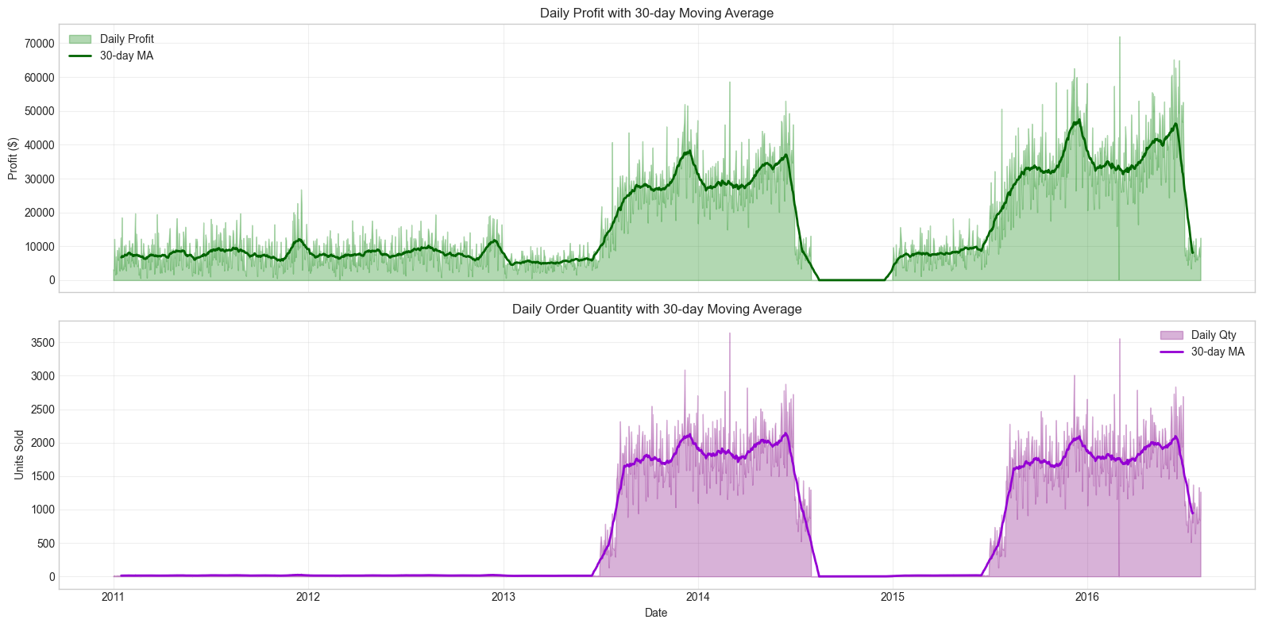
Time series

Slide 9
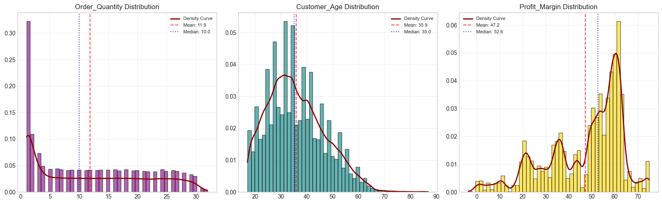
Distribution Analysis

Slide 10
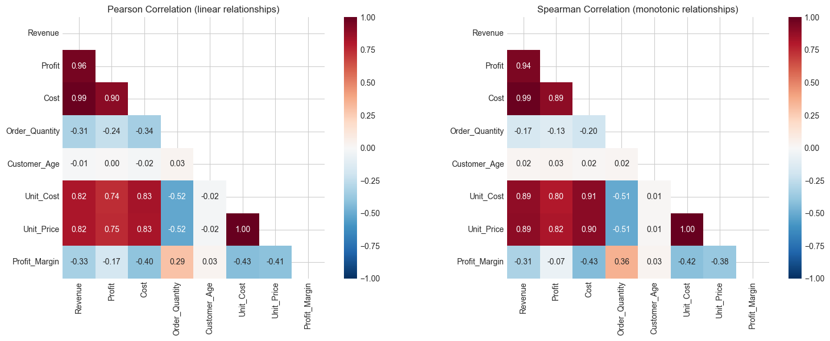
Correlation Analysis

Slide 11
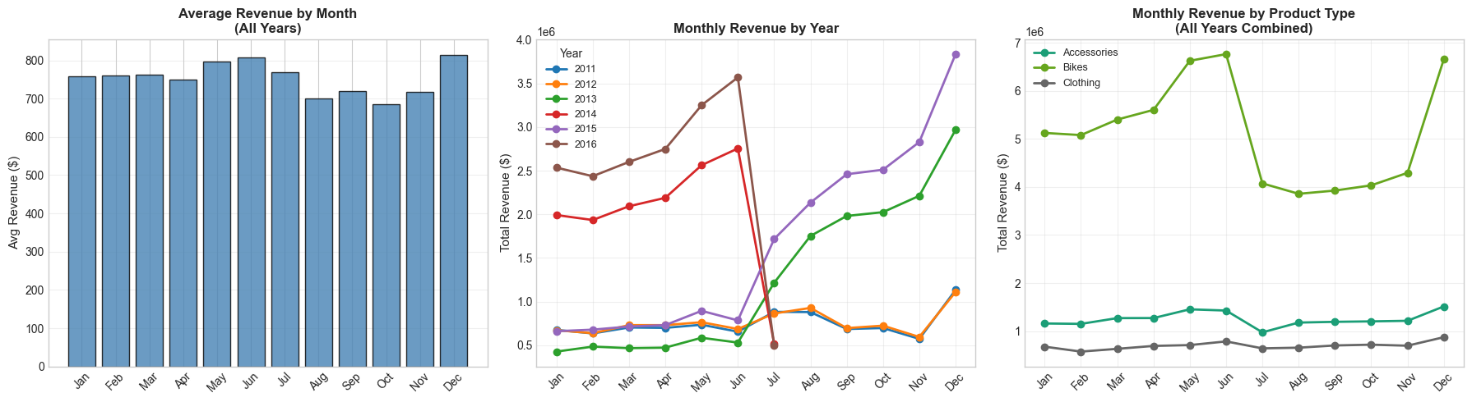
Monthly Pattern Analysis

Slide 12
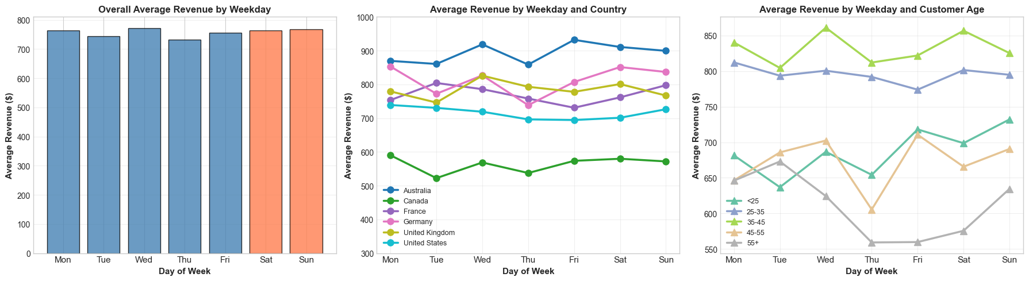
Weekly Pattern Analysis

Slide 13
Probability analysis

Slide 14
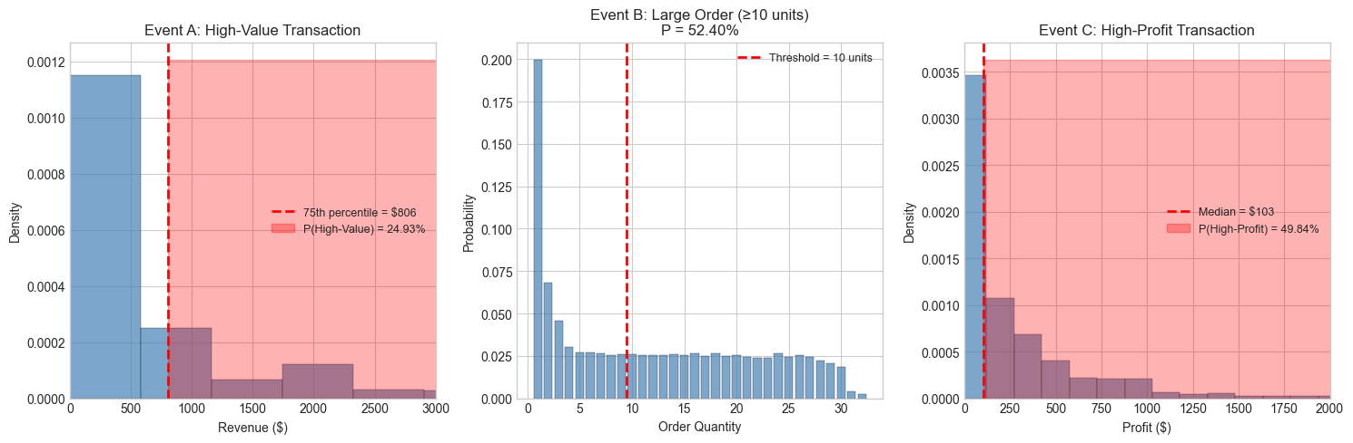
Threshold-based PA

Slide 15
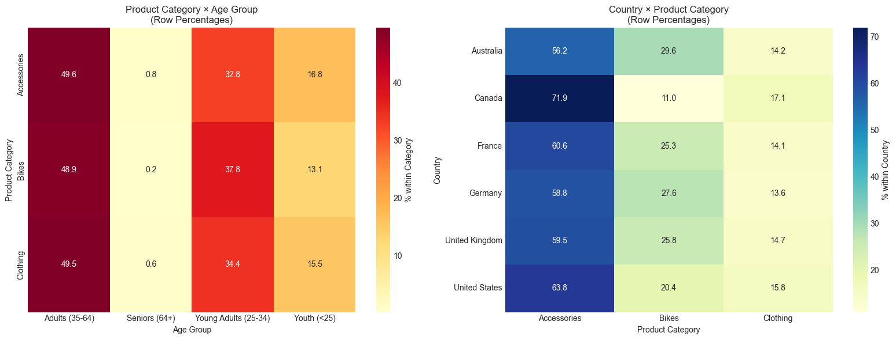
Cross Tabulation Analysis

Slide 16
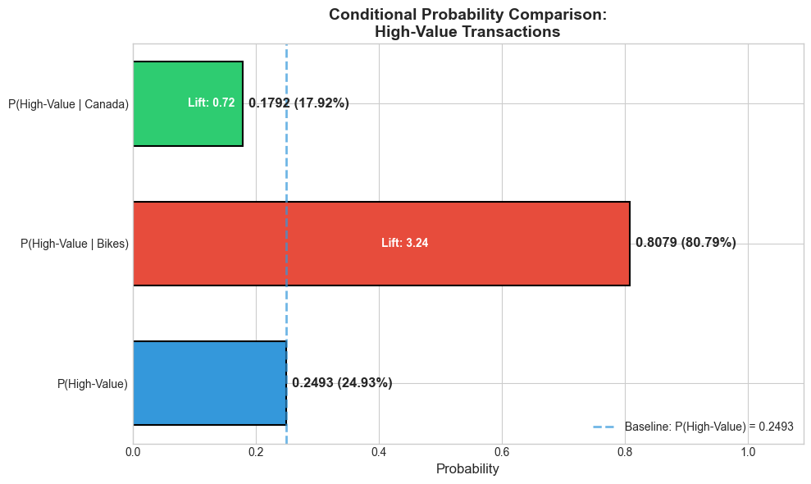
Conditional Probability
P(High-Value) = 24,93%
P(High-Value | Bikes) = 80,79%
P(High-Value | Canada) = 17,92%

Slide 17
Statistical theory applications

Slide 18
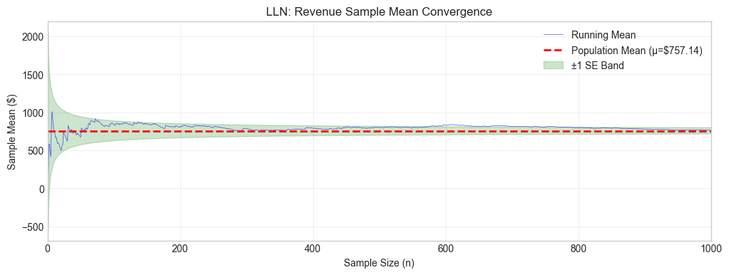
Law of Large Numbers

Slide 19
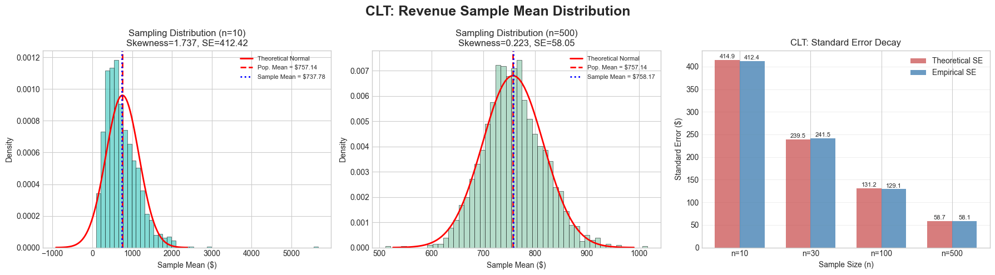
Central Limit Theorem

Slide 20
Regression ANalysis

Slide 21
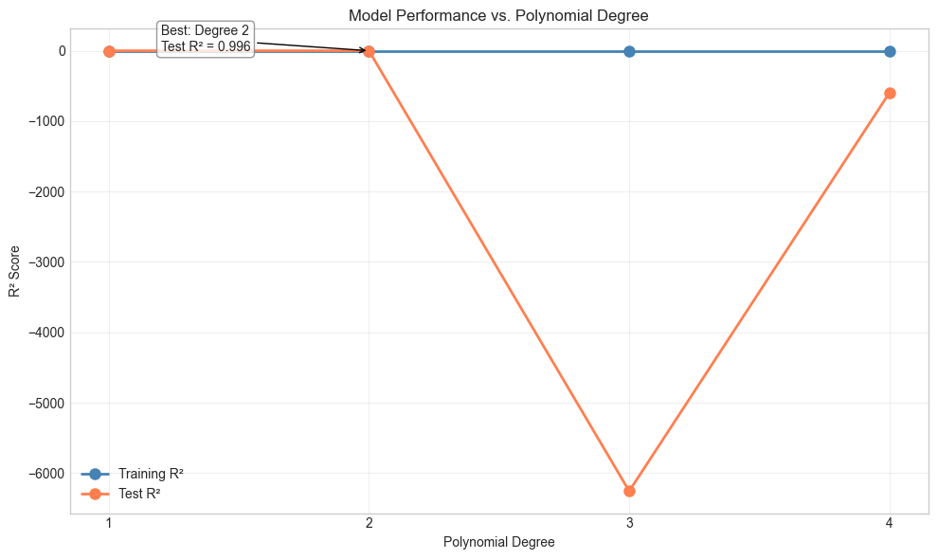
Model Selection
Compared polynomial degrees 1–4
Degree 2 achieves best test R² = 0.996
Notes:
We tested different polynomial degrees to find the right model complexity. Degree 1 is simple linear regression, degree 2 adds interaction terms. As you can see, degrees 1 and 2 perform nearly identically with R² around 0.995. But when we go to degree 3 or 4, the model completely fails on test data—the test R² drops to negative thousands. This is classic overfitting: the model memorizes the training data but can't generalize. So we selected degree 2 as the optimal balance between complexity and generalization

Slide 22
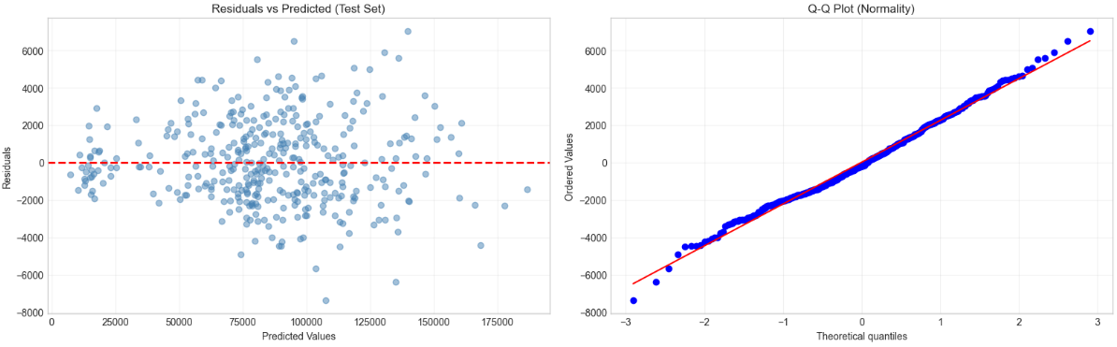
Model Validation
Notes:
Interesting!
Residuals vs Predicted: Random scatter, no pattern → good fit
Q-Q Plot: Points follow line → residuals are norma
These four plots validate our model. Top left shows residuals are randomly scattered around zero with no funnel shape, meaning our predictions are unbiased across all revenue levels. Top right is a Q-Q plot confirming the residuals follow a normal distribution.

Slide 23
Dimensionality Reduction

Slide 24
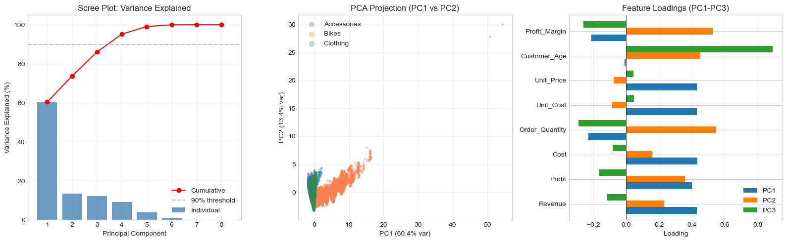
PCA

Slide 25
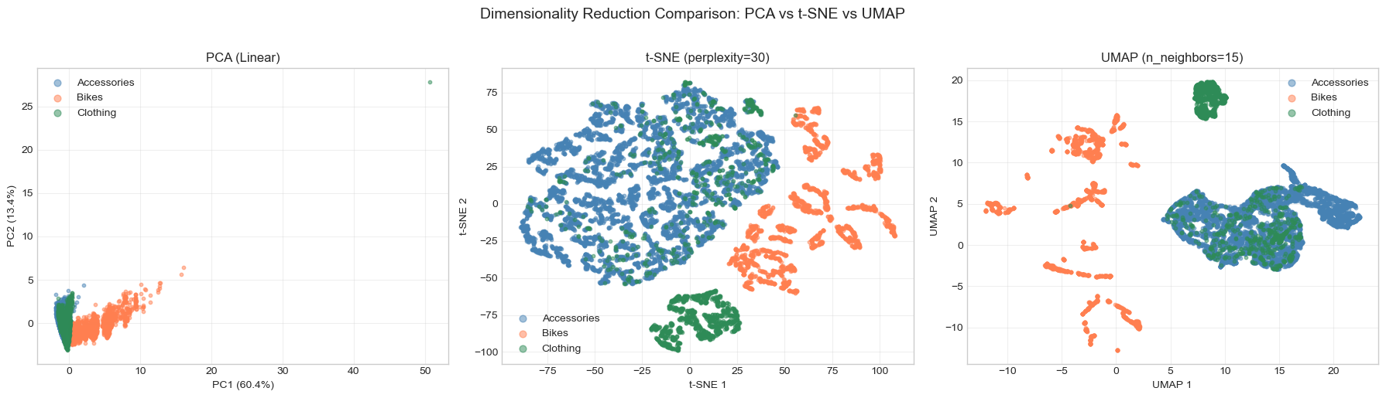
PCA, t-SNE and UMAP

Slide 26
Q&A
Notes:
Flexible and Robust Test Communication Board with sbRIO

