Slide 1

Amazon Sales EDA
Bharath Kumar Reddy Kotte
kottebharathkumarreddy@gmail.com

Slide 2
Problem Statement
E-commerce companies face challenges in analyzing large volumes of order data to optimize sales and fulfillment processes. This project aims to analyze and visualize e-commerce order data to uncover trends, identify inefficiencies, and provide actionable insights for improving operations.

Slide 3
Tech Stack
Programming Language
Python: Primary language used for data analysis and visualization.
Libraries/Frameworks:
Pandas: For data manipulation, cleaning, and preprocessing.
Matplotlib: For creating static visualizations such as bar charts, line charts, and scatter plots.
Seaborn: For statistical data visualization, providing a high-level interface for drawing attractive graphs.
NumPy: For numerical computations and handling large arrays of data
Data Visualization Tools:
Matplotlib & Seaborn: Used within Python to generate a variety of visualizations.

Slide 4
Data Overview
Order ID, Date, Status: Basic order information.
Fulfillment & Fulfilled By: Fulfillment details.
Sales Channel & Shipping: Sales platform and shipping info.
Category, Size, Quantity: Product specifics.
Amount & Currency: Financial data.
Shipping Address: City, state, country.
B2B Indicator: Identifies B2B transactions.

Slide 5
Steps Taken for Data Cleaning and Preprocessing
Data Import:
Loaded the dataset into a pandas DataFrame for analysis.
Handling Missing Values:
Identified and filled or removed missing values to ensure data integrity.
Data Type Conversion:
Converted columns like Date to datetime format and Amount to numeric types for accurate analysis.
Duplicate Removal:
Checked for and removed any duplicate records to avoid skewed results.
Column Standardization:
Standardized column names for consistency and ease of use.

Slide 6
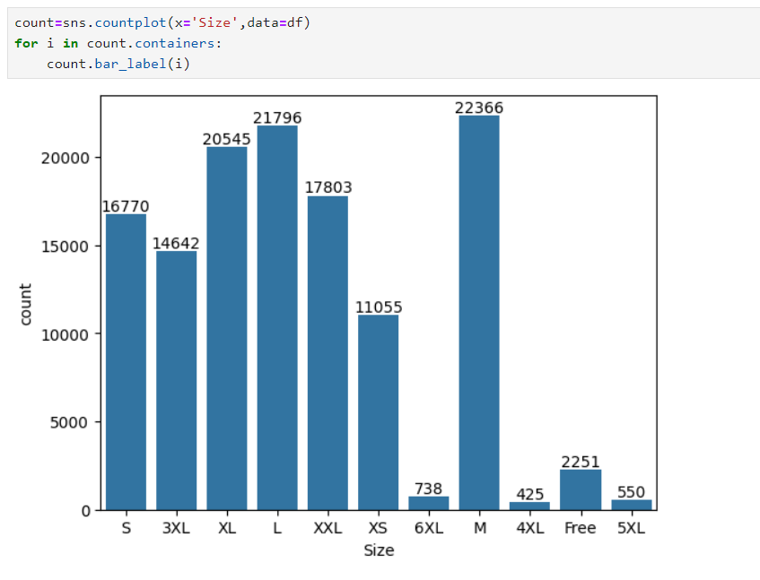
Count of each t-shirts by size

Slide 7
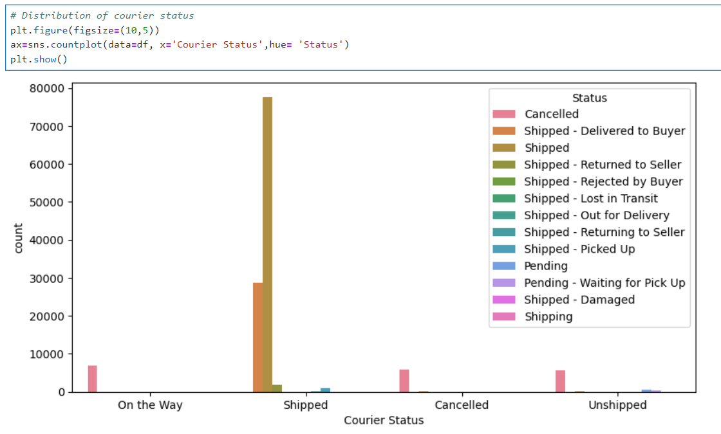
Distribution of courier status

Slide 8
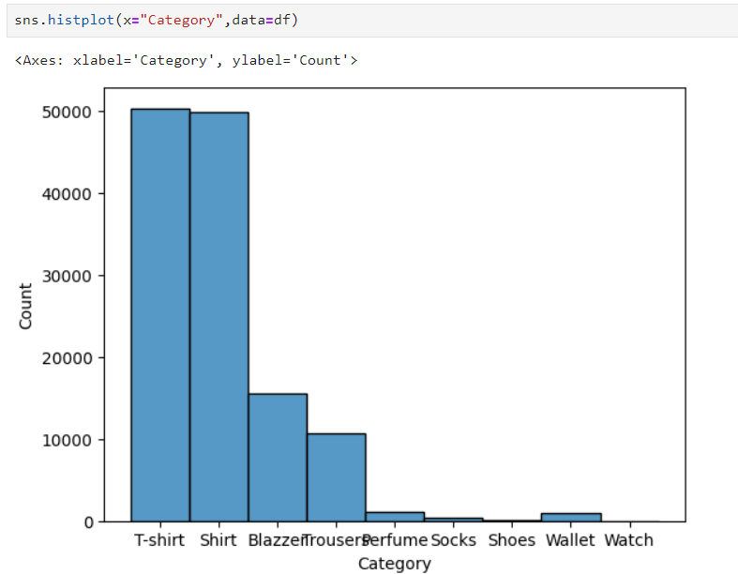
Distribution by category

Slide 9
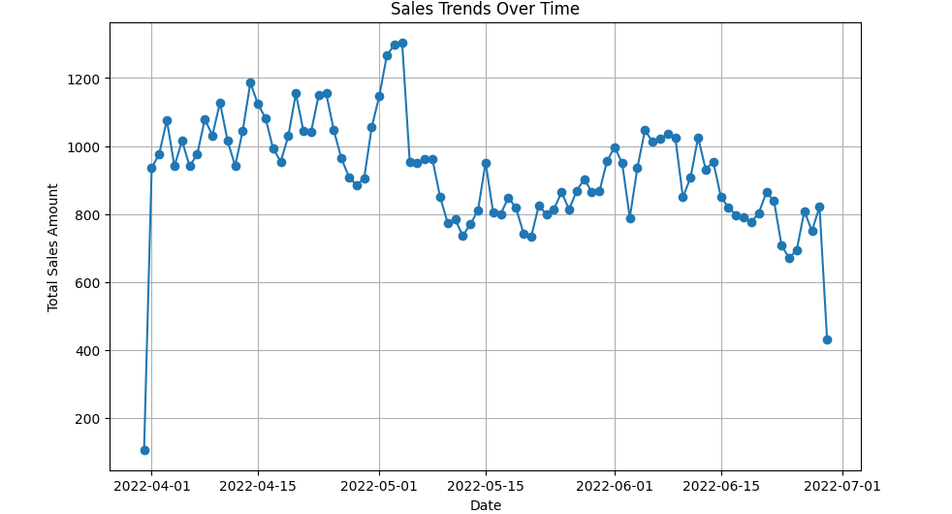
Sales Trends overtime

Slide 10
Insights and Findings:
Sales Trends:
Description: Analyzed sales data over time to identify peak periods and low-sales months, helping forecast demand and optimize inventory and marketing strategies.
Geographic Distribution:
Description: Mapped sales by region to highlight areas with high and low sales, aiding in targeted marketing and distribution planning.
Product Category Insights:
Description: Assessed sales by product category to identify top-performing categories, guiding inventory management and promotional strategies

Slide 11
Conclusion
This project effectively analyzed e-commerce order data to uncover valuable insights into sales performance and fulfillment processes. By identifying sales trends, understanding geographic distribution, and evaluating product category performance, we have gained actionable knowledge to optimize inventory, improve marketing strategies, and enhance operational efficiency. These findings support strategic decision-making and can drive better customer experiences and increased revenue in the e-commerce sector.

Slide 12

Thank You

