Slide 1

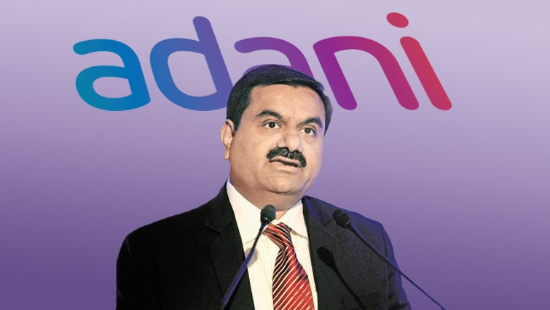
Growth
With
Goodness
Adani Group
Stocks Price Analysis Presentation
By
Koushik Debnath

Slide 2
Case Study and Detections
Objectives
Data Analysis
Most Important Factors
Dataset Analysis
Adani Share’s Company Wise Distribution
Contents
Stock’s Opening Prices
Adani’s Biggest and Smallest Company
Adani’s Top Profit-Making Stocks
Adani’s Down-falling Stocks
Shares with Dividends and Stock Splits
Hindenburg Report Analysis and Its Effects
Conclusion

Slide 3
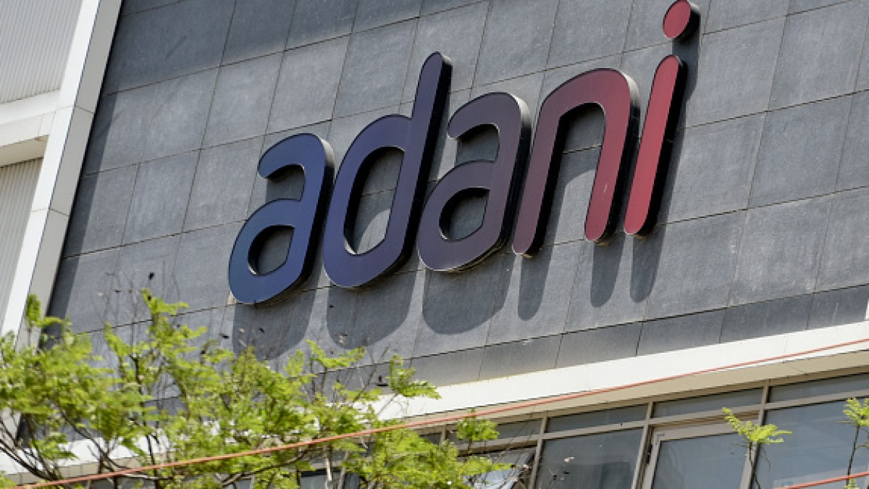
Case Study
This case study consists of 1 data set.
This dataset consists of all share’s details of various companies of Adani Group worldwide.
This dataset consists of 10 columns (Timestamp, Symbol, Company, Open, High, Low, Close, Volume, Dividends, Stock_Splits)

Slide 4
Detections
"Ambuja Cements Limited" has the highest number of shares in the share market among Adani Group (5134).
“Adani Wilmar Limited” has the lowest number of shares in the share market among Adani Group (261).
“Adani Transmission Limited” has the highest share value till now (4236.450).
"Ambuja Cements Limited" has the lowest volume of shares in the share market (0).
"Adani Enterprises" has the lowest share value (-0.011) among the Adani shares.
“Adani Total Gas Limited” has the highest growth rate with the highest rising value (382.364).
Now, The number of non-profitable shares is 17451 and the number of profitable shares is 14042.
“Adani Enterprises Limited” has the record of having the highest down fall rate with a downfall of 859.650.
"Adani Enterprises Limited" has the highest share volume percentage among the Adani Group (31.6129%).
“New Delhi Television Limited” has the lowest share volume percentage among the Adani Group (1.0645%).
“Adani Enterprise Limited” has the highest volume of shares among the Adani Group (35786447777).
“New Delhi Television Limited” has the lowest volume of shares among the Adani Group (1205058402).
“ACC Limited” has the highest dividends (58).
“Adani Ports and special Economic Zone Limited” has the highest shock splits (5).
After the Hindenburg report is published, many shares of Adani Group closed with its all time lowest value.
“Adani Total Gas Limited” has the highest average share price (1068.5116041).
“Adani Power Limited” has the lowest average share price (76.4889688).
“Adani Total Gas Limited” has the highest risk assessment value (1168.0708642328673).
“Adani Power Limited” has the lowest risk assessment value (70.3965055866).

Slide 5
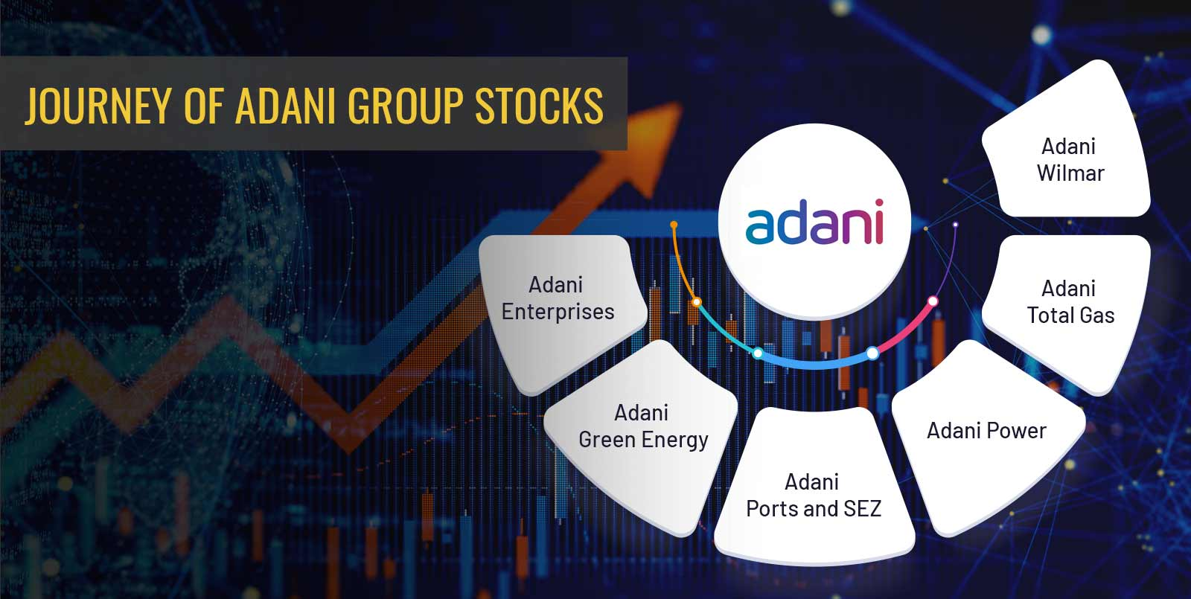
Objectives
Analysing the share prices of different companies within the Adani Group within the given timestamp.
Publishing all the detections based on the data analysis.

Slide 6
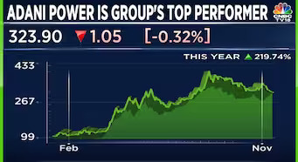
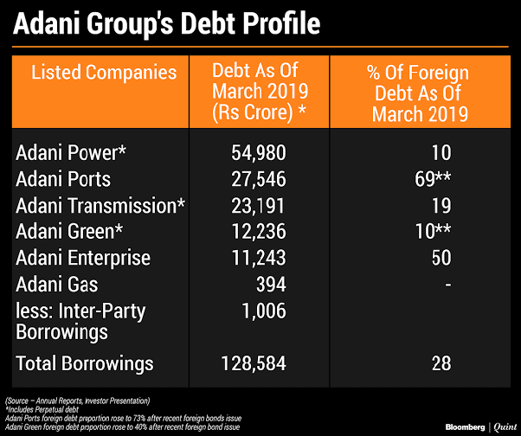
Data Analysis
To analyse the data, those various factors should be considered that affect the business directly or indirectly.
In this case study, there is a table called “adani_stocks” which is inside tha database called “adani_stocks_analysis” which consists of 10 columns and 31493 rows which contains all details about the opening price, closing price, timestamp, volume and so on.
Here in this table, the primary key is the combination of two columns (Close + Volume).

Slide 7
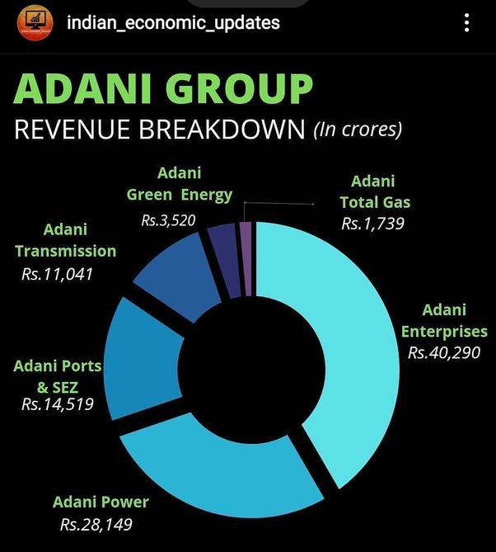
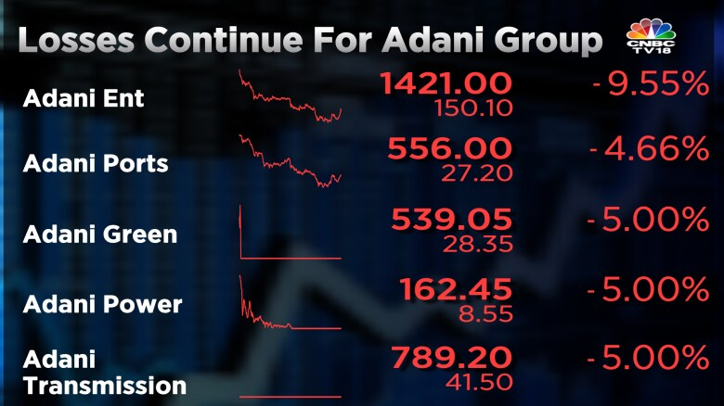
Most Important Factors to Analyse Business
Historical data analysis
Fundamental analysis
Industry and market trends
Risk assessment
Peer comparison
Dividends and stocks splits
Company wise rise or fall of share prices
Long-term outlook
Diversification

Slide 8
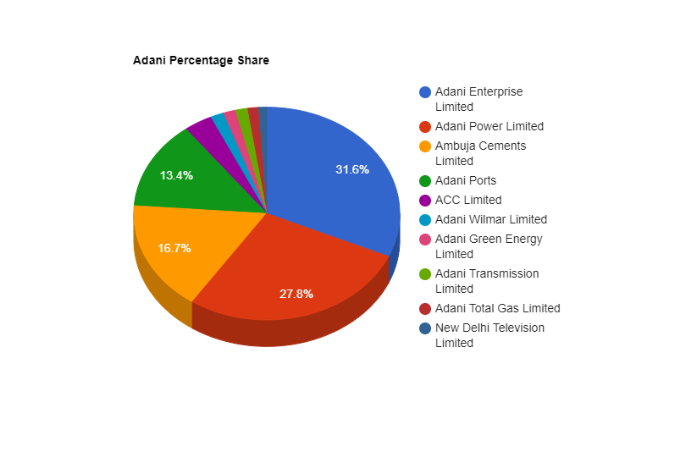
Adani Share’s Company Wise Distribution
"Adani Enterprises Limited” and “Adani Power”
Limited together hold almost 60% of the total
shares in the Adani Group.
“New Delhi Television Limited” has the smallest
share in the Adani Group.
“New Delhi Television Limited”,
“Adani Total Gas Limited”, “Adani Transmission
Limited”, “Adani Green Energy Limited” and
“Adani Wilmar Limited” – They contains only
contain 6.95% of the total shares in the
Adani Group.

Slide 9
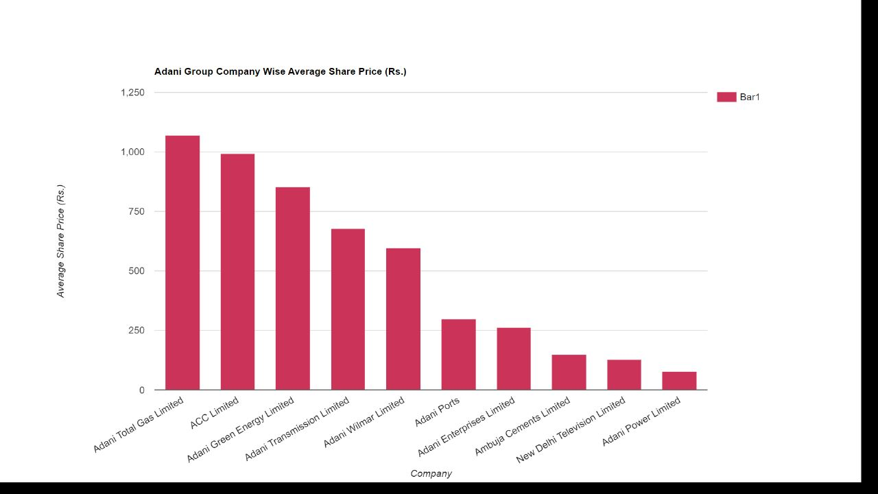
Average Share Price In Rupees By Company
From this bar graph, it has been determined
that “Adani Total Gas Limited” has the highest
average share price drop among all the
companies of Adani Group.
“Adani Power Limited” has the lowest average
share price among all the companies of
Adani Group.

Slide 10
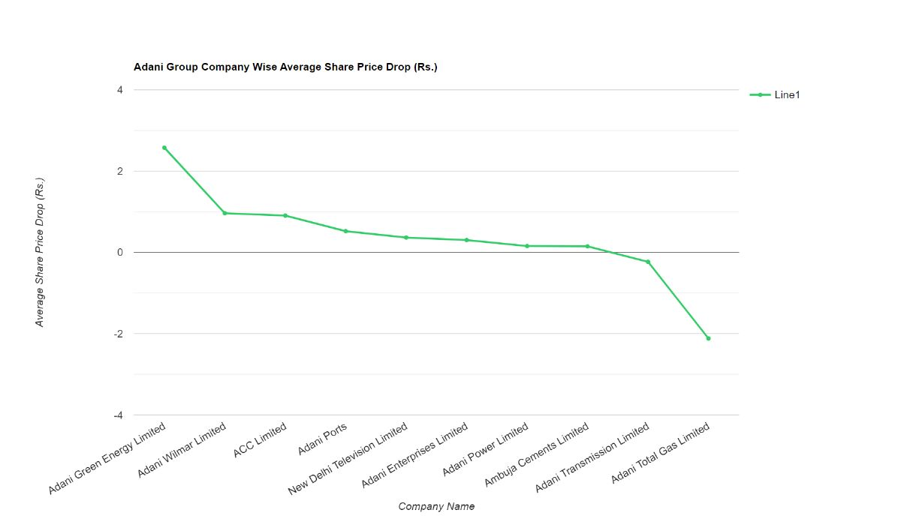
Adani Group Company Wise Average Share Price Drop (Rs.)
“Adani Total Gas Limited” has the highest
average share price drop (2.1190225)
“Adani Green Energy Limited” has the highest
average share price rise (2.5764224)

Slide 11
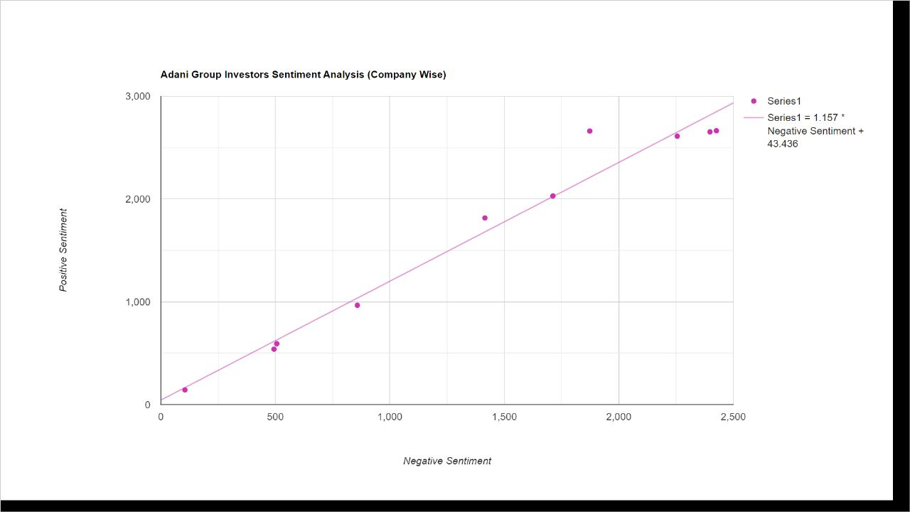
Investor Sentiment Analysis (Company Wise)
Fig : This figure shows the sentiment analysis graph of all companies

Slide 12
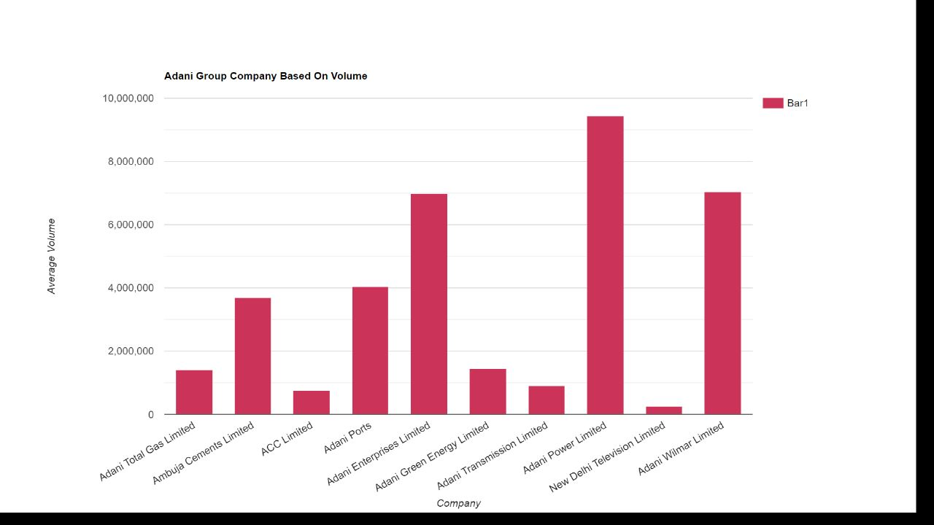
Adani Group Volume Wise All Companies
From this analysis, it can be concluded that
“Adani Power Limited” has the highest average
volume of 9442187.2809
“New Delhi Television Limited” has the lowest
average volume of 259543.0545

Slide 13
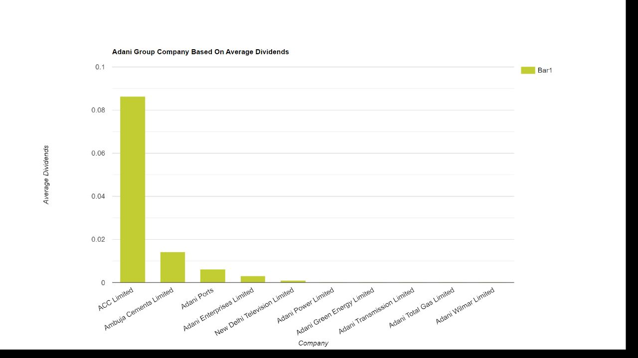
Analysing The History of Dividends Paid By The Companies

Slide 14
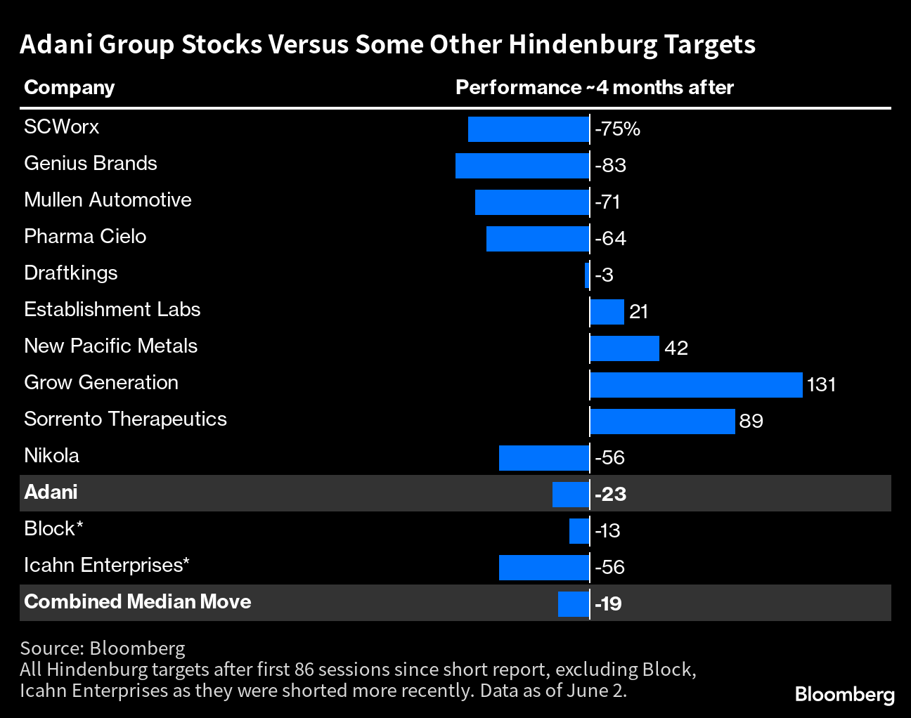
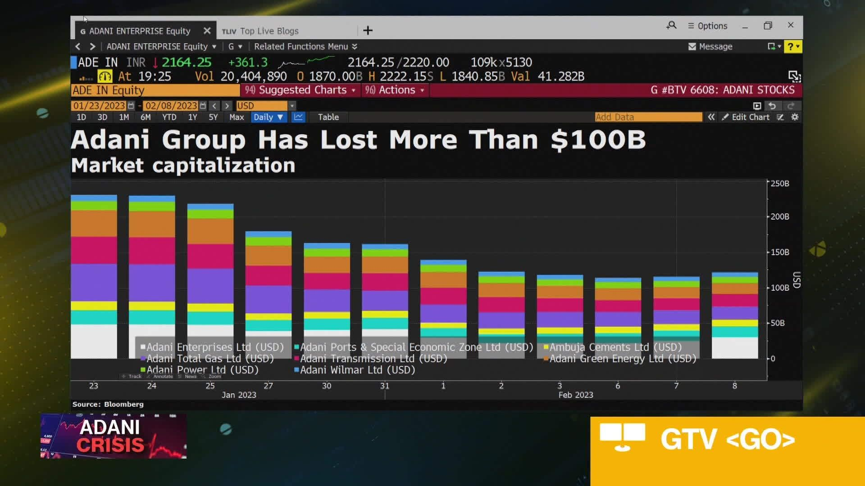
Hindenburg Report and Its Effect
On January 24, 2023 U.S. based activist investor Hindenburg Research disclosed a short
position against the Adani Group and published a report accusing the conglomerate of
engaging in “brazen stock manipulation and accounting fraud scheme over the course
of decades.”
The Adani Group has lost $118 billion in just 10 days, a 50 percent decline since Hindenburg
accused the group of stock manipulation, improper use of tax havens, money laundering
and mounting debts.

Slide 15
Conclusion
After conducting a comprehensive analysis of the share market data for all companies within the Adani
Group, it can be inferred that despite Mr. Adani's rise to become the 3rd richest person in the world, the
publication of the Hindenburg report on January 24, 2023, has had a significant impact on most of the Adani
Group's shares, rendering them non-profitable. Overall, the shares have experienced a considerable decline
of 31%.
Now, the future of Adani Group remains uncertain, and only time will reveal the outcomes and prospects
for the company. Investors and stakeholders should remain cautious and vigilant, closely monitoring the
developments and performance of Adani Group's shares as they navigate through these challenging times.
Prudent decision-making and attention to market dynamics will be crucial in shaping Adani's trajectory
moving forward.

Slide 16
Thank
You

