Slide 1


ARCHIVAL AND RETRIEVAL OF MISSING OBJECTS USING IMAGE MATCHING ALGORITHMS AND ADVANCED MACHINE VISION TECHNIQUES
PHASE 1: REQUIREMENT GATHERING

Slide 2
outline
Project overview and team roles (kenneth) 1.5 minutes
Objectives and scope and requirement gathering process(Roderic)- 1.5 minutes
Objective
Why is requirement gathering important?
Requirement gathering process
Stakeholder Analysis(Ojong) 45 seconds
Role, interest and expectation
Requirement Gathering methods(ojong) 45 seconds
Requirement Gathering Per stake holder(kenneth) –1.5 minutes
Requirement Documentation And Prioritization(marrie) 1 minutes
ASSUMPTIONS AND CONSTRAINTS (Julius) 1.5 minutes
Conclusion(Marrie) – 1minutes

Slide 3
Project overview and team roles
Brief introduction
What is the Project all About?
What is this Phase All about
The team and members roles during this phase

Slide 4
Objectives and scope
Goal of this phase
What will be done
Stakeholders involvement
Need Comprehensions
Convert Need to actionable Requirement
Why is this phase important ?

Slide 5
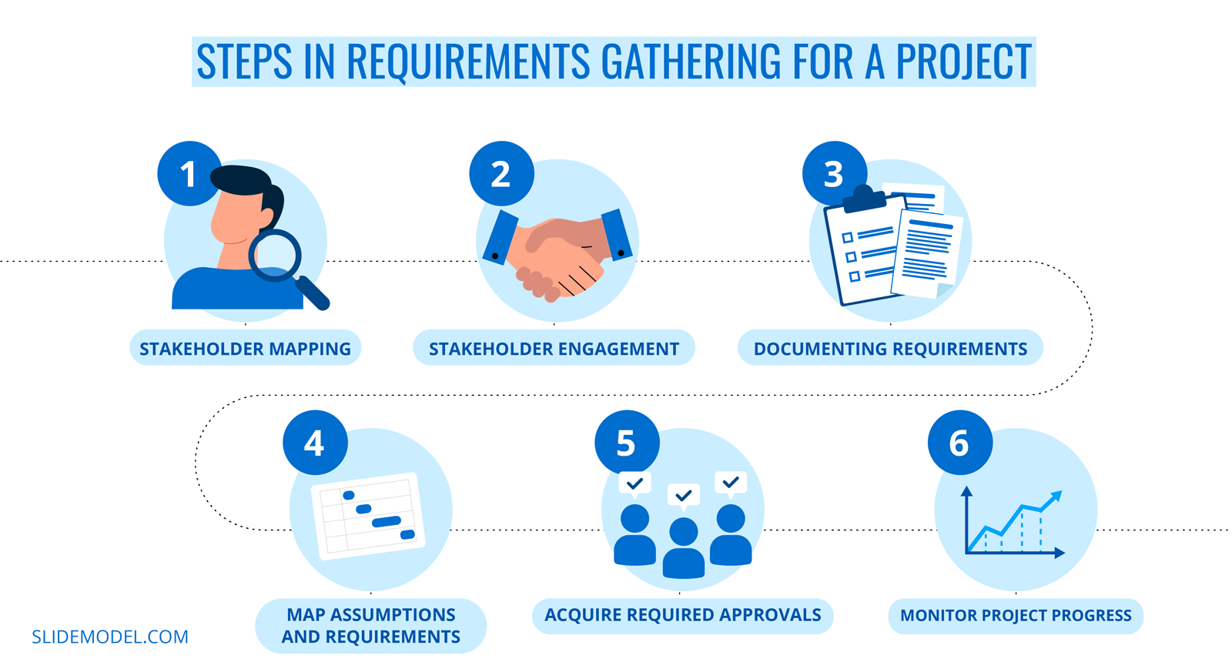
Requirement gathering process

Slide 6
Stakeholder Analysis.
Stakeholder: End Users, Administrator, Technical Team, Sponsor and supervisor ,
Roles and Responsibilities
Interests:
Requirements, Expectations, and Concerns

Slide 7
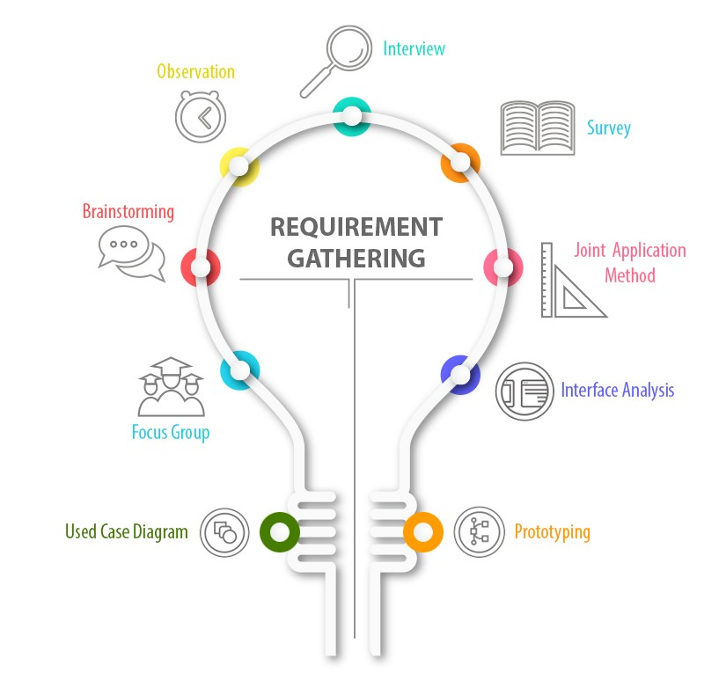
Requirement Gathering methods
Brainstorming(developers)
Interview(in-person)
Survey(google forms)
Prototyping(wireframes)

Slide 8
Requirement Gathering Per stake holder
Stakeholder: End Users, Administrator, Technical Team, Sponsor and supervisor ,
Methods used
Questions ask
Sample response(Adolescent, adult)
Persona

Slide 9
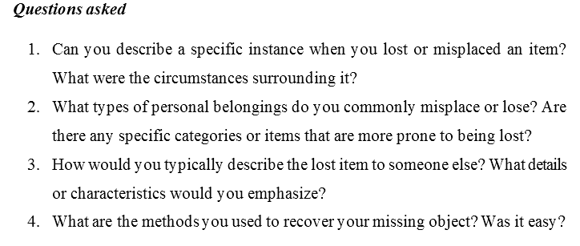
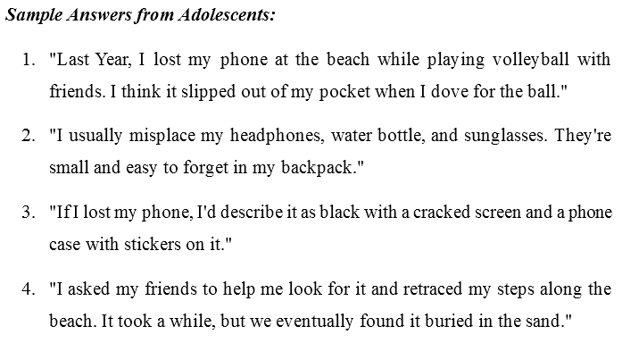
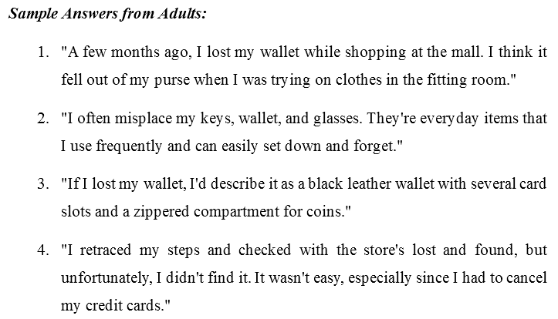
Requirement Gathering Per stake holder Sample questions and answers

Slide 10
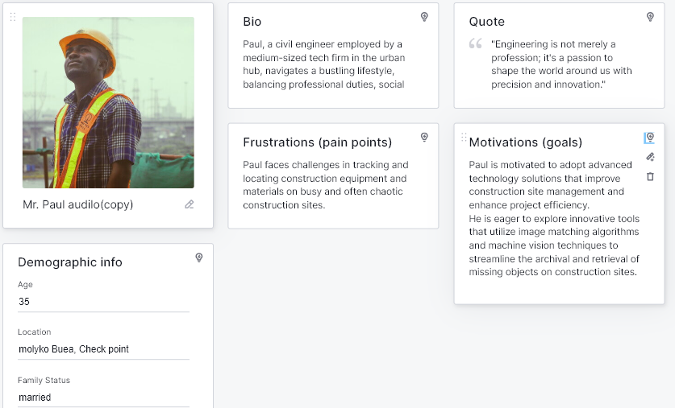
Persona(user representative)

Slide 11
Requirement Documentation And Prioritization
Documentation
Functional
non-functional
Prioritization
Criteria For Priotization
High priority requirements
Medium priority requirements
User requirements

Slide 12
ASSUMPTIONS AND CONSTRAINTS
Assumptions
Users have smartphones
Potential impact
Low quality(picture quality)
Users have stable internet Connection
Potential impact
Slow internet connectivity(slow image upload)

Slide 13
ASSUMPTIONS AND CONSTRAINTS
Constraints:
Budget Constraints
Impact
Time constraint
Impact
Technical limitations
impact

Slide 14
Conclusion
Recap of the presentation

Slide 15
Thanks for your kind attention group 6

