Slide 1
INTERNET PROGRAMMING AND MOBILE DEVELOPMENT Task-1
“The future of mobile is the future of online. It is how people access online content now.” - David Murphy
Supervisor: Dr Nkemeni Valery

Slide 2
Outline
Introduction
Types of Mobile and Their Differences
Discuss About Mobile App Programming Languages
A review and Comparison of Mobile App Development Frameworks
Discuss About mobile application architectures and design patterns
Mobile App architecture
Mobile App Design Pattern
Requirement Engineering(how to collect and analyse user requirements).
How to estimate mobile app development cost

Slide 3
Introduction
In the palm of our hands, we hold a world that’s constantly evolving and expanding - the world of mobile applications.
As our reliance on smartphones continues to grow, so does the demand for mobile apps that cater to every aspect of our lives.
From ordering food to tracking our fitness, these apps have woven themselves into the fabric of our daily routines. But have you ever wondered about the magic that brings these apps to life? That’s where mobile application development comes in.

Slide 4
1. MAJOR TYPES OF APPS AND THEIR DIFFERENCES
Native Apps
Progressive Web Apps (PWA)
Hybrid Apps

Slide 5
Native Apps
Native apps are applications for mobile devices built with the native language of chosen platforms: Objective C and swift for IOS, Java and Kotlin for Android.
Advantages
It works well offline.
High-level security is guaranteed by the OS itself.
Disadvantages
More development time, especially when building the app for multiple platforms.

Slide 6
Progressive Web Apps (PWA)
are typically accessed via a web browser of your choice but can be installed and accessed on a device. Examples of PWA are Spotify, Alibaba.com, Uber, Pinterest etc.
Advantages
Accessible via a website
Cheap and faster in development
Disadvantages
Offline functionalities are Limited

Slide 7
Hybrid Apps
These are mobile applications that combines elements of both native app and web-based apps
Advantages
Hybrids apps can be developed once and deployed across multiple platforms such as (IOS, Android and windows) with minimal code changes.
Hybrid apps can access native device feature such as camera, GPS etc.
disadvantages
Has limited offline functionalities

Slide 8
Differences between Native, Hybrid and PWAs Apps
Features | Native Apps | Hybrids Apps | PWAs
Language | iOS- Swift Android- Java and Kotlin | HTML, CSS and JavaScript | HTML, CSS and JavaScript
Platform | iOS or Android | WebView | Web browser
Security and Maintenance | Highest security and Maintenance | Safe Maintenance | Lowest Security and Maintenace
Access to mobile feature | Yes | Limited | No
Development Process | Hardest and Slowest | Easy and Quick | Easiest and quickest

Slide 9
MOBILE APP PROGRAMMING LANGUAGES
For Android
Java
Kotlin
For IOS
Objective-C
Swift
For Cross Platform
JAVASCRIPT (USED WITH REACT NATIVE)
DART(USED WITH FLUTTER)
C# (USED WITH XAMARIN)

Slide 10
Java vs. Kotlin
Similarities
IOS development: Both are used for IOS development
Interoperability: swift is designed to be highly interoperable with Objective-C. Meaning objective c code can be used in swift and vice versa.
Differences
Features | Kotlin | Java
Syntax | More concise and expressive | Less concise and expressive
Backward compatibility | Not as strong as java, may require new language features that require the new version of kotlin compiler | Very strong ensuring that previously written code in older versions run smoothly in newer versions
Functional programming | Has better support for functional programming , it provides highordered functions, lambda functions and built-in functions making it easier to style functional code | has less support for functional programming concepts

Slide 11
Objective-C vs. Swift
Similarities
IOS development: Both are used for IOS development
Interoperability: swift is designed to be highly interoperable with Objective-C. Meaning objective c code can be used in swift and vice versa.
Differences
Features | Swift | Objective-C
Syntax | More modern and concise | Verbose syntax
Performance | Faster | slower
Compatibility | Uses Automatic Reference Counting (ARC) and ARC-swift | Uses only ARC
 | for memory management making it more efficient

Slide 12
Mobile App development Framework Review and Comparison
Evolution of App Development Frameworks
Mobile app development frameworks have evolved due to technology advancements and changing development paradigms. We can expect further innovations in artificial intelligence, blockchain integration, and immersive technologies.
In the year 2024, with the ongoing expansion of mobile technology, the decision on the most fitting mobile development framework is increasingly vital for both developers and companies

Slide 13
Common Mobile Development Frameworks
React Native: Developed by Facebook, React Native is a JavaScript framework for building native apps for Android and iOS.
Flutter: Flutter is a UI toolkit from Google for building natively compiled applications for mobile, web, and desktop from a single codebase. It uses the Dart language and offers a rich set of pre-designed widgets.
Xamarin: Xamarin is a Microsoft-owned framework that allows you to build apps for Android, iOS, and Windows using C# and .NET.
Ionic: Ionic is a popular, free framework for building cross-platform mobile apps using web technologies like HTML, CSS, and JavaScript1.

Slide 14
Comparison of mobile App Frameworks with respect to key matrices
Framework | Language | Performance | Cost & Time to Market | UX & UI | Complexity | Community Support
React Native | JavaScript | High | Moderate | High | Moderate | Strong
Flutter | Dart | High | Moderate | High | Moderate | Growing
Xamarin | C# | High | Moderate | High | High | Strong
Ionic | HTML, CSS, JavaScript | Moderate | Low | High | Low | Strong

Slide 15
Mobile App Architecture
What Is Mobile App Architecture?
Mobile app architecture is the structural design and organization of a mobile application, outlining how various components and modules of the app are interconnected and work together to achieve its functionality

Slide 16
Key Components of Mobile App Architecture
User Interface (UI) Layer
The UI layer is responsible for the presentation of the app to the user. It includes the visual elements and components that users interact with, such as screens, buttons, forms, navigation menus, and any graphical elements.
Application Logic Layer
The application logic layer, also known as the business logic layer, houses the core functionality of the app. It includes algorithms, business rules, and processes that control the app’s behavior.
Data Layer
The data layer manages data storage, retrieval, and communication with external data sources. It includes databases, server APIs, and any data repositories that the app interacts with.

Slide 17
Types of Mobile App Architecture
Monolithic Architecture
In monolithic architecture, all components and modules of an application are tightly integrated into a single, unified unit.. Characteristics: Single codebase, Tight Coupling. Advantages: Does not require communication between separate services, Easier to develop, test, and initially deploy
Microservices Architecture
In a microservices architecture, an application uses small, independent, and loosely coupled services that operate simultaneously to provide its functionality. Service Independence, Loose Coupling, Distributed Deployment…., Flexibility to choose the most appropriate technology for each service, Failure in one service is less likely to impact the entire application
Model-View-Controller (MVC):
It divides the application into three interconnected components, each with a specific role and responsibility.:
Model(It represents the data and business logic of the app), View(Its responsibility is to render the user interface and present data to the user), Controller(It works like an intermediary between the Model and the View. It receives user input, processes it, and communicates with the Model to retrieve or update data.)

Slide 18
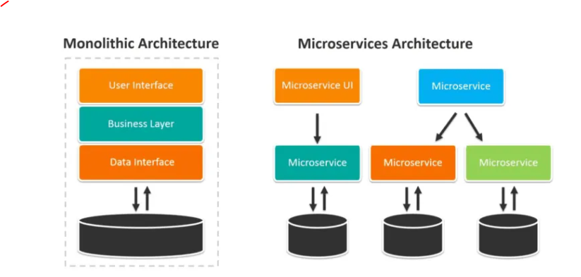
Monolitic vs Microservice

Slide 19
Requirement Engineering
What is requirement Engineering ?
Requirements engineering (RE) is the process of defining, documenting, and maintaining requirements in the engineering design process.
Why is requirements Engineering important ?
explaining your mobile app vision to developers so clearly that they conceive it the way you do.
Spend less: . IBM once claimed this:
“Time not spent in requirements is time spent in rework — at 200 times the cost.”

Slide 20
Types of product requirements
When you get an idea to make an app, you need to ask yourself three main questions:
Why? Why do you need a mobile app?
Who? Who will use your app?
How? How will you achieve your desired business outcomes and meet users’ expectations?
Answers to these questions form three main levels of requirements for mobile app development: business requirements, user requirements, and system requirements.

Slide 21
Types of product requirements
Each level also has an assortment of functional and non-functional requirements.
Functional requirements relate to your app’s operation and features you’re going to implement.
Non-functional requirements define characteristics and constraints that aren’t connected to functional requirements.
performance, reliability, availability, and usability.
The app development process; security, methodology, Standards, Development Language
The external environment,

Slide 22
Business requirements
focus on reasons why building a mobile application is essential for our business, the changes the app will entail, and the outcomes we expect it will deliver. To keep our product vision clear to our development company, you should record our business requirements in a mobile app business requirements document (BRD).

Slide 23
Business requirements
Based on the vision and scope document proposed by Karl Wiegers in the third edition of Software Requirements, we can see the following BRD structure
Background: situation that led you to the idea of creating a mobile app
Business opportunity: strengths and advantages of the app compared to existing solutions on the market.
Business objectives: benefits you expect to get from building a mobile app in a quantitative and measurable way. Your objectives must be SMART

Slide 24
Business requirements
Success metrics: what indicators will help stakeholders understand that your project has achieved success
Monetization model: how your mobile app will generate revenue.
Business risks: Think of possible situations that can adversely affect your mobile app development. For example, what will you do if you get too few downloads?
we can represent our project scope using different tools. The most comprehensive is a lean canvas. It represents the segments of a business plan crucial for developing documentation for all mobile applications

Slide 25
User requirements
Here, it’s time to focus on your users’ needs
When it comes to user requirements, it’s sensible to start with these three steps:
Step 1: Classify users – Feature they use, Access level, Platform used, Frequency of visit
Step 2: Identify product champions -- Choose individuals who can represent each group of users and communicate user requirements to your project manager
Step 3 — Agree on the requirements decision-makers for your project

Slide 26
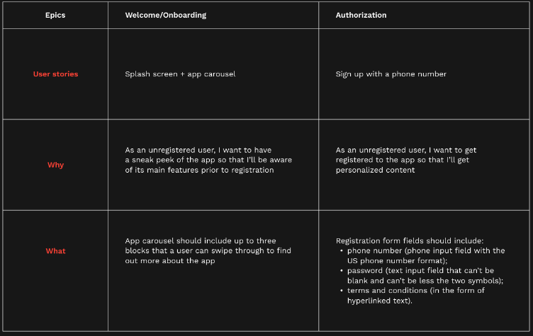

User requirements
Record feedback from users in a user requirements document (URD). To do this, you can use the following techniques:
A user persona:
User stories: Itemize actions users will perform within your app to meet their goals. Then arrange these actions in a natural sequence to determine a typical user journey through your app.

Slide 27
System requirements
We need to talk to developers. They’ll give us feedback on whether it’s technically possible to realize our original plans for the app’s functionality
. After constructive dialogue with our team, we have to write down the agreed requirements in a software requirements specification (SRS) for a mobile application that contains the following blocks

Slide 28
System requirements
After constructive dialogue with our team, we have to write down the agreed requirements in a software requirements specification (SRS) for a mobile application that contains the following blocks.
Functional requirements
Subsystem requirements: for software and hardware subsystems
Business rules(Corporate policy, Government regulations, Industry standards etc)
Data requirements
External interfaces
Localization requirements

Slide 29
Activities Involved in drafting a document for requirements
So, in Summary Drafting a document of requirements for your mobile app project is commonly about performing four activities:
Elicitation: This involves asking what users expect from a new product, listening to what they say, and watching what they do.
Analysis: This involves processing user feedback to understand, classify, and relate this information to possible mobile app functionalities.
Documenting: It’s essential to document your app idea as a product hypothesis and product objectives.

Slide 30
Activities Involved in drafting a document for requirements
Creating User Personas and User Stories:
Developing App Wireframes or an App Prototype:
Listing App Features and Functional Requirements:
Deciding on the App Tech Stack and Technical Performance Characteristics

Slide 31
How to estimate mobile app development cost
Factors Influencing Mobile App Development Cost
Technical Expertise
Programming Fundamentals: A developer’s grasp of core programming concepts affects development speed and efficiency..
Mobile-Specific Languages: Proficiency in languages relevant to the target platform (Java/Kotlin for Android, Swift/Flutter/React Native for iOS) is crucial.
Planning & Design Complexity:
App Functionality: Complex functionalities with extensive features require more development time, pushing the cost upwards. Simpler apps with basic features are faster and cheaper to develop.
Platform Selection: Developing for both iOS and Android doubles the workload, significantly increasing the cost. Choosing a single platform (based on the target audience) is a more cost-effective approach.
User Interface Design: A complex, feature-rich UI design necessitates more design hours, impacting the cost. A well-planned, intuitive UI can be achieved efficiently, reducing design expenses.

Slide 32
The formula for Calculating Mobile App Development Cost
Total Development Time (TDT)
Hourly Rate (HR): cost per hour for development team
Complexity Factor
Basic Features: CF = 1.0
Moderate Features: CF = 1.5
Advanced Features: CF = 2.0
Extensive Features: CF = 2.5
Platform Factor (PF):
Single Platform: PF = 1.0
Dual Platform: PF = 1.2
Multi-Platform: PF = 1.5
Design Cost (DC): UI, UX

Slide 33
Estimation Formula
Estimated Cost = TDT * HR * CF * PF + DC

Slide 34
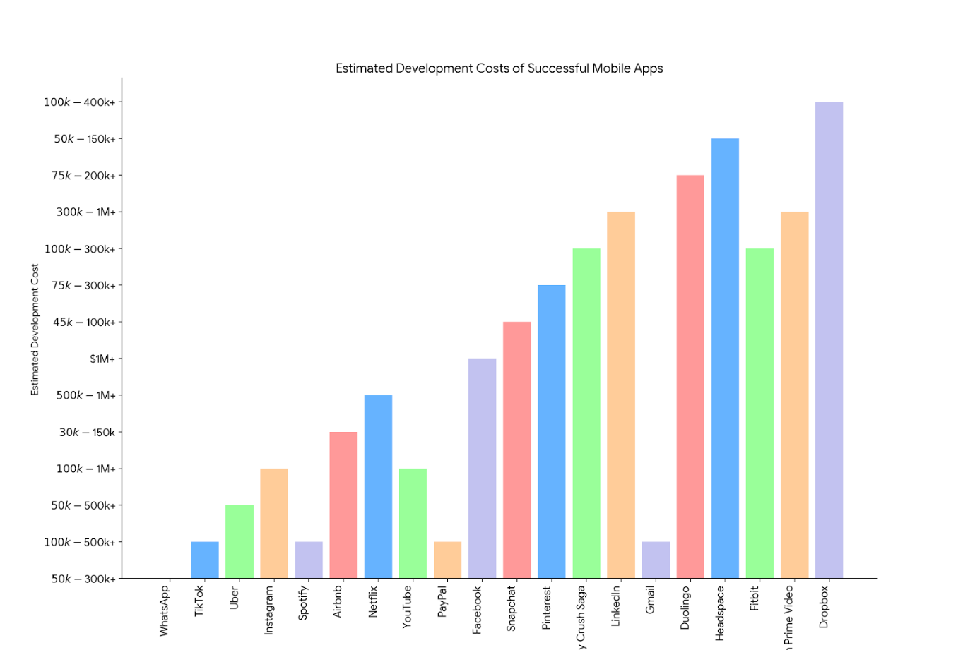
Estimated Development Costs of Successful Mobile App

Slide 35
Thanks for your Kind attention

