Slide 1
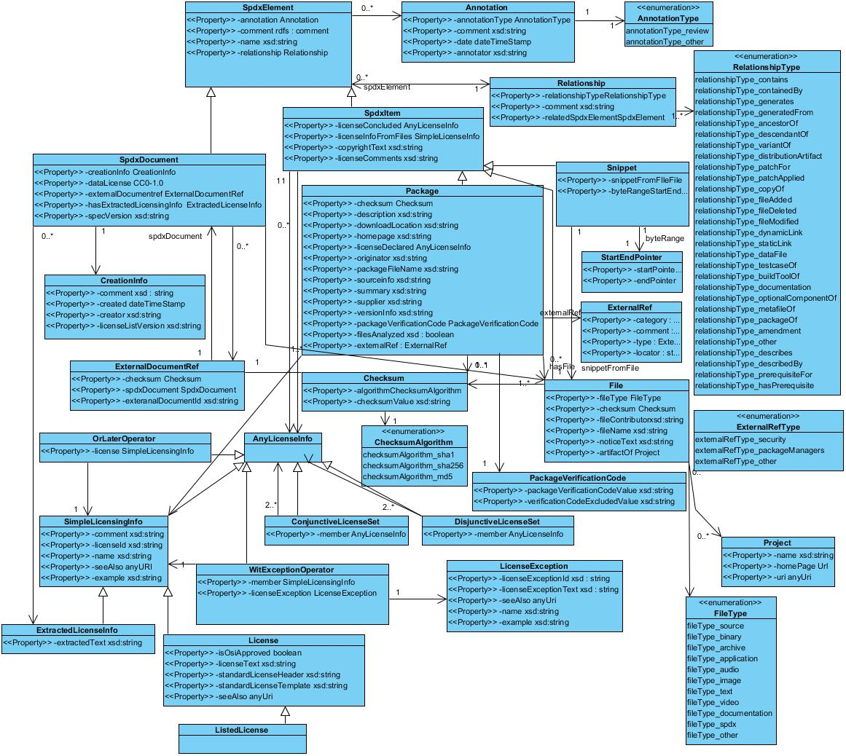
0.*
TargetProductInfo
“ExpirationInfo” might be placed to this level
0.*
“TargetProductInfo” (proposed “Prerequisite Produce Name” before) might be placed as this level
Usage Information (T.B.D)
Usage information such as “not fit with final product, but for verification (T.B.D)” (proposed “License Compatibility” before) might be placed as this level

