Slide 1
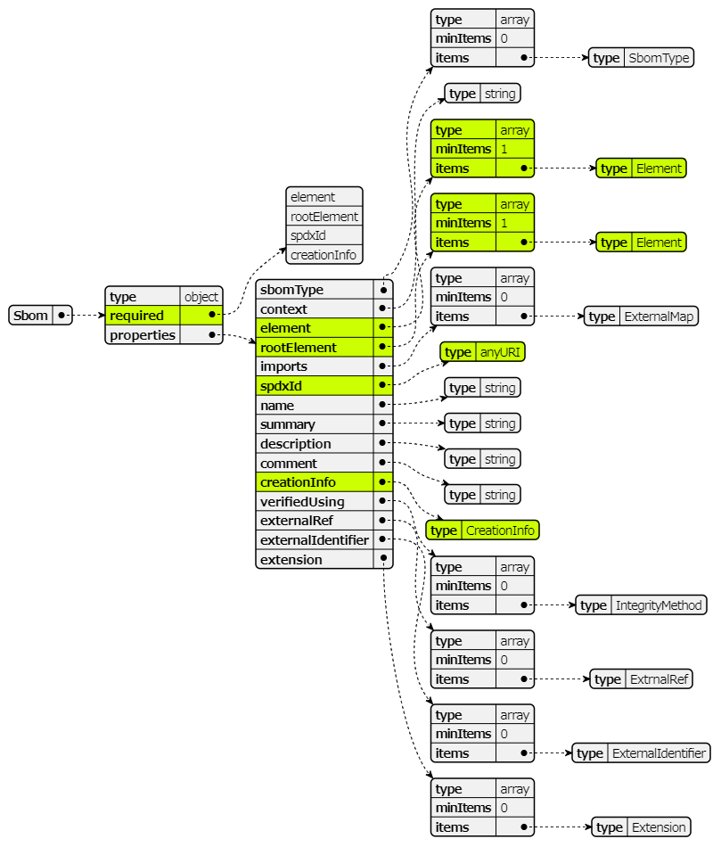
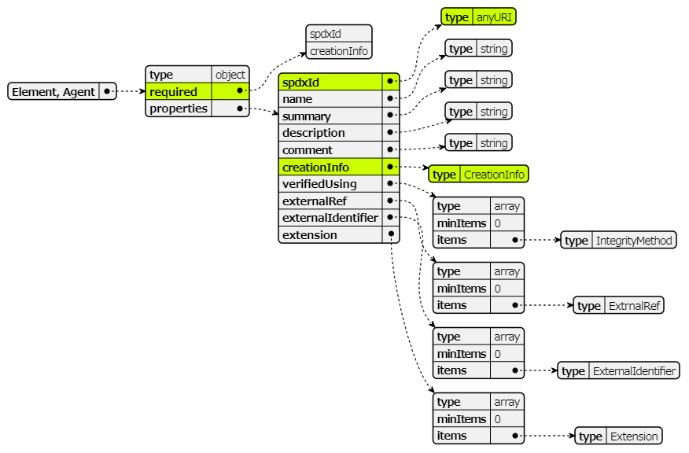
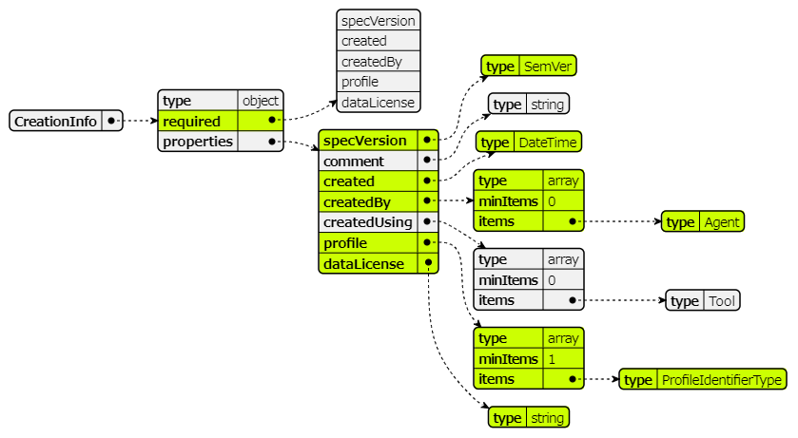
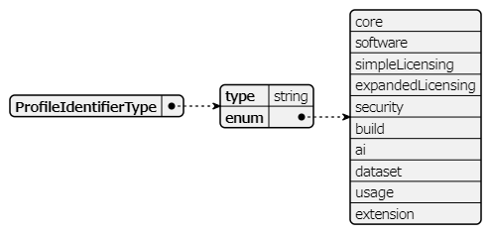

JSON Schema for Sbom Class in Lite Profile
Mandatory
Element

Slide 2
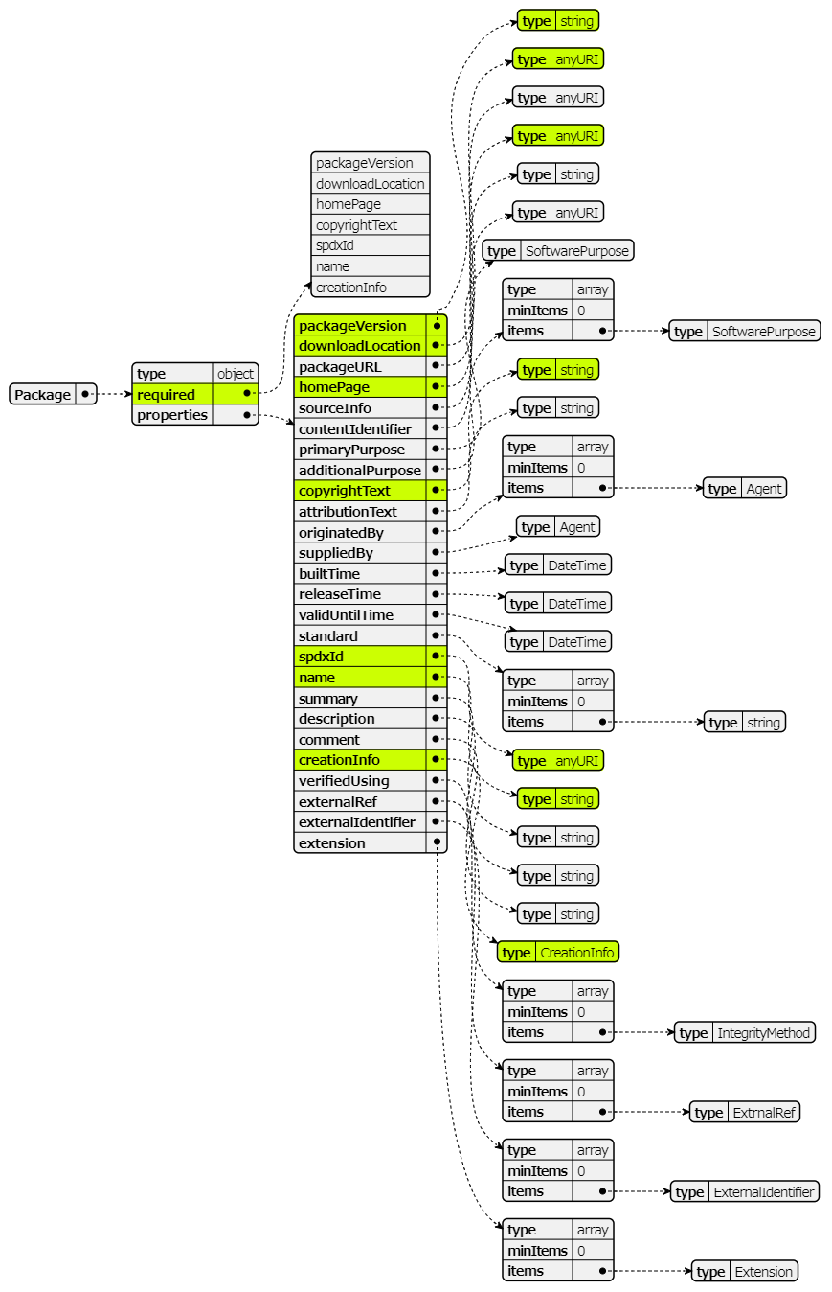
JSON Schema for Package Class in Lite Profile
Mandatory
Element

Slide 3
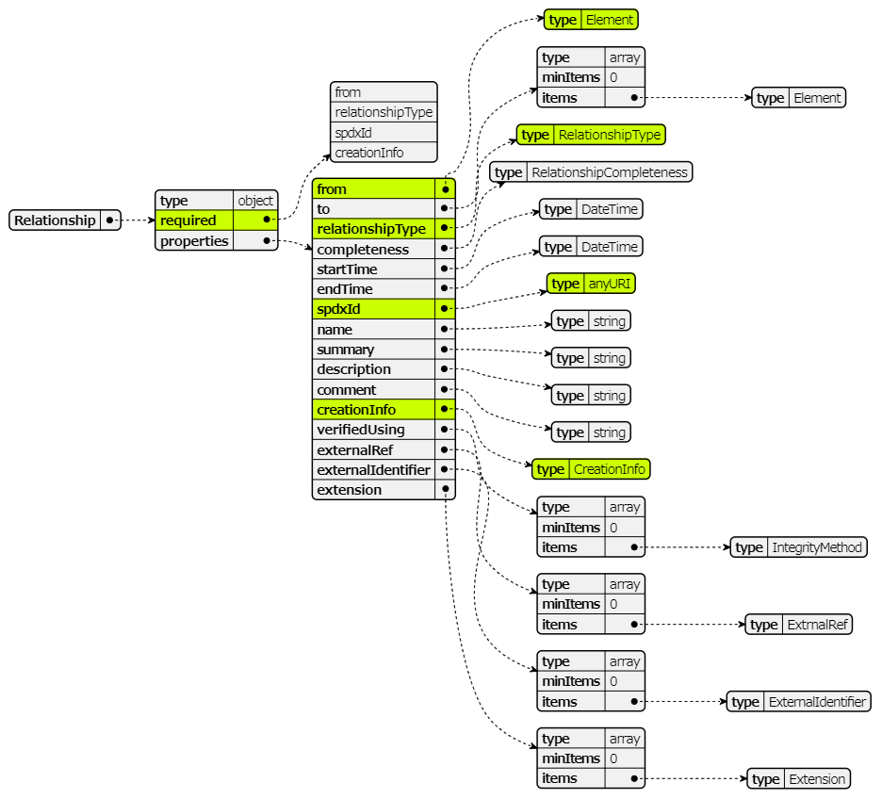
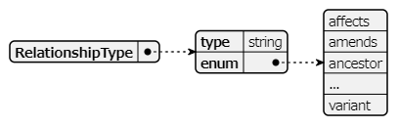
JSON Schema for Relationship Class in Lite Profile
Mandatory
Element
https://github.com/spdx/spdx-3-model/blob/main/model/Core/Vocabularies/RelationshipType.md

Slide 4
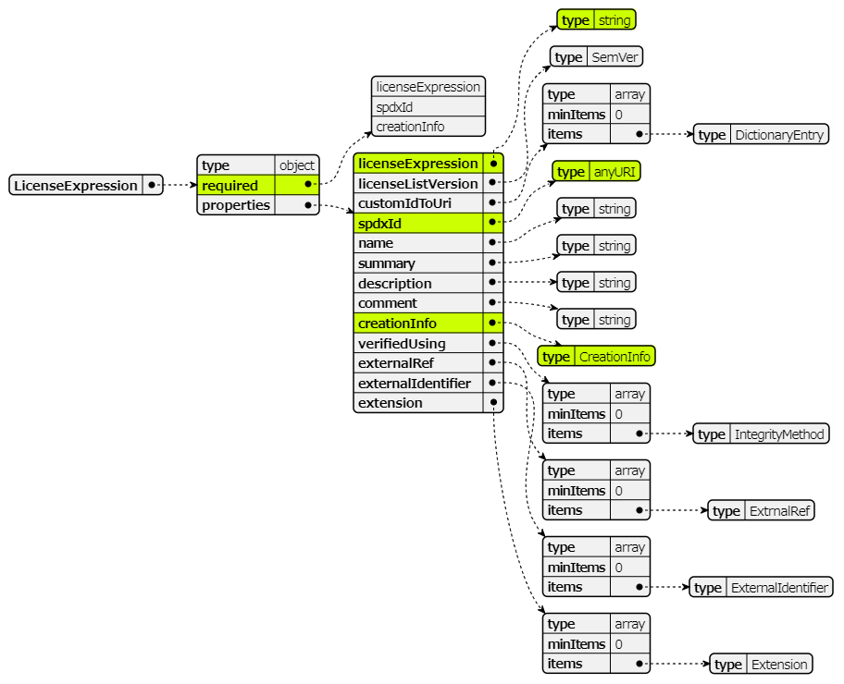
JSON Schema for LicenseExpression Class in Lite Profile
Mandatory
Element

Slide 5
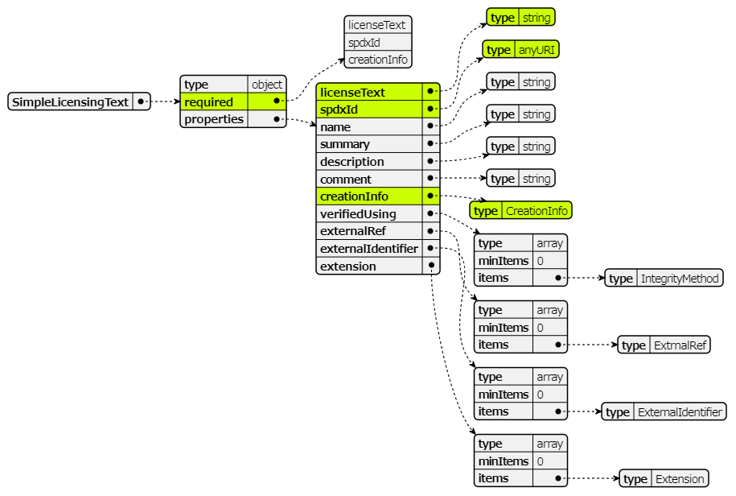
JSON Schema for SimpleLicensingText Class in Lite Profile

