Slide 1
SPDX v2.3とv3.0の変更点について
當麻 徹
パイオニア（株）

Slide 2
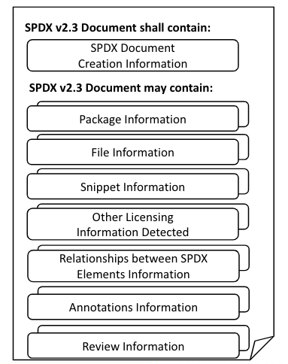
v2.3から3.0の変更点
v2.3
v3.0
Profile Core
Profile Software
Profile Licensing
Profile Security
Profile Build
Profile Usage
Profile AI
Profile Service

Slide 3
v2.3から3.0の変更点（全体）
v2.3
v3.0
Profile Core
Profile Software
Profile Licensing
Profile Security
Profile Build
Profile Usage
Profile AI
Profile Service
deprecated

Slide 4
v2.3から3.0の変更点（Package部分）
v2.3
v3.0
Package Information
Profile Core
7.1 Package name field
7.2 Package SPDX identifier field
7.3 Package version field
Profile Software
7.21 External reference field
7.22 External reference comment field
Profile Licensing
7.4 Package file name field
7.5 Package supplier field
7.6 Package originator field
7.7 Package download location field
7.8 Files analyzed field
7.9 Package verification code field
7.10 Package checksum field
7.11 Package home page field
7.12 Source information field
7.18 Package summary description field
7.19 Package detailed description field
7.20 Package comment field
Profile Security
Profile Build
Profile Usage
Profile AI
7.13 Concluded license field
7.14 All licenses information from files field
7.15 Declared license field
7.16 Comments on license field
7.17 Copyright text field
7.23 Package attribution text field
7.24 Primary Package Purpose field
7.25 Release Date
7.26 Built Date
7.27 Valid Until Date
Profile Service

Slide 5
v2.3のPackage Informationが大きくなりすぎたのを各所に分散した感じ

Slide 6
以降は素材とかメモ

Slide 7
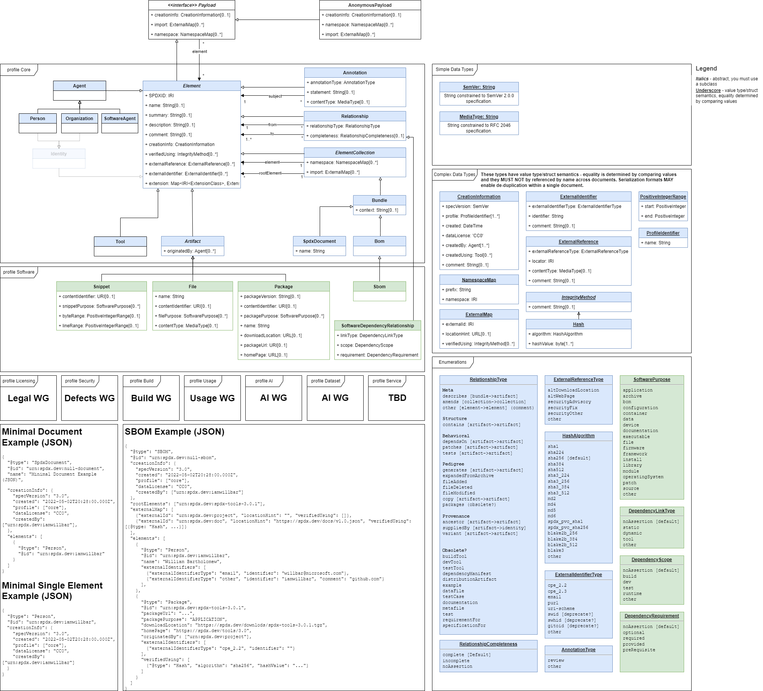
v3.0の図

Slide 8
V3.0
Profile Core
Profile Software
Profile Licensing
Profile Security
Profile Build
Profile Usage
Profile AI
Profile Service

