Slide 1
Qx
Done for now
Q: Why should I care about OSS?
A:
Licensing
Software is protected by copyright, license
You have to follow the license
You have to respect the author
There are court cases for license violation
OSS can be obtained and used without following the procedures such as contract
Normally, the license conditions are checked in the procedures such as contract, but OSS can be used without doing that
Introduced at the grassroots, it becomes unmanageable
OSS comes in as a dependency
Some things are not recognized that they are being used
You have to understand the difference between Freeware and OSS (free software) and handle it according to the terms of use
There are many cases where it is difficult to make a decision → This is where OSPO becomes necessary
Use with peace of mind
Security (vulnerability)
A problem is discovered after introduction and a response is required. If you do not know what you are using at that time, the response will be delayed or impossible.
Widely used/open source makes it easy for attackers
On the other hand, since there are many developers and users, countermeasures are quick
Using OSS with peace of mind
Depends on the state of the community
Maintaining a state of peace of mind by contributing and participating in the community
Note)Assumes initial questions

Slide 2
Q: What are the advantages of OSS activities?
A:
Advantages of using open source software
Use existing software (ease of development)
Use cutting-edge software (technology)
Because the software was created by many people, the level is high
Because many people use it, bugs are easy to find, and fixes are accurate and fast
Benefits of community activities
Development resource efficiency through community cooperation
Opportunity to acquire human resources (company side)
As an engineer, you can increase your own value and gain opportunities for activities
Human resource development
Benefits from business strategy
Expansion of market and potential customer base through community and involvement in development direction
Establishment and dissemination of de facto standards
Next time consider mapping with OSPO stages (2023/5/26)

Slide 3
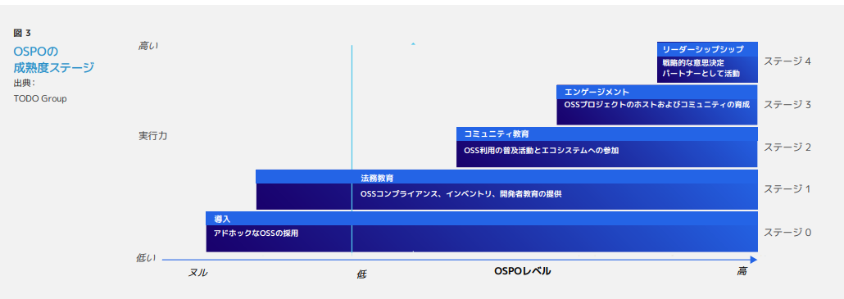
Q: What are the advantages of OSS activities?
Fix
Bugs are easier to find, and fixes are more accurate and faster by many engineers than by the company alone
Development resource efficiency through community cooperation
Place for human resource development and retention/acquisition of human resources
Enhancing market value and providing opportunities for engineers to engage in activities to attract human resources
Creating businesses that utilize OSS
Expanding the market and potential customer base
Establishing and disseminating de facto standards
Building an ecosystem
Obtaining legitimacy for activities
Obtaining endorse from community participants
Reliable use of OSS in business
Using OSS in its original form necessary for business-to-business transactions
Risk control of OSS use throughout the supply chain
Using existing software (making development easier)
Using cutting-edge software (technology)
Because the software was created by many people, the level is high
Alignment of corporate expectations and community movements through community
Involvement in development direction
Motivation of engineers
Leadership
Core members of decision making as community leaders
Engagement
Decision meeting participants
Community education
Early contributors
https://www.linuxfoundation.jp/wp-content/uploads/2022/11/ja_LFR_LFAID_Deep_Dive_Open_Source_Program_Offices_0830.pdf
Ibrahim Haddad, “A Deep Dive Into Open Source Program Offices:
Structure, Roles, Responsibilities, and Challenges “ foreword by Chris Aniszczyk, August, 2022

Slide 4
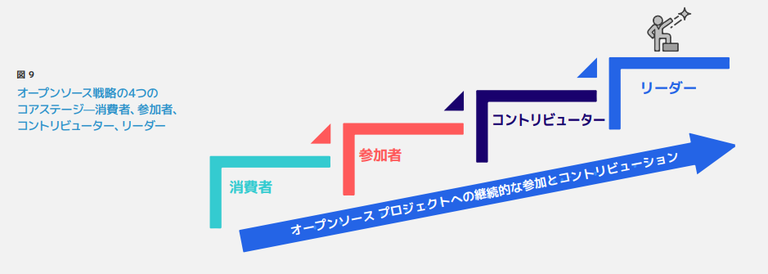
Q: What are the advantages of OSS activities?
Fix
Bugs are more easily found and fixed more accurately and faster by many engineers than by the company alone
Development resource efficiency through community cooperation
Place for human resource development and retention/acquisition of human resources
Enhancement of market value for engineers and incentive for human resources by providing a place for activities
Creation of businesses utilizing OSS
Expansion of market and potential customer base
Establish and spread de facto standards
Build an ecosystem
Obtain legitimacy for activities
Gain endorse from community participants
Secure use of OSS in business
Use OSS in its original form necessary for inter-company transactions
Risk control of OSS use throughout the supply chain
Using existing software (making development easier)
Using cutting-edge software (technology)
Since the software was created by many people, the level is high
Alignment of corporate expectations and community movements through community
Involvement in development direction
Motivation of engineers

Slide 5
What is OSPO in the first place?
2023/10/27 Discussion - Next 12/22 Continue
(Summarized as a high-level concept)
What OSPO is working on
Challenges
Coping with the current situation where OSS is used more than 80%
Initiatives
Finding and promoting ways to engage with OSS and the OSS community as a company
As I mentioned briefly before, I feel that OSPO is about bridging the gap between the internal and OSS culture
It's just an image of catching up, so I feel it's not enough
Bridging the organization and the OSS community is OSPO
The role of OSPO is to stage awareness and mindset within the company
Inculcate not only engineers but also OSS-like ways of working (things that are becoming commonplace outside the company) within the company
Efforts to adopt the ways that have been successful in the OSS community within the company in order to successfully implement large-scale development
Efforts to incorporate (become a member of) the company into the ecosystem created by OSS
Efforts to develop the company's business by utilizing the OSS ecosystem
Bridging between the logic of the company and the logic of OSS, aiming for the development of both
Corporate engineers working in the OSS community should be dedicated to OSS activities
OSPO members should consider the logic side of the company and implement strategies separately from them
If OSPO members and OSS activity members are confused, the activity members will suffer
Positioning of OSPO people in the company
I'm not a divisional person or an OSS activity engineer. I'm thinking of both.
I use multiple positions. (This makes it difficult to do OSPO)
Aim for and create a state where OSS activities have value and benefits from both the company and the OSS community
Why don't we discuss the meaning of the name Open Source Program Office?
Meaning of Program
A Program Officer (program officer, PO) is a person who plans and manages research and grant programs at a research institution, think tank, or foundation.
There is also a view that it is conducted on an ongoing basis.

Slide 6
What is OSPO?
2023/12/22 Continue
What skills are OSPO members looking for?
Wide range?
Software development skills (at some level)
Knowledge of licensing
Basic knowledge of legal and intellectual property
Common understanding in the community (intent, background)
Communication skills
English proficiency
Spirit of respect
Motivation, mental capacity to withstand headwinds
Ability to explain
Skills as an educator
Experience and appropriateness of community activities
Proper understanding of OSS development methods, ecosystem and community
Understanding and respect for OSS and community culture
Values of participants
What are the responsibilities of OSPO?
License management
Suggestions and advice on the use of OSS in business strategies
Activating activities in the OSS community
Educating people about OSS
Educating people about the risks of using OSS
Educating people about the utility and community benefits of OSS
Managing CLA:
Internal privileges that OSPO should have
Path to speak to C-level

Slide 7
What is OSPO anyway?
2023/12/22 Continue
What is the optimal size of OSPO?
What percentage of total engineers?
(initially large and gradually decreasing) that changes with the maturity stage of OSS
What is the external involvement required for OSPO?
Participate in, contribute to, and discuss OSS events
Absorb external information and bring it back to the company
Support for the company (engineers) to communicate their opinions outside the company and build a common understanding
Promote demonstrating the company's stance as a company (Cooperation, fellowship, and human resource acquisition)
OSS Project Management
CLA setup strategy, management
M & A perspective
Support not only company acquisitions, but also project acquisitions (?) How to evaluate OSPO performance How to justify activities Percentage of understanding in the company? How to show contribution to the business
OSPO Performance Evaluation Methods
How to justify activities
Percentage of people in the company who understand
How to show contribution to the business
Awareness
What is the start of OSPO?
License compliance, education
Reference: https://ospomindmap.todogroup.org/jp

Slide 8
What is OSPO in the first place?
2024/1/26 Continued
OSPO is to work (in various ways) for the whole organization to be able to handle OSS properly.
Is it for the whole organization or just the department that handles OSS?
Taking DX as an example, IT is to be used by the whole organization to change == OSS version of this
The whole organization needs to be transformed to meet OSS
Becoming an Open Source Company
Becoming like RedHat
The way we develop technology and disseminate information adopts Open Source Community methods
A company that has a good bridge between the organization and the OSS community
A bridge is a company that understands and communicates both corporate and community common sense
Create a state in which the entire organization, each department, and each person can and does bridge
Bridge Example
A state in which the Planning and Development Departments can smoothly launch a new business using OSS based on the understanding of the OSS community
A state in which all members of the organization understand and practice that OSS contributions are business benefits
A state in which it is explained that OSS contributions are connected to business activities
The proportion of OSS in the world is increasing, and it is necessary to adjust business activities to changes in the world, and the means to do so will be related to OSS activities
Response to AI and new regulations (Security, ethics, etc.)
Examples of business benefits
For SoC vendors, OSS activities will ensure that the Linux distribution of SoCs is maintained stably in the community over the long term, leading to increased SoC adoption and differentiation
Open activities will appeal to companies, which will benefit product reliability and adoption
Creating a potential market for OSS users
Creating a support business by increasing the number of OSS users
Android Example

Slide 9
What is OSPO in the first place?
2024/2/16 Continued
How about saying "OSPO is the pilot of the organization's OSS Journey"?
The OSS Journey of an organization is different in each organization.
I think it is to support and push rather than to go ahead and pull, so the word pilot does not feel right.
There is a direction and strategy as an organization, and the role of OSPO is to show how to engage with OSS and the OSS community for that purpose, and to promote it.
The action for that depends on the state (stage) of each organization.
For example:
Work with existing departments in the organization.
OSPO is the intermediary between Corporate Portfolio and Project Management.
Stage 0 demonstrates the need for compliance and broadens the understanding of licensing.
Stage 1: Communicate the benefits of providing bug fixes to the community
Stage 2: Show the benefits of sharing development man-hours (costs) by contributing to OSS. Create an internal system (system) that facilitates OSS activities.
Stage 3:
Stage 4:
The organizational form for OSS varies from company to company.
I think we can discuss what OSS Journey is.
How to explain the OSS Initiative
How to communicate the Shared Cost
How to communicate the Program ===> I'll dig a little deeper next time!
PMI= Program as a Project Management Institute term
PMO=Program Management Office: An organization for successfully managing multiple projects
PMP site: https://ssaits.jp/promapedia/concepts/project-program-portfolio.html
Program = “an officially organized system of services, activities, or opportunities that help people achieve something” from https://dictionary.cambridge.org/ja/dictionary/english/program
https://ospoglossary.todogroup.org/ospo-definition/
and say, "The role of OSPO is to understand the changes in the business environment caused by OSS and to encourage the company to adapt to this changing environment."
Adapting has stages: (1) reacting to the change that is directly related to it, (2) understanding the context of the change, anticipating and preparing for the next change, (3) thinking about the desired state and creating change to achieve that state, etc.
2/29 Proposal: Discuss how to set up/operate OSPO

Slide 10
What is OSPO?
2024/3/22 Continue
and say, "The role of OSPO is to understand the changes in the business environment caused by OSS and to encourage the company to adapt to this changing environment."
Conformity has stages: →"conform to and coexist with"
① Reacting to directly related changes,
② Understanding the background of change, anticipating and preparing for the next change,
③ Thinking about a desired state and creating changes to achieve that state,
etc.
Beyond a certain stage, OSPO acts as a bridge between the community and the organization
Getting HR involved in the OSS community helps bridge the success of activities such as hiring
distributing business flyers in the community, sponsoring, etc.
The distance between the OSS world and the company depends on how the company understands OSS.
The distance decreases as the maturity stage increases.
At first the company is separated, but gradually the company enters the OSS world.
The degree of penetration and scale become the OSS strategy.
2/29 points to: Discuss how to launch OSPO/strategy: OSPO Strategy

Slide 11
OSPO Strategy: How to launch OSPO/Operation
2024/3/22 Continue
Stage 0 → 1 Operation
Tell about the case of the lawsuit
Experience a painful experience and keenly realize the necessity
Identify the issues related to OSS, and after seeing the overall experience, decide the priority of the efforts and work on it
When you follow the issue in front of you, you are in a state of limbo and there is no end in sight
It is easier to get the overall experience first
When you want to create an OSPO, you need an OSS strategy
But it is not easy to create a strategy
For the example of an OSS strategy, what does OSPO do to realize it
Strategy Consider what OSPO does to realize the OSS strategy of the second company (Development and sales company of products such as TVs and cameras) in the discussion
What is the OSS strategy of this company?
Contribute bug fixes
Compliance
Keep up with version upgrades

Slide 12
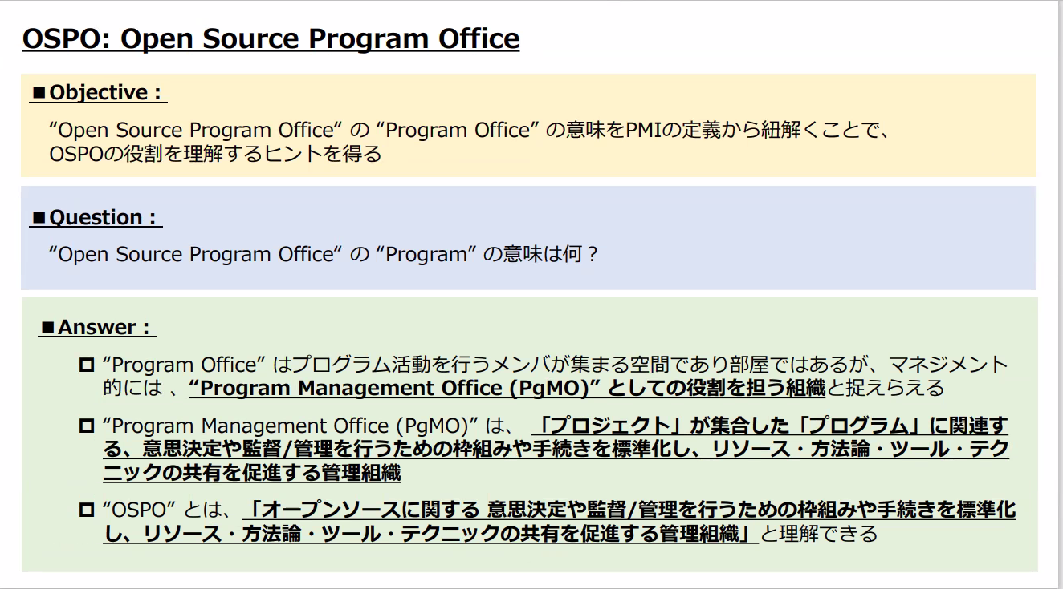
Open Source Program What is an Office Program?
2024/4/26
Participants: 7
Portfolio, Program, Project
Project-Product
Project is where Output comes from, Program is where Outcome comes comes from
The scope of OSPO is different for each company
Project level, Program level, Portfolio level
Maybe it's better not to stick to the word Program Open Source Office
After all, it's better to have Program in it. It's better because the management and promotion aspects are conveyed.

Slide 13
2024/5/24
At first, the contribution was persuading the boss at the grassroots.
OSPO was born trying to do it collectively as a company.
OSPO is difficult only through grassroots activities, and it also requires an approach from the top.
How to create a top approach? I want best practices...
It would be good to have a document called "The Road to COSO (Chief Open Source Officer)"
In order for OSS from a business perspective to be recognized as a company, it would be easier to move to the C level
Comments from sales
In the case of the software business, there is a growing recognition that it is advantageous to understand OSS and the community in order to sell.
With regard to SBOM, export regulations, etc., it would be better to convey clearly and correctly that understanding of OSS and the community + participation in the community to create standards are useful in businesses other than software.
There are places where customers see such things.

Slide 14
What is OSPO?
2023/8/25 Discussion
Where it is on the organizational chart depends on the company.
Roles also vary
Within R & D, CTO Office, Security Office, Risk Compliance, Certificate of Authenticity, Legal Intellectual Property
Where it should be placed varies depending on the company's stage
The fact that it cannot fit into the role of one place above is the reason why there is a debate about where it should be placed
It also varies depending on which role of OSPO the company focuses on
OSPO is a framework that acts as a bridge for the company to cooperate with Open Source, which is a different culture, and smoothly utilizes it
OSPO is an organization that aims to realize cooperation between Open Source, which is an OSS community with a different culture, and groups and organizations, so that their activities are naturally incorporated into the movement of the community
In order to utilize the OSS community, it is a preparation room to understand the culture and be able to act appropriately within the company (this is the definition around stage 0 and 1)
It will develop from here
There are also various ways of OSPO
Virtual-Real
Multiple locations - One centralized location
There may be a trend in which multiple OSPOs are created separately within the company, and as they grow, they will merge into one.
If OSPOs are clustered in one place, they will not function.
They will be left to their own devices, and it will not work.
They will stop learning about OSS culture.
They will be responsible for educating and spreading the word.
In the future, they will share OSS information internally so that they can contribute to the OSS community outside the company.
There is a life cycle: it grows and becomes smaller when it is penetrated.
Spread Culture → Utilize Business
One Vision of OSPO: "Contributing to the Community = Company Success"
Is it the role of OSPO to update the culture within the company by catching changes in industry culture and trends?
The role of OSPO is to grasp trends within the community and apply them to the business (culture is one of them) [Business planning activities?]

Slide 15
Qx
What is OSPO?
Here is a summary of what OSPO does in each stage of the company
2023/10/27
First of all, Fix
OSPO is a framework that serves as a bridge for a company to cooperate with Open Source, a different culture, and smoothly utilizes it
OSPO is an organization that aims to realize cooperation between OSS communities, groups, and organizations with different cultures called Open Source, and to integrate their activities naturally into the movement of the community.
The role of OSPO is to grasp trends in the community, further lead the community, create trends, and apply them to the business.
The role of working to ensure that the above is firmly established as a corporate culture
The role of promoting license compliance throughout the company
The preparation room for understanding the culture and being able to act appropriately within the company in order to utilize the OSS community
In the future, in order to be able to contribute to the OSS community outside the company, the first step is to share OSS information within the company, and to build the OSS community within the company and increase interaction
Q: What is OSPO?
A:
Advantages of using open source software
Use existing software (ease of development)
Use cutting-edge software (technology)
Because the software was created by many people, the level is high
Because many people use it, bugs are easy to find, and fixes are accurate and fast
Benefits of community activities
Development resource efficiency through community cooperation
Opportunities to acquire human resources (corporate side)
As an engineer, you can increase your own value and gain opportunities for activities
Human resource development
Benefits from business strategy
Expansion of market and potential customer base through community and involvement in development direction
Establishment and dissemination of de facto standards
Next time consider mapping with OSPO stages (2023/5/26)
One aspect of OSPO is to realize "community contribution = company success"
The role of OSPO is to update the culture within the company by catching changes in industry culture and trends
Has a role to enlighten and spread license
Activities to propagate that OSS is important and that licenses should be protected
Leadership
Core member of decision-making as a leader in the community
Engagement
Decision meeting participants
Community education
Early contributors
Non-Stage Roles
Have the role of enlightening and spreading
There is a life cycle: it grows, and when it penetrates, it becomes smaller.
https://www.linuxfoundation.jp/wp-content/uploads/2022/11/ja_LFR_LFAID_Deep_Dive_Open_Source_Program_Offices_0830.pdf
Ibrahim Haddad, “A Deep Dive Into Open Source Program Offices:
Structure, Roles, Responsibilities, and Challenges “ foreword by Chris Aniszczyk, August, 2022

Slide 16
Consideration of OSPO's organizational growth
2023/9/22 DISCUSSION
Where it is on the organizational chart varies from company to company
Roles also vary
Within R & D, CTO Office, Security Office, Risk Compliance, Certificate of Authenticity, Legal Intellectual Property
Different stages of a company change where it is placed above
The fact that it cannot fit into the role of one place above is the reason why people argue about where it should be placed
It also changes depending on which role of OSPO a company focuses on
OSPO is also different
Virtual-Real
In multiple locationsCentralized
There is also a tendency for multiple OSPOs to break up within a company, and then merge as they grow.
OSPOs don't work if they're all in one place
It doesn't work because people say, "We can just leave it to you."
I'm afraid that people will stop learning about OSS culture.
Thinking about how OSPO started
In the beginning, there was no word for OSPO, and people were preaching that OSS was important and that we should protect our licenses
They started with a better understanding of GPL and other licenses
The life cycle of OSPO itself:
Ibrahim's session at OSS EU: https://sched.co/1OZJh (around 1: 05)
In depth: The Open Source Program Office - The Linux Foundationhttps://www.linuxfoundation.jp/publications/2022/11/a-deep-dive-into-open-source-program-offices/
Ibrahim Haddad, “A Deep Dive Into Open Source Program Offices: Structure, Roles, Responsibilities, and Challenges “ foreword by Chris Aniszczyk, August, 2022

Slide 17
Changes in awareness of OSS
2023/10/27 Discussion
 | Use in business activities | Compliance | Contribution
Stage 4 | Understanding that revitalizing the community is necessary for business stability | Proposing and promoting better licensing | Proposing and promoting the development of new functions and modules
Stage 3 | Understanding that good communication with the community leads to product improvement | Exchange opinions with the community about license handling and tools | Participate in community updates and bug fixes
Stage 2 | Realize that quality is substantially high. Realize that even if there is a bug, it will be fixed | Respect community opinions and statements | Utilize community updates and bug information. Report of detected bugs and usage records
Stage 1 | Minimum usage reports and information disclosure in accordance with license | Legal minimum | Minimum source disclosure per license
Stage 0 | Use it because it's free | Not sure. If you can't find it. | It's a loss to hand over your code
Increased return
Increased cost
Balancing point between cost and return varies from company to company

Slide 18
7/11 Plenary Breakout Sessions
Q: What does OSPO need? How do I launch OSPO?
A:
Resources (People, money)
Different scale depending on what you do in OSPO
Minimum: Enforce license compliance internally
Further: Increase scale as you expand into education, contributions and strategy
Minimum number of people required for organizational continuity
Mindset
The intention of the top management
The idea of the top management is important because it is accompanied by money.
License compliance is considered essential, but how can we go beyond that?

Slide 19
Step to start using OSS
Use cutting-edge software (technology)
Because the software was created by many people, the level is high
Use existing software (ease of development)
(reduce in-house development effort)

Slide 20
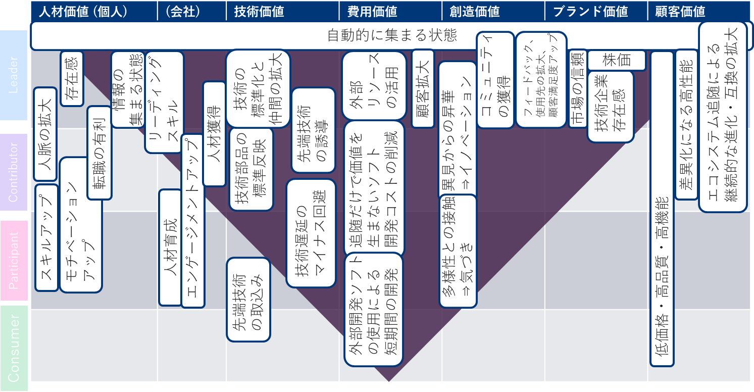
Consumer-Leader Open Source Value Map

Slide 21
Consumer-Leader Open Source Value Map
 | Human Resource Value (Individual) | (Company) | Technology Value | Cost Value | Creative Value | Brand Value | Customer Value
the state of automatically gathering
Leader
Contributor
Participant
Consumer

Slide 22
Qx
Q: Why is community leadership so difficult?
A:

Slide 23
Qx
Q: Why is unified management of OSS needed across the company? (Why is it that OSS is already being used so much?)
A:
Importance
US Executive Order requiring supply chain management of OSS: It has become a procurement condition
It is required to manage it firmly from a security perspective
OSS has become something that supports social infrastructure systems
If there is a problem with the included OSS, it will have a big impact
ISO adoption, industry movement (Teleco WG, etc.)
Need for Company-Wide Unified Management
Mistakes made by some departments affect the entire company (Reputation due to mistakes made by other departments becomes the evaluation of the own department)
Improving the overall level of the internal supply chain
The number of cases handled by non-software engineers is increasing
Outsourcing management, hardware managers manage the entire product including software, OSS compliance understanding of outsourcers varies, etc.
Q's background:
I am proud that I have been doing this because I thought it should be done in the field, but why is the whole company now trying to do this?
The move to create rules without any problems has caused a negative reaction.

Slide 24
Qx
Q: How should I proceed with OSPO?
A:
Start by looking at examples from other companies and finding issues that your company is not aware of.
Tell them why you created OSPO.
I want to prepare answers for people who are thinking about creating OSPO for the first time.
(Example)When trying to create OSPO in your company, it is easier to educate your company if you have examples from other companies.
The form of OSPO should be different in each company.
It is good to start by clarifying why you want to create OSPO.
For example:
Software house type company A:
The main body is each organization. OSPO supports this.
There are OSPO members in each department, and OSPO is a virtual organization.
(In the case of software-housing companies and non-software-housing companies)
Reference
https://www.linuxfoundation.jp/publications/2022/11/a-deep-dive-into-open-source-program-offices/
https://www.linuxfoundation.jp/wp-content/uploads/2022/11/ja_LFR_LFAID_Deep_Dive_Open_Source_Program_Offices_0830.pdf

Slide 25
Qx
Q: (TO: A company that already has an OSPO organization) Why did you create OSPO?
A:
Start by looking at other companies' examples and finding issues that your company is not aware of.
Tell them why you created OSPO.
I want to prepare an answer for those who are thinking about creating OSPO for the first time.
(Example)When trying to create OSPO in your company, it is easier to educate your company if you have examples from other companies.
The form of OSPO should be different in each company.
It is good to start by clarifying why you want to create OSPO.
For example:
Software house type company A:
The main body is each organization. OSPO supports this.
There are OSPO members in each department, and OSPO is a virtual organization.
(In the case of software-housing companies and non-software-housing companies)
Reference
https://www.linuxfoundation.jp/publications/2022/11/a-deep-dive-into-open-source-program-offices/
https://www.linuxfoundation.jp/wp-content/uploads/2022/11/ja_LFR_LFAID_Deep_Dive_Open_Source_Program_Offices_0830.pdf

Slide 26
Qx
Q: I want to create an OSPO. What should I start with?
A:
Start by looking at examples from other companies and finding issues that your company is not aware of.
Tell them why you created OSPO.
Prepare an answer for those who are thinking about creating an OSPO for the first time.
(Example)When trying to create an OSPO within your company, it is easier to educate your company if you have examples from other companies.
The form of OSPO should be different for each company.
Start by clarifying why you want to create an OSPO.
For example:
Software house type company A:
The main body is each organization. OSPO supports this.
There are OSPO members in each department, and OSPO is a virtual organization.
(In the case of software-housing companies and non-software-housing companies)
Reference
https://www.linuxfoundation.jp/publications/2022/11/a-deep-dive-into-open-source-program-offices/
https://www.linuxfoundation.jp/wp-content/uploads/2022/11/ja_LFR_LFAID_Deep_Dive_Open_Source_Program_Offices_0830.pdf

Slide 27
Q1
Q: What is the organizational structure and membership of OSPO?
A:
I would like to prepare an answer for those who are thinking about creating OSPO for the first time.
(Example)When trying to create OSPO in the company, it is easier to educate the company if there are examples from other companies.
The form of OSPO can be different in each company.
It is good to start by clarifying the reason why you want to create OSPO.
For example:
Software house type company A:
The main body is each organization. The OSPO supports this.
There are OSPO members in each department, and the OSPO is a virtual organization.
(In the case of software-housing companies and non-software-housing companies)
Reference
https://www.linuxfoundation.jp/publications/2022/11/a-deep-dive-into-open-source-program-offices/
https://www.linuxfoundation.jp/wp-content/uploads/2022/11/ja_LFR_LFAID_Deep_Dive_Open_Source_Program_Offices_0830.pdf

Slide 28
Q1 Reference Links
A Deep Dive into Open Source Program Offices: Structure, Roles, Responsibilities, and Challenges
https://www.linuxfoundation.org/research/a-deep-dive-into-open-source-program-offices
Deep Dive: Open Source Program Office Organizational Structure, Roles, Responsibilities, and Challenges
https://www.linuxfoundation.jp/blog/2022/11/japanese-version-of-a-deep-dive-into-open-source-program-offices-launch/
Creating an Open Source Program
https://www.linuxfoundation.org/resources/open-source-guides/creating-an-open-source-program?hsLang=en
Creating Open Source Programs
https://www.linuxfoundation.jp/resources/open-source-guides/creating-an-open-source-program/
OSPO 101 Training Modules
https://github.com/todogroup/ospo-career-path/tree/main/OSPO-101
Evolution of the Open Source Program Office (OSPO)
https://www.linuxfoundation.jp/wp-content/uploads//2022/08/LFResearch_OSPO_Report-jp.pdf

Slide 29
Question Candidate (blue text added in MTG)
Why do I need to manage OSS? (Why is it that OSS is already being used so much?) Slide link
What is OSPO?
(TO: Companies that already have an OSPO organization) Why did you create OSPO?
I want to create OSPO. Where do I start?
What is the organizational structure and membership of OSPO?
(In the case of software-housing companies and non-software-housing companies)
What is the organization and authority of OSPO?
(OSPO budget, OSPO report lines, OSPO default internal rule violations, etc.)
Do you require SBOM from the software supplier?
(What's the timing? Format? Do you want to check the contents? How often? You're asking for a renewal?)
Do you have enough SBOM management tools?
(How do you see what's in the SBOM? What are the SBOM quality judgments/criteria? Can I see the SBOM difference?)
What about OSS copyright?
(As per copyright law? Do you have company rules? Are community activities business? What about personal OSS developed before employment?)
Do you manage OSS in OSS?
(What's the catch? Managing OSS What is OSS's view on unsecured/unguaranteed? Internal explanation logic?)
Have you received applications from internal development departments to use software that uses OSS?
(What is the content of the application? What if my application is violated? What is the application violation check after application approval?)
[2/10] What are the legal and intellectual property contributions to OSPO?
What are the legal responsibilities? )
[2/10] What are the responsibilities of SBOM requirements during procurement?
(What are the responsibilities of if the content, contract and SBOM are not submitted?)
What issues does OSPO deal with?
Why do we need OpenChain activities?
How do we find OSS vulnerabilities?
How do we interact with the community?

Slide 30
2023/3/24 Chat of the meeting
15:38:26
I thought it would be easier to understand why first.
15:42:19
Maybe it would be nice to have an OSPO maturity stage.
15:46:44
https://www.linuxfoundation.jp/resources/open-source-guides/creating-an-open-source-program/#2
There are definitely a lot of places to start at the bottom of this role.
15:48:13
Chats should be 'saved chat' at the end to be transcribed and kept with the minutes ~
15:48:36
Reacted to "Chats should be 'saved chat' at the end to be transcribed and kept with the minutes ..." with ??
15:50:44
What about the contents of the leaflet?
15:50:55
What about the contents of the Reacted to leaflet? " with ??
15:52:37
What about the contents of the leaflet ... for?? This has been dealt with in
15:52:53
It's like literacy.
15:54:14
I used to explain that you would become a thief.
15:55:53
I think it's better to break down the "executive order" one more step and write "executive order requiring OSS supply chain management."
15:56:58
I used to say "No More OSS Thief."
15:57:19
The executive order is more about security than license management.
15:57:27
Reacted to "The executive order is more about licensing ..." with ??
15:57:52
Reacted to "No More OSS Thief ..." with ??
15:59:26
He even cited the Tokyo Olympics logo theft issue ...
16:00:17
Reacted to "He cited the Tokyo Olympics logo theft issue ..." with ??
15:06:12
There seems to be a question what is OSPO in the first place?
15:07:11
"What is OSPO in the first place? ..." For?? This is a response
15:07:45
This is a white paper that describes the organization structure in TODO.
https://www.linuxfoundation.org/research/a-deep-dive-into-open-source-program-offices
15:07:47
Here's What You've Seen Before
Deep Dive: The Open Source Program Office Organization, Roles, Responsibilities and Challenges By Linux Foundation Japan November 29, 2022
https://www.linuxfoundation.jp/blog/2022/11/japanese-version-of-a-deep-dive-into-open-source-program-offices-launch/
15:10:42
Maybe some old documents are missing ・・・?
https://www.linuxfoundation.org/resources/open-source-guides/creating-an-open-source-program?hsLang=en
15:13:07
Here's What You've Seen
15:13:09
https://github.com/todogroup/ospo-career-path/blob/main/module3/README.md
15:13:57
https://github.com/todogroup/ospo-career-path/blob/main/OSPO-101/module3/README.md
15:14:15
Is this it?
15:14:16
https://github.com/todogroup/ospo-career-path
15:15:09
https://www.linuxfoundation.jp/resources/open-source-guides/creating-an-open-source-program/#4
15:15:14
It seems important to organize the information that everyone has shared and make a list.
15:20:09
https://www.linuxfoundation.jp/resources/open-source-guides/creating-an-open-source-program/
Here it is...
15:22:13
OSS promotion, right?
15:23:10
Reacted to OSS promotion, right? with??

Slide 31
Q: What are the benefits of OSS activities that leverage OSS?
Use existing software (ease of development)
Use cutting-edge software (technology)
The software was created by many people, so the level is high
Leadership
Core decision makers as community leaders
Engagement
Decision meeting participants
Community education
Early contributors
https://www.linuxfoundation.jp/wp-content/uploads/2022/11/ja_LFR_LFAID_Deep_Dive_Open_Source_Program_Offices_0830.pdf
Ibrahim Haddad, “A Deep Dive Into Open Source Program Offices:
Structure, Roles, Responsibilities, and Challenges “ foreword by Chris Aniszczyk, August, 2022

Slide 32
Q: What are the benefits of OSS activities that leverage OSS?
Use OSS securely in business
Use OSS in its original form necessary for inter-company transactions
Risk control for the use of OSS throughout the supply chain
Use existing software (ease of development)
Use cutting-edge software (technology)
The software was created by many people, so the level is high
Leadership
Core decision makers as community leaders
Engagement
Decision meeting participants
Community education
Early contributors
https://www.linuxfoundation.jp/wp-content/uploads/2022/11/ja_LFR_LFAID_Deep_Dive_Open_Source_Program_Offices_0830.pdf
Ibrahim Haddad, “A Deep Dive Into Open Source Program Offices:
Structure, Roles, Responsibilities, and Challenges “ foreword by Chris Aniszczyk, August, 2022

Slide 33
Q: What are the advantages of OSS activities that utilize OSS?
Bugs are easier to find, and fixes are more accurate and faster by more engineers than by the company alone.
Development resource efficiency through community cooperation
Place for human resource development and retention/acquisition of human resources
Increase market value for engineers and provide a place for activities to attract human resources
You can safely use OSS in your business
You can use OSS in its original form, which is necessary for business-to-business transactions
Risk control for the use of OSS throughout the supply chain
Use existing software (make development easier)
Use cutting-edge software (technology)
The software was created by many people, so the level is high.
https://www.linuxfoundation.jp/wp-content/uploads/2022/11/ja_LFR_LFAID_Deep_Dive_Open_Source_Program_Offices_0830.pdf
Ibrahim Haddad, “A Deep Dive Into Open Source Program Offices:
Structure, Roles, Responsibilities, and Challenges “ foreword by Chris Aniszczyk, August, 2022

Slide 34
Q: What are the advantages of OSS activities?
It is easier to find bugs, more accurate and faster to fix them by more engineers than by the company alone.
Development resource efficiency through community cooperation
Place for human resource development and retention/acquisition of human resources
Enhancement of market value to engineers and inducement of human resources by providing a place for activities
Use OSS securely in business
Use OSS in its original form necessary for inter-company transactions
Risk control for the use of OSS throughout the supply chain
Use existing software (ease of development)
Use cutting-edge software (technology)
The software was created by many people, so the level is high
Alignment of expectations as a company through community with community movements
Involvement in development direction
Improvement of motivation of engineers
https://www.linuxfoundation.jp/wp-content/uploads/2022/11/ja_LFR_LFAID_Deep_Dive_Open_Source_Program_Offices_0830.pdf
Ibrahim Haddad, “A Deep Dive Into Open Source Program Offices:
Structure, Roles, Responsibilities, and Challenges “ foreword by Chris Aniszczyk, August, 2022

Slide 35
Q: What are the advantages of OSS activities?
It is easier to find bugs, more accurate and faster to fix them by more engineers than by the company alone.
Development resource efficiency through community cooperation
Place for human resource development and retention/acquisition of human resources
Enhancement of market value to engineers and inducement of human resources by providing a place for activities
Creation of businesses utilizing OSS
Expansion of market and potential customer base
Establishment and diffusion of de facto standards
Building an ecosystem
Getting legitimacy for your activities
Getting endorse from community participants
Use OSS securely in business
Use OSS in its original form necessary for inter-company transactions
Risk control for the use of OSS throughout the supply chain
Use existing software (ease of development)
Use cutting-edge software (technology)
The software was created by many people, so the level is high
Alignment of expectations as a company through community with community movements
Involvement in development direction
Motivation of engineers
https://www.linuxfoundation.jp/wp-content/uploads/2022/11/ja_LFR_LFAID_Deep_Dive_Open_Source_Program_Offices_0830.pdf
Ibrahim Haddad, “A Deep Dive Into Open Source Program Offices:
Structure, Roles, Responsibilities, and Challenges “ foreword by Chris Aniszczyk, August, 2022

Slide 36
Qx
What is OSPO?
Here's a summary of what OSPO does at each stage of the company
Q: What is OSPO?
A:
Advantages of using open source software
Use existing software (ease of development)
Use cutting-edge software (technology)
Because the software was created by many people, the level is high
Because many people use it, bugs are easy to find, and fixes are accurate and fast
Benefits of community activities
Development resource efficiency through community cooperation
Opportunities to acquire human resources (corporate side)
As an engineer, you can increase your own value and gain opportunities for activities
Human resource development
Benefits from business strategy
Expansion of market and potential customer base through community and involvement in development direction
Establishment and dissemination of de facto standards
Mapping with OSPO stages next time (2023/5/26)
have a role in educating and promoting licensing
activities such as OSS is important and protecting licensing
Leadership
Core members of decision making as community leaders
Engagement
Decision meeting participants
Community education
Early contributors
Leadership
As a community leader and a key decision maker
Engagement
Decision meeting participants
Community education
Early contributors
https://www.linuxfoundation.jp/wp-content/uploads/2022/11/ja_LFR_LFAID_Deep_Dive_Open_Source_Program_Offices_0830.pdf
Ibrahim Haddad, “A Deep Dive Into Open Source Program Offices:
Structure, Roles, Responsibilities, and Challenges “ foreword by Chris Aniszczyk, August, 2022

Slide 37
Qx
What is OSPO?
Here's a summary of what OSPO does at each stage of the company
Have a role in promoting license compliance throughout the company
Preparation room to understand the culture and be able to act appropriately within the company in order to utilize the OSS community
In the future, in order to contribute to the OSS community outside the company, first share OSS information within the company, and build the OSS community within the company to increase interaction
Q: What is OSPO?
A:
Advantages of using open source software
Use existing software (ease of development)
Use cutting-edge software (technology)
Because the software was created by many people, the level is high
Because many people use it, bugs are easy to find, and fixes are accurate and fast
Benefits of community activities
Development resource efficiency through community cooperation
Opportunities to acquire human resources (corporate side)
As an engineer, you can increase your own value and gain opportunities for activities
Human resource development
Benefits from business strategy
Expansion of market and potential customer base through community and involvement in development direction
Establishment and dissemination of de facto standards
Mapping with OSPO stages next time (2023/5/26)
Have a role in educating and promoting the license
Activities to promote the importance of OSS and the importance of protecting the license
Leadership
Core members of decision making as community leaders
Engagement
Decision meeting participants
Community education
Early contributors
Leadership
As a community leader and a key decision maker
Engagement
Decision meeting participants
Community education
Early contributors
https://www.linuxfoundation.jp/wp-content/uploads/2022/11/ja_LFR_LFAID_Deep_Dive_Open_Source_Program_Offices_0830.pdf
Ibrahim Haddad, “A Deep Dive Into Open Source Program Offices:
Structure, Roles, Responsibilities, and Challenges “ foreword by Chris Aniszczyk, August, 2022

Slide 38
Qx
What is OSPO?
I summarized what OSPO does in each stage of the company.
OSPO is a framework that provides a bridge for companies to collaborate on different cultures of Open Source and make use of it smoothly.
OSPO is an organization that aims to realize cooperation between OSS communities, groups, and organizations with different cultures of Open Source and make their activities naturally incorporated into the movement of the community
Responsible for promoting compliance with the license throughout the company
Preparation room to understand the culture and take appropriate actions within the company in order to utilize the OSS community
In the future, in order to contribute to the OSS community outside the company, first share OSS information within the company and build the OSS community within the company to increase interaction
Q: What is OSPO?
A:
Advantages of using open source software
Use existing software (ease of development)
Use cutting-edge software (technology)
Because the software was created by many people, the level is high
Because many people use it, bugs are easy to find, and fixes are accurate and fast
Benefits of community activities
Development resource efficiency through community cooperation
Opportunities to acquire human resources (corporate side)
As an engineer, you can increase your own value and gain opportunities for activities
Human resource development
Benefits from business strategy
Expansion of market and potential customer base through community and involvement in development direction
Establishment and dissemination of de facto standards
Mapping with OSPO stages next time (2023/5/26)
It has the role of enlightening and spreading the license
Activities to spread the message that OSS is important and that we should protect the license
https://www.linuxfoundation.jp/wp-content/uploads/2022/11/ja_LFR_LFAID_Deep_Dive_Open_Source_Program_Offices_0830.pdf
Ibrahim Haddad, “A Deep Dive Into Open Source Program Offices:
Structure, Roles, Responsibilities, and Challenges “ foreword by Chris Aniszczyk, August, 2022

Slide 39
Qx
What is OSPO?
I summarized what OSPO does in each stage of the company.
OSPO is a framework that provides a bridge for companies to collaborate on different cultures of Open Source and make use of it smoothly.
OSPO is an organization that aims to realize cooperation between OSS communities, groups, and organizations with different cultures of Open Source and to make their activities naturally incorporated into the movement of the community
Responsible for promoting compliance with the license throughout the company
Preparation room for understanding the culture and taking appropriate actions within the company in order to utilize the OSS community
In the future, in order to be able to contribute to the OSS community outside the company, OSPO will first share OSS information within the company and build an OSS community within the company to increase interaction
Q: What is OSPO?
A:
Advantages of using open source software
Use existing software (ease of development)
Use cutting-edge software (technology)
Because the software was created by many people, the level is high
Because many people use it, bugs are easy to find, and fixes are accurate and fast
Benefits of community activities
Development resource efficiency through community cooperation
Opportunities to acquire human resources (corporate side)
As an engineer, you can increase your own value and gain opportunities for activities
Human resource development
Benefits from business strategy
Expansion of market and potential customer base through community and involvement in development direction
Establishment and dissemination of de facto standards
Mapping with OSPO stages next time (2023/5/26)
One aspect of OSPO is to realize "contributing to the community = company success"
The role of OSPO is to keep up with changes in industry culture and trends and update the culture within the company
It has the role of enlightening and spreading the license
Activities to spread the message that OSS is important and that we should protect the license
https://www.linuxfoundation.jp/wp-content/uploads/2022/11/ja_LFR_LFAID_Deep_Dive_Open_Source_Program_Offices_0830.pdf
Ibrahim Haddad, “A Deep Dive Into Open Source Program Offices:
Structure, Roles, Responsibilities, and Challenges “ foreword by Chris Aniszczyk, August, 2022

Slide 40
Qx
What is OSPO?
Here is a summary of what OSPO does in each stage of the company
OSPO is a framework that serves as a bridge for a company to cooperate with Open Source, a different culture, and smoothly utilizes it
OSPO is an organization that aims to realize cooperation between OSS communities, groups, and organizations with different cultures called Open Source, and to integrate their activities naturally into the movement of the community.
The role of OSPO is to grasp trends in the community, further lead the community, create trends, and apply them to the business.
The role of working to ensure that the above is firmly established as a corporate culture
The role of promoting license compliance throughout the company
The preparation room for understanding the culture and being able to act appropriately within the company in order to utilize the OSS community
In the future, in order to be able to contribute to the OSS community outside the company, the first step is to share OSS information within the company, and to build the OSS community within the company and increase interaction
Q: What is OSPO?
A:
Advantages of using open source software
Use existing software (ease of development)
Use cutting-edge software (technology)
Because the software was created by many people, the level is high
Because many people use it, bugs are easy to find, and fixes are accurate and fast
Benefits of community activities
Development resource efficiency through community cooperation
Opportunities to acquire human resources (corporate side)
As an engineer, you can increase your own value and gain opportunities for activities
Human resource development
Benefits from business strategy
Expansion of market and potential customer base through community and involvement in development direction
Establishment and dissemination of de facto standards
Next time consider mapping with OSPO stages (2023/5/26)
One aspect of OSPO is to realize "community contribution = company success"
The role of OSPO is to update the culture within the company by catching changes in industry culture and trends
Has a role to enlighten and spread license
Activities to propagate that OSS is important and that licenses should be protected
Non-Stage Roles
Role to Enlighten and Infiltrate
There is a life cycle: grow bigger, and when it penetrates, grow smaller
https://www.linuxfoundation.jp/wp-content/uploads/2022/11/ja_LFR_LFAID_Deep_Dive_Open_Source_Program_Offices_0830.pdf
Ibrahim Haddad, “A Deep Dive Into Open Source Program Offices:
Structure, Roles, Responsibilities, and Challenges “ foreword by Chris Aniszczyk, August, 2022

Slide 41
2024/6/28 agenda
Explanation of the code of conduct of the meeting
Purpose of this meeting
Introduction of self & main concern about OSPO
How to proceed in the future
Disseminate results after a break?
Does it meet the needs of the participants?
Select FAQ topics from the interests and discuss them

Slide 42
Interests
I want people to understand OSS correctly.
If there are no internal rules based on a correct understanding, development people will be in trouble.
Flag waving within the company
I want people to be able to use OSS to improve work efficiency and focus on areas where they should focus more
Contribution activities are not evaluated correctly
There is no understanding of what the company needs
What are the steps that can be taken in the field
As I was listening to the introduction, I thought that LF developed the information to be understood, so here is the link
Open Source Guide for Enterprises – The Linux Foundation
And then there's the material from when we announced our contributions, including the case study that semiconductor Nvidia is doing for the business.
https://static.sched.com/hosted_files/ossna2024/05/QuantitativeMethodContributionValue-KS_MK_202404.pdf
What Intel is saying to the outside world
How Intel Supports Open Source from the Inside Out
Who do we want our executives to be?
How can OSS help the business?
The metrics for OSS activities
I want our divisions to be able to think of OSS as their own business.
The current situation of AI is similar to the first situation of OSS (Don't use it because it's dangerous, etc.)
Japanese companies tend not to move without external pressure. Can we do something about this?
I want to do not only governance but also leading.
Cybersecurity is also getting attention.
There is a temperature difference between departments in the company.
There is a problem in the process when bringing OSS. (I want them to choose a safe OSS.)
What kind of people are needed to gather OSPO members?
I think the issues of OSPO are different between Japan and overseas.

Slide 43
Has software changed from being developed to being procured?
Cloud services have become the mainstream, developing as OSS and making money from services. Japan has not caught up with this.
Is it unique to Japan?
Proposed FAQ theme:
What is a contribution?
Deepen understanding
How to communicate
How to measure value
OSS contributions are easier to communicate when explained through standardization committee activities

Slide 44
Collection of material (2024/7/26)
Why is OSS education a company-wide education?
Collect examples from other companies and let them know
Is there a common model for dividing educational content (Foundations, Licenses, Practices, Strategies)?
Education for management (awareness raising): A good way for general managers, section chiefs, and management
How to start: Where to start
Collect and share triggers in LT. I feel there are differences in the industry.
The desired relationship between the OSS community and companies and why
EU countries, cities have OSPO
EU Commission Waves Flag: To Combat US Big Tech
Building a system for each municipality is too much |Hal Seki (note.com)
Why not let people know that they need OSS/OSPO to make money?
Let people know that community activities can bring benefits to the company

Slide 45
2024/8/23 About Contribution
Contribution
Example:Issue reports, defect reports, and revision proposals
Document creation, event participation, and active promotion of events
Introduce and promote the community through blogs, etc.
In general, anything that invigorates the community becomes a Contribution.
Contribution (Sponsorship)
Cost for projects, events, and membership to the Foundation
Provision of goods and infrastructure
Why contributions are necessary and important
Don't put your company at a disadvantage: Create documentation, build a common understanding
Expand your horizons on your devices (competitive area) (increase users)
As an SIer, avoid vendor lock-in when making software in-house
Increase your company's presence and win business deals
Improve developer (employee) satisfaction ➡ Increase a sense of belonging and attract developers
On the hiring side, find and hire people who are active in the community
Development and technical aspects
Use the community as a place to solve technical issues (Make our products competitive by improving their performance and functions)
Control development costs by following security measures (Contributions reduce costs by reducing differences between versions of OSS)
Raise your own value as an individual engineer: Achievements remain as public information
But it's hard to get people to agree with me
OSS forms a de facto standard
It's easier to get people to agree with me if I can map the current OSS model to the past success model
I can't show well how the money I spend is going to be returned ➡ It's difficult if it's not top-down
It's harder to break even if OSS is just a software development activity
If you don't do it, someone will do it How to communicate the old
How to communicate a successful company
Instead of looking for a workaround to a problem, gather wisdom and get a root solution

