Slide 1
Qx
Complete for now
Q: Why should I be careful with OSS?
A:
Licensing Aspects
Software is protected by copyrights and licenses
You have to comply with the license
You have to respect the author
There are court cases for license violation
OSS can be obtained and used without going through any procedures such as contract.
Normally, the license conditions are checked through the procedures such as contract, but OSS can be used without doing so.
be introduced at the grassroots and become unmanageable
OSS is a dependency that comes in on its own
There are things it doesn't know it's using
You have to understand the difference between Freeware and OSS (free software) and handle it according to the terms of use
It is often difficult to decide → This is where OSPO becomes necessary
Use without worry
Security (Vulnerability)
Problems are discovered after deployment and action is required. If you don't know what you are using at that time, the response will be delayed or impossible.
It is easy for the attacker to do because it is widely used/the source is public.
On the other hand, there are many developers and users, so measures are taken quickly.
Use OSS safely
Depend on the state of the community
Stay safe by contributing and participating in the community
Note)Assume early stage questions

Slide 2
Q: What are the benefits of OSS activities that utilize OSS?
A:
Benefits of using open source software
Use existing software (makes development easier)
Use state-of-the-art software (technology)
This software was created by many people, so it has a high level
Since many people use it, it is easy to find bugs, correct them accurately and quickly
Benefits of community activities
Efficient development resources through community collaboration
Opportunities to acquire human resources (enterprise side)
As an engineer, you can improve your value and gain opportunities for activities
human resources development
Business strategic benefits
Expansion of the market and potential customer base through the community and involvement in development direction
Establishment and dissemination of de facto standards
Next time consider mapping with OSPO stages (2023/5/26)

Slide 3
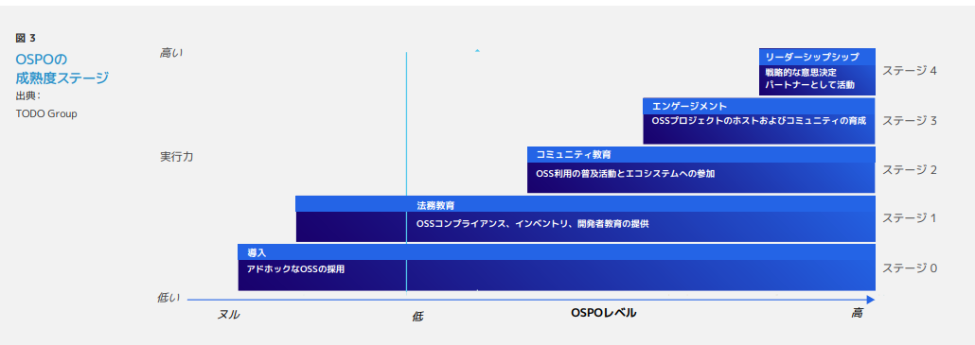
Q: What are the benefits of OSS activities?
Fix
It is easier for many engineers to find bugs and fix them accurately and quickly than dealing with it by themselves.
Efficient development resources through community collaboration
Human resource development and retention/acquisition
Ability to motivate human resources by increasing market value and providing opportunities for engineers
Creation of business utilizing OSS
Expansion of market and potential customer base
Establishment and dissemination of de facto standards
Establishment of ecosystem
Obtaining legitimacy of activities
Obtaining endorsements from community participants
Being able to use OSS safely in business
Being able to use OSS in its original form necessary for business-to-business transactions
Risk control of OSS use throughout the supply chain
Using existing software (making development easier)
Using state-of-the-art software (technology)
This software was created by many people, so it has a high level.
Aligning Corporate Expectations and Community Movements through Communities
Engaging in Development Directions
Motivating Engineers
Leadership
A core decision-making member as a community leader
Engagement
Decision Meeting Participants
Community Education
Early Contributors
https://www.linuxfoundation.jp/wp-content/uploads/2022/11/ja_LFR_LFAID_Deep_Dive_Open_Source_Program_Offices_0830.pdf
Ibrahim Haddad, “A Deep Dive Into Open Source Program Offices:
Structure, Roles, Responsibilities, and Challenges “ foreword by Chris Aniszczyk, August, 2022

Slide 4
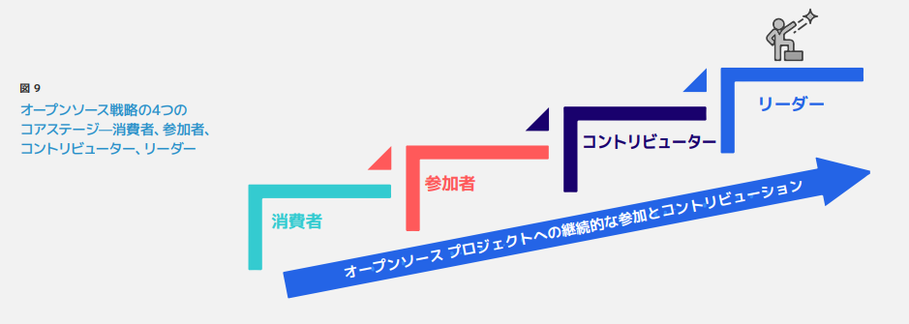
Q: What are the benefits of OSS activities?
Fix
It is easier for many engineers to find bugs and fix them accurately and quickly than dealing with it by themselves.
Efficient development resources through community collaboration
Human resource development and retention/acquisition
Ability to induce human resources by increasing market value and providing opportunities for activities to engineers
Creation of business utilizing OSS
Expansion of market and potential customer base
Establishment and dissemination of de facto standards
Establishment of ecosystem
Obtaining legitimacy of activities
Obtaining endorsements from community participants
Being able to use OSS safely in business
Being able to use OSS in its original form necessary for business-to-business transactions
Risk control of OSS use throughout the supply chain
Using existing software (making development easier)
Using state-of-the-art software (technology)
This software was created by many people, so it has a high level.
Alignment of corporate expectations and community movements through community
Engagement in development direction
Motivation of engineers

Slide 5
What is OSPO anyway?
2023/10/27 Discussion - Next 12/22 Continued
(I will summarize it as a higher concept.)
What OSPO is working on
Issues
Meet the current situation where more than 80% of OSS is used
Initiatives
Finding and promoting ways to engage with OSS and the OSS community as a company
As I've written briefly before, I feel that OSPO= bridging the gap between internal and OSS culture
It's just an image of catching up, so I feel it's not enough
to bridge the organization and the OSS community is OSPO
OSPO's role is to stage up awareness and mindset within the enterprise
Instill OSS-like ways of working (something that is becoming commonplace externally) within the organization, not just engineers
Work to bring successful ways of working within the OSS community for successful development at scale
Work to integrate (become part of) the ecosystem created by OSS
Develop the business by utilizing the OSS ecosystem
Interact between the logic of the company and the logic of OSS and aim for the development of both
Corporate engineers working in the OSS community should focus on OSS activities
OSPO members think about the logic side of the company and implement the strategy separately from the person.
When OSPO members and OSS activity members are confused, activity members suffer.
Position of OSPO people in the company
Not a divisional person, not an OSS activity engineer. I think both.
I use different positions. (This makes OSPO difficult.)
Aiming for/creating a state where OSS activities have value and benefits from both the enterprise and the OSS community
Why don't we discuss the meaning of the name Open Source Program Office?
Meaning of Program
A program officer (program officer, PO) is a person who plans and manages research and grant programs at research institutions, think tanks, foundations, etc.
There is a view that it is done continuously.

Slide 6
What is OSPO anyway?
2023/12/22 Continue
The skills that OSPO members need
to be broad?
software development techniques (at some level)
licensing knowledge
basic knowledge of legal affairs and intellectual property
common understanding in the community (intent, background)
communication skills
English skills
Spirit of respect
Motivation, mental ability to withstand headwinds
Ability to explain
Skills as an educator
Experience and appropriateness of community activities
OSS development methods and correct understanding of ecosystem communities
Understanding and respecting the culture of OSS and communities
Participant values
What responsibilities should OSPO fulfill?
License management
Proposals and advice on the use of OSS in business strategies
Activating activities in the OSS community
Educating about OSS
Educating about risks when using OSS
Educating about the value of using OSS and community effects
Managing CLA:
Internal privileges to OSPO
Pass to speak to C-level

Slide 7
What is OSPO anyway?
2023/12/22 Continued
What is the best size for OSPO?
What percentage of total engineers?
Changes in OSS maturity stage (be large in the beginning and gradually diminish)
What external involvement is required for OSPO?
Participate in, contribute to, and discuss OSS events
Absorb external information and bring it back to the company
Support for companies (engineers) to share their opinions outside the company and form a common understanding
Promote the company's stance (Cooperation, peer building, and talent acquisition)
OSS project management
CLA configuration strategy, managing
M & A perspective
Not just corporate acquisitions, but project acquisitions (? ) support
OSPO performance evaluation methods
Activity justification methods
Percentage of people in the company who understand
How to show your contribution to the business
Awareness
What is the start of OSPO
License compliance, education
Reference: https://ospomindmap.todogroup.org/jp

Slide 8
What is OSPO?
2023/8/25 Discussion
Where it is on the org chart depends on the company.
It has different roles.
In R & D, CTO Office, Security Office, Risk Compliance, Product Certificate, Legal Intellectual Property
When companies are in different stages, where they are placed above changes
It doesn't fit into the role of one place above is the reason why there is a debate about where to place
It also depends on which role the company focuses on in OSPO
OSPO is a framework that bridges and smoothly utilizes the different cultures of Open Source in order for the company to cooperate.
OSPO is an organization that aims to realize the cooperation of the OSS community, groups and organizations with different cultures of Open Source, and to integrate their activities naturally into the movement of the community.
The preparation room to understand the culture and to be able to act appropriately within the company in order to utilize the OSS community (this is the definition around stage 0, 1)
develop from here
There are various ways of OSPO
Virtual Real
Multiple Locations - Centralized
As a result, multiple OSPOs will be generated separately within the company, and they will be consolidated as they grow.
OSPOs will not work if they are consolidated in one place.
It will not work because it will be left here.
I am afraid that I will stop learning OSS culture.
It has the role of enlightening and instilling
Eventually, in order to contribute to the external OSS community, the first step is to share OSS information within the company.
It has a life cycle: it gets bigger, and then it gets smaller when it penetrates.
Instill culture → use business
One aspect of OSPO is to realize "community contribution = company success"
Is it OSPO's role to catch changes in industry culture and trends and update internal culture?
Is it OSPO's role to catch trends in the community and apply them to the business (culture is one of them) [Corporate planning activities?]

Slide 9
Qx
What is OSPO?
Here is a summary of what OSPO does in each stage of the company.
2023/10/27
Fix for now
OSPO is a framework to smoothly utilize Open Source as a bridge for companies to cooperate with different cultures
Open Source is an organization that aims to collaborate with OSS communities, groups, and organizations of different cultures and to integrate their activities naturally into community movements.
The role of OSPO is to understand trends in the community and to lead the community, create trends, and apply them to the business.
The role of OSPO in working to ensure that the above is firmly established in the corporate culture.
The role of OSPO in promoting thorough license compliance throughout the company.
The preparation room to understand the culture and be able to act appropriately within the company in order to utilize the OSS community.
In order to contribute to the OSS community outside the company, the first step is to share OSS information within the company.
Q: What is OSPO?
A:
Benefits of using open source software
Use existing software (makes development easier)
Use state-of-the-art software (technology)
This software was created by many people, so it has a high level
Since many people use it, it is easy to find bugs, correct them accurately and quickly
Benefits of community activities
Efficient development resources through community collaboration
Opportunities to acquire talent (company side)
As an engineer, you can improve your value and gain opportunities for activities
Human resource development
Business strategic benefits
Expansion of the market and potential customer base through the community and involvement in development direction
Establishment and dissemination of de facto standards
Next time consider mapping with OSPO stages (2023/5/26)
One aspect of OSPO is to realize "community contribution = company success"
The role of OSPO is to catch changes in the culture and trends of the industry and update the culture of the company
Have a role in enlightening and instilling licenses
to evangelize that OSS is important and that licenses should be protected
Leadership
A core decision-making member as a community leader
Engagement
Decision Meeting Participants
Community Education
Early Contributors
Non-Stage Roles
Have the role of enlightening and instilling
It has a life cycle: it gets bigger, and then it gets smaller when it penetrates.
https://www.linuxfoundation.jp/wp-content/uploads/2022/11/ja_LFR_LFAID_Deep_Dive_Open_Source_Program_Offices_0830.pdf
Ibrahim Haddad, “A Deep Dive Into Open Source Program Offices:
Structure, Roles, Responsibilities, and Challenges “ foreword by Chris Aniszczyk, August, 2022

Slide 10
OSPO Organizational Growth Considerations
2023/9/22 DISCUSSION
Where they are on the org chart varies from company to company
and their roles vary
R & D, CTO Office, Security Office, Risk Compliance, Product Certificate, Legal Intellectual Property
Different stages of the company will change where you place the above
things that don't fit into the role of one place above are the reasons why people argue about where to place
depending on which role the company focuses on in OSPO.
OSPO also has a variety of
Virtual Real
Multiple Locations - Centralized
As a result, multiple OSPOs may be generated separately within the company, and they may come together as the company grows.
When OSPOs come together in one place, they stop working.
It's like, "I can leave it here," and it doesn't work.
I'm afraid I'll stop learning OSS culture.
I'm going to look at how OSPO started.
In the beginning, there was no word for OSPO. OSS was important, let's keep the license, evangelism.
I started by getting a better understanding of GPL and other licenses.
Life cycle of OSPO itself:
Ibrahim session at OSS EU: https://sched.co/1OZJh (around 1: 05)
Reference: Deep dive: Open Source Program Office - The Linux Foundation https://www.linuxfoundation.jp/publications/2022/11/a-deep-dive-into-open-source-program-offices/
Ibrahim Haddad, “A Deep Dive Into Open Source Program Offices: Structure, Roles, Responsibilities, and Challenges “ foreword by Chris Aniszczyk, August, 2022

Slide 11
Changes in awareness of OSS
2023/10/27 Discussion
 | Use in business activities | Compliance | Contribution
Stage 4 | Understanding that revitalizing communities is necessary for business stability | Proposing and promoting better licensing | Proposing and promoting the development of new functions and modules
Stage 3 | Understanding that good communication with the community will improve the product | Discuss licensing and tools with the community | Participate in community updates and troubleshooting
Stage 2 | Realize that the quality is substantially higher. Realize that even if there is a defect, it will be fixed. | Respect the opinions and statements of the community | Use community updates and defect information. Report discovered defects and report usage results.
Stage 1 | Minimum usage report and information disclosure in accordance with the license. | legally minimal response | minimum source disclosure under license
Stage 0 | use for free | I'm not sure. I hope I can't find it. | It's a loss to give my code.
Increased return
Increased cost
Cost and return balance points vary from company to company

Slide 12
7/11 Plenary Breakout Session
Q: What does OSPO need? How do I launch OSPO?
A:
Resources (People, money)
Scale depends on what you do with OSPO
Minimum: Enforce license compliance internally
Even: Scale as education, contributions, and strategy spread
Given the continuity of the organization, the minimum number needed is more than one person
Mindset
top intention
top thought is important because it comes with money
up to license compliance is considered essential, but how can we go beyond that?

Slide 13
Steps to get started with OSS
Use state-of-the-art software (technology)
This software was created by many people, so it has a high level
Use existing software (makes development easier)
(reduces in-house development effort)

Slide 14
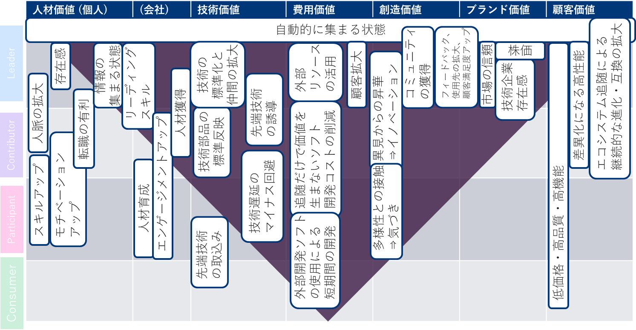
Consumer ~ Leader Open Source Value Map

Slide 15
Consumer ~ Leader Open Source Value Map
 | Human Resource Value (Individual) | (Company) | Technology value | Cost value | Creative value | Brand value | Customer value
state of automatically gathering
Leader
Contributor
Participant
Consumer

Slide 16
Qx
Q: Why is community leadership so difficult?
A:

Slide 17
Qx
Q: Why is there a need for unified management of OSS? (Why is OSS used so much now?)
A:
Importance
US Executive Order Requiring OSS Supply Chain Management: It's Becoming a Procurement Condition
It's Required to Be Well Managed from a Security Perspective
OSS Has Become a Support for Social Infrastructure Systems
Problems with the included OSS can have a big impact
ISO, industry movement (Teleco WG, etc.)
Need for company-wide unified management
The mishandling of some departments affects the entire company (the reputation due to the mistakes of other departments is the evaluation of the own department)
Improving the overall level of the internal supply chain
Increasingly handled by non-software engineers
Outsourced management, hardware managers managing the entire product, including software, and outsourcers' varying understanding of OSS compliance
Q Background:
Why is the whole company trying to work on something that we are proud to do in the field?
The movement to create rules without problems is causing negative reactions.

Slide 18
Qx
Q: How should we proceed with OSPO?
A:
We start by looking at other companies' examples and finding issues that we are not aware of.
We should tell them why we created OSPO.
We want to prepare an answer for those who are thinking about creating OSPO for the first time.
(Example)When trying to create OSPO in the company, it is easy to educate the company if there are examples of other companies.
The form of OSPO can be different in each company.
It is good to start by clarifying the reason why you want to make OSPO.
For example,
Software house company A:
Each organization is the main entity. OSPO supports it.
Each department has OSPO members, and OSPO is an organization that meets virtually.
(In the case of software-house companies and non-software-house companies,)
References
https://www.linuxfoundation.jp/publications/2022/11/a-deep-dive-into-open-source-program-offices/
https://www.linuxfoundation.jp/wp-content/uploads/2022/11/ja_LFR_LFAID_Deep_Dive_Open_Source_Program_Offices_0830.pdf

Slide 19
Qx
Q: (TO: A company that already has an OSPO organization) Why did you create OSPO?
A:
Start by looking at other companies' examples and finding issues that you haven't noticed.
Tell them why you created OSPO.
I want to prepare an answer for those who are thinking about creating OSPO for the first time.
(Example)When trying to create OSPO in the company, it is easy to educate the company if there are examples of other companies.
The form of OSPO can be different in each company.
It is good to start by clarifying the reason why you want to make OSPO.
For example,
Software house company A:
Each organization is the main entity. OSPO supports it.
Each department has OSPO members, and OSPO is an organization that meets virtually.
(In the case of software-house companies and non-software-house companies,)
References
https://www.linuxfoundation.jp/publications/2022/11/a-deep-dive-into-open-source-program-offices/
https://www.linuxfoundation.jp/wp-content/uploads/2022/11/ja_LFR_LFAID_Deep_Dive_Open_Source_Program_Offices_0830.pdf

Slide 20
Qx
Q: I want to make an OSPO. What should I start with?
A:
Start by looking at other companies' examples and finding issues that you haven't noticed.
Tell them why you created OSPO.
I want to prepare an answer for those who are thinking about creating OSPO for the first time.
(Example)When trying to create OSPO in the company, it is easy to educate the company if there are examples of other companies.
The form of OSPO can be different in each company.
It is good to start by clarifying the reason why you want to make OSPO.
For example,
Software house company A:
Each organization is the main entity. OSPO supports it.
Each department has OSPO members, and OSPO is an organization that meets virtually.
(In the case of software-house companies and non-software-house companies,)
References
https://www.linuxfoundation.jp/publications/2022/11/a-deep-dive-into-open-source-program-offices/
https://www.linuxfoundation.jp/wp-content/uploads/2022/11/ja_LFR_LFAID_Deep_Dive_Open_Source_Program_Offices_0830.pdf

Slide 21
Q1
Q: What is the organization and membership structure of OSPO?
A:
I would like to prepare an answer for those who are thinking of creating OSPO for the first time.
(Example)When trying to create OSPO in the company, it is easy to educate the company if there are examples of other companies.
The form of OSPO can be different in each company.
It is good to start by clarifying the reason why you want to make OSPO.
For example,
Software house company A:
Each organization is the main entity. OSPO supports it.
Each department has OSPO members, and OSPO is an organization that meets virtually.
(In the case of software-house companies and non-software-house companies,)
References
https://www.linuxfoundation.jp/publications/2022/11/a-deep-dive-into-open-source-program-offices/
https://www.linuxfoundation.jp/wp-content/uploads/2022/11/ja_LFR_LFAID_Deep_Dive_Open_Source_Program_Offices_0830.pdf

Slide 22
Q1 Reference Links
A Deep Dive into Open Source Program Offices: Structure, Roles, Responsibilities, and Challenges
https://www.linuxfoundation.org/research/a-deep-dive-into-open-source-program-offices
Deep Thinking: Open Source Program Office Organization Structure, Roles, Responsibilities, and Challenges
https://www.linuxfoundation.jp/blog/2022/11/japanese-version-of-a-deep-dive-into-open-source-program-offices-launch/
Creating an Open Source Program
https://www.linuxfoundation.org/resources/open-source-guides/creating-an-open-source-program?hsLang=en
Creating Open Source Programs
https://www.linuxfoundation.jp/resources/open-source-guides/creating-an-open-source-program/
OSPO 101 Training Modules
https://github.com/todogroup/ospo-career-path/tree/main/OSPO-101
Evolution of the Open Source Program Office (OSPO)
https://www.linuxfoundation.jp/wp-content/uploads//2022/08/LFResearch_OSPO_Report-jp.pdf

Slide 23
Candidate Question (Blue characters were added during MTG)
Why is OSS management necessary? (Why is OSS used so much now?) Slidelink
What is OSPO?
(TO: A company that already has an OSPO organization) Why did you create OSPO?
I want to create OSPO, what should I start with?
What is the organization and membership of OSPO?
(In the case of software-house companies and non-software-house companies,)
What is the organization and authority of OSPO?
(OSPO budgets, OSPO report lines, OSPO default corporate rule violations, and so on)
Are you requesting an SBOM from a software supplier?
(What's the timing? Format? Do you want to check the contents? How often do you update? Are you requesting an update?)
Are there enough SBOM management tools?
(How do you see the contents of the SBOM? What is the quality judgment/standard of SBOM? Can you see the SBOM difference?)
What is the copyright of OSS?
(Copyright law? Do you have company rules? Is community work? What about personal OSS for pre-employment development?)
Do you manage OSS with OSS?
(What do I have to look out for? Managing OSS What is your approach to unsecured/unguaranteed OSS? What's the internal explanation logic?)
Do you apply for the use of software using OSS from the internal development department?
(What's in the application? What if there's an application violation? What is the application violation check after application approval?)
【2/10 】 What are the contributions to OSPO from the Ministry of Legal Affairs and the Ministry of Finance?
What is the responsibility of the legal decision? )
[2/10 Raised] What is the responsibility of the SBOM request at the time of procurement?
(What is the responsibility of when content, contract, and SBOM are not submitted?)
What are the issues that OSPO deals with?
Why do we need OpenChain activities?
How do we find OSS vulnerabilities?
How do we interact with the community?

Slide 24
2023/3/24 meeting chat
15:38:26
I thought it would be easier to understand why first.
15:42:19
Maybe it would be better to have the maturity stage of OSPO.
15:46:44
https://www.linuxfoundation.jp/resources/open-source-guides/creating-an-open-source-program/#2
There are certainly a lot of places in this role that start at the bottom.
15:48:13
Let's "save the chat" at the end, transcribe it and keep it with the minutes ~
15:48:36
Reacted to "For the chat," save the chat "at the end ..." with ??
15:50:44
What about the contents of the leaflet?
15:50:55
What about the contents of the Reacted to leaflet? " with ??
15:52:37
What is the contents of the leaflet ...? Against?? I responded with
15:52:53
It's like literacy.
15:54:14
I used to explain, "You'll become a thief."
15:55:53
I think it's better to break down the "executive order" and write an "executive order requiring OSS supply chain management."
15:56:58
I once said "No More OSS thieves" (as in movie thieves)
15:57:19
The executive order is more about security than it is about license management.
15:57:27
Reacted to "The executive order is less about license management ..." with ??
15:57:52
Reacted to "No More OSS Thief ..." with ??
15:59:26
I even cited the Tokyo Olympics logo theft problem ...
16:00:17
Reacted to "I cited the Tokyo Olympics logo theft problem ..." with ??
15:06:12
The question seems to be what OSPO is all about.
15:07:11
"OSPO is ..." against?? I responded with
15:07:45
This is a white paper that shows the organization structure on TODO.
https://www.linuxfoundation.org/research/a-deep-dive-into-open-source-program-offices
15:07:47
This is the material I have seen before.
Deep Thinking: Open Source Program Office Organization Structure, Roles, Responsibilities, and Challenges By Linux Foundation Japan November 29, 2022
https://www.linuxfoundation.jp/blog/2022/11/japanese-version-of-a-deep-dive-into-open-source-program-offices-launch/
15:10:42
Maybe some of the documents I used to see are gone ・・・?
https://www.linuxfoundation.org/resources/open-source-guides/creating-an-open-source-program?hsLang=en
15:13:07
Here they are.
15:13:09
https://github.com/todogroup/ospo-career-path/blob/main/module3/README.md
15:13:57
https://github.com/todogroup/ospo-career-path/blob/main/OSPO-101/module3/README.md
15:14:15
Is this it?
15:14:16
https://github.com/todogroup/ospo-career-path
15:15:09
https://www.linuxfoundation.jp/resources/open-source-guides/creating-an-open-source-program/#4
15:15:14
It seems important to organize and list the information you shared.
15:20:09
https://www.linuxfoundation.jp/resources/open-source-guides/creating-an-open-source-program/
Here it is.
15:22:13
OSS promotion, I guess.
15:23:10
Reacted to "OSS promotion, I guess" with??

