Slide 1
SBOM sg adhoc mtg 2023/01/06
OpenChain JWG

Slide 2
Anti-Trust Policy Notice
Linux Foundation meetings involve participation by industry competitors, and it is the intention of the Linux Foundation to conduct all of its activities in accordance with applicable antitrust and competition laws. It is therefore extremely important that attendees adhere to meeting agendas, and be aware of, and not participate in, any activities that are prohibited under applicable US state, federal or foreign antitrust and competition laws.
Examples of types of actions that are prohibited at Linux Foundation meetings and in connection with Linux Foundation activities are described in the Linux Foundation Antitrust Policy available at http://www.linuxfoundation.org/ antitrust-policy. If you have questions about these matters, please contact your company counsel, or if you are a member of the Linux Foundation, feel free to contact Andrew Updegrove of the firm of Gesmer Updegrove LLP, which provides legal counsel to the Linux Foundation.

Slide 3
独占禁止法順守ポリシー (Antitrust Policy)
【参考】
Linux Foundation (以下LFと略す) の会議は、産業界で競合関係にある企業同士の参加が不可欠です。LFは、すべての活動を、適用されるべきすべての独占禁止法/競争法に則って運営します。従って、会議の出席者は、アジェンダに沿って会議を進め、国内外の独占禁止法/競争法の下で禁止されているいかなる活動にも参加しないよう、注意を払うことが非常に重要です。
LFの会議において、またLFの活動に関連して、禁止されている行動の例は、https://www.linuxfoundation.jp/antitrust-policy/ から入手できるLF独占禁止法順守ポリシーに記載されています。これらの事項について質問がある場合は、あなたの会社の法律顧問に問い合わせるか、もしあなたがLFのメンバーであるならば、LFの法律顧問である Gesmer Updegrove LLP の Andrew Updegrove にお問い合わせください。

Slide 4
今日のお題
UsageProfile 議論
課題抽出
UsageProfileを付与する単位は?
package毎? リリース物全体に1つ?
次回議事録担当

Slide 5
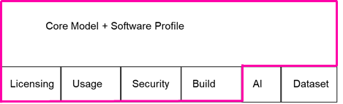
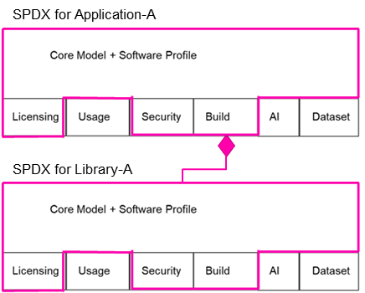
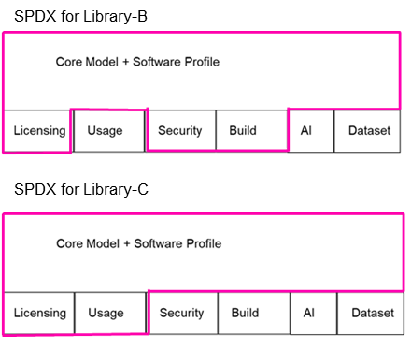
UsageProfile Usecase Example
Contracts
Company A (Supplier)
Company B
(Product Maker)
C Div will create SBOM with UsageProfile for Deliverables.
C Division
A Division
Use only for debugging
static link
Application A
(Build)
Application A
(Binary)
Deliverables
Application A
(Binary)
Library A
(Build)
Application B
(Binary)
Application B
(Build)
Library B
(Binary)
will replace with lib-D (Build) int next release
Library C
(Binary)
B Division
Library B
(Binary)
Library B
(Build)
Library C
(Binary)
Library C
(Binary)
SBOM
Company A releases Deliverables in several installments over the life of the contract
Notes:
Company A releases Deliverables in several installments over the life of the contract
Midway releases may contain contractual terms that should be communicated. For example, it uses a library that it plans to be replaced in next release, contains an application for only debugging purposes, etc.

Slide 6
DESCRIBED / DESCRIBED_BY relationship
PACKAGE_OF relationship
METAFILE_OF relationship
Usage Profile Elements for Deliverables A for Product B
SPDX Document ABCD-YYYY-MM-DD
Usage Prof. Elem. of Distro. X for Prod. B
Usage Prof. Elem. of Pkg. D for Prod. B
Distro. X modified as Deliverables A
SPDX Desc. for
Pkg. C
(App C1.exe)
Pkg. D
(Lib D2.dll)
Pkg. E
(Independent App E3.exe)
Config File for Product B by Distro. X

Slide 7
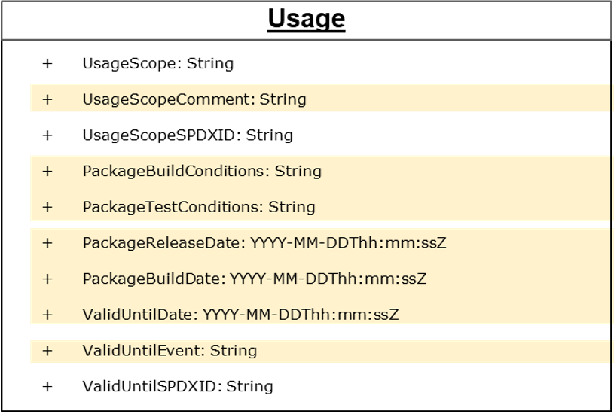
質問
UsageScopeに記載するべき文は何?
UsageScopeSPDXIDは、UniqueなTag名にしなきゃいけないのか?
{“UsageProfile”: { “SPDXID”: ID, ... } } とならない?
PackageBuildConditionsがあるとしたら、Package単位でUsageProfile付けるしかないのでは?
PackageBuildConditionsの具体的な記載内容例は?
ValidUntilSPDXIDとUsageScopeSPDXIDの違い、使い分けは?

