Slide 1
OpenChain JWG SBOM-sg
2023/03/28

Slide 2
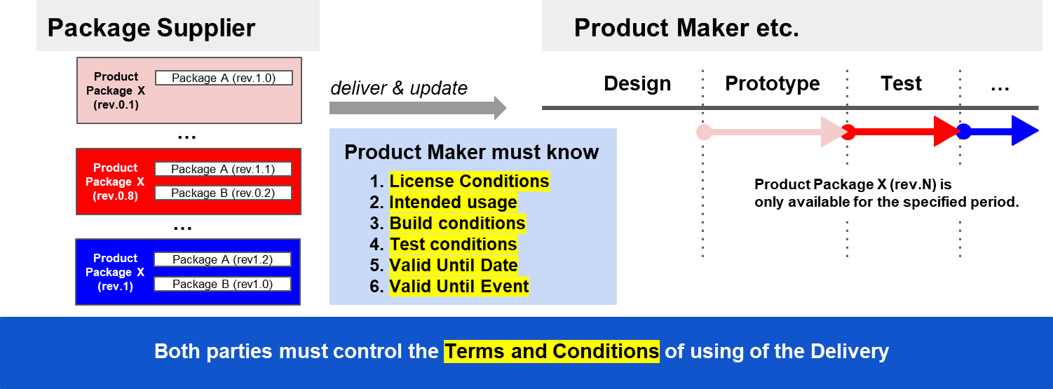
Usage Profile: to tell intentions as “Usage” for Delivery product

Slide 3
Information and Conditions that need to be delivered
Information need to be delivered
Information about which OSS license they are using
Build options and test information
Terms of Use for these deliverables
Expiration date and time OR Expiration event
When and Who created this document (UsageProfile BOM)
Condition 1: UsageProfile can be applied and integrated into each of the following:
Deliverables
Distribution
Packages
Condition 2: UsageProfile can express the priority of the relationship between each profile.

Slide 4
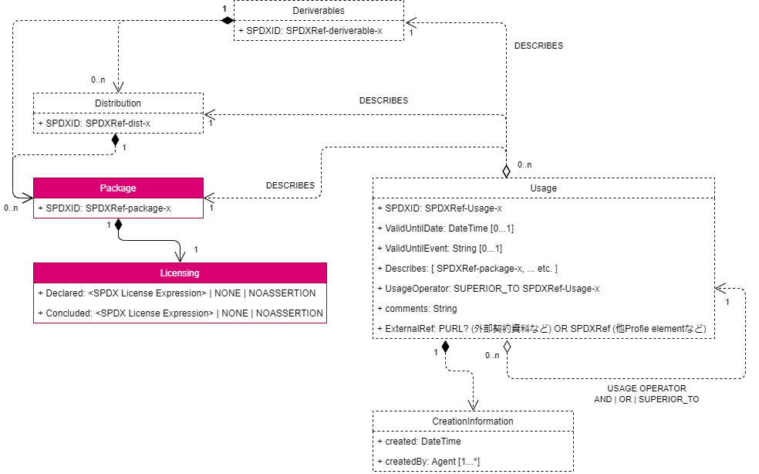
Information and Conditions that need to be delivered
Information need to be delivered
Information about which OSS license they are using
Build options and test information
Terms of Use for these deliverables
Expiration date and time OR Expiration event
When and Who created this document (UsageProfile BOM)

Slide 5
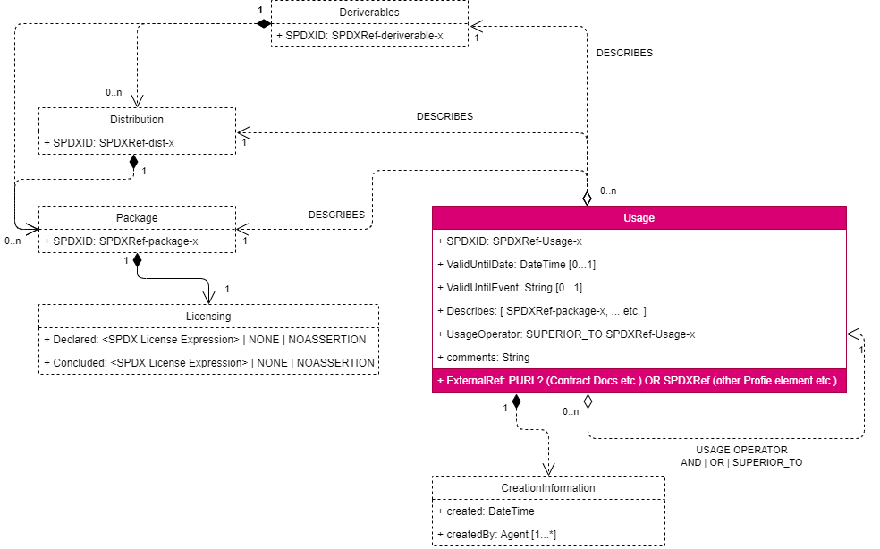
Information and Conditions that need to be delivered
Information need to be delivered
Information about which OSS license they are using
Build options and test information
Terms of Use for these deliverables
Expiration date and time OR Expiration event
When and Who created this document (UsageProfile BOM)
*Pasting references to SPDX generated by Build Profile

Slide 6
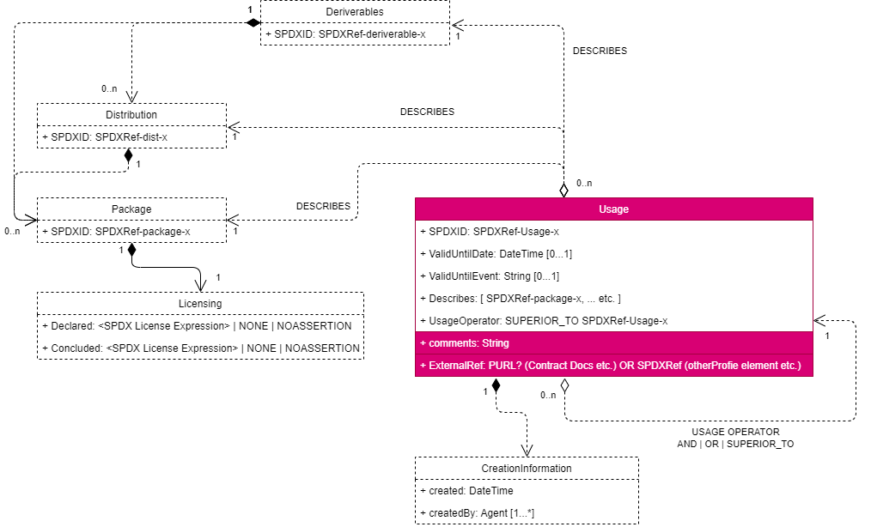
Information and Conditions that need to be delivered
Information need to be delivered
Information about which OSS license they are using
Build options and test information
Terms of Use for these deliverables
Expiration date and time OR Expiration event
When and Who created this document (UsageProfile BOM)
*Reference to external contract materials in PURL, etc.
*Supplement with comments

Slide 7
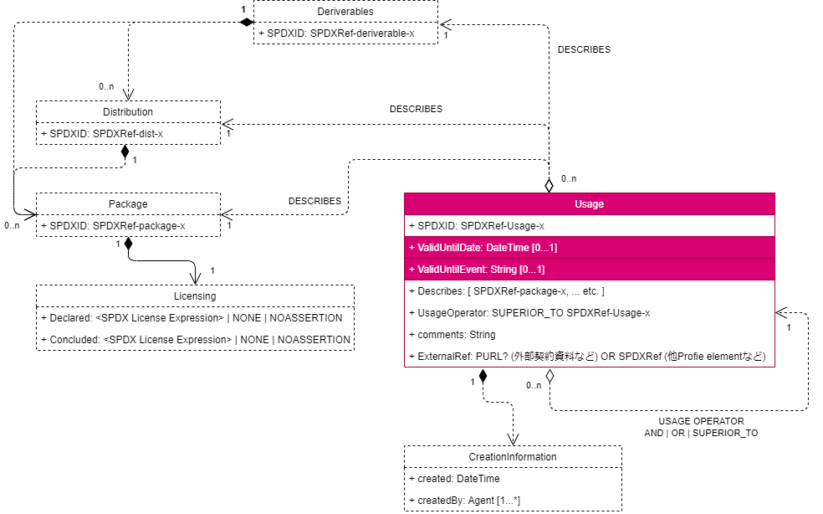
Information and Conditions that need to be delivered
Information need to be delivered
Information about which OSS license they are using
Build options and test information
Terms of Use for these deliverables
Expiration date and time OR Expiration event
When and Who created this document (UsageProfile BOM)

Slide 8
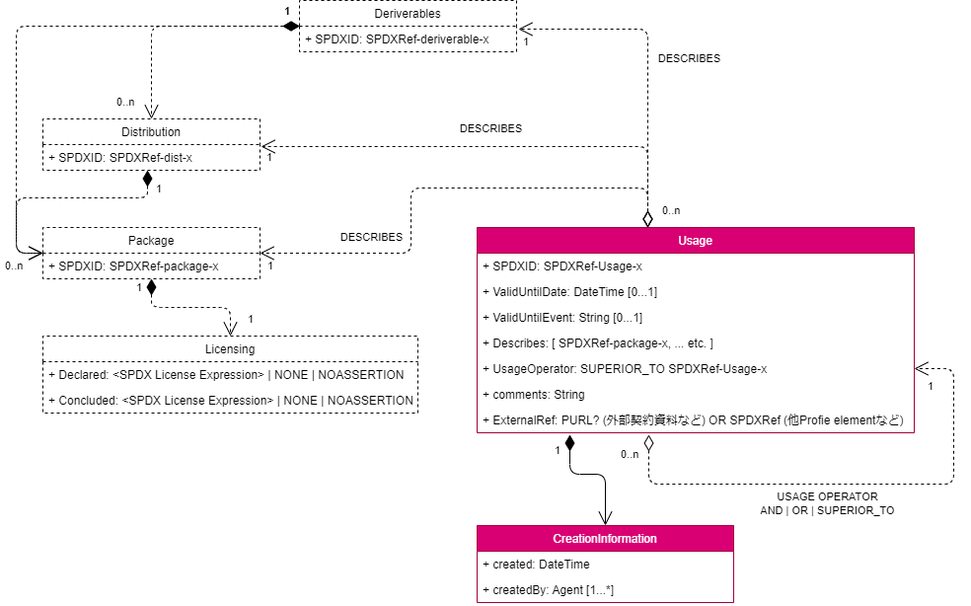
Information and Conditions that need to be delivered
Information need to be delivered
Information about which OSS license they are using
Build options and test information
Terms of Use for these deliverables
Expiration date and time OR Expiration event
When and Who created this document (UsageProfile BOM)

Slide 9
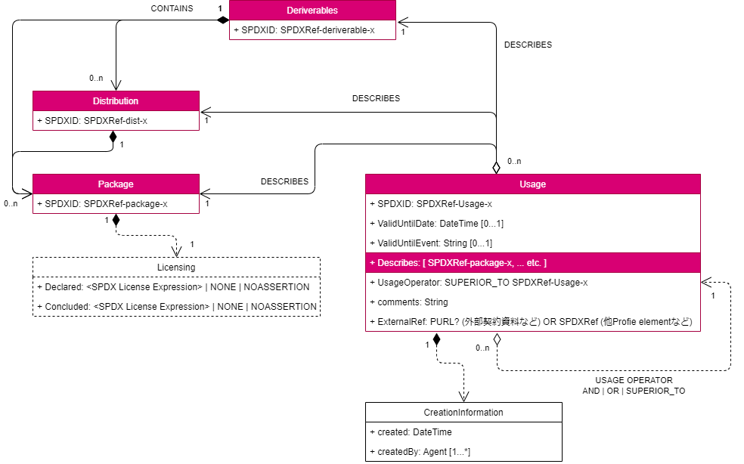
Information and Conditions that need to be delivered
Condition 1: UsageProfile can be applied and integrated into each of the following:
Deliverables
Distribution
Packages

Slide 10
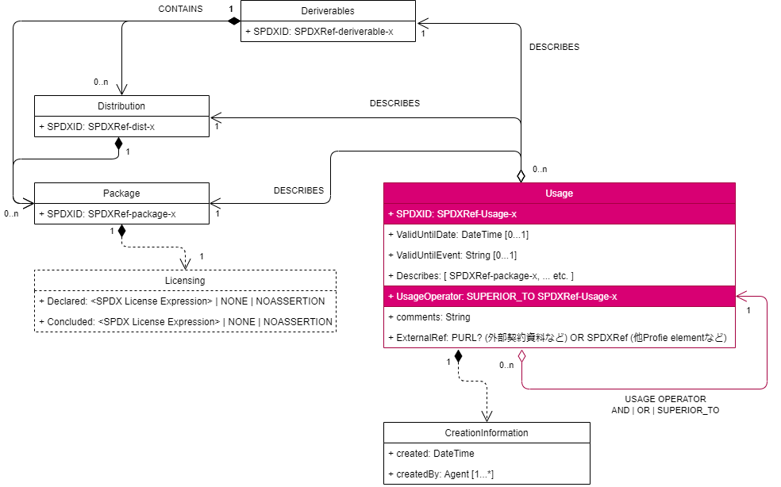
information and conditions that need to be passed
Condition 2: UsageProfile can express the priority of the relationship between each profile.

