Slide 1
SBOM sg adhoc mtg 2023/01/06
OpenChain JWG

Slide 2
Anti-Trust Policy Notice
Linux Foundation meetings involve participation by industry competitors, and it is the intention of the Linux Foundation to conduct all of its activities in accordance with applicable antitrust and competition laws. It is therefore extremely important that attendees adhere to meeting agendas, and be aware of, and not participate in, any activities that are prohibited under applicable US state, federal or foreign antitrust and competition laws.
Examples of types of actions that are prohibited at Linux Foundation meetings and in connection with Linux Foundation activities are described in the Linux Foundation Antitrust Policy available at http://www.linuxfoundation.org/ antitrust-policy. If you have questions about these matters, please contact your company counsel, or if you are a member of the Linux Foundation, feel free to contact Andrew Updegrove of the firm of Gesmer Updegrove LLP, which provides legal counsel to the Linux Foundation.

Slide 3
独占禁止法順守ポリシー (Antitrust Policy)
【参考】
Linux Foundation (以下LFと略す) の会議は、産業界で競合関係にある企業同士の参加が不可欠です。LFは、すべての活動を、適用されるべきすべての独占禁止法/競争法に則って運営します。従って、会議の出席者は、アジェンダに沿って会議を進め、国内外の独占禁止法/競争法の下で禁止されているいかなる活動にも参加しないよう、注意を払うことが非常に重要です。
LFの会議において、またLFの活動に関連して、禁止されている行動の例は、https://www.linuxfoundation.jp/antitrust-policy/ から入手できるLF独占禁止法順守ポリシーに記載されています。これらの事項について質問がある場合は、あなたの会社の法律顧問に問い合わせるか、もしあなたがLFのメンバーであるならば、LFの法律顧問である Gesmer Updegrove LLP の Andrew Updegrove にお問い合わせください。

Slide 4
今日のお題
本日のAdhoc Mtgの主題について
新しい方 及び 少し忘れてしまった方 向け。何故UsageProfileを議論し続けているのか、簡単に背景説明
1/10(火) SPDX Asia Telco向け UsageProfile資料完成

Slide 5
簡単な背景説明
経緯と現状
OpenChain JWG 有志がSPDX WG Asia Telcoに参加、SPDX WGの最新動向を伺ったり、日本産業界から見たSPDXへの要望などを伝えてきた。 ↓ Full SPDXに対応できない企業がまずは手作業で最低限必要な情報を作成したい、という要望から生まれた仕様が、SPDX v2.1 で SPDX Liteとして盛り込まれた。
SPDX v3.0 では、目的に応じて各Profileを定めるという方向性が示されており、特に日本企業のソフトウェアサプライチェーンを考えた場合に、SPDXの運用上課題となりそうな点をUsageProfileとして盛り込みたい、という要望を出している。
SBOM sg 今日の目標
来週1/10(火) 10:00-11:00 JSTに、SPDX Asia Telcoが予定されている。(参加したい方はML/Slack/DMなどでご連絡ください。転送します。)
UsageProfileについて資料完成
ユースケース説明スライド
以下をどうするか、決める https://github.com/OpenChain-Project/OpenChain-JWG/blob/master/subgroups/sbom-sg/meetings/adhoc-20221223.md 宿題から https://github.com/spdx/meetings に、spdx-asiaのスケジュールをKateさんが記載。 JWG SBOM sgのミーティングスケジュールを記載し、UsageProfileのmaterialをmeeting repo にprofile dir切るなどしてcommit/pushすること。

Slide 6
UsageProfile Usecase Example
Contracts
Company X (Supplier)
Company Y
(Product Maker)
Division X-3
Division X-1
Use only for debugging
static link
Application A
(Build)
Application A
(Binary)
Deliverables
Application A
(Binary)
Library A
(Build)
Application B
(Binary)
Application B
(Build)
Library B
(Binary)
will replace with lib-D (Build) int next release
Library C
(Binary)
Division X-2
Library B
(Binary)
Library B
(Build)
Library C
(Binary)
Library C
(Binary)
SBOM
Company X releases Deliverables in several installments over the life of the contract
Notes:
Company A releases Deliverables in several installments over the life of the contract
Midway releases may contain contractual terms that should be communicated. For example, it uses a library that it plans to be replaced in next release, contains an application for only debugging purposes, etc.

Slide 7
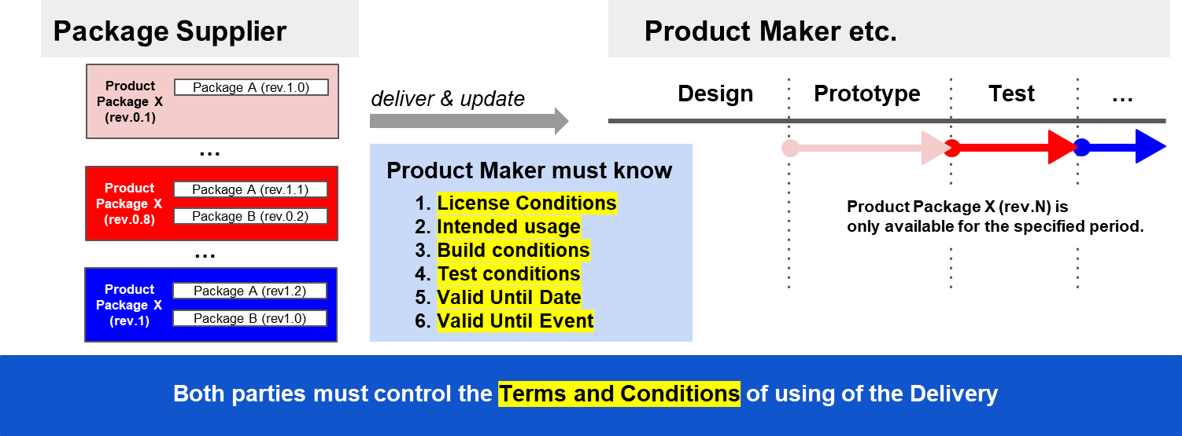
Usage Profile: to tell intentions as “Usage” for Delivery product

Slide 8
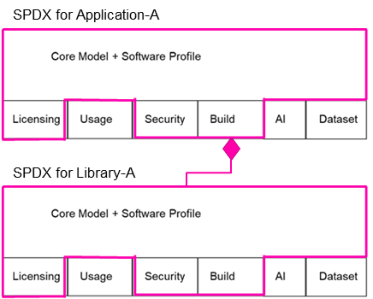
UsageProfile Usecase Example
Contracts
Company A (Supplier)
Company B
(Product Maker)
C Division
A Division
Use only for debugging
static link
Application A
(Build)
Application A
(Binary)
Deliverables
Application A
(Binary)
Library A
(Build)
Application B
(Binary)
Application B
(Build)
Library B
(Binary)
A div does not know that Application A is used only for debugging purpose.
will replace with lib-D (Build) int next release
Library C
(Binary)
B Division
Library B
(Binary)
Library B
(Build)
Library C
(Binary)
Library C
(Binary)
SBOM
Notes:
Company A releases Deliverables in several installments over the life of the contract
Midway releases may contain contractual terms that should be communicated. For example, it uses a library that it plans to be replaced in next release, contains an application for only debugging purposes, etc.

Slide 9
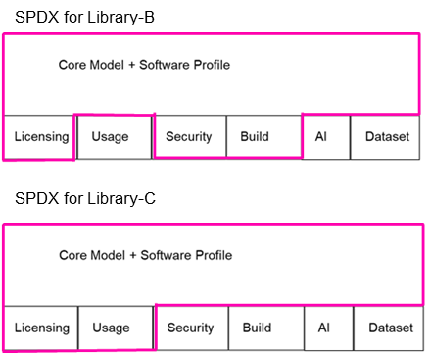
UsageProfile Usecase Example
Contracts
Company A (Supplier)
Company B
(Product Maker)
C Division
Only B Div knows lib-C will be replaced in the next release
A Division
static link
Application A
(Build)
Application A
(Binary)
Deliverables
Application A
(Binary)
Library A
(Build)
Application B
(Binary)
Application B
(Build)
will replace with lib-D (Build) int next release
Library B
(Binary)
B Division
Library C
(Binary)
Library B
(Binary)
Library B
(Build)
Library C
(Binary)
Library C
(Binary)
SBOM
Company A releases Deliverables in several installments over the life of the contract
Notes:
Company A releases Deliverables in several installments over the life of the contract
Midway releases may contain contractual terms that should be communicated. For example, it uses a library that it plans to be replaced in next release, contains an application for only debugging purposes, etc.

Slide 10
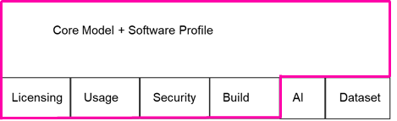
UsageProfile Usecase Example
Contracts
Company A (Supplier)
Company B
(Product Maker)
C Div will create SBOM with UsageProfile for Deliverables.
C Division
A Division
Use only for debugging
static link
Application A
(Build)
Application A
(Binary)
Deliverables
Application A
(Binary)
Library A
(Build)
Application B
(Binary)
Application B
(Build)
Library B
(Binary)
will replace with lib-D (Build) int next release
Library C
(Binary)
B Division
Library B
(Binary)
Library B
(Build)
Library C
(Binary)
Library C
(Binary)
SBOM
Company A releases Deliverables in several installments over the life of the contract
Notes:
Company A releases Deliverables in several installments over the life of the contract
Midway releases may contain contractual terms that should be communicated. For example, it uses a library that it plans to be replaced in next release, contains an application for only debugging purposes, etc.

Slide 11
DESCRIBED / DESCRIBED_BY relationship
PACKAGE_OF relationship
METAFILE_OF relationship
Usage Profile Elements for Deliverables A for Product B
SPDX Document ABCD-YYYY-MM-DD
Usage Prof. Elem. of Distro. X for Prod. B
Usage Prof. Elem. of Pkg. D for Prod. B
Distro. X modified as Deliverables A
SPDX Desc. for
Pkg. C
(App C1.exe)
Pkg. D
(Lib D2.dll)
Pkg. E
(Independent App E3.exe)
Config File for Product B by Distro. X

Slide 12
SBOM sg meeting schedule
次回、1/10(火) 16:00-18:00 Automation & SBOM合同ミーティング (月1)
隔週で良い? 毎週やる?
UsageProfile提案が固まるまで毎週開催、とか? → 毎週火曜 17:00-18:00 を予定しておく
その他 UsageProfile提案と並行してSBOMガイド作成に入る予定

