Slide 1
SBOM SG
2023/06/13

Slide 2
Anti-Trust Policy Notice
Linux Foundation meetings involve participation by industry competitors, and it is the intention of the Linux Foundation to conduct all of its activities in accordance with applicable antitrust and competition laws. It is therefore extremely important that attendees adhere to meeting agendas, and be aware of, and not participate in, any activities that are prohibited under applicable US state, federal or foreign antitrust and competition laws.
Examples of types of actions that are prohibited at Linux Foundation meetings and in connection with Linux Foundation activities are described in the Linux Foundation Antitrust Policy available at http://www.linuxfoundation.org/ antitrust-policy. If you have questions about these matters, please contact your company counsel, or if you are a member of the Linux Foundation, feel free to contact Andrew Updegrove of the firm of Gesmer Updegrove LLP, which provides legal counsel to the Linux Foundation.

Slide 3
独占禁止法順守ポリシー (Antitrust Policy)
【参考】
Linux Foundation (以下LFと略す) の会議は、産業界で競合関係にある企業同士の参加が不可欠です。LFは、すべての活動を、適用されるべきすべての独占禁止法/競争法に則って運営します。従って、会議の出席者は、アジェンダに沿って会議を進め、国内外の独占禁止法/競争法の下で禁止されているいかなる活動にも参加しないよう、注意を払うことが非常に重要です。
LFの会議において、またLFの活動に関連して、禁止されている行動の例は、https://www.linuxfoundation.jp/antitrust-policy/ から入手できるLF独占禁止法順守ポリシーに記載されています。これらの事項について質問がある場合は、あなたの会社の法律顧問に問い合わせるか、もしあなたがLFのメンバーであるならば、LFの法律顧問である Gesmer Updegrove LLP の Andrew Updegrove にお問い合わせください。

Slide 4
SPDX Asia Meeting 2023/06/13
https://github.com/spdx/spdx-3-model/pull/350 のPRについて、zvrさん、maxさんにもレビュー依頼をしてくれた。また、彼らとの詳細な議論をEU-JP friendlyな時間で行えないか、という依頼も飛んでます
mandatory elementの指定をする際に、minCount: 1を使うのは正しい (Garyさん
上位クラスにminCount: 1で定義されているものは、下位クラスで再定義しなくても良いが、何がmandatory elementなのかわかりづらくなっているので、議論中
License ClassよりもCustom License Classをinheritするのが良いのでは？
今日のtech meetingでは、Core/Licensing Profileに関する議論が行われる予定
@Tak さんよりOpenSSF Sterling toolingとの議論について質問。SPDX コミュニティからも参加者は居るとの回答。KateさんやGaryさんはまだOpen SSF Slackに入ってキャッチアップしてる段階(?)
@norio kobota がOSSJPでSPDX 3.0 Profileの詳細やProfileの作り方、PRの仕方などを発表したいと考えていることを紹介。レビューなどをしてもらえるように依頼→OK。今日の合同Mtgでも紹介予定。資料は英語化してコミュニティに共有予定。(OSSJPでの発表、一緒に誰かやりませんか)
@Tak さんから、6/14 に開催される SBOM a Rama eventについて質問。発表予定の資料を見せてもらいながら、SBOM Qualityについて課題になってることが共有された。イベントの申し込みは残念ながらもう〆切を過ぎてます。https://www.eventbrite.com/e/sbom-a-rama-2023-tickets-637617951457

Slide 5
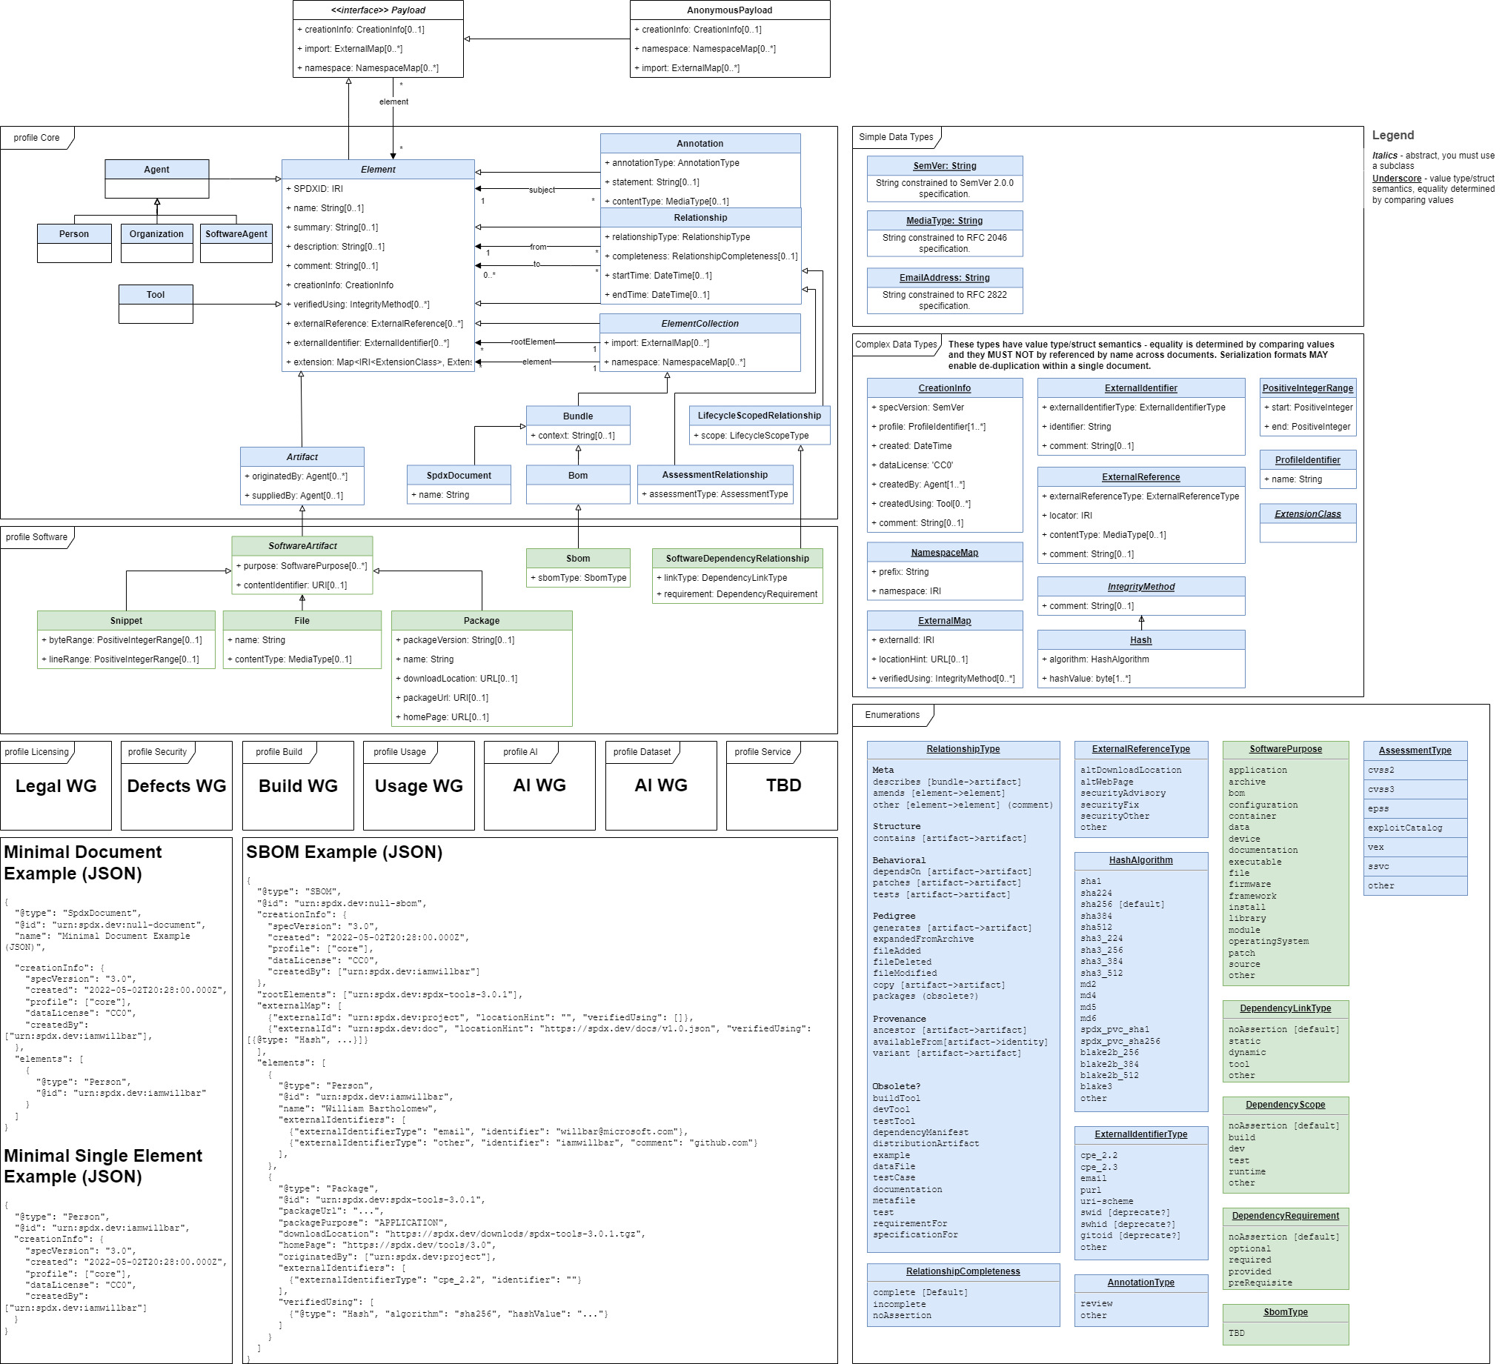
SPDX v3.0 model の歩き方
spdx-3-model/model.png at cb37ac018d464cabc11d4b590c7830a489c8f1f5 · spdx/spdx-3-model (github.com)
モデルの関係性を全体図で把握する
SBOMとして扱いたい情報がどのクラスに含まれているのか、探す

Slide 6
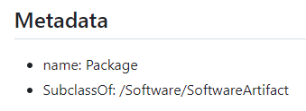
SPDX v3.0 model の歩き方
例
ソフトウェアパッケージに関する情報をSBOMに含めたい場合
Element
spdx-3-model/model/Core/Classes/Element.md at cb37ac018d464cabc11d4b590c7830a489c8f1f5 · spdx/spdx-3-model · GitHub
ソフトウェアパッケージの情報は、Package Classに含まれているはず！
どのようなElementがこのClassに含まれているのかは、上位の抽象クラスを含めて把握する必要があります
inherit
Artifact
spdx-3-model/model/Core/Classes/Artifact.md at cb37ac018d464cabc11d4b590c7830a489c8f1f5 · spdx/spdx-3-model · GitHub
SoftwareArtifact
spdx-3-model/model/Software/Classes/SoftwareArtifact.md at cb37ac018d464cabc11d4b590c7830a489c8f1f5 · spdx/spdx-3-model · GitHub
Package
spdx-3-model/model/Software/Classes/Package.md at cb37ac018d464cabc11d4b590c7830a489c8f1f5 · spdx/spdx-3-model · GitHub

Slide 7
Properties
Package
SoftwareArtifact
Artifact
Element
各プロパティの内容を確認していきます
Properties
packageVersion
type: xsd:string
minCount: 0
maxCount: 1
downloadLocation
type: xsd:anyURI
minCount: 0
maxCount: 1
packageUrl
type: xsd:anyURI
minCount: 0
maxCount: 1
homePage
type: xsd:anyURI
minCount: 0
maxCount: 1
sourceInfo
type: xsd:string
minCount: 0
maxCount: 1
Properties
contentIdentifier
type: xsd:anyURI
minCount: 0
maxCount: 1
primaryPurpose
type: SoftwarePurpose
minCount: 0
maxCount: 1
additionalPurpose
type: SoftwarePurpose
minCount: 0
concludedLicense
type: /Licensing/LicenseField
minCount: 0
maxCount: 1
declaredLicense
type: /Licensing/LicenseField
minCount: 0
maxCount: 1
copyrightText
type: xsd:string
minCount: 0
maxCount: 1
attributionText
type: xsd:string
minCount: 0
maxCount: 1
Properties
originatedBy
type: Agent
minCount: 0
suppliedBy
type: Agent
minCount: 0
builtTime
type: DateTime
minCount: 0
maxCount: 1
releaseTime
type: DateTime
minCount: 0
maxCount: 1
validUntilTime
type: DateTime
minCount: 0
maxCount: 1
standard
type: xsd:string
minCount: 0
Properties
spdxId
type: xsd:anyURI
minCount: 1
maxCount: 1
name
type: xsd:string
maxCount: 1
summary
type: xsd:string
maxCount: 1
description
type: xsd:string
maxCount: 1
comment
type: xsd:string
maxCount: 1
creationInfo
type: CreationInfo
minCount: 0
maxCount: 1
verifiedUsing
type: IntegrityMethod
externalReference
type: ExternalReference
minCount: 0
externalIdentifier
type: ExternalIdentifier
minCount: 0
extension
type: Extension
minCount: 0

Slide 8
Properties
Package
SoftwareArtifact
Artifact
Element
Properties
packageVersion
type: xsd:string
minCount: 0
maxCount: 1
downloadLocation
type: xsd:anyURI
minCount: 0
maxCount: 1
packageUrl
type: xsd:anyURI
minCount: 0
maxCount: 1
homePage
type: xsd:anyURI
minCount: 0
maxCount: 1
sourceInfo
type: xsd:string
minCount: 0
maxCount: 1
Properties
contentIdentifier
type: xsd:anyURI
minCount: 0
maxCount: 1
primaryPurpose
type: SoftwarePurpose
minCount: 0
maxCount: 1
additionalPurpose
type: SoftwarePurpose
minCount: 0
concludedLicense
type: /Licensing/LicenseField
minCount: 0
maxCount: 1
declaredLicense
type: /Licensing/LicenseField
minCount: 0
maxCount: 1
copyrightText
type: xsd:string
minCount: 0
maxCount: 1
attributionText
type: xsd:string
minCount: 0
maxCount: 1
Properties
originatedBy
type: Agent
minCount: 0
suppliedBy
type: Agent
minCount: 0
builtTime
type: DateTime
minCount: 0
maxCount: 1
releaseTime
type: DateTime
minCount: 0
maxCount: 1
validUntilTime
type: DateTime
minCount: 0
maxCount: 1
standard
type: xsd:string
minCount: 0
Properties
spdxId
type: xsd:anyURI
minCount: 1
maxCount: 1
name
type: xsd:string
maxCount: 1
summary
type: xsd:string
maxCount: 1
description
type: xsd:string
maxCount: 1
comment
type: xsd:string
maxCount: 1
creationInfo
type: CreationInfo
minCount: 0
maxCount: 1
verifiedUsing
type: IntegrityMethod
externalReference
type: ExternalReference
minCount: 0
externalIdentifier
type: ExternalIdentifier
minCount: 0
extension
type: Extension
minCount: 0
minCount: 1
Mandatory Element
1つ以上存在してはいけない

Slide 9
Properties
Package
SoftwareArtifact
Artifact
Element
Properties
packageVersion
type: xsd:string
minCount: 0
maxCount: 1
downloadLocation
type: xsd:anyURI
minCount: 0
maxCount: 1
packageUrl
type: xsd:anyURI
minCount: 0
maxCount: 1
homePage
type: xsd:anyURI
minCount: 0
maxCount: 1
sourceInfo
type: xsd:string
minCount: 0
maxCount: 1
Properties
contentIdentifier
type: xsd:anyURI
minCount: 0
maxCount: 1
primaryPurpose
type: SoftwarePurpose
minCount: 0
maxCount: 1
additionalPurpose
type: SoftwarePurpose
minCount: 0
concludedLicense
type: /Licensing/LicenseField
minCount: 0
maxCount: 1
declaredLicense
type: /Licensing/LicenseField
minCount: 0
maxCount: 1
copyrightText
type: xsd:string
minCount: 0
maxCount: 1
attributionText
type: xsd:string
minCount: 0
maxCount: 1
Properties
originatedBy
type: Agent
minCount: 0
suppliedBy
type: Agent
minCount: 0
builtTime
type: DateTime
minCount: 0
maxCount: 1
releaseTime
type: DateTime
minCount: 0
maxCount: 1
validUntilTime
type: DateTime
minCount: 0
maxCount: 1
standard
type: xsd:string
minCount: 0
Properties
spdxId
type: xsd:anyURI
minCount: 1
maxCount: 1
name
type: xsd:string
maxCount: 1
summary
type: xsd:string
maxCount: 1
description
type: xsd:string
maxCount: 1
comment
type: xsd:string
maxCount: 1
creationInfo
type: CreationInfo
minCount: 0
maxCount: 1
verifiedUsing
type: IntegrityMethod
externalReference
type: ExternalReference
minCount: 0
externalIdentifier
type: ExternalIdentifier
minCount: 0
extension
type: Extension
minCount: 0
minCount: ?
多分、minCound: 0だと思われるが、省略可能かどうかの定義は無くどのように扱っているのか現時点で不明

Slide 10
Properties
Package
SoftwareArtifact
Artifact
Element
Properties
packageVersion
type: xsd:string
minCount: 0
maxCount: 1
downloadLocation
type: xsd:anyURI
minCount: 0
maxCount: 1
packageUrl
type: xsd:anyURI
minCount: 0
maxCount: 1
homePage
type: xsd:anyURI
minCount: 0
maxCount: 1
sourceInfo
type: xsd:string
minCount: 0
maxCount: 1
Properties
contentIdentifier
type: xsd:anyURI
minCount: 0
maxCount: 1
primaryPurpose
type: SoftwarePurpose
minCount: 0
maxCount: 1
additionalPurpose
type: SoftwarePurpose
minCount: 0
concludedLicense
type: /Licensing/LicenseField
minCount: 0
maxCount: 1
declaredLicense
type: /Licensing/LicenseField
minCount: 0
maxCount: 1
copyrightText
type: xsd:string
minCount: 0
maxCount: 1
attributionText
type: xsd:string
minCount: 0
maxCount: 1
Properties
originatedBy
type: Agent
minCount: 0
suppliedBy
type: Agent
minCount: 0
builtTime
type: DateTime
minCount: 0
maxCount: 1
releaseTime
type: DateTime
minCount: 0
maxCount: 1
validUntilTime
type: DateTime
minCount: 0
maxCount: 1
standard
type: xsd:string
minCount: 0
Properties
spdxId
type: xsd:anyURI
minCount: 1
maxCount: 1
name
type: xsd:string
maxCount: 1
summary
type: xsd:string
maxCount: 1
description
type: xsd:string
maxCount: 1
comment
type: xsd:string
maxCount: 1
creationInfo
type: CreationInfo
minCount: 0
maxCount: 1
verifiedUsing
type: IntegrityMethod
externalReference
type: ExternalReference
minCount: 0
externalIdentifier
type: ExternalIdentifier
minCount: 0
extension
type: Extension
minCount: 0
type: CreationInfo
このプロパティの型
XML schemaで表される基本型もしくは定義したクラス

Slide 11
Properties
Package
SoftwareArtifact
Artifact
Element
Properties
packageVersion
type: xsd:string
minCount: 0
maxCount: 1
downloadLocation
type: xsd:anyURI
minCount: 0
maxCount: 1
packageUrl
type: xsd:anyURI
minCount: 0
maxCount: 1
homePage
type: xsd:anyURI
minCount: 0
maxCount: 1
sourceInfo
type: xsd:string
minCount: 0
maxCount: 1
Properties
contentIdentifier
type: xsd:anyURI
minCount: 0
maxCount: 1
primaryPurpose
type: SoftwarePurpose
minCount: 0
maxCount: 1
additionalPurpose
type: SoftwarePurpose
minCount: 0
concludedLicense
type: /Licensing/LicenseField
minCount: 0
maxCount: 1
declaredLicense
type: /Licensing/LicenseField
minCount: 0
maxCount: 1
copyrightText
type: xsd:string
minCount: 0
maxCount: 1
attributionText
type: xsd:string
minCount: 0
maxCount: 1
Properties
originatedBy
type: Agent
minCount: 0
suppliedBy
type: Agent
minCount: 0
builtTime
type: DateTime
minCount: 0
maxCount: 1
releaseTime
type: DateTime
minCount: 0
maxCount: 1
validUntilTime
type: DateTime
minCount: 0
maxCount: 1
standard
type: xsd:string
minCount: 0
Properties
spdxId
type: xsd:anyURI
minCount: 1
maxCount: 1
name
type: xsd:string
maxCount: 1
summary
type: xsd:string
maxCount: 1
description
type: xsd:string
maxCount: 1
comment
type: xsd:string
maxCount: 1
creationInfo
type: CreationInfo
minCount: 0
maxCount: 1
verifiedUsing
type: IntegrityMethod
externalReference
type: ExternalReference
minCount: 0
externalIdentifier
type: ExternalIdentifier
minCount: 0
extension
type: Extension
minCount: 0
minCount: ?
maxCount: ?
複数あっても全くなくても良い？不明

Slide 12
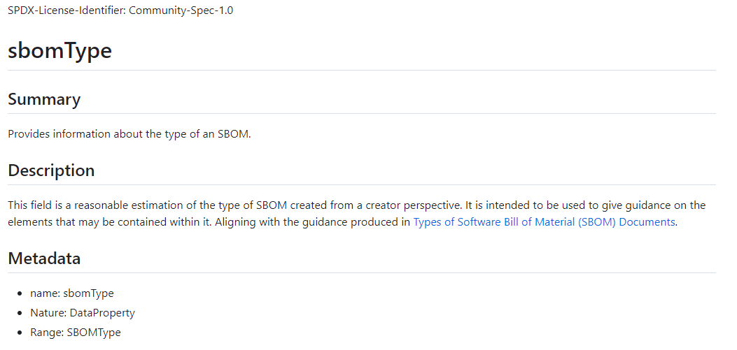
各プロパティの説明
SBOM
spdx-3-model/model/Software/Classes/Sbom.md at cb37ac018d464cabc11d4b590c7830a489c8f1f5 · spdx/spdx-3-model · GitHub
プロパティの詳細を確認します
Properties
sbomType
type: SBOMType
minCount: 0
spdx-3-model/model/Software/Properties/sbomType.md at cb37ac018d464cabc11d4b590c7830a489c8f1f5 · spdx/spdx-3-model · GitHub
プロパティの概要、説明、詳細が書かれている

Slide 13
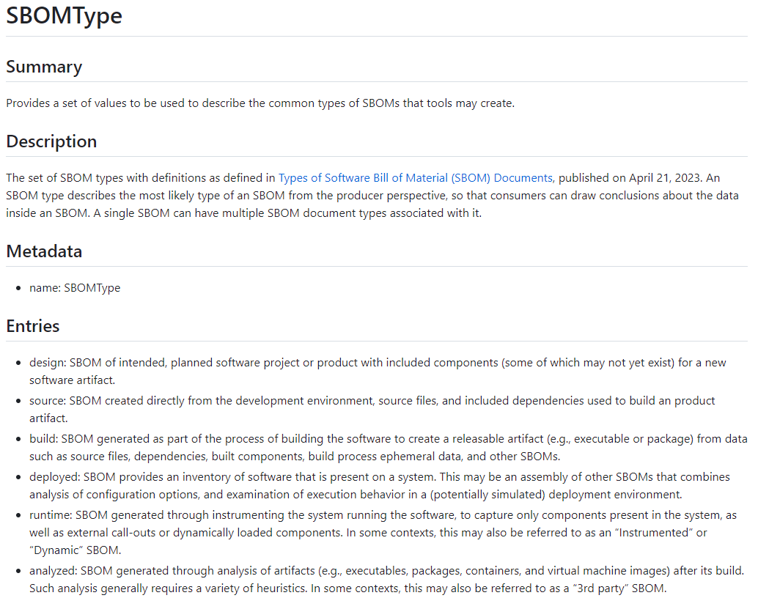
各プロパティに設定する値の制限
プロパティはKey – Value となっていますが、その Value側に取りうる範囲を制限する場合には、Vocabulariesが設定されています
spdx-3-model/model/Software/Vocabularies/SBOMType.md at cb37ac018d464cabc11d4b590c7830a489c8f1f5 · spdx/spdx-3-model · GitHub

