Slide 1
Issues and concerns on SPDX Lite and SPDX V 3.0
Can SPDX Lite be defined across Profile?
In V 3.0, SPDX Lite fields are split into Core Profile, Softtware Profile and Licensing Profile
Can SPDX Lite be defined across Profiles?
What is the position of what is defined across Profile? (Can you call it a Profile?)
Does the SPDX Lite need to satisfy the NTIA minimum elements? Is it particularly necessary to revise V 2.3 to accommodate this?
For SPDX Lite to satisfy the NTIA minimum elements, it must include Relationship field
In V 3.0, the Licensing Profile should have the same issues
Relationship is difficult for beginners and different from the concept of SPDX Lite
Benefits of Relationship in license compliance is unclear
If the NTIA minimum elements requirement is not satisfied, SPDX Lite will no longer be used in the market as SBOMs as defined by legislation (= SPDX Lite is no longer usable).

Slide 2
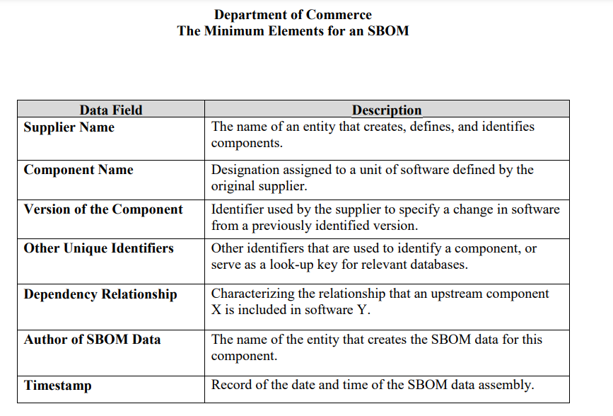
Reference: NTIA Minimum Elements

Slide 3
Going back to the basics and positioning SPDX Lite
Personal thoughts on SPDX Lite (apart from the V 3.0 spec situation)
We created SPDX Lite as a minimum elements for license compliance.
(In that sense), SPDX Lite deserves a place at the minimum elements of the Licensing Profile.
NTIA minimum item refers to general SBOMs (SW management)
License compliance and general SBOMs (SW management) is different in scope

Slide 4
Ideas on SPDX Lite in SPDX v3.0
Licensing minimum elements
SPDX Lite as defined in SPDX v2.3
General SBOM minimum elements
SPDX Lite v3 = (SPDX Lite v2.3) + (minimum Relationship field)
minimum Relationship field: {“CONTAINS”, “NONE”} (only these can be used)
Example #1: CONTIANS A-package
Example #2: CONTAINS B-package, C-package, D-package, …
Example #3: NONE

