Slide 1
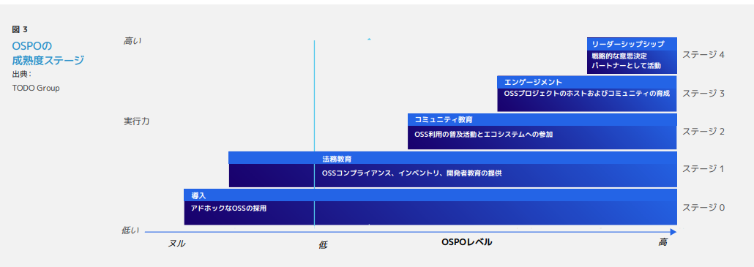
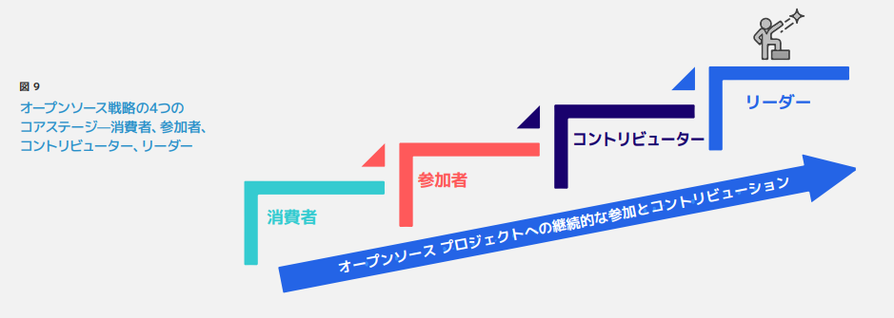
Qx
Q: What are the benefits of using OSS?
A:
Benefits of using open source software
Use existing software (makes development easier)
Use cutting-edge software (technology)
A lot of people have come together to make this software, so it has a high level of quality
A lot of people use it, so bugs are easy to find and fixes are accurate and quick
Benefits of community activities
Efficient development resources through community collaboration
There is an opportunity for talent acquisition (on the corporate side)
As an engineer, you can increase your own value and gain places for activities
Human resource development
Business strategic benefits
Expand market and potential customer base through community and engage in development direction
Establish and disseminate de facto standards
Consider mapping OSPO stages next time (2023/5/26)
https://www.linuxfoundation.jp/wp-content/uploads/2022/11/ja_LFR_LFAID_Deep_Dive_Open_Source_Program_Offices_0830.pdf

Slide 2
Qx
Complete for now
Q: Why should I be careful with OSS?
A:
Licensing aspects
Software is protected by copyright, license
Must comply with license
Must have respect for author
There are court cases for violation of license
OSS can be obtained and used without any procedures, especially contracts
OSS can be used without checking license conditions, etc. through normal, contracts, etc procedures
to be introduced at a grassroots level and become unmanageable
OSS has some dependencies that come in on their own
Some things they don't recognize they're using
You have to understand the difference between Freeware and OSS (free software) and handle it according to the terms of use
It is often difficult to decide - > This is where OSPO is needed
Use with peace of mind
Security (vulnerabilities)
Problems are discovered after deployment and must be addressed. If you do not know what you are using at that time, the response will be delayed or impossible
Widely used/easy for attackers to do because the source is public
On the other hand, there are many developers and users, so measures are quick.
Using OSS with confidence
Depends on the state of the community
Maintain a sense of security by contributing to and participating in the community
Note)Initial questions and assumptions

Slide 3
Qx
Q: Why do you need company-wide management of OSS? (Why is it that OSS is already in so much use now?)
A:
Importance
US Executive Order Requiring OSS Supply Chain Management: Because It's Becoming a Procurement Condition
Requires tight management from a security perspective
OSS has come to support social infrastructure systems
Problems with the included OSS have major consequences
ISOs, industry moves (such as Teleco WG)
Need for company-wide unified management
Mistakes made by some departments can affect the entire company (reputation due to mistakes made by other divisions can be evaluated by own divisions)
Raising the overall level in the internal supply chain
Increasingly handled by non-software engineers
Outsourcing management, hardware managers managing the entire product, including software, outsourcers have a mixed understanding of OSS compliance, etc.
Q Background:
I have a pride in myself that I thought I should do it on the field, but why is the whole company trying to do it now?
The move to make rules when there are no problems is causing a negative reaction

Slide 4
Qx
Q: What is OSPO?
A:
Start by looking at other companies' examples and finding challenges your company is not aware of
Tell them why you created OSPO
I want to have an answer for people who are thinking of creating an OSPO for the first time
(Example)When you try to create an OSPO internally, it is easy to educate yourself internally if you have examples from other companies
The shape of an OSPO can be different for each company
It's good to start by making clear why you want to create an OSPO
For example:
Software house company A:
Principal is each organization. Supporting that is the OSPO
Each department has a member of the OSPO, and the OSPO is a virtual collective organization
(In the case of software house companies, non-software house companies)
References
https://www.linuxfoundation.jp/publications/2022/11/a-deep-dive-into-open-source-program-offices/
https://www.linuxfoundation.jp/wp-content/uploads/2022/11/ja_LFR_LFAID_Deep_Dive_Open_Source_Program_Offices_0830.pdf

Slide 5
Qx
Q: (TO: Companies that already have OSPO organizations) Why did you create OSPO?
A:
Start by looking at other companies' examples and finding challenges that your company is not aware of
Tell them why you created OSPO
I want to have an answer for people who are thinking of creating an OSPO for the first time
(Example)When you try to create an OSPO internally, it is easy to educate yourself internally if you have examples from other companies
The shape of an OSPO can be different for each company
It's good to start by making clear why you want to create an OSPO
For example:
Software house company A:
Principal is each organization. Supporting that is the OSPO
Each department has a member of the OSPO, and the OSPO is a virtual collective organization
(In the case of software house companies, non-software house companies)
References
https://www.linuxfoundation.jp/publications/2022/11/a-deep-dive-into-open-source-program-offices/
https://www.linuxfoundation.jp/wp-content/uploads/2022/11/ja_LFR_LFAID_Deep_Dive_Open_Source_Program_Offices_0830.pdf

Slide 6
Qx
Q: I'd like to create an OSPO, but where do I start?
A:
Start by looking at other companies' examples and finding challenges that your company hasn't noticed
Tell them why you created OSPO
I want to have an answer for people who are thinking of creating an OSPO for the first time
(Example)When you try to create an OSPO internally, it is easy to educate yourself internally if you have examples from other companies
The shape of an OSPO can be different for each company
It's good to start by making clear why you want to create an OSPO
For example:
Software house company A:
Principal is each organization. Supporting that is the OSPO
Each department has a member of the OSPO, and the OSPO is a virtual collective organization
(In the case of software house companies, non-software house companies)
References
https://www.linuxfoundation.jp/publications/2022/11/a-deep-dive-into-open-source-program-offices/
https://www.linuxfoundation.jp/wp-content/uploads/2022/11/ja_LFR_LFAID_Deep_Dive_Open_Source_Program_Offices_0830.pdf

Slide 7
Q1
Q: What is the organizational structure and membership of the OSPO?
A:
I would like to have an answer for those who are thinking of creating an OSPO for the first time.
(Example)When you try to create an OSPO internally, it is easy to educate yourself internally if you have examples from other companies.
The shape of an OSPO can be different for each company
It's good to start by making clear why you want to create an OSPO
For example:
Software house company A:
Principal is each organization. Supporting that is the OSPO
Each department has a member of the OSPO, and the OSPO is a virtual collective organization
(In the case of software house companies, non-software house companies)
References
https://www.linuxfoundation.jp/publications/2022/11/a-deep-dive-into-open-source-program-offices/
https://www.linuxfoundation.jp/wp-content/uploads/2022/11/ja_LFR_LFAID_Deep_Dive_Open_Source_Program_Offices_0830.pdf

Slide 8
Q1 Reference Links
A Deep Dive into Open Source Program Offices: Structure, Roles, Responsibilities, and Challenges
https://www.linuxfoundation.org/research/a-deep-dive-into-open-source-program-offices
Deep Discussion: The Open Source Program Office Organizational Structure, Roles, Responsibilities, and Challenges
https://www.linuxfoundation.jp/blog/2022/11/japanese-version-of-a-deep-dive-into-open-source-program-offices-launch/
Creating an Open Source Program
https://www.linuxfoundation.org/resources/open-source-guides/creating-an-open-source-program?hsLang=en
Creating Open Source Programs
https://www.linuxfoundation.jp/resources/open-source-guides/creating-an-open-source-program/
OSPO 101 Training Modules
https://github.com/todogroup/ospo-career-path/tree/main/OSPO-101
Evolution of the Open Source Program Office (OSPO)
https://www.linuxfoundation.jp/wp-content/uploads//2022/08/LFResearch_OSPO_Report-jp.pdf

Slide 9
Question candidate (blue is added during MTG)
Why is OSS management necessary? (Why is it that OSS is already in so much use now?) slide link
What is OSPO?
(TO: a company that already has an OSPO organization) Why did you create OSPO?
I want to create an OSPO, what do I start with?
What is the organizational structure and membership of the OSPO?
(In the case of software house companies, non-software house companies)
What is the organization and authority of the OSPO?
(OSPO budgets, OSPO reporting lines, OSPO handling of violations of default internal rules, etc.)
Requesting SBOMs from software suppliers?
(Timing? What's the format? Do you want to check the contents? How often do you update? Requesting an update?)
Are there enough tools to manage SBOMs?
(How do you see the contents of the SBOMs? What is the quality judgment/quality standard for SBOMs? Can you see the SBOM difference?)
What about OSS copyright?
(As per copyright law? Do you have company policies? Are Community Activities Business? For personal OSS in pre-employment development?)
Managing OSS with OSS?
(What's the catch? Managing OSS What is OSS's view on unsecured/unguaranteed? Internal explanation logic?)
Applying for software using OSS from internal development departments?
(What's in the application? What if there's an application violation? What is the application violation check after approval?)
2/10: How much do the legal and intellectual departments contribute to the OSPO?
Are they responsible for making legal decisions? )
Proposed 2/10: Are they responsible for requiring SBOMs in procurement?
(What is the content, the contract, and the responsibility of when SBOMs are not submitted?)
What are the issues handled by OSPO?
Why OpenChain's work is necessary
How do I find OSS vulnerabilities?
How do I deal with the community?

Slide 11
2023/3/24 meeting chats
15:38:26
I thought it would be easier to understand why first.
15:42:19
Maybe it would be nice to have an OSPO maturity stage.
15:46:44
https://www.linuxfoundation.jp/resources/open-source-guides/creating-an-open-source-program/#2
There certainly seems to be a lot of places in this role where you start at the bottom.
15:48:13
Let's "save the chat" at the end of the chat, transcribe it and keep it with the minutes!
15:48:36
Reacted to "save the chat" at the end of the chat ... " with ??
15:50:44
How about the contents of the leaflet?
15:50:55
How about the contents of the Reacted to "leaflet? " with ??
15:52:37
"The contents of the leaflet ..." against?? responded with
15:52:53
It's like literacy.
15:54:14
I used to explain, "You'll be a thief."
15:55:53
Maybe I should break down the "Executive Order" one more time and write at least an "Executive Order Requiring OSS Supply Chain Management."
15:56:58
I've said "No More OSS Thief" (like a movie thief)
15:57:19
The executive order is more about security than it is about license management.
15:57:27
Reacted to "The executive order is more from a license management point of view ..." with ??
15:57:52
Reacted to "No More OSS Thief" (Movie Thief ... " with ??
15:59:26
He even cited the Tokyo Olympics logo theft issue ...
16:00:17
Reacted to "Cited the Tokyo Olympics logo theft issue ..." with ??
15:06:12
What is OSPO in the first place?
15:07:11
"What is OSPO in the first place is ..." Against?? responded with
15:07:45
This is a whitepaper in which the organization structure is listed in TODO.
https://www.linuxfoundation.org/research/a-deep-dive-into-open-source-program-offices
15:07:47
Here are the documents I have seen before.
Deep Thoughts: 'Open Source Program Office' Organizational Composition, Roles, Responsibilities, and Challenges By Linux Foundation Japan November 29, 2022
https://www.linuxfoundation.jp/blog/2022/11/japanese-version-of-a-deep-dive-into-open-source-program-offices-launch/
15:10:42
A document I once saw might be missing ・・・?
https://www.linuxfoundation.org/resources/open-source-guides/creating-an-open-source-program?hsLang=en
15:13:07
Here it is.
15:13:09
https://github.com/todogroup/ospo-career-path/blob/main/module3/README.md
15:13:57
https://github.com/todogroup/ospo-career-path/blob/main/OSPO-101/module3/README.md
15:14:15
Is this it?
15:14:16
https://github.com/todogroup/ospo-career-path
15:15:09
https://www.linuxfoundation.jp/resources/open-source-guides/creating-an-open-source-program/#4
15:15:14
It seems important to organize and list the information you've shared.
15:20:09
https://www.linuxfoundation.jp/resources/open-source-guides/creating-an-open-source-program/
Here it is.
15:22:13
OSS promotion, I guess.
15:23:10
Reacted to "OSS promotion, I guess" with??

