Slide 1
Usage Profile 2023/01/10
OpenChain JWG SBOM sg

Slide 2
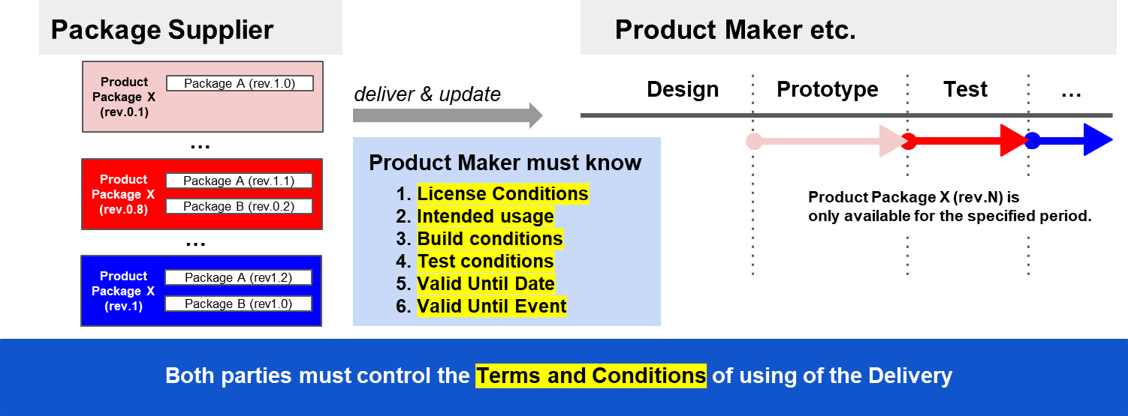
Usage Profile: to tell intentions as “Usage” for Delivery product
Deriverable
Deriverable
Deriverable

Slide 3
UsageProfile Usecase Example
Contracts
Company X (Supplier)
Company Y
(Product Maker)
Division X-3
Division X-1
Use only for debugging
static link
Application A
(Build)
Application A
(Binary)
Deliverables
Application A
(Binary)
Library A
(Build)
Application B
(Binary)
Application B
(Build)
Library B
(Binary)
will replace with lib-D (Build) int next release
Library C
(Binary)
Division X-2
Library B
(Binary)
Library B
(Build)
Library C
(Binary)
Library C
(Binary)
SBOM
Company X releases Deliverables in several installments over the life of the contract
Notes:
Company X releases Deliverables in several installments over the life of the contract
Midway releases may contain contractual terms that should be communicated. For example, it uses a library that it plans to be replaced in next release, contains an application for only debugging purposes, etc.

Slide 4
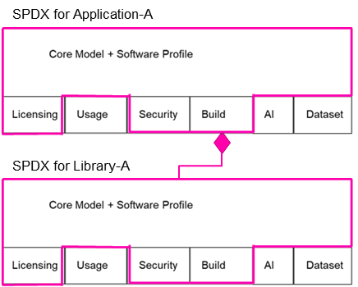
UsageProfile Usecase Example
Contracts
Company X (Supplier)
Company Y
(Product Maker)
Division X-3
Division X-1
Use only for debugging
static link
Application A
(Build)
Application A
(Binary)
Deliverables
Application A
(Binary)
Library A
(Build)
Application B
(Binary)
Application B
(Build)
Library B
(Binary)
Div X-1 does not know that Application A is used only for debugging purpose.
will replace with lib-D (Build) int next release
Library C
(Binary)
Division X-2
Library B
(Binary)
Library B
(Build)
Library C
(Binary)
Library C
(Binary)
SBOM
Notes:
Company X releases Deliverables in several installments over the life of the contract
Midway releases may contain contractual terms that should be communicated. For example, it uses a library that it plans to be replaced in next release, contains an application for only debugging purposes, etc.

Slide 5
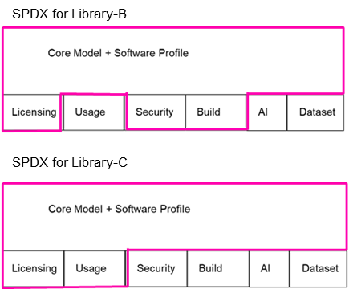
UsageProfile Usecase Example
Contracts
Company X (Supplier)
Company Y
(Product Maker)
Division X-3
Only Div X-2 knows lib-C will be replaced in the next release
Division X-1
static link
Application A
(Build)
Application A
(Binary)
Deliverables
Application A
(Binary)
Library A
(Build)
Application B
(Binary)
Application B
(Build)
will replace with lib-D (Build) int next release
Library B
(Binary)
Division X-2
Library C
(Binary)
Library B
(Binary)
Library B
(Build)
Library C
(Binary)
Library C
(Binary)
SBOM
Notes:
Company X releases Deliverables in several installments over the life of the contract
Midway releases may contain contractual terms that should be communicated. For example, it uses a library that it plans to be replaced in next release, contains an application for only debugging purposes, etc.

Slide 6
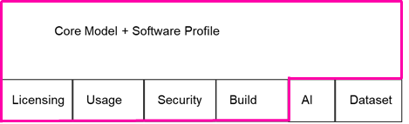
UsageProfile Usecase Example
Contracts
Company X (Supplier)
Company Y
(Product Maker)
Div X-3 will create SBOM with UsageProfile for Deliverables.
Division X-3
Division X-1
Use only for debugging
static link
Application A
(Build)
Application A
(Binary)
Deliverables
Application A
(Binary)
Library A
(Build)
Application B
(Binary)
Application B
(Build)
Library B
(Binary)
will replace with lib-D (Build) int next release
Library C
(Binary)
Division X-2
Library B
(Binary)
Library B
(Build)
Library C
(Binary)
Library C
(Binary)
SBOM
Notes:
Company X releases Deliverables in several installments over the life of the contract
Midway releases may contain contractual terms that should be communicated. For example, it uses a library that it plans to be replaced in next release, contains an application for only debugging purposes, etc.

Slide 7
Same situation will be occurred in the supply chain
Tier 2
Contracts
Contracts
static link
Application A
(Build)
Product Maker
Supplier
(Tier 1)
Library A
(Build)
Application A
(Binary)
Use only for debugging
Deliverables
SBOM
Application A
(Binary)
Application B
(Binary)
will replace with lib-D (Build) int next release
Contracts
Library B
(Binary)
Tier 2
Library C
(Binary)
Deliverables
Library B
(Build)
Library C
(Binary)
Library B
(Binary)
Library C
(Binary)
SBOM
SBOM

Slide 8
Relationships between elements (draft)
DESCRIBED / DESCRIBED_BY relationship
PACKAGE_OF relationship
METAFILE_OF relationship
Usage Profile Elements for Deliverables A for Product B
SPDX Document ABCD-YYYY-MM-DD
Usage Prof. Elem. of Distro. X for Prod. B
Usage Prof. Elem. of Pkg. D for Prod. B
Distro. X modified as Deliverables A
SPDX Desc. for
Pkg. C
(App C1.exe)
Pkg. D
(Lib D2.dll)
Pkg. E
(Independent App E3.exe)
Config File for Product B by Distro. X

