Slide 1
17th meeting OpenChain reference tooling work group
The OpenChain reference tooling work group 2020

Slide 2
Agenda
Top | Name | Actors
1. | News | All
2. | Github repo | Oliver
3. | Introduction to barista (afternoon only) | Kevin Nelson
4. | Next meeting | Oliver

Slide 3
News
New pull request: https://github.com/Open-Source-Compliance/Sharing-creates-value/pull/87/files/8fecddf01f6c2a2e68fa14dab24a044a95e4b86d
Adding CODE_OF_CONDUCT, CONTRIBUTING, CHARTER
Changed: README
The OW2con’20 will take place in the week June 17 – June 18 via video streams and video conference.
Registration: https://www.ow2con.org/view/2020/?year=2020&event=OW2con20
Program: https://www.ow2con.org/view/2020/Program?year=2020&event=OW2con20

Slide 4
News
The OSADL networking week will take place in the week June 22 – June 25 via video streams and video conference. (https://www.osadl.org/2020-OSADL-Networking-Week-Registration.nww2020-register.0.html)
Program: https://www.osadl.org/?id=3311.html Informational software scanning: Technology and practice, Philippe Ombredanne, nexB Inc. and AboutCode.org
Efficient OSS component analysis with FOSSology, Oliver Fendt, Siemens AG
Forensic scanning of binary programs: Challenges and approaches, Armijn Hemel MSc., Tjaldur Software Governance Solutions

Slide 5
News
Open Source Summit North America June 29 – July 2, virtual conference: https://events.linuxfoundation.org/open-source-summit-north-america/program/schedule/
Open Source Summit Japan September 15 – 16: CFP still open, ends on July 11. https://events.linuxfoundation.org/open-source-summit-japan/
Open Source Summit Europe October 26 – 28: CFP still open, ends on July 26. https://events.linuxfoundation.org/open-source-summit-europe/
SFScon November 13 – 14: CFP still open, ends on June 30. https://www.sfscon.it/

Slide 6
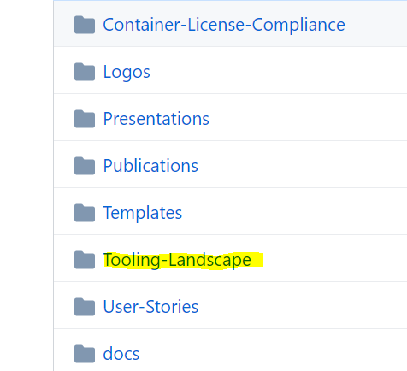
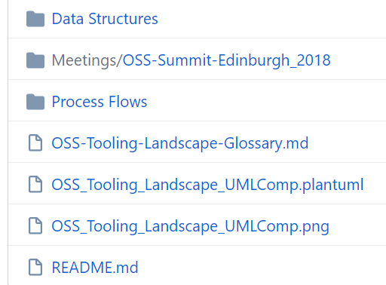
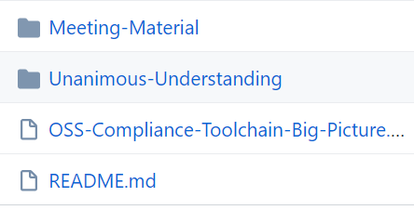
Github repo
Current

Slide 7
Github repo
Proposal
Container-License-Compliance
Logos
Meeting-Material
Presentations
Publications
Templates
Tooling-Landscape
Data Structures
Process Flows
OSS-Tooling-Landscape-Glossary.md
Static-Models
OSS-Compliance-Toolchain-Big-Picture.jpg
OSS_Tooling_Landscape_UMLComp.png
OSS_Tooling_Landscape_UMLComp.plantuml

Slide 8
Github repo
Proposal for next rework:
Make it REUSE conformant https://reuse.software/dev/
Work to get the CII badge https://github.com/coreinfrastructure/best-practices-badge/blob/master/doc/criteria.md

Slide 9
Agenda
Top | Name | Actors
1. | News | All
2. | Github repo | Oliver
3. | Introduction to barista (afternoon only) | Kevin Nelson
4. | Next meeting | Oliver

Slide 10
Next meeting
1st of July
Topics:
Github repo
Fossology scanning in CI Gaurav Mishra

Slide 11
Links / Communication
Where to communicate what?
Github:
https://github.com/Open-Source-Compliance/Sharing-creates-value
Slack:
https://join.slack.com/t/ossbasedcompl-bhx9742/shared_invite/enQtODE2MTMxNzUyNDY1LWQyNWVlNzkyMjhhOWUyNDdjNDJlMzk0YzU0NDUwNzQ2YzY0Mzc1N2Y2NjhhZGEyN2JmNDE0ZTg2MTBjYmM3MWI
Mailing List:
Subscription page: https://groups.io/g/oss-based-compliance-tooling
Email address: oss-based-compliance-tooling@groups.io

