Slide 1

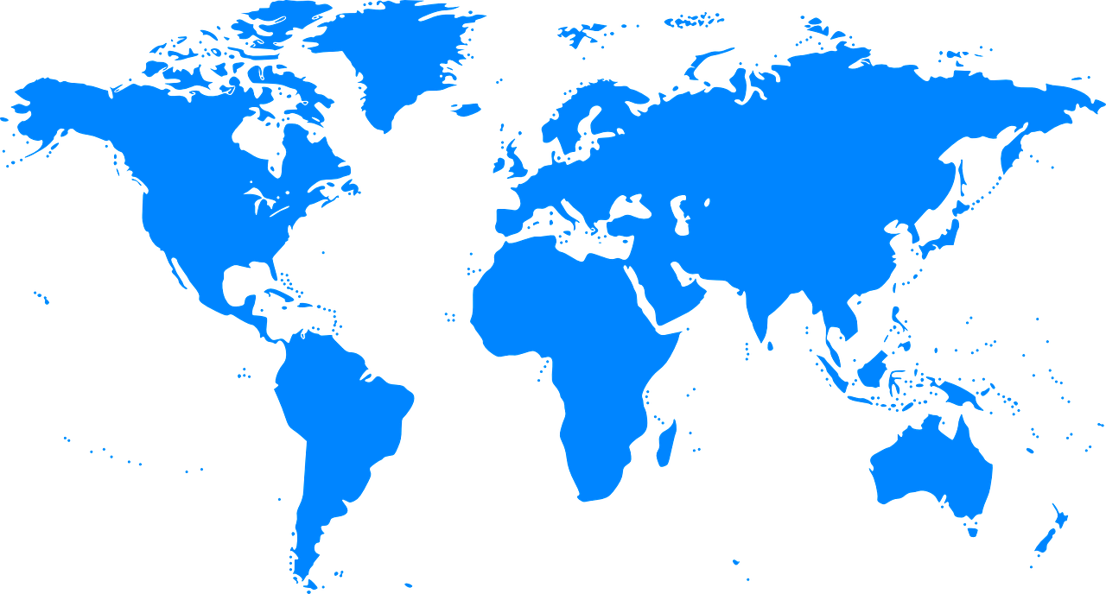
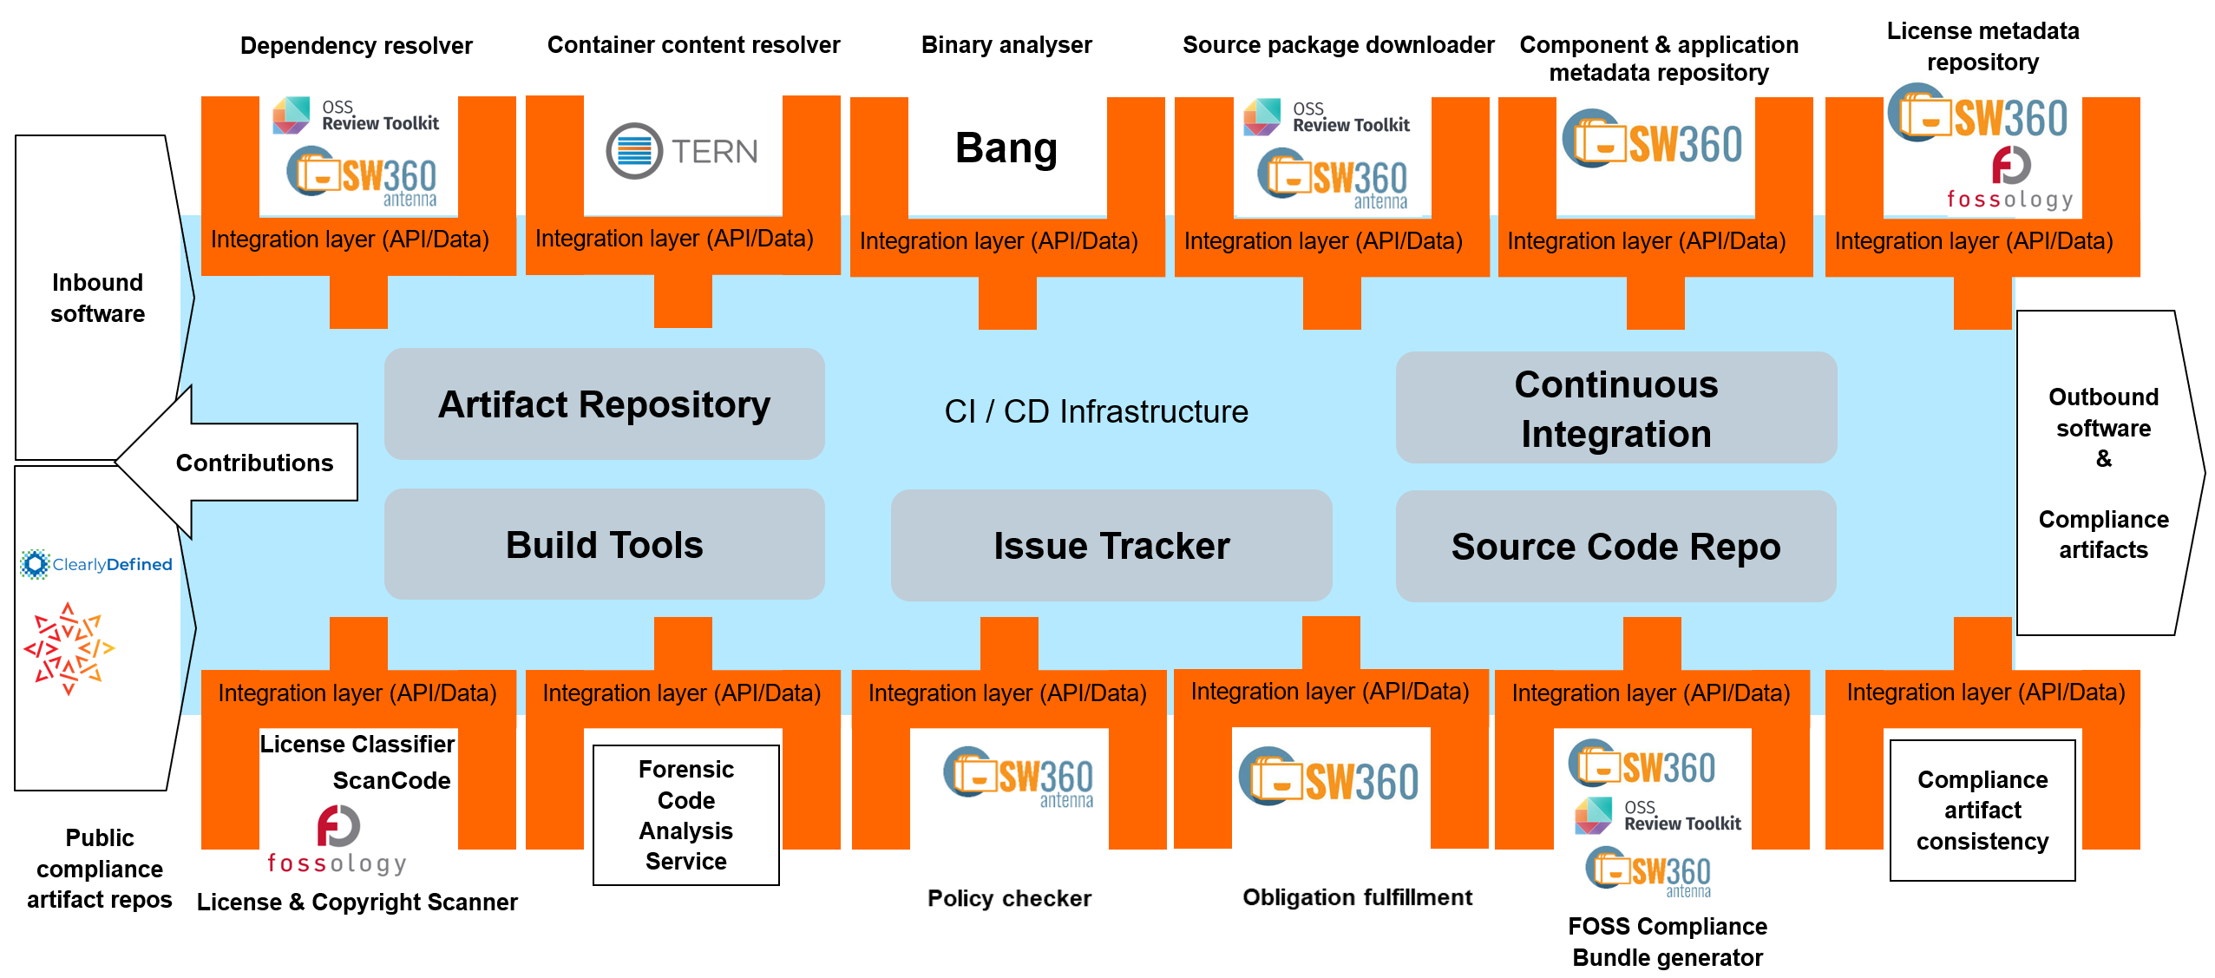
Tooling Work Group
We are building an open source compliance toolchain ecosystem with open source tools as an open source project. To accomplish this we:
Use existing independent tooling projects
Provide reference workflows to allow their adoption
Provide the concepts and glue to ensure easy interoperability and integration in existing environments
Provide reference turnkey toolchains that can be used without fees by anybody
World-Wide Collaboration, World-Wide Availability
Example Automation Implementation Using Open Source Tools
Join Us in Creating a New Era for Open Source Compliance
Mailing List: oss-based-compliance-tooling@groups.io
Subscription page: https://groups.io/g/oss-based-compliance-tooling
Online meetings: Bi-weekly - Invitations are sent to the mailing list
Website: https://oss-compliance-tooling.org/
And of course we are on GitHub:
https://github.com/Open-Source-Compliance/Sharing-creates-value

Slide 2
Big Picture – Integrated Compliance Toolchain
Inbound software
Dependency resolver
Container content resolver
Binary analyzer
Source package downloader
Component & application metadata repository
License Obligations Database
Integration layer (API/Data)
Integration layer (API/Data)
Integration layer (API/Data)
Integration layer (API/Data)
Integration layer (API/Data)
Integration layer (API/Data)
Outbound software
&
Compliance artifacts
Artifact Repository
Continuous Integration
Contributions
CI / CD Infrastructure
Public compliance artifact repos
Build Tools
Issue Tracker
Source Code Repo
Integration layer (API/Data)
Integration layer (API/Data)
Integration layer (API/Data)
Integration layer (API/Data)
Integration layer (API/Data)
Integration layer (API/Data)
License & Copyright Scanner
Forensic Code Analysis Service
Policy checker (Compliance Checker)
Obligation fulfillment
FOSS Compliance Bundle generator
Compliance artifact consistency

Slide 3







Example Automation Implementation Using Open Source Tools
Dependency resolver
Container content resolver
Binary analyzer
Source package downloader
Component & application metadata repository
License metadata repository
Inbound software
Bang
Integration layer (API/Data)
Integration layer (API/Data)
Integration layer (API/Data)
Integration layer (API/Data)
Integration layer (API/Data)
Integration layer (API/Data)
Outbound software
&
Compliance artifacts
Artifact Repository
Continuous Integration
Contributions
CI / CD Infrastructure
Build Tools
Issue Tracker
Source Code Repo
Integration layer (API/Data)
Integration layer (API/Data)
Integration layer (API/Data)
Integration layer (API/Data)
Integration layer (API/Data)
Integration layer (API/Data)
License Classifier
Forensic Code Analysis Service
Compliance artifact consistency
ScanCode
Public compliance artifact repos
License & Copyright Scanner
FOSS Compliance Bundle generator

