Slide 1

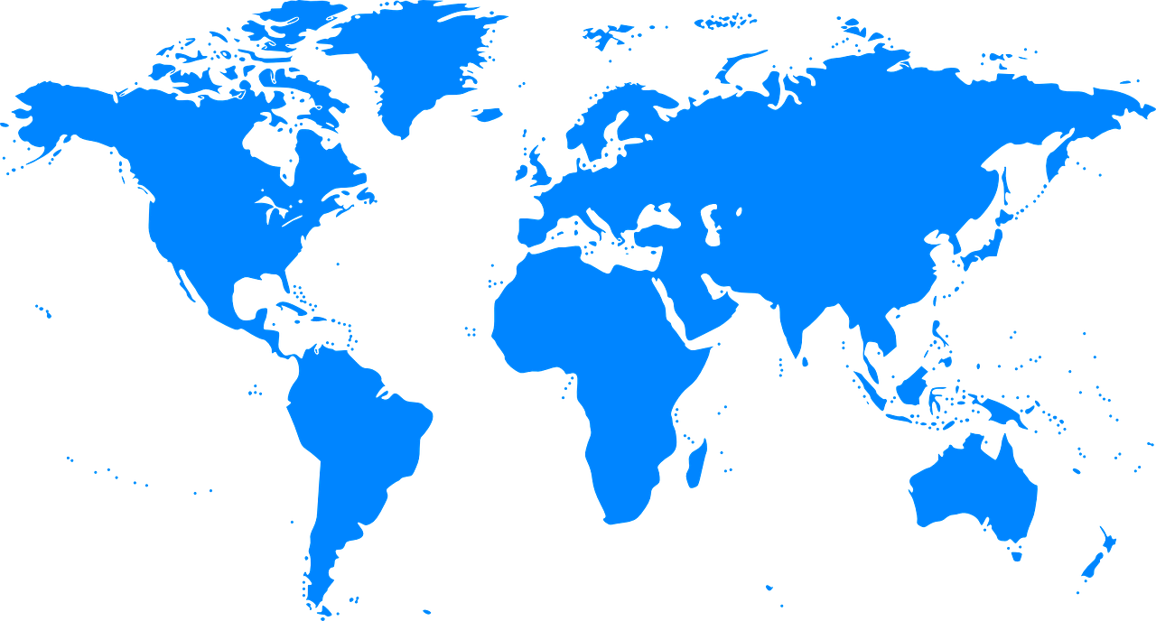
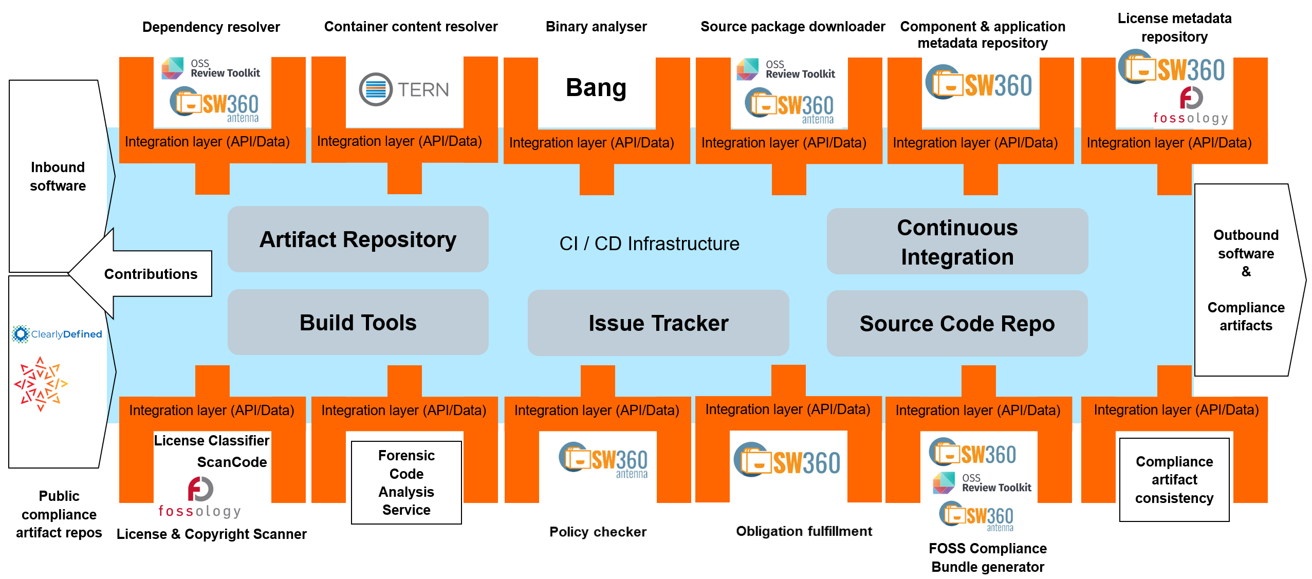
Tooling Work Group
We are building an open source compliance toolchain ecosystem with open source tools as an open source project. To accomplish this we:
Use existing independent tooling projects
Provide reference workflows to allow their adoption
Provide the concepts and glue to ensure easy interoperability and integration in existing environments
Provide reference turnkey toolchains that can be used without fees by anybody
World-Wide Collaboration, World-Wide Availability
Example Automation Implementation Using Open Source Tools
Join Us in Creating a New Era for Open Source Compliance
Mailing List: oss-based-compliance-tooling@groups.io
Subscription page: https://groups.io/g/oss-based-compliance-tooling
Online meetings: Bi-weekly - Invitations are sent to the mailing list
Website: https://oss-compliance-tooling.org/
And of course we are on GitHub:
https://github.com/Open-Source-Compliance/Sharing-creates-value

