Slide 1
KOUKI SABRINE
TOPIC:Pessimism

Slide 2
Defenition
Statistics
Consequences
Signs
Fixes

Slide 3
Definition
Pessimism is a negative mental attitude in which an undesirable outcome is anticipated from a given situation. Pessimists tend to focus on the negatives of life in general.
Pessimists get a lot of flak for their inclination toward negativity and their tendency to expect the worst in most situations.

Slide 4
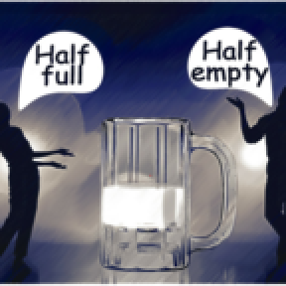
a pessimist usually see the glass as half empty, while an optimist see the glass as half full.

Slide 5
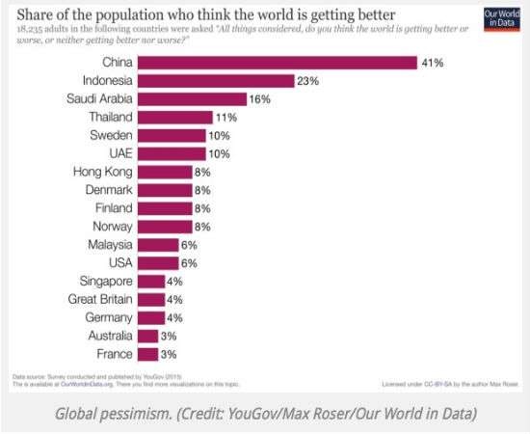
Statistics for pessimism

Slide 6
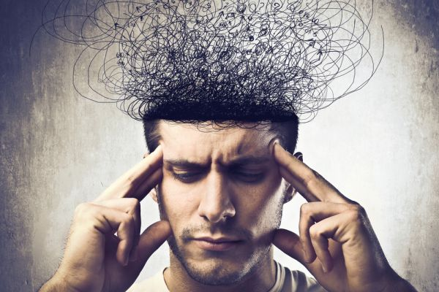
consequences of pessimism
Pessimism affects one's attitudes, motivations and actions. Because these factors affect what people do to prevent illness and how they act if sick, pessimists are less healthy than optimists.

Slide 7
Signs of pessimism
YOU GIVE UP EARLY:
Pessimists tend to give up and move on when challenged while optimists keep trying to solve the problems.
YOU EXPECT BAD NEWS:
You might have heard “expect the worst but hope for the best.” Well, the pessimist expects the worst and doesn’t hope at all.
YOU DISPLAY SELFISH BEHAVIOR:
The pessimist rarely thinks of others and focuses on their interests and challenges.

Slide 8

He seems to reach the end of hope.

Slide 9
The fixes
Try the “fake it until you make it” approach and don’t give up at the first sign of trouble.
The optimist is successful because they keep their hopes up, work hard and continue to expect good things to happen – even in the face of disappointing news.
Start doing random acts of kindness for family, friends, and colleagues without any agenda. Make the act all about them and leave your feelings out of it.

Slide 10
THANK YOU

