Slide 1
Implementing the UServ Product
Derby with the TAKE rule compiler
  Jens Dietrich, Massey University NZ
  j.b.dietrich@massey.ac.nz

Slide 2
Two versions
  Version 1 – static compilation, no external fact sources used – can be started from TAKE web page (requires Java WebStart 1.6).
  http://code.google.com/p/take
  Subversion: http://take.googlecode.com/svn/trunk/RuleML2007_challenge/
  Version 2 – dynamic compilation, uses facts from lightweight web service and DB.
  I.e., rules are compiled when loaded!
  Subversion: http://take.googlecode.com/svn/trunk/RuleML2007_challenge/

Slide 3
About the Scenario
  UServ Product Derby Case Study
  Car insurance rules
  published by the business rule forum to benchmark rule applications
  http://www.businessrulesforum.com/2005_Product_Derby.pdf
  69 rules -> 111 source code files, 354 classes
  Compilation takes 2567 ms on a system with a 2.0GH T5600 dual core processor, 2.0GB of RAM running on Ubuntu 7.10 with Java 1.6.
  Handicaps: loggings switched on, code pretty printing

Slide 4
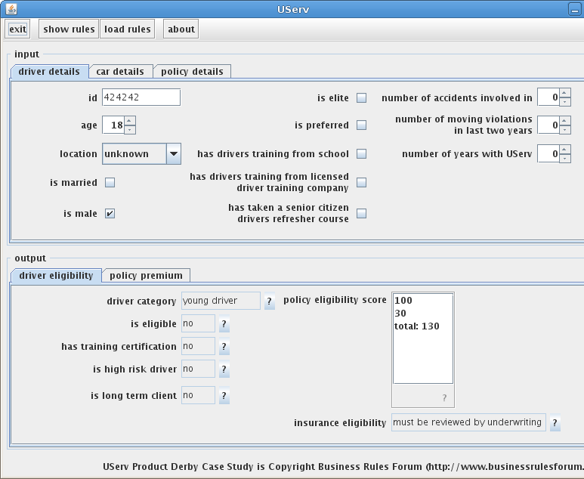
The Application
Simple UI
Changes in input area cause changes in output area – queries are reissued.
input area
query results
show explanations

Slide 5
Rule Implementation
  Now uses TAKE scripts, R2ML version planned.
  Comprehensive use of meta data in scripts.
  Meta data can be retrieved in application (use [?] buttons).

Slide 6
Access Resource from DB
List of special locations is read from HSQL DB
External fact store wraps a JDBC result set
  @author=Jens Dietrich
  @date=2007-10-18
  @description=list of special locations
  external DP_00x: specialLocation[Driver]
  @category=Driver Premiums Rule Set
  @author=Jens Dietrich
  @date=2007-09-12
  @description=If young driver and married and located in special
  location, then increase premium by $700.
  DP_01: if driverCategory[driver,"young driver"] and isMarried[driver] and specialLocation[driver] then additionalDriverPremium[driver,700]

Slide 7
Access Resources from WebService
DUI conviction lookup implemented as web service
dummy web service returns a boolean for an id (id contains 42 – must have a DUI conviction)
RESTful – simple GET request, not SOAP
  @author=Jens Dietrich
  @date=2007-09-12
  @description=If the driver has been convicted of a DUI, then the driver qualifies
  as a High Risk Driver.
  DE_DRC01: if hasBeenConvictedOfaDUI[driver] then isHighRiskDriver[driver]
  @author=Jens Dietrich
  @date=2007-10-19
  @description=get info about DUI conviction from external data source
  external DRCx: hasBeenConvictedOfaDUI[Driver]

Slide 8
Built in aggregation
Functions can be defined using standard` aggregation functions
similar to GROUP BY construct in SQL
  aggregation eligibilityScore = sum x policyEligibilityScore[car,driver,x]
  @author=Jens Dietrich
  @date=2007-09-12
  @description=If car is Provisional then increase policy eligibility score by 50.
  ES_01b: if autoEligibility[car,"provisional"] then policyEligibilityScore[car,driver,50]
  @author=Jens Dietrich
  @date=2007-09-12
  @description=If eligibility score is less that 100, then client is eligible for insurance.
  ES_04: if eligibilityScore(car,client)<100 then insuranceEligibility[car,client,"eligible"]

Slide 9
Negation
Negation is polymorphic
In predicate is defined in object model, negation is explicit
Otherwise, negation is negation as failure
  explicit negation – predicate references Java property
  @description=If the car has Driver and Passenger airbags then lower the
  premium by 15%.
  AD_02: if hasAirbags[car] and hasFrontPassengerAirbag[car] and not
  hasSidePanelAirbags[car] then premiumDiscount[car,15]
  NAF – negated predicate is defined by rules
  @description=Driver is a Typical Driver is all of the following are true: Not a
  Young Driver,Not a Senior Driver.
  DP_07: if not driverCategory[driver,"young driver"] and not
  driverCategory[driver,"senior driver"] then driverCategory[driver,"typical driver"]

Slide 10
Reloading Rules
  Will trigger recompilation.
  Generated rules are stored in ./takeWorkingDir/src
  Compiled rules are stored in ./takeWorkingDir/bin
  package name contains timestamp for versioning
  Rules loaded with URLClassLoader into application

Slide 11
Reloading Rules - code
  KnowledgeBaseManager<UservRules> kbm =
  new KnowledgeBaseManager<UservRules>();
  Bindings bindings = new SimpleBindings();
  bindings.put("HighTheftProbabilityAutoList",HighTheftProbabilityAutoList.getList());
  bindings.put("CurrentYear",new GregorianCalendar().get(Calendar.YEAR));
  bindings.put("NextYear",new GregorianCalendar().get(Calendar.YEAR)+1);
  Bindings factStores = new SimpleBindings();
  factStores.put("DP_00x", new SpecialLocationsSource());
  factStores.put("DRCx", new DUIConvictionInfoSource());
  FileInputStream in = new FileInputStream(“userv.take”);
  UservRules kb = kbm.getKnowledgeBase(
  UservRules.class,
  ScriptKnowledgeSource(in),
  bindings,
  factStores);

