Slide 1
Implementing the UServ Product
Derby with the TAKE rule compiler
Jens Dietrich, Massey University NZ
j.b.dietrich@massey.ac.nz

Slide 2
Two versions
Version 1 – static compilation, no external fact sources used – can be started from TAKE web page (requires Java WebStart 1.6).
http://code.google.com/p/take
Version 2 – dynamic compilation, uses facts from lightweight web service and DB.
I.e., rules are compiled when loaded!

Slide 3
About the Scenario
UServ Product Derby Case Study
Car insurance rules
published by the business rule forum to benchmark rule applications
http://www.businessrulesforum.com/2005_Product_Derby.pdf
69 rules -> 111 source code files, 354 classes
Compilation takes 2567 ms on a system with a 2.0GH T5600 dual core processor, 2.0GB of RAM running on Ubuntu 7.10 with Java 1.6.
Handicaps: loggings switched on, code pretty printing

Slide 4
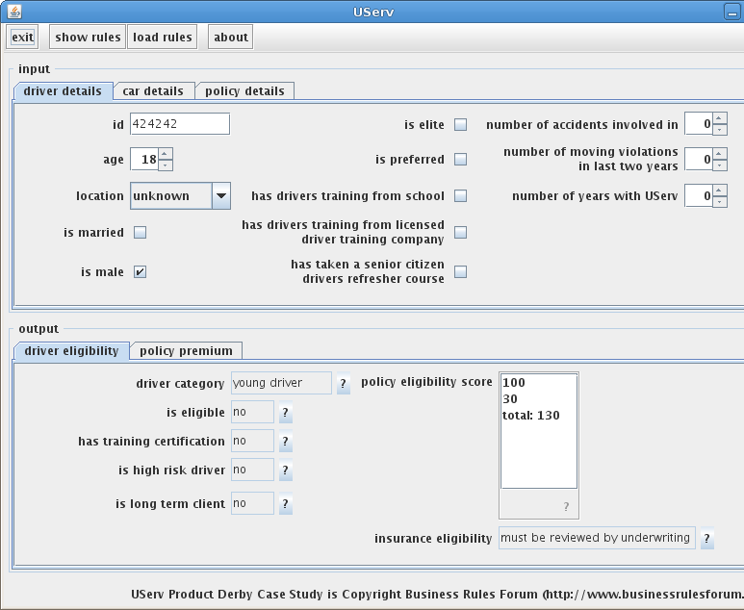
The Application
Simple UI
Changes in input area cause changes in output area – queries are reissued.

Slide 5
Rule Implementation
Now uses TAKE scripts, R2ML version planned.
Comprehensive use of meta data in scripts.
Meta data can be retrieved in application (use [?] buttons).

Slide 6
Access Resource from DB
List of special locations is read from HSQL DB
External fact store wraps a JDBC result set
@author=Jens Dietrich
@date=2007-10-18
@description=list of special locations
external DP_00x: specialLocation[Driver]
@category=Driver Premiums Rule Set
@author=Jens Dietrich
@date=2007-09-12
@description=If young driver and married and located in special
location, then increase premium by $700.
DP_01: if driverCategory[driver,"young driver"] and isMarried[driver] and specialLocation[driver] then additionalDriverPremium[driver,700]

Slide 7
Access Resources from WebService
DUI conviction lookup implemented as web service
dummy web service returns a boolean for an id (id contains 42 – must have a DUI conviction)
RESTful – simple GET request, not SOAP
@author=Jens Dietrich
@date=2007-09-12
@description=If the driver has been convicted of a DUI, then the driver qualifies
as a High Risk Driver.
DE_DRC01: if hasBeenConvictedOfaDUI[driver] then isHighRiskDriver[driver]
@author=Jens Dietrich
@date=2007-10-19
@description=get info about DUI conviction from external data source
external DRCx: hasBeenConvictedOfaDUI[Driver]

Slide 8
Built in aggregation
Functions can be defined using standard` aggregation functions
similar to GROUP BY construct in SQL
aggregation eligibilityScore = sum x policyEligibilityScore[car,driver,x]
@author=Jens Dietrich
@date=2007-09-12
@description=If car is Provisional then increase policy eligibility score by 50.
ES_01b: if autoEligibility[car,"provisional"] then policyEligibilityScore[car,driver,50]
@author=Jens Dietrich
@date=2007-09-12
@description=If eligibility score is less that 100, then client is eligible for insurance.
ES_04: if eligibilityScore(car,client)<100 then insuranceEligibility[car,client,"eligible"]

Slide 9
Negation
Negation is polymorphic
In predicate is defined in object model, negation is explicit
Otherwise, negation is negation as failure
explicit negation – predicate references Java property
@description=If the car has Driver and Passenger airbags then lower the
premium by 15%.
AD_02: if hasAirbags[car] and hasFrontPassengerAirbag[car] and not
hasSidePanelAirbags[car] then premiumDiscount[car,15]
NAF – negated predicate is defined by rules
@description=Driver is a Typical Driver is all of the following are true: Not a
Young Driver,Not a Senior Driver.
DP_07: if not driverCategory[driver,"young driver"] and not
driverCategory[driver,"senior driver"] then driverCategory[driver,"typical driver"]

Slide 10
Reloading Rules
Will trigger recompilation.
Generated rules are stored in ./takeWorkingDir/src
Compiled rules are stored in ./takeWorkingDir/bin
package name contains timestamp for versioning
Rules loaded with URLClassLoader into application

Slide 11
Reloading Rules - code
KnowledgeBaseManager<UservRules> kbm =
new KnowledgeBaseManager<UservRules>();
Bindings bindings = new SimpleBindings();
bindings.put("HighTheftProbabilityAutoList",HighTheftProbabilityAutoList.getList());
bindings.put("CurrentYear",new GregorianCalendar().get(Calendar.YEAR));
bindings.put("NextYear",new GregorianCalendar().get(Calendar.YEAR)+1);
Bindings factStores = new SimpleBindings();
factStores.put("DP_00x", new SpecialLocationsSource());
factStores.put("DRCx", new DUIConvictionInfoSource());
FileInputStream in = new FileInputStream(“userv.take”);
UservRules kb = kbm.getKnowledgeBase(
UservRules.class,
ScriptKnowledgeSource(in),
bindings,
factStores);

