Slide 1

BUSINESS INTELLIGENCE
Customer Insight Recommendation System
Turning raw e-commerce data into actionable business insights through an interactive intelligence dashboard.
PYTHON
FLASK
PANDAS
CHART.JS

Slide 2

THE CHALLENGE
From Raw Data to Decisions
E-commerce companies collect thousands of transactions daily — but raw sales data alone doesn't answer the questions that drive growth.
Which products actually drive revenue?
Which customers are most valuable?
Which markets perform best?
What actions should leadership take?
The Solution
This system converts transactional data into clear, decision-ready insights — bridging the gap between data collection and business strategy.

Slide 3






PROJECT OBJECTIVES
Six Pillars of Insight
Sales Performance
Customer Behavior
Track revenue trends and identify high-performing periods
Segment customers by value and understand purchasing patterns
Product Demand
Country Revenue
Rank top-selling products and quantify demand volume
Map revenue distribution across global markets
Business Patterns
Smart Recommendations
Discover hidden trends and correlations in transaction data
Generate data-driven strategies for inventory and marketing

Slide 4
DATASET OVERVIEW
Online Retail II Dataset
A comprehensive transactional dataset spanning multiple countries and years of e-commerce activity.
Feature
Description
Pipeline
Dataset → Cleaning → Analytics
Raw transactions are systematically cleaned and engineered into analysis-ready features.
Invoice Number
Unique transaction identifier
Product Description
Item name and details
Quantity
Units purchased per transaction
Invoice Date
Timestamp of purchase
Unit Price
Price per unit in GBP
Customer ID
Unique buyer identifier
Country
Customer's geographic location

Slide 5
PIPELINE
Data Processing Workflow
Analysis-Ready Data
Data Cleaning
Clean, structured dataset processed using Python, Pandas, and NumPy — fully prepared for analytics and visualization.
Raw Dataset
Removed missing customer records
Filtered cancelled invoices
Eliminated invalid entries
Date format conversion
Feature engineering
Online Retail II — unprocessed transactional records with missing values and cancelled invoices.

Slide 6


ARCHITECTURE
System Architecture
The architecture follows a layered pipeline — each stage refines raw data into progressively higher-value outputs, culminating in an interactive Flask dashboard that delivers actionable business intelligence.
Flask Dashboard
Interactive UI for insights
Recommendation Engine
Generate personalized suggestions
Analytics Module
Statistical and ML analysis
Data Processing
Python and Pandas transformations
Flask serves the frontend, while Pandas handles all backend data transformations.
Dataset Layer
Raw data sources and ingestion

Slide 7
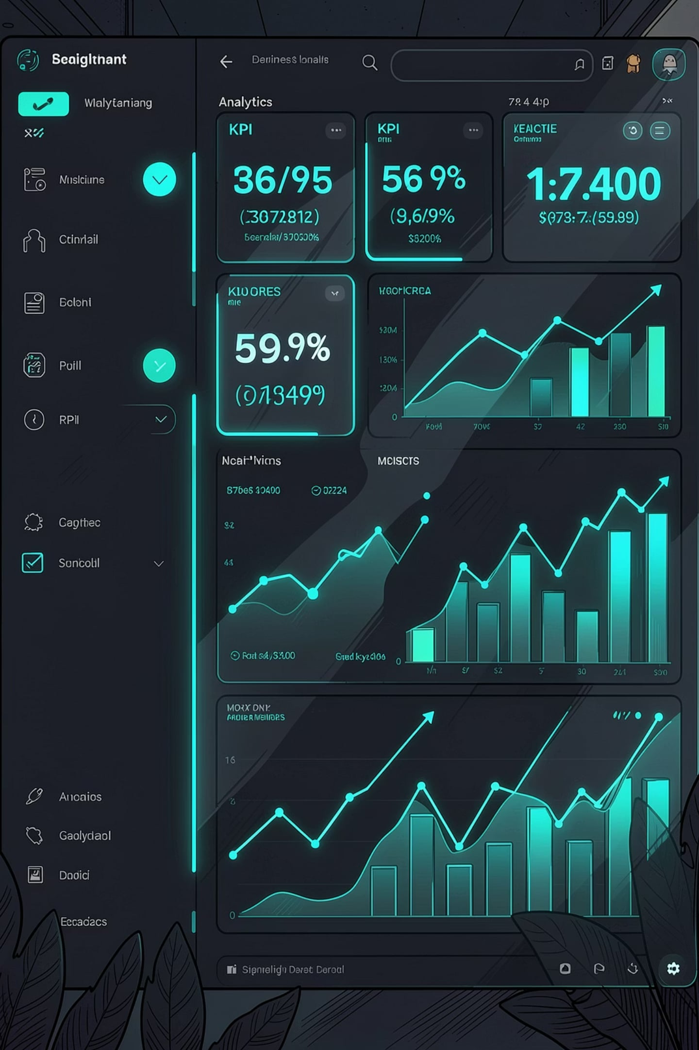
DASHBOARD
Live KPI Dashboard
£7.24M
Total Sales
Revenue across all markets
15,195
Total Orders
Transactions processed
4,277
Customers
Unique buyers analyzed
£476
Avg. Order Value
Revenue per transaction
Dynamic KPI tracking with interactive filters for country and year — delivering a real-time dashboard experience.

Slide 8
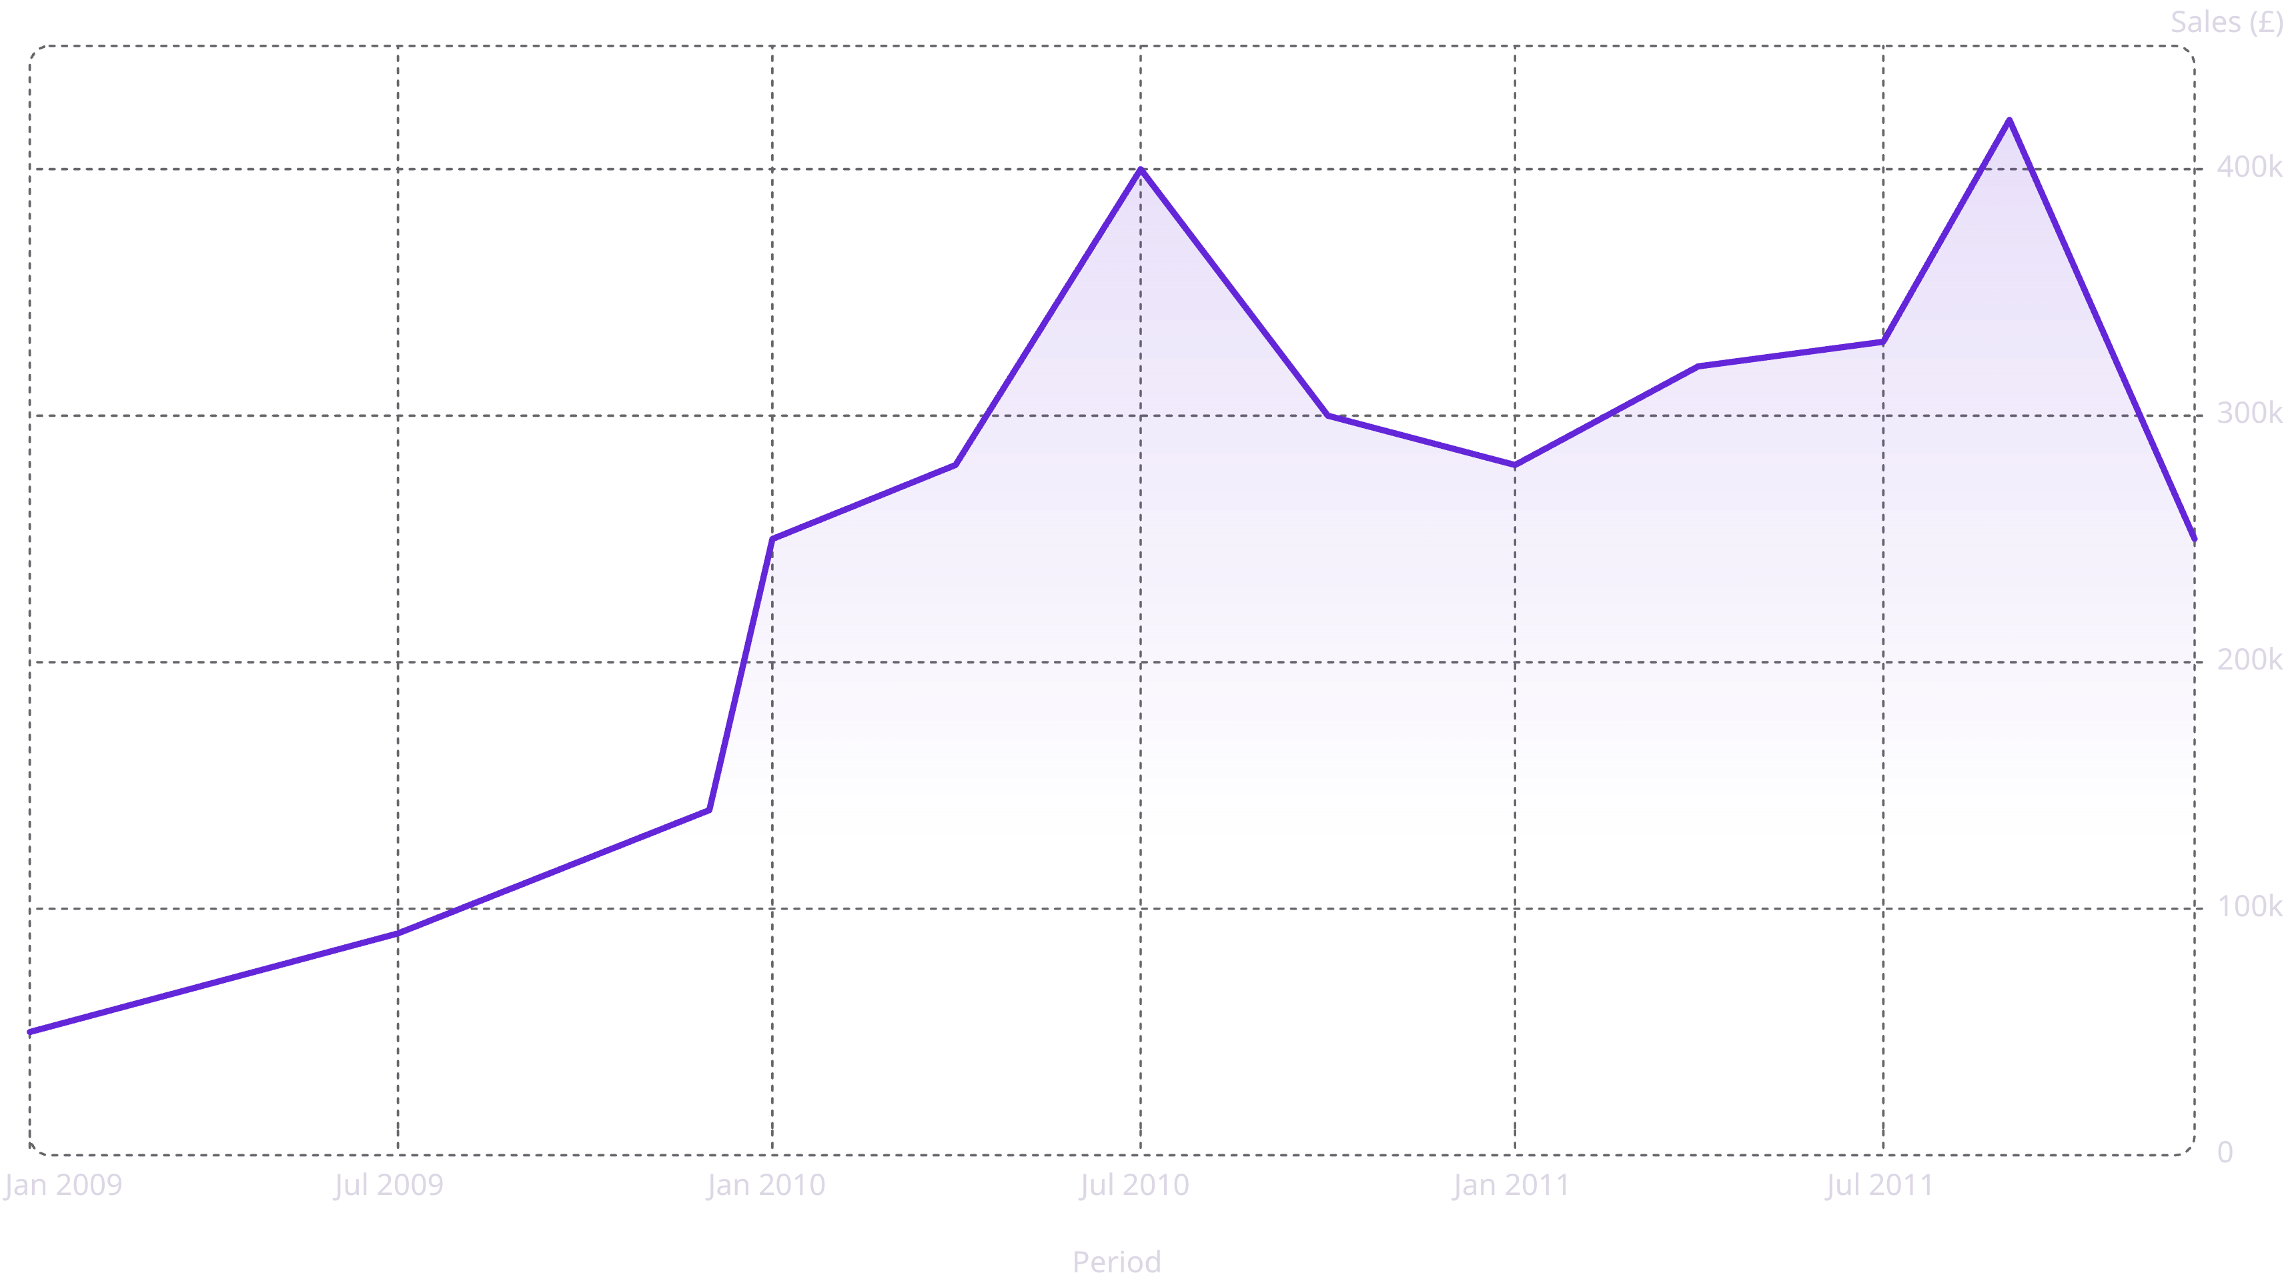
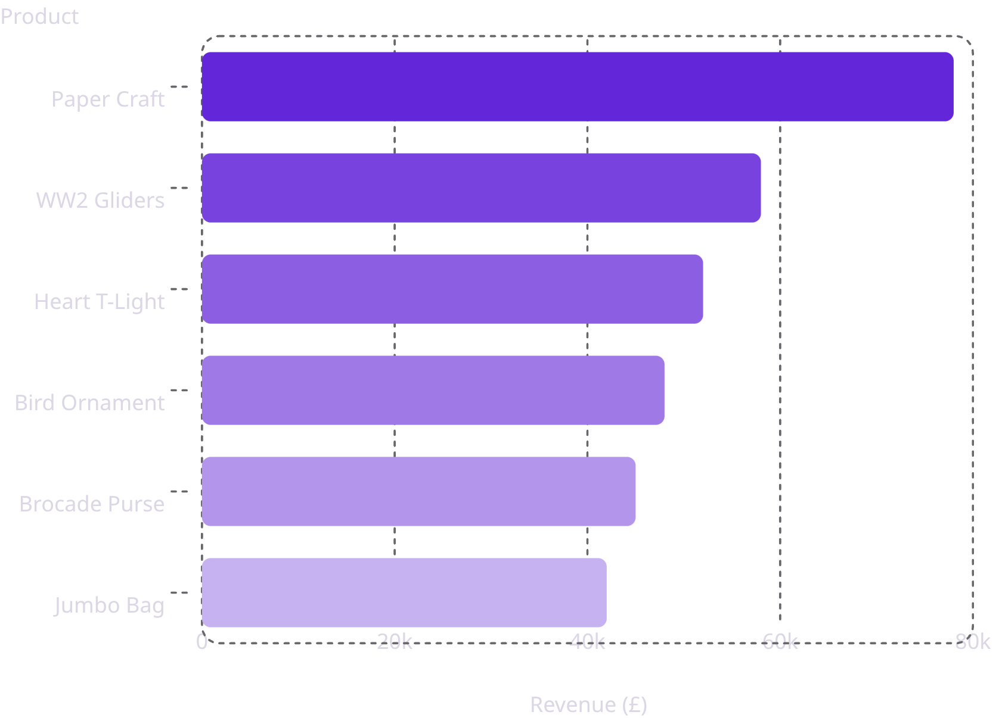
SALES ANALYTICS
Monthly Sales Trend
Sales surged dramatically from Jan 2010, peaking at £400K in Jul 2010 and sustaining £250K–£420K through 2011 — demonstrating strong post-ramp revenue retention.
Product Demand Analysis
Paper Craft, Little Birdie leads with £78K in revenue and 80,995 units sold.
These rankings directly inform inventory planning — ensuring high-demand SKUs remain in stock while underperformers get targeted promotional support.

Slide 9
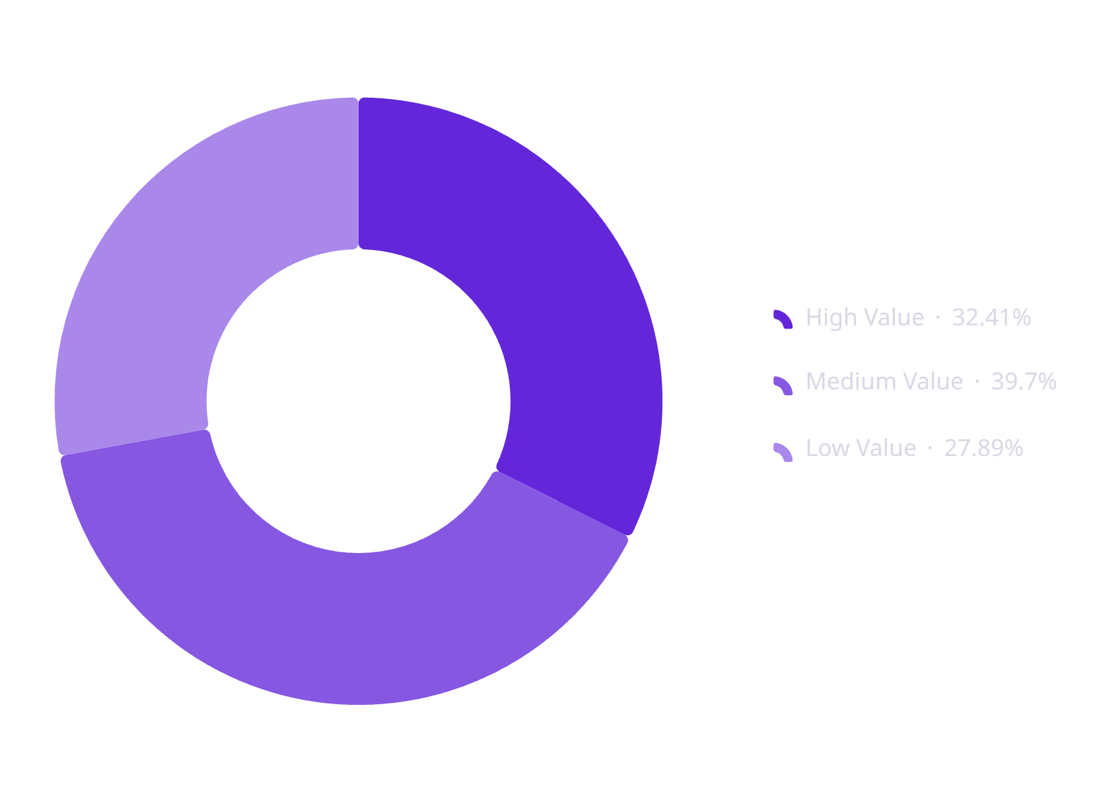
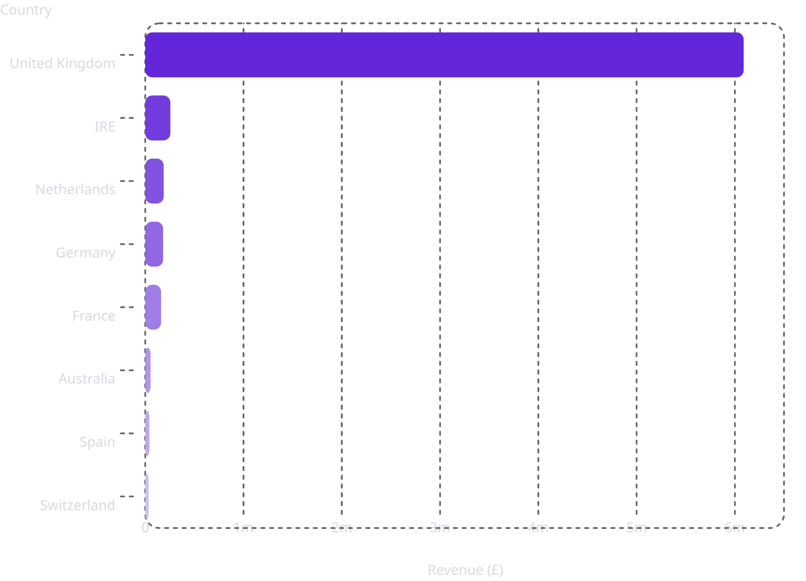
CUSTOMER & MARKET
Segmentation & Market Performance
🌍 Country Revenue Distribution
Customer segments by value tier. Medium Value is the largest group at 1,698 customers, with 2,557 repeat customers across all segments.
The United Kingdom dominates with £6.09M in revenue — 84% of total sales. Identifying loyal customers and profitable regions enables targeted retention strategies.

Slide 10
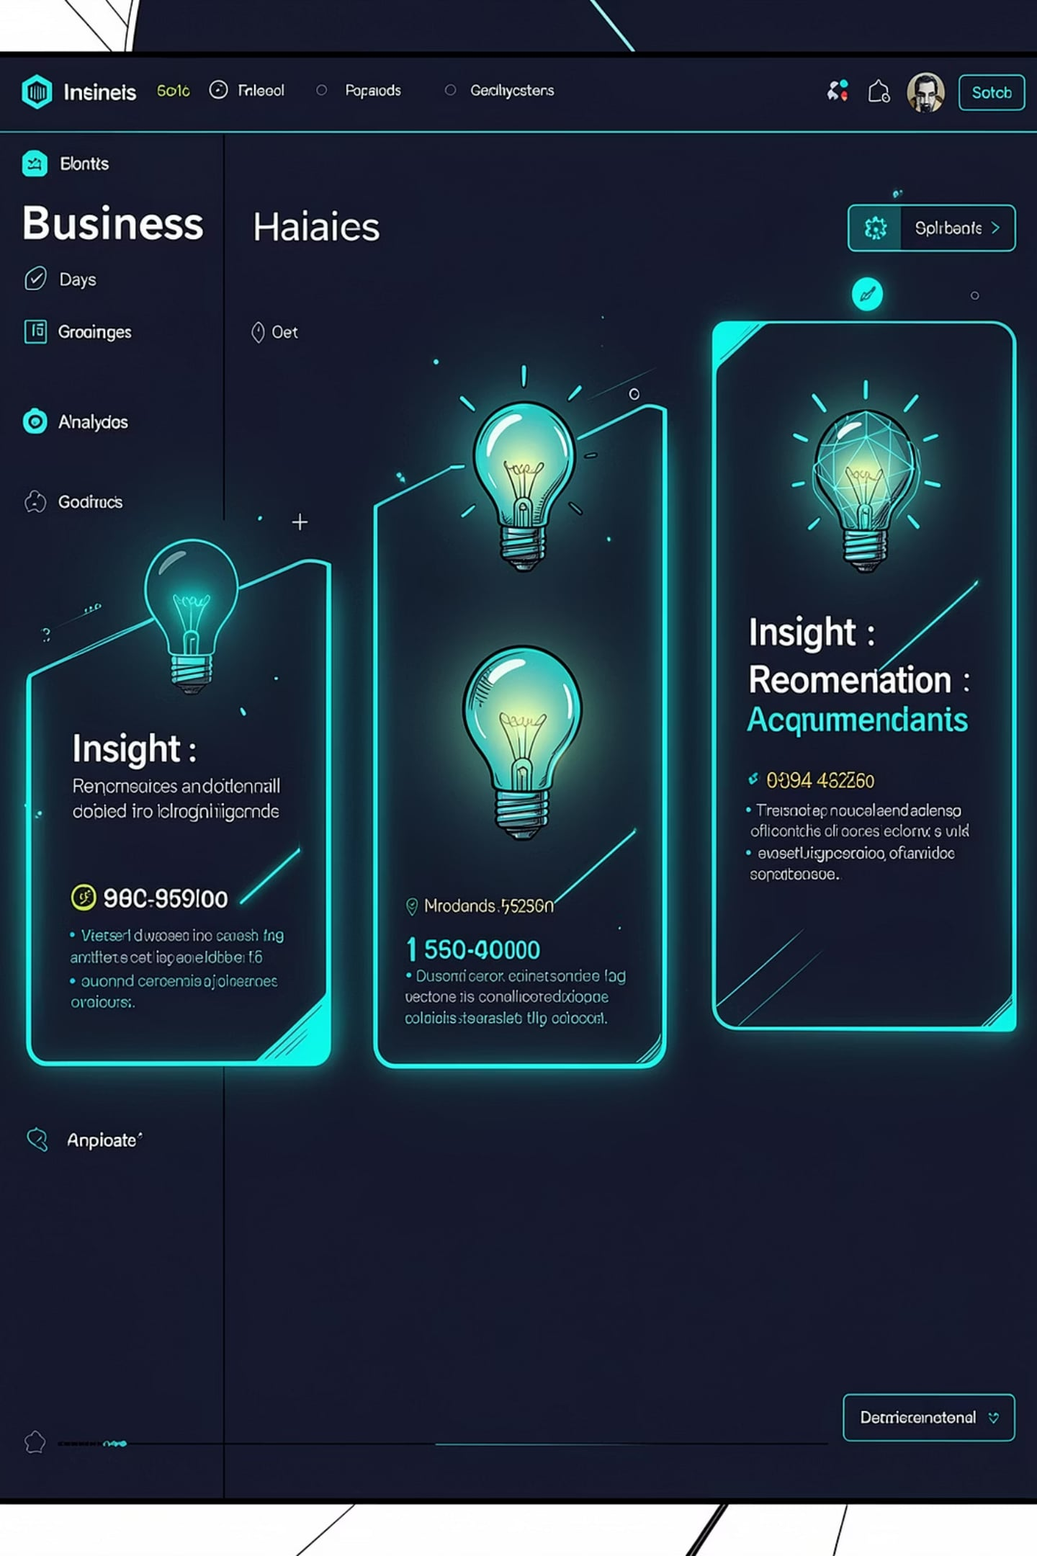





RECOMMENDATIONS
Strategic Business Recommendations
Market Diversification
Inventory Optimization
UK contributes the highest revenue. Continue investing in this market while expanding marketing efforts in other regions to reduce dependency on a single market.
"Paper Craft, Little Birdie" is the highest-selling product. Maintain sufficient inventory and consider bundling with complementary products to increase revenue.
Average Order Value
AOV of £476 has room to grow. Introduce product bundles, cross-selling strategies, and targeted discount offers to encourage higher spend per purchase.
Built by Kounain Siddiquee
Python · Flask · Pandas · Chart.js — Customer Insight Recommendation System

