Slide 1
Sarcasm Detection using NLP Techniques
Yamini Pathuri, Koundinya Raghava Nerella
Course: APLN552_01
Instructor: Srinivas Bangalore

Slide 2
Problem Motivation
Sarcasm is the use of language that normally signifies the opposite in order to mock or convey contempt.
Sarcasm differs in various countries, where as useful to detect the hate speech, harassment, or any other negative behaviour online which can be addressed properly.
The use of sentiment analysis in natural language processing is common for determining people's subjective opinions. However, the accuracy of the analysis may be compromised if sarcasm is used in the text. To ensure an accurate understanding of people's true intentions, detecting sarcasm is crucial.

Slide 3
Related Works
The study presented in this paper [1] involved conducting experiments with various LSTMs (long-short term memory networks) and BERT (Bidirectional Encoder Representations from Transformers) models to detect sarcasm in Discussion Forum data, including both response-only and context-and-response formats. The analysis focused on evaluating the performance of these models, and the findings indicated that utilizing context information can enhance the accuracy of LSTM models for sarcasm detection.
In [2] used the transfer learning approach involves utilizing related intermediate tasks such as sentiment classification and emotion detection to enhance the model's knowledge of sarcasm, which is often associated with implied negative sentiment and emotions. The experimental results on diverse datasets demonstrate that the BERT models outperform many previous models, highlighting their effectiveness in detecting sarcasm in natural language text.

Slide 4
Data Collection
The data which we have used in our project is extracted from Kaggle [1].
The data is directly available as train.csv and test.csv files.
The data is mainly based on the Twitter tweets.

Slide 5
Methodology
We have used logistic regression, n-grams and pretrained model called Universal Sentence Encoder model.

Slide 6
Logistic Regression model
Logistic regression is a simple yet powerful method for sarcasm detection that can effectively capture the relationship between input features and the probability of sarcasm. It is also computationally efficient and can handle high-dimensional feature spaces.
In logistic regression, the goal is to model the probability that a given input belongs to a particular class, given a set of input features. The model learns the relationship between the input features and the target variable (sarcasm or non-sarcasm) by estimating a set of weights that best fit the training data.
In the context of sarcasm detection, logistic regression can be used to model the relationship between various input features (such as n-grams, sentiment scores, or syntactic patterns) and the probability that a given text is sarcastic.
Once trained, the logistic regression model can be used to predict the sarcasm label of new input texts. The model takes in the numerical feature representation of the input text and computes a probability that the text is sarcastic. If the probability exceeds a certain threshold, the model predicts that the text is sarcastic; otherwise, it predicts that the text is not sarcastic.

Slide 7
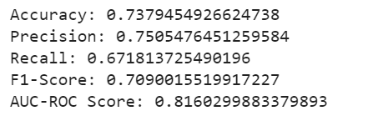
Logistic Regression contd….
From the logistic regression model:
Example to check whether the given sentence sarcasm or not?

Slide 8
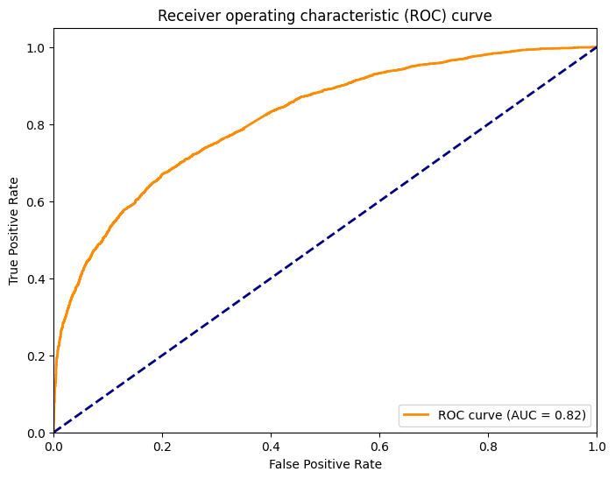
AUC-ROC curve for logistic regression
In sarcasm detection, the AUC-ROC curve is a graphical representation of the model's true positive rate (TPR) versus its false positive rate (FPR) as the decision threshold is varied.

Slide 9
n-grams
n-grams are commonly used in sarcasm detection as a feature extraction technique to capture patterns of language use that are typical of sarcastic expressions.
n-grams can help detect this gap by analyzing patterns of word usage in a given text. For example, in sarcastic statements, there may be unexpected combinations of words, such as negations or words with opposite meanings.
n-grams can be used to extract such patterns and provide a numerical representation of the text that can be used as input to machine learning algorithms for sarcasm detection. We can typically use a combination of different n-grams (such as unigrams, bigrams, and trigrams) and various techniques for feature selection and weighting to improve the accuracy of sarcasm detection models.
Overall, n-grams are a valuable tool in sarcasm detection because they help capture the nuances of language use that are characteristic of sarcastic expressions, and can thus help distinguish between sarcastic and non-sarcastic utterances.

Slide 10
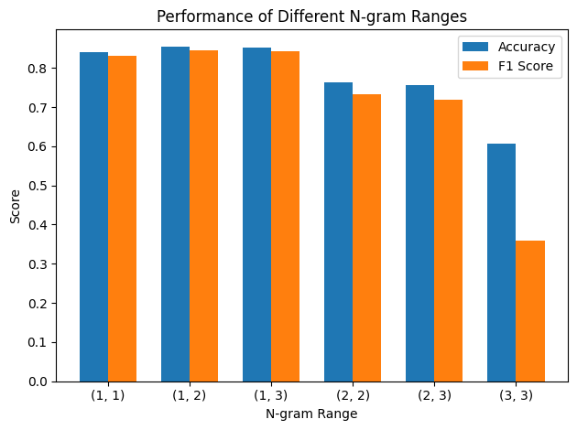
n-grams contd….
We have experimented with the different n-grams ranges as follows:
And the Accuracy and F-1 score is as follows:
Fig: Accuracy and F-1 scores bar chart

Slide 11
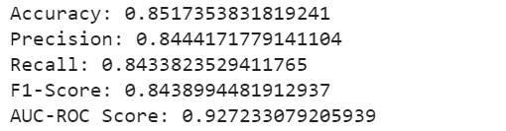
n-grams contd….
If we take (1,2) n-gram range:
Example to check whether the given sentence sarcasm or not?

Slide 12
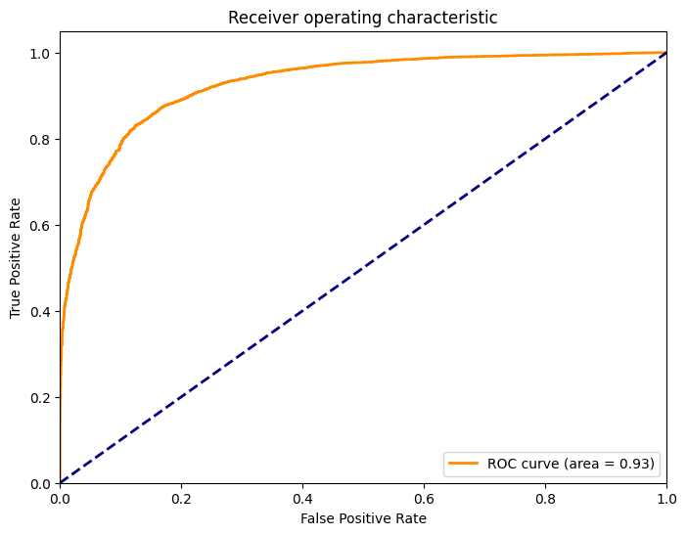
AUC-ROC curve for n-grams
The AUC-ROC (Area Under the Curve of the Receiver Operating Characteristic) is a performance metric used to evaluate the effectiveness of a classification model in distinguishing between positive and negative classes, including sarcasm detection.
The TPR represents the proportion of true sarcasm instances that are correctly identified by the model, while the FPR represents the proportion of non-sarcastic instances that are incorrectly classified as sarcasm.

Slide 13
Universal Sentence Encoder (USE)
The Universal Sentence Encoder (USE) is a pre-trained model that can encode text into high-dimensional vectors, allowing us to measure the semantic similarity between different sentences.
The approach to using the USE for sarcasm detection is to use it as a feature extractor. We can input our sarcasm dataset into the USE and get the embeddings for each sentence.
To train the machine learning model, we need to label our dataset with sarcasm annotations.
After training our machine learning model, we can use it to predict the sarcasm label for new sentences. We can first input the sentence into the USE to get the embedding, and then feed this embedding into our machine learning model to get a sarcasm prediction.

Slide 14
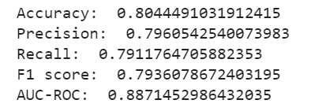
USE contd….
Using the pretrained model the accuracy, F-1 score will be:
Examples to check whether the given sentence sarcasm or not?

Slide 15
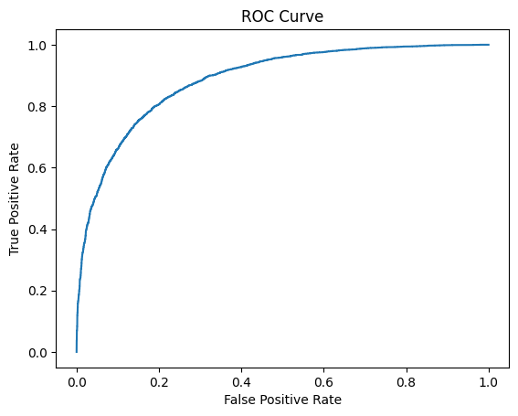
AUC-ROC curve for USE
The AUC-ROC score ranges from 0 to 1, where 0.5 indicates a random classifier, and 1.0 represents a perfect classifier. A higher AUC-ROC score indicates better model performance in correctly classifying sarcasm instances.

Slide 16
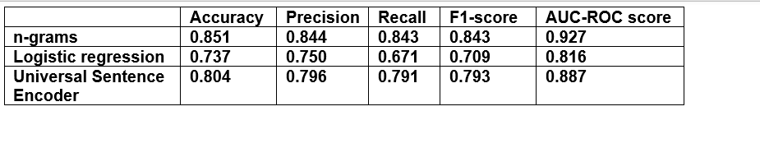
Results
Table 1: Results

Slide 17
Conclusion/Future Work
Improving model accuracy: While the USE model is a good starting point, there is always room for improvement in terms of model accuracy. We could explore using more advanced machine learning algorithms, such as deep neural networks, to improve performance.
Multi-lingual sarcasm detection: The current model is trained on English data, but sarcasm is prevalent in many other languages as well. We could explore building models for sarcasm detection in other languages.
Real-time detection: In many settings, such as social media, sarcasm detection needs to happen in real-time. We could explore building models that can detect sarcasm in real-time.
Sarcasm generation: While sarcasm detection is an important problem, it's also interesting to explore generating sarcastic text. We could explore building models that can generate sarcastic text, which could have applications in fields like natural language generation and chatbots etc.,

Slide 18
References
https://www.kaggle.com/datasets/farhanch67/twitter-sracastic-classification-dataset
https://web.stanford.edu/class/archive/cs/cs224n/cs224n.1194/reports/custom/15791781.pdf
Savini, E.; Caragea, C. Intermediate-Task Transfer Learning with BERT for Sarcasm Detection. Mathematics 2022, 10, 844. https:// doi.org/10.3390/math10050844
Yitao Cai, Huiyu Cai, and Xiaojun Wan. 2019. Multi-Modal Sarcasm Detection in Twitter with Hierarchical Fusion Model. In Proceedings of the 57th Annual Meeting of the Association for Computational Linguistics, pages 2506–2515, Florence, Italy. Association for Computational Linguistics.

