Slide 1
Zoom Case Study
By: Karl Unverferth

Slide 2
Question: Should ZoomInfo purchase the vendor data?
Assumptions
Vendor title grade is a comparison of the vendor title and the actual title
Example line 2 is partial since both have “vice president”
ZoomInfo title grade is a comparison of the ZoomInfo title and the actual title
Example line 3 is incorrect since zoom and real are different
The category “equivalent” should indicate similar values

Slide 3
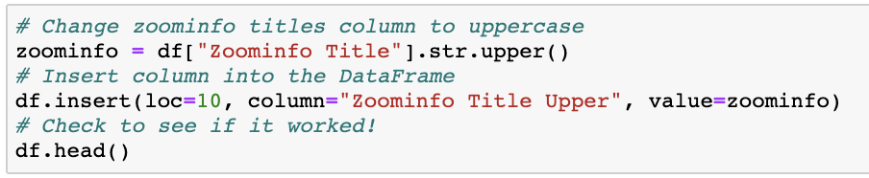
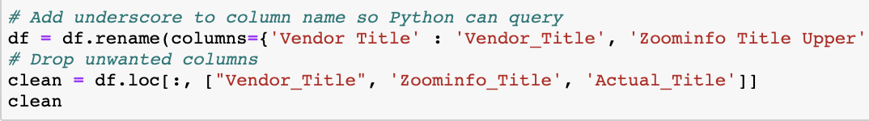
Question: Should ZoomInfo purchase the vendor data?
Data Cleaning!
Using Pandas in an iPythonNotebook
The comments detail the process

Slide 4
Results & Conclusion
Grade columns may not be accurate
Example line 60, vendor and actual are the same but the vendor grade is incorrect
To determine where the vendor data will improve ZoomInfo’s data I queried where the Vendor Title is the same as the actual title and where ZoomInfo is not the same as the actual title. This will give us the exact amount of data points that the vendor data can improve the ZoomInfo data.

Slide 5
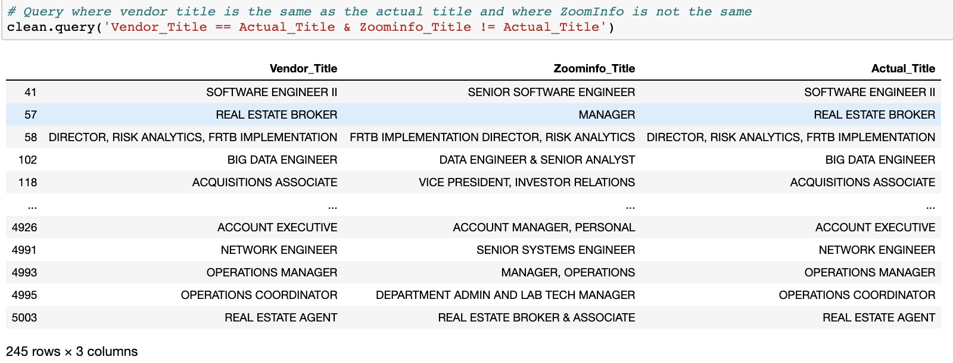
Results & Conclusion
ZoomInfo should not purchase the Vendor data as there are only 245 datapoints that can be updated out of the original 5011 datapoints.

