Slide 1
Customer shopping behaviour
What drives revenue, repeat buying, and the next commercial decisions.

Slide 2
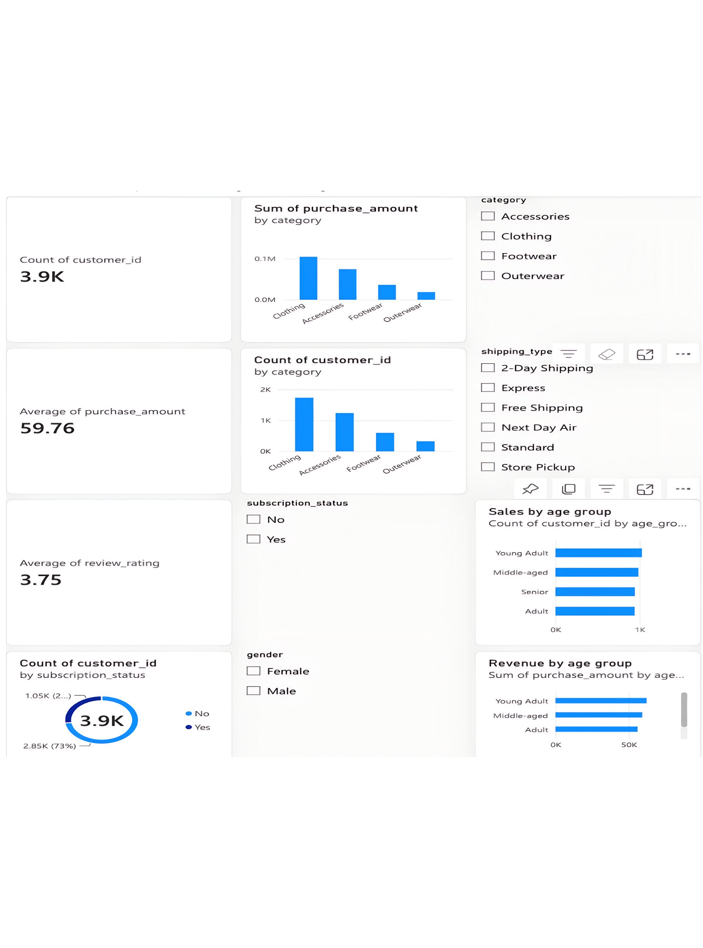
Revenue is broad-based, not driven by ticket size
$233,081
Total revenue
$59.76
3.75/5
Average purchase
Average rating
Average spend is similar across gender, subscription status, and age groups.

Slide 3
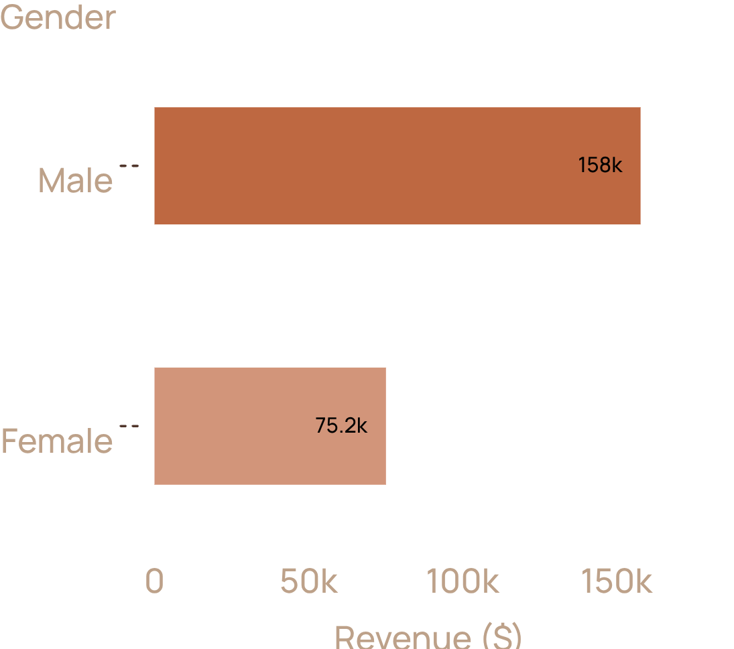
Men generate most revenue, but the gap needs context
Use this as a revenue mix signal, not proof that men spend more per purchase.
Male revenue: $157,890 · female revenue: $75,191
The report flags discounts as appearing only on male purchases, so the discount field should be validated before comparing behaviour by gender.

Slide 4

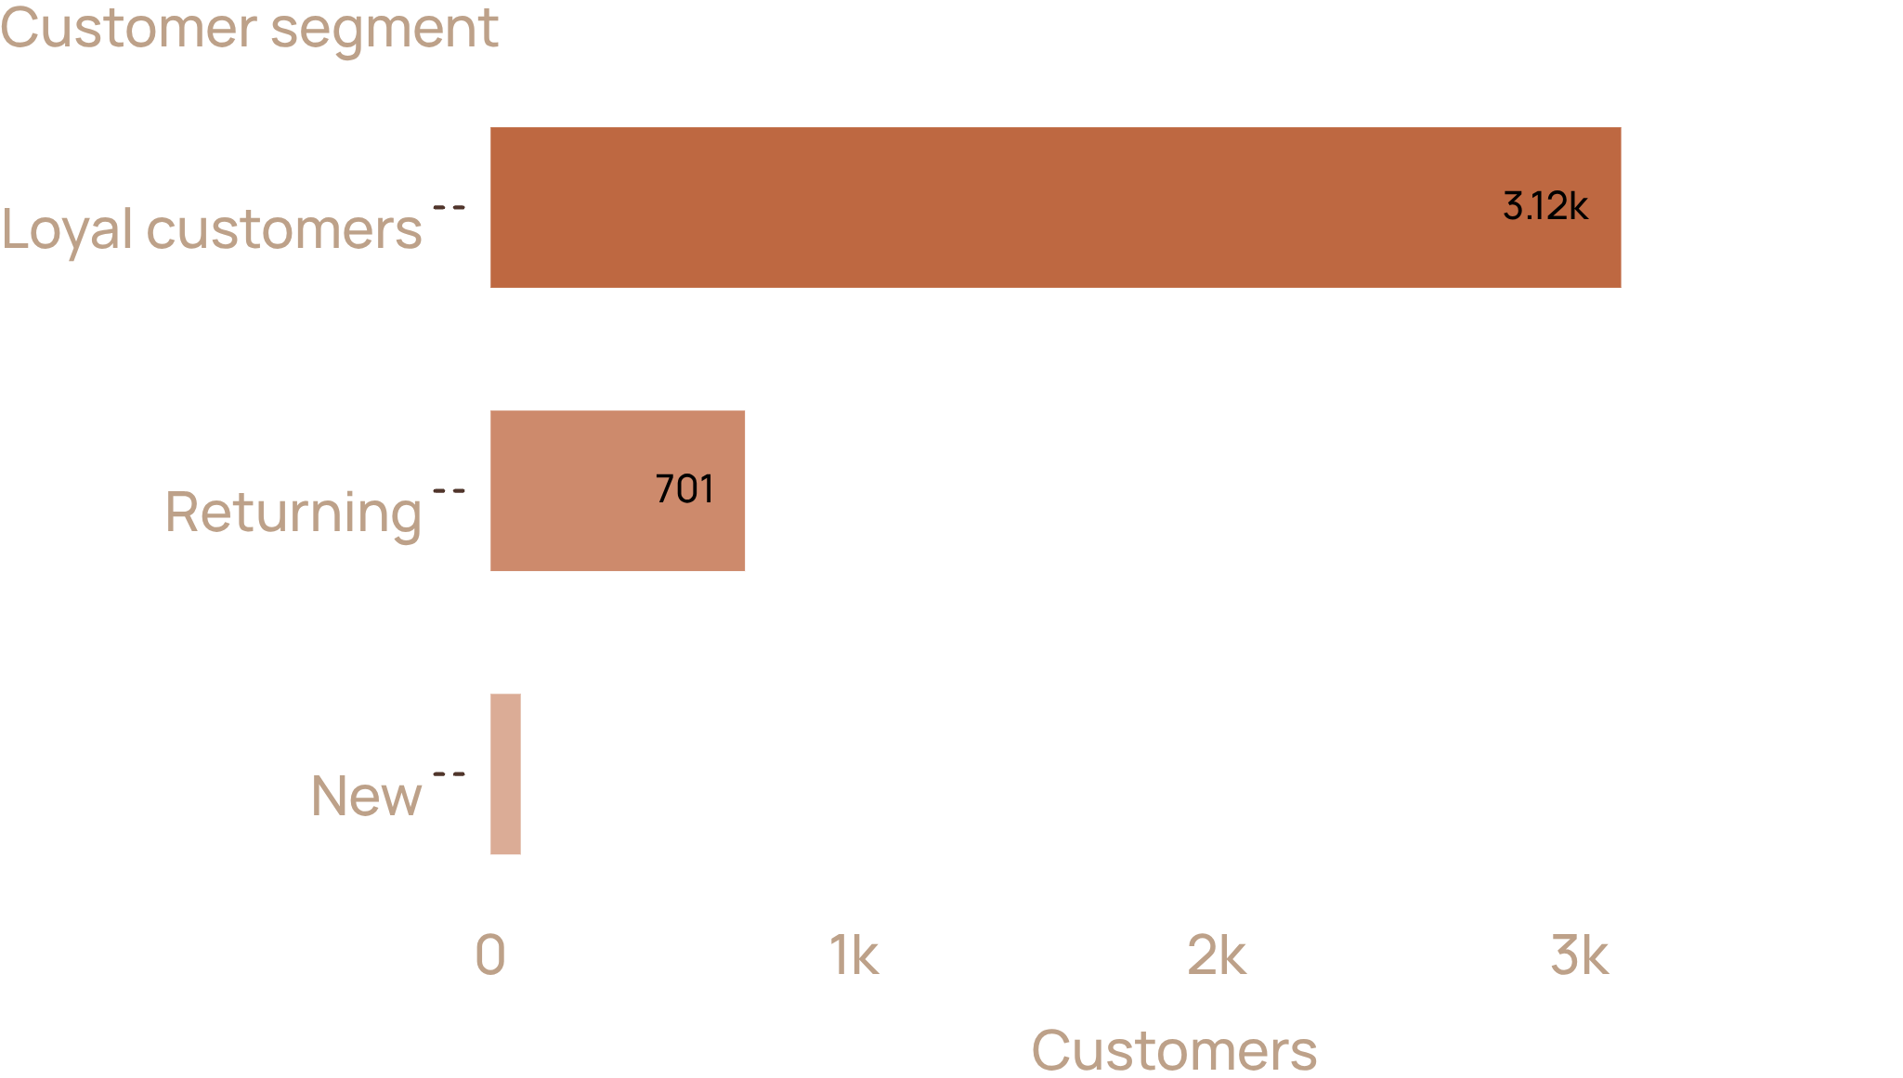
The customer base is overwhelmingly repeat-led
Loyal customers have more than 10 previous purchases.
The growth question is retention and frequency, not just acquisition.

Slide 5
Most repeat buyers sit outside the subscription
Revenue
Average spend
Among customers with more than 5 previous purchases, 2,518 are not subscribed and 958 are subscribed.
$170,436 without a subscription
$62,645 with one
$59.87 without a subscription
$59.49 with one
2,518
958
not subscribed
subscribed

Slide 6
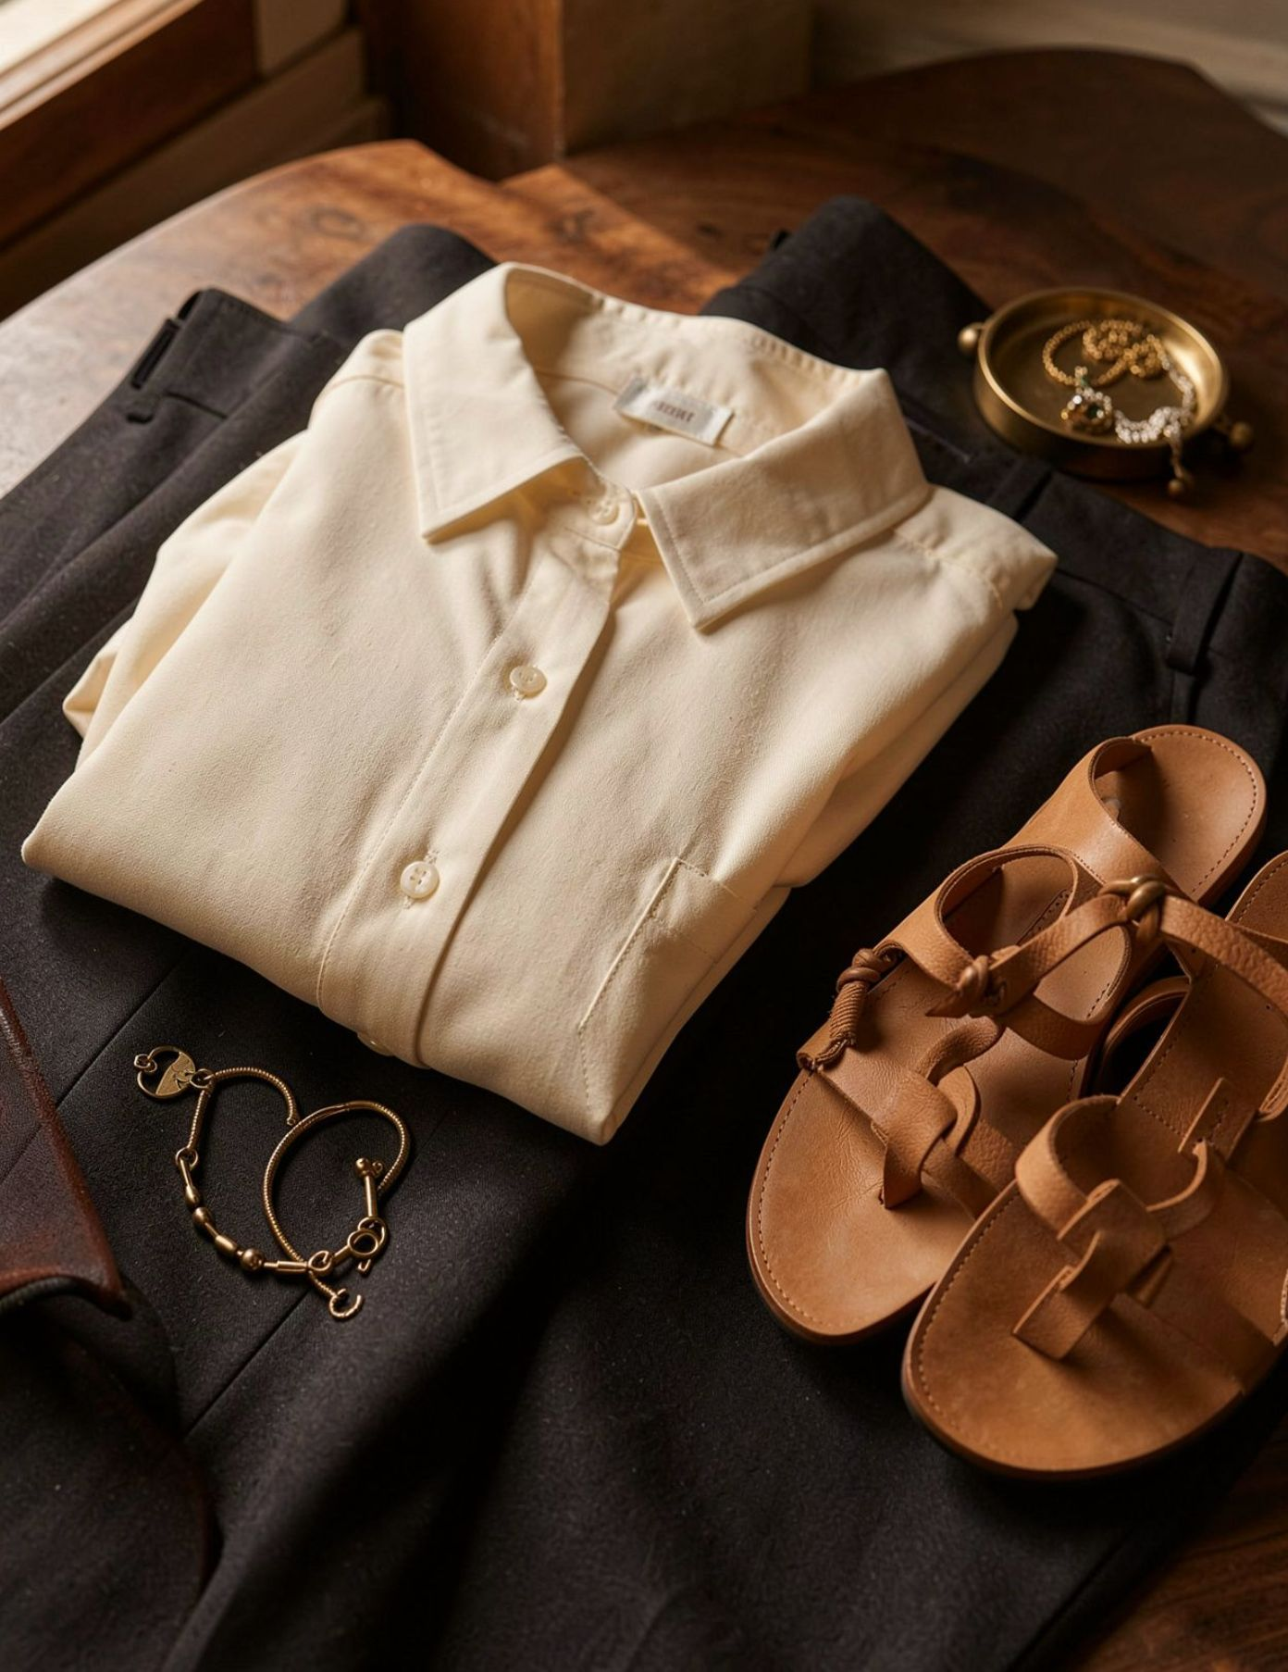
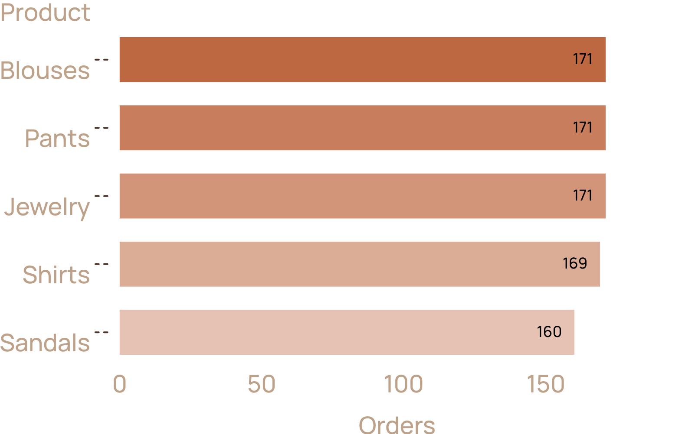
Clothing is the commercial anchor
Clothing produces nearly half of revenue.
Keep depth in blouses and pants, tied at 171 orders, with shirts close behind at 169. Jewelry adds scale at 171 orders and sandals at 160.

Slide 7
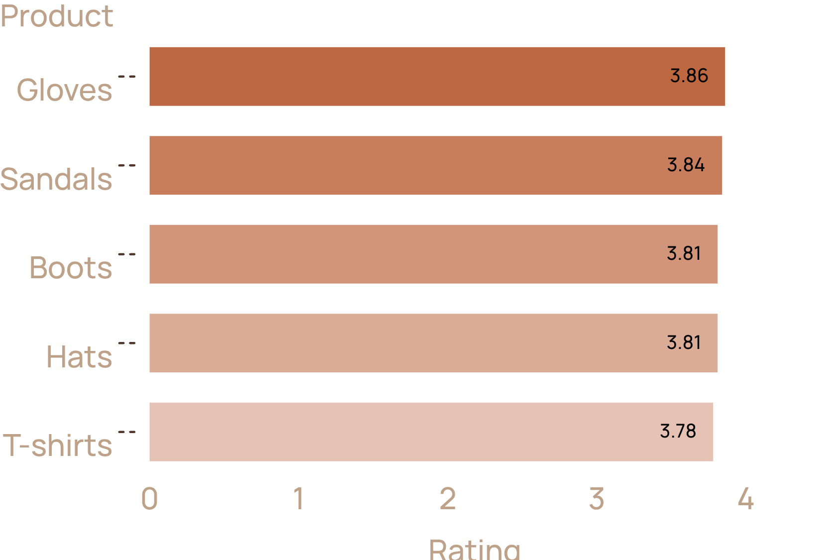
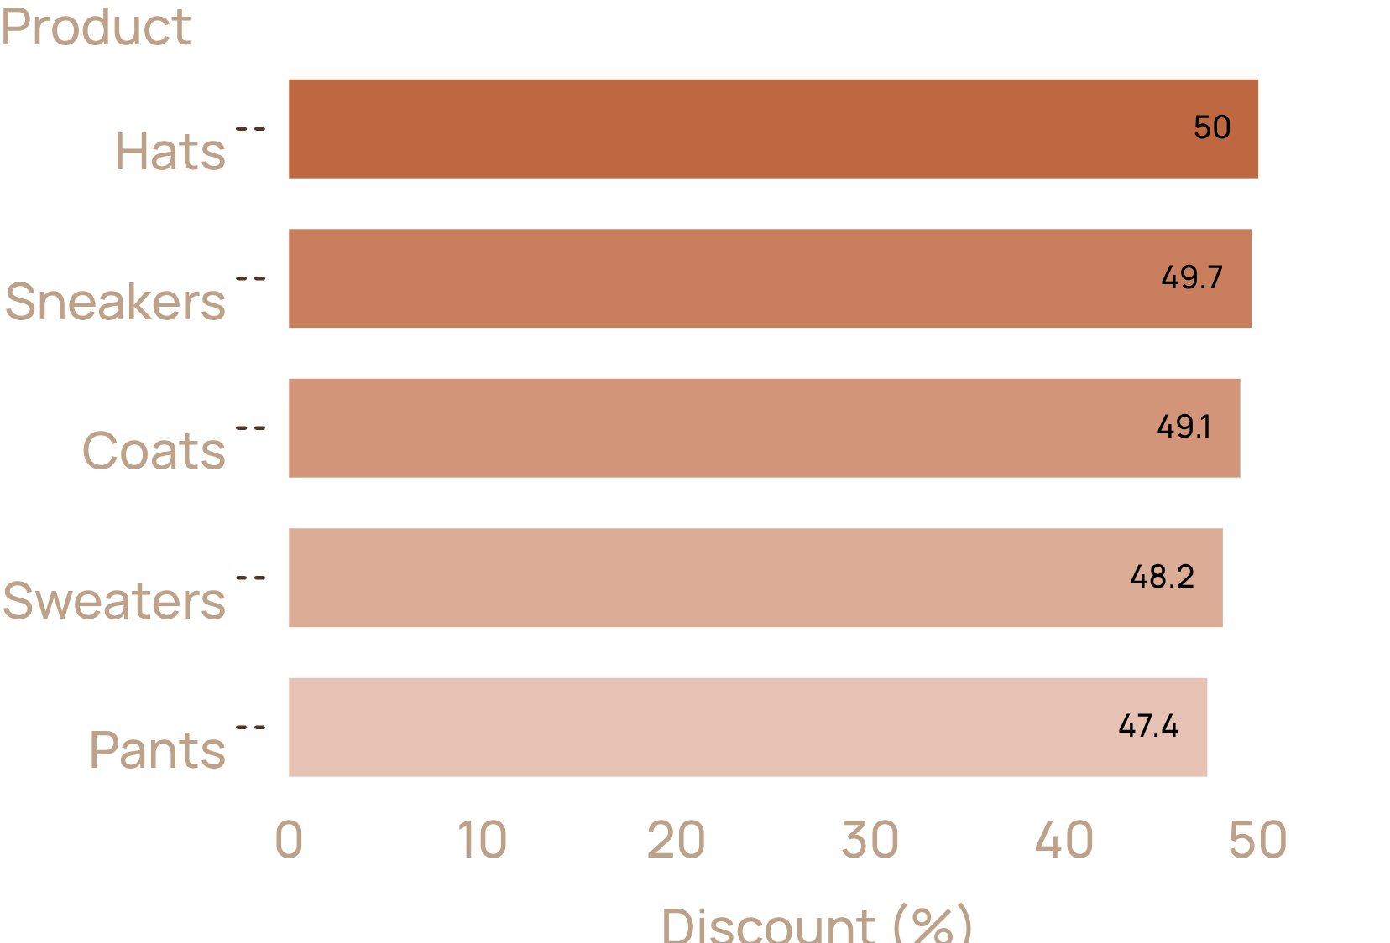
No single product or promotion dominates
Use the portfolio view, not a single “winner” product story.
Highest-rated products
Top discount rates

Slide 8
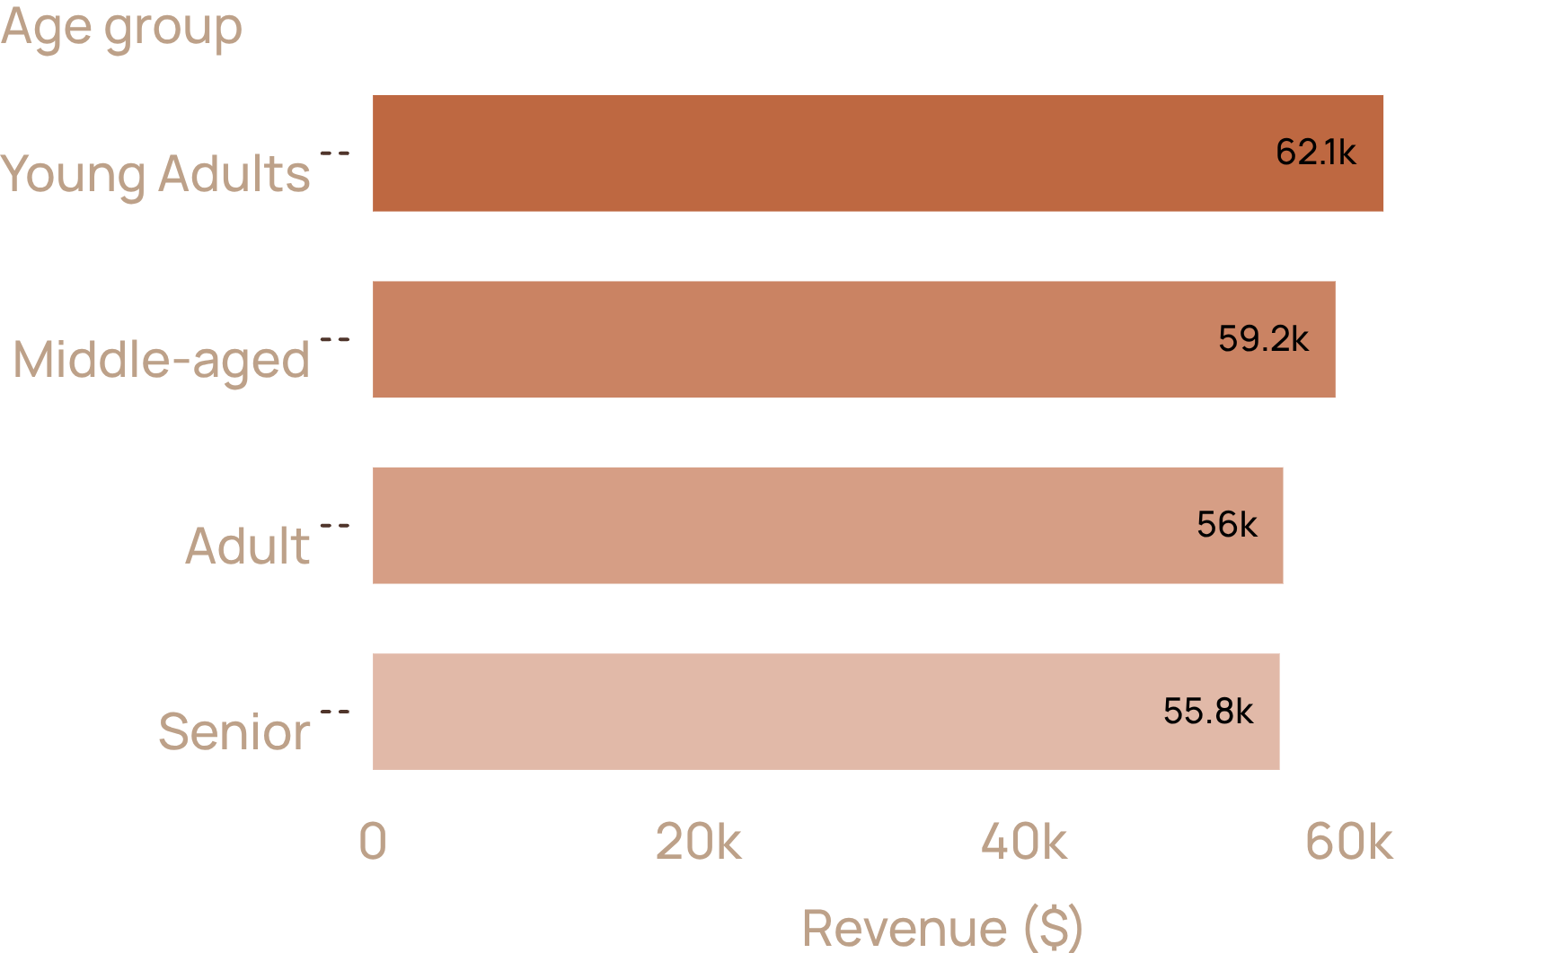
Age and shipping are secondary levers
Both differences are too small to anchor the commercial strategy.
$60.48
$58.46
Express average purchase
Standard average purchase
Young Adults lead revenue at $62,143, followed by Middle-aged $59,197, Adult $55,978, and Senior $55,763.

Slide 9
Three actions follow from the evidence
01
02
03
Treat clothing as the core range
Redesign the subscription
Validate the discount field
Protect availability in the leading items.
Build a clearer benefit; current membership is not lifting spend.
Then keep age and shipping as supporting views.

