Slide 1
DATA ANALYTICS · FINTECH
UPI Payments
Analytics & Fraud Detection
How 550K transaction records become operational, risk, customer, and retention insights.

Slide 2




THE DECISION SYSTEM
A payment dataset becomes a decision system
From transaction performance to customer retention.
Measure transaction performance and value.
Find failure, reversal, pending, and fraud-labelled patterns.
Segment customers and explore acquisition and retention.
Deliver the findings through interactive Power BI reporting.
02

Slide 3
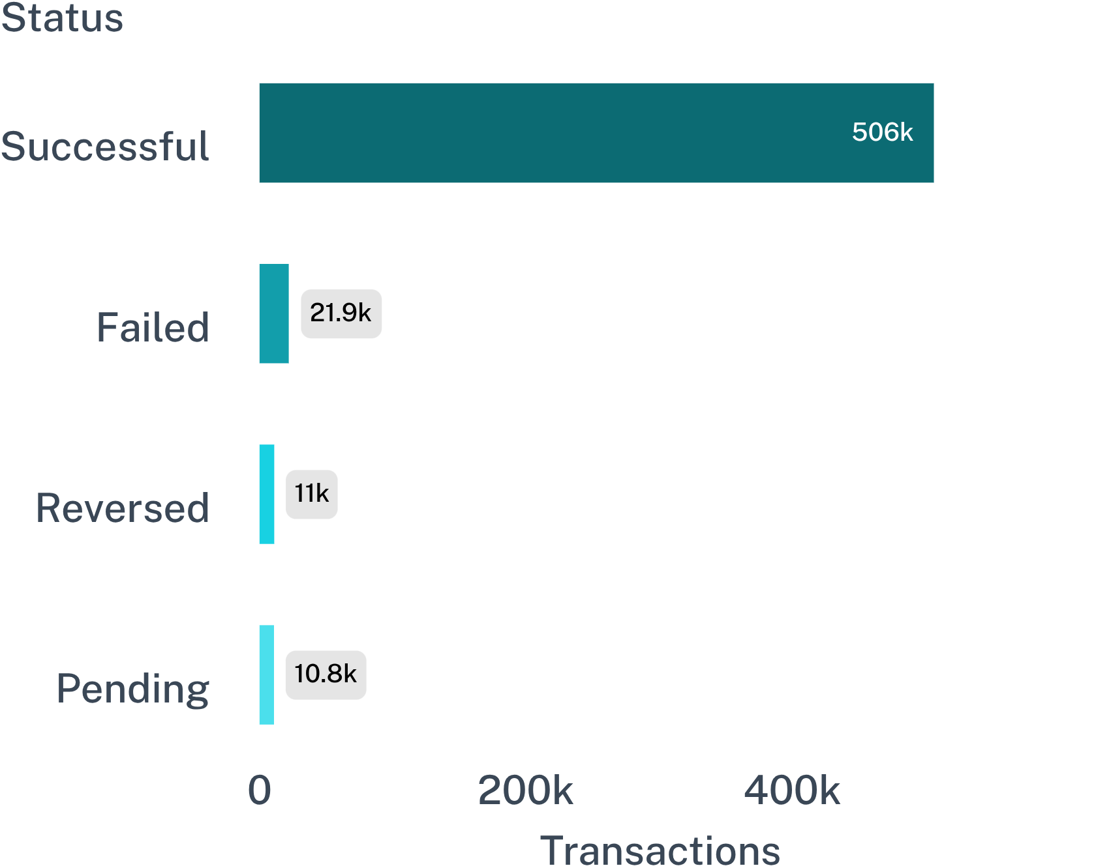
DATASET STARTING POINT
The project starts with 550K transaction records
550,000
79,916
total transactions
unique customers
506,247
21,905 failed
successful transactions
11,019 reversed · 10,829 pending
Successful transactions dominate the dataset, while failed, reversed, and pending states define the operational tail.
03

Slide 4
ANALYTICAL WORKFLOW
The workflow moves from raw records to business insight
1
2
Understand
Clean and standardise
Understand the data structure, types, distributions, and quality issues.
Clean and standardise fields; create transaction-status indicators.
3
4
Engineer
Query, visualise, validate, and publish
Engineer customer-level features for RFM and cohort analysis.
Query, visualise, validate, and publish the findings.
04

Slide 5




Python, PostgreSQL, SQL, and Power BI divide the work
Python
PostgreSQL + SQL
Cleaning, transformation, feature engineering, and exploration.
Storage, analytical queries, window functions, and exports.
Power BI
Git & GitHub
Interactive reporting for performance, risk, customers, and retention.
Version control for the project workflow.
05

Slide 6
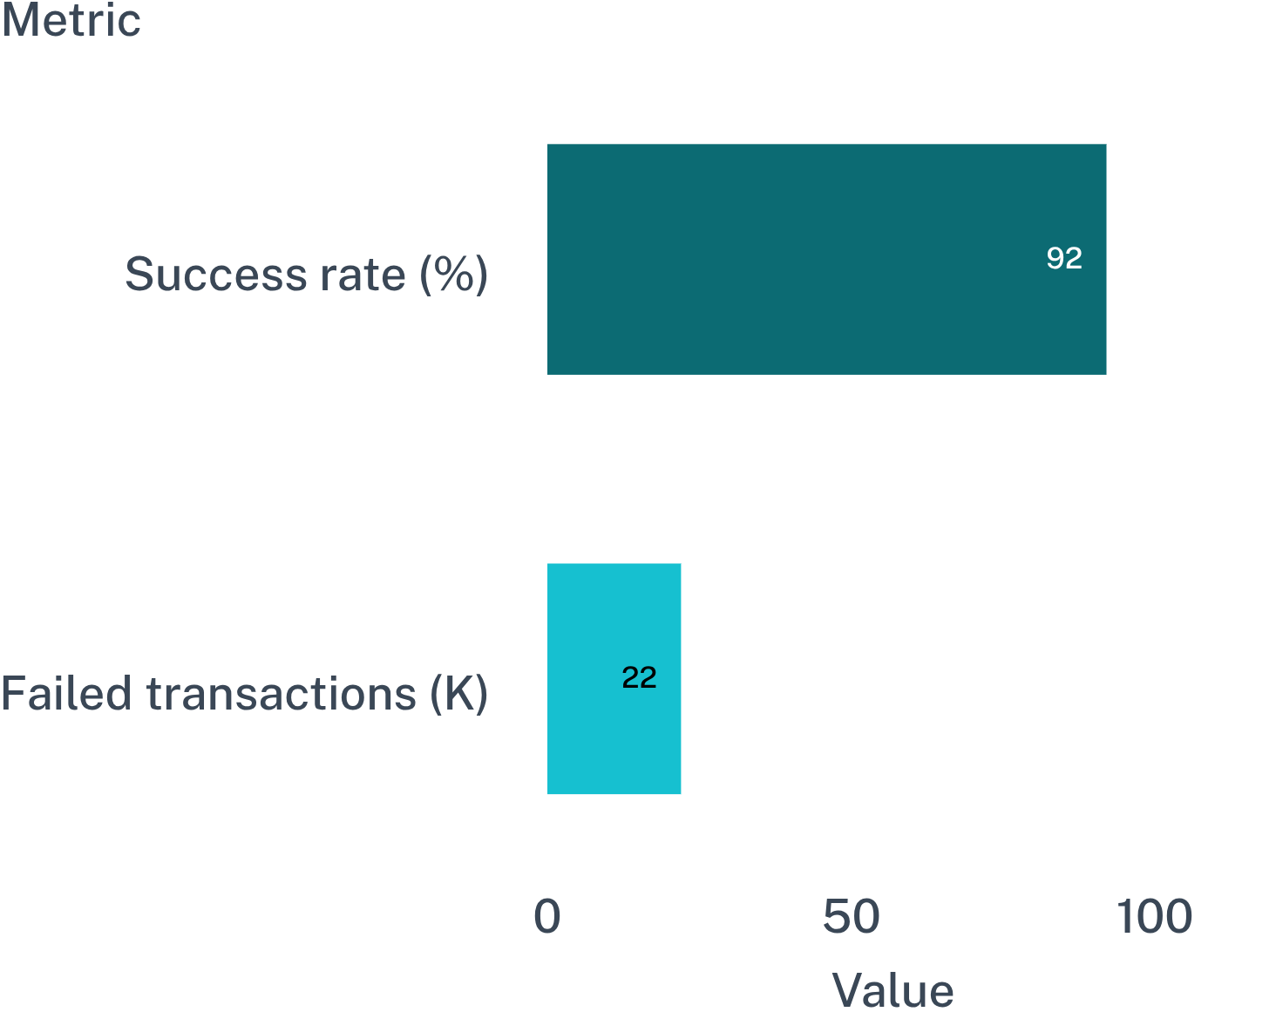
OPERATIONAL LENS
Payment performance is the first operational lens
Compare successful, failed, reversed, and pending outcomes. Break performance down by payment method, time, and geography. Use failure-rate patterns to identify where operational investigation should start.
The dashboard reports a rounded 92.0% success rate alongside 22K failed transactions; reconcile dashboard figures with source data before treating them as audited results.
06

Slide 7
RISK EXPLORATION
Fraud analysis is pattern exploration, not a production model
1
EXPLORE
2
COMPARE
3
Method boundary
Inspect the labelled transactions
Surface concentration patterns
The project uses the dataset’s existing fraud indicator; it does not independently train or verify a fraud model.
Review fraud-labelled transactions by state, payment method, and merchant category.
Compare fraud-labelled and non-fraud transactions to surface concentration patterns.
07

Slide 8



CUSTOMER SEGMENTATION
RFM segmentation turns transactions into customer groups
FIVE SEGMENTS
High Value · Loyal
Regular · At Risk · Inactive
Recency
Frequency
How recently a customer transacted.
How often a customer transacted.
Rule-based customer groups that connect transaction history to acquisition and retention analysis.
Monetary
How much a customer spent.
08

Slide 9






POWER BI REPORTING
The dashboard connects five views of the business
Interactive Power BI
Executive Overview
Customers
Payment Performance
Fraud & Risk
09

Slide 10
VALIDATION GATE
Dashboard metrics
Fraud findings
Depend on the supplied indicator, not verified ground truth.
Rounded for presentation; reconcile with the underlying datasets.
RFM classifications
Cohort retention
Useful analysis still needs validation before decisions
Rule-based.
Denominators require validation before business use.
10

