Slide 1
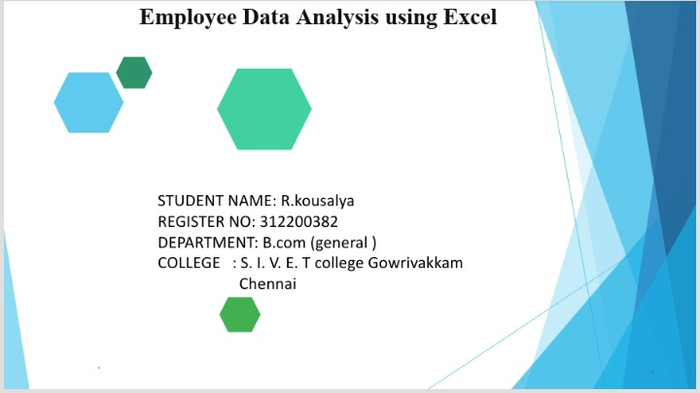
Employee Data Analysis using Excel
STUDENT NAME:
REGISTER NO:
DEPARTMENT:
COLLEGE

Slide 3

PROJECT TITLE
Employee Performance Analysis using Excel

Slide 4


AGENDA
Problem Statement
Project Overview
End Users
Our Solution and Proposition
Dataset Description
Modelling Approach
Results and Discussion
Conclusion
3/21/2024 Annual Review

Slide 5
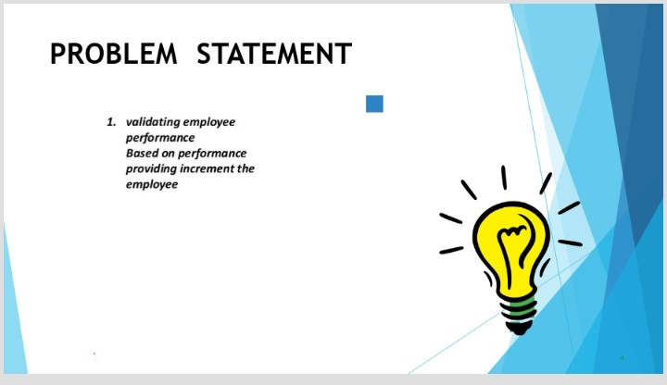

PROBLEM STATEMENT

Slide 6
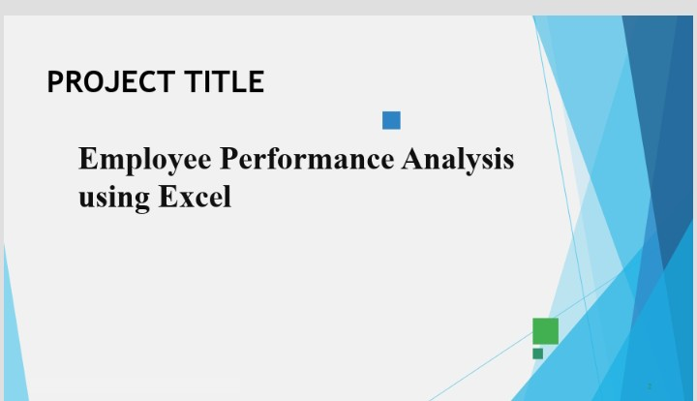

PROJECT OVERVIEW
.

Slide 7
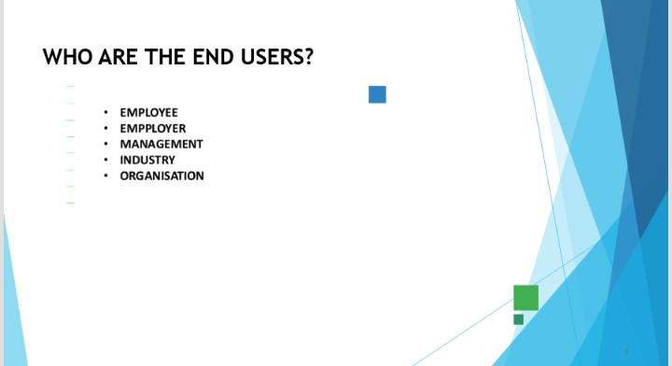

WHO ARE THE END USERS?

Slide 8
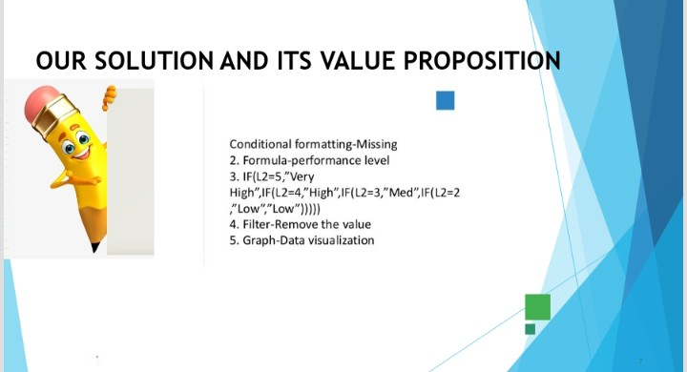

OUR SOLUTION AND ITS VALUE PROPOSITION

Slide 9
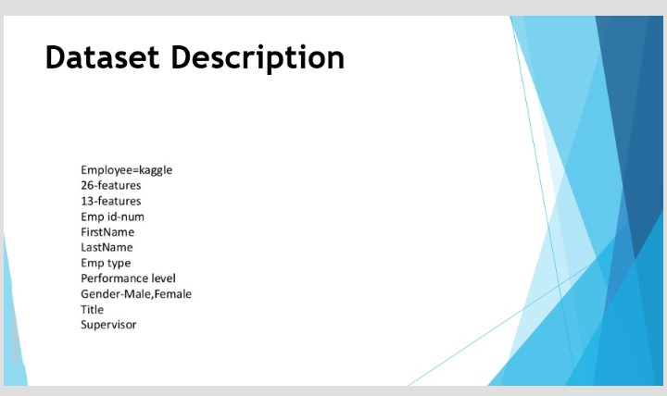
Dataset Description

Slide 10
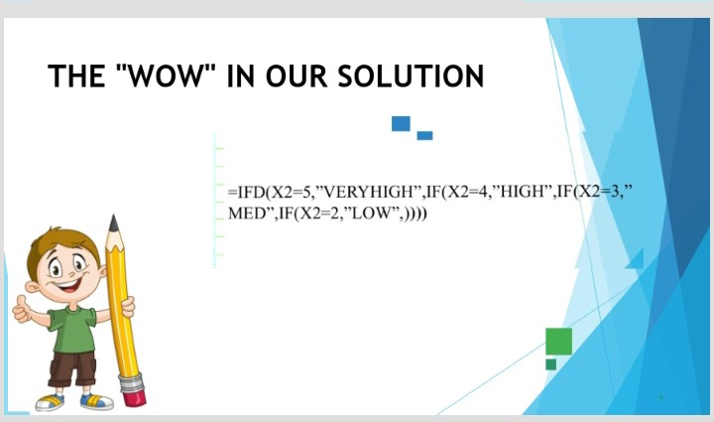

THE "WOW" IN OUR SOLUTION
3/21/2024 Annual Review
10

Slide 11
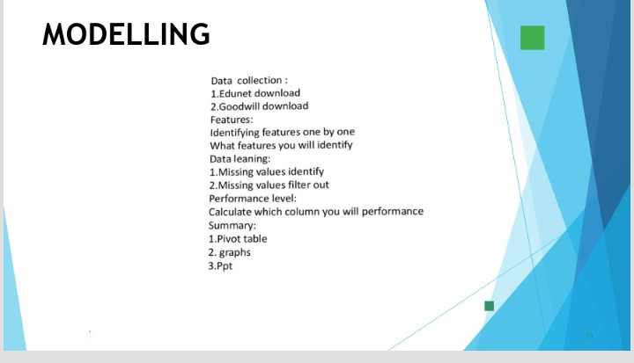
MODELLING
11

Slide 12
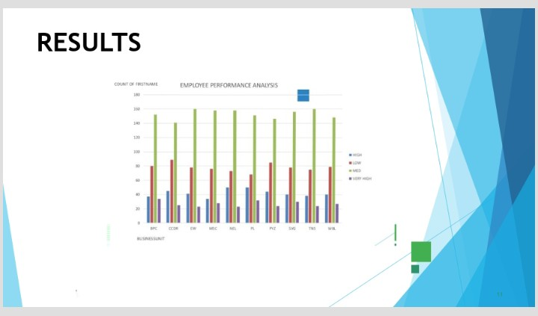
RESULTS
12

Slide 13
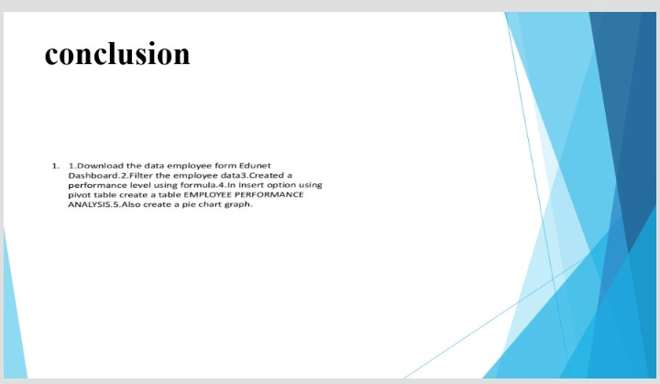
conclusion

