Slide 1
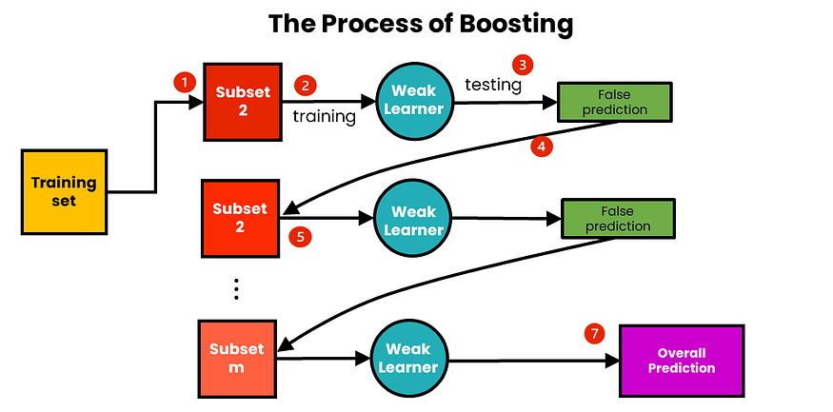
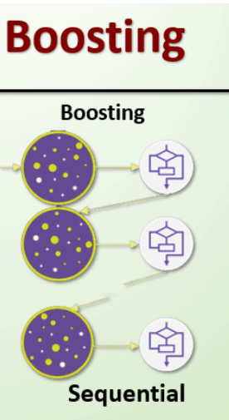
Boosting Algorithm

Slide 2
The following are the steps in the boosting algorithm:
Initialize weights: At the start of the process, each training example is given equal weight.
2.Train a weak learner: The weighted training data is used to train a weak learner. A weak learner is a simple model that outperforms random guessing only marginally. A decision tree with a few levels, for example, can be employed as a weak learner.
3.Error calculation: The error of the weak learner on the training data is computed. The weighted sum of misclassified cases constitutes the error.
4.Update weights: Weights are updated according to the mistake rate of the training examples. Misclassified examples are given higher weights, whereas correctly classified examples are given lower weights.
5.Repeat: Steps 2–4 are repeated several times. A new weak learner is trained on the updated weights of the training examples in each cycle.
6.Combine weak learners: The final model is made up of all of the weak learners that were trained in the preceding steps. The accuracy of each weak learner is weighted, and the final prediction is based on the weighted total of the weak learners.
7.Forecast: The finished model is used to forecast fresh instances’ class labels.

Slide 3
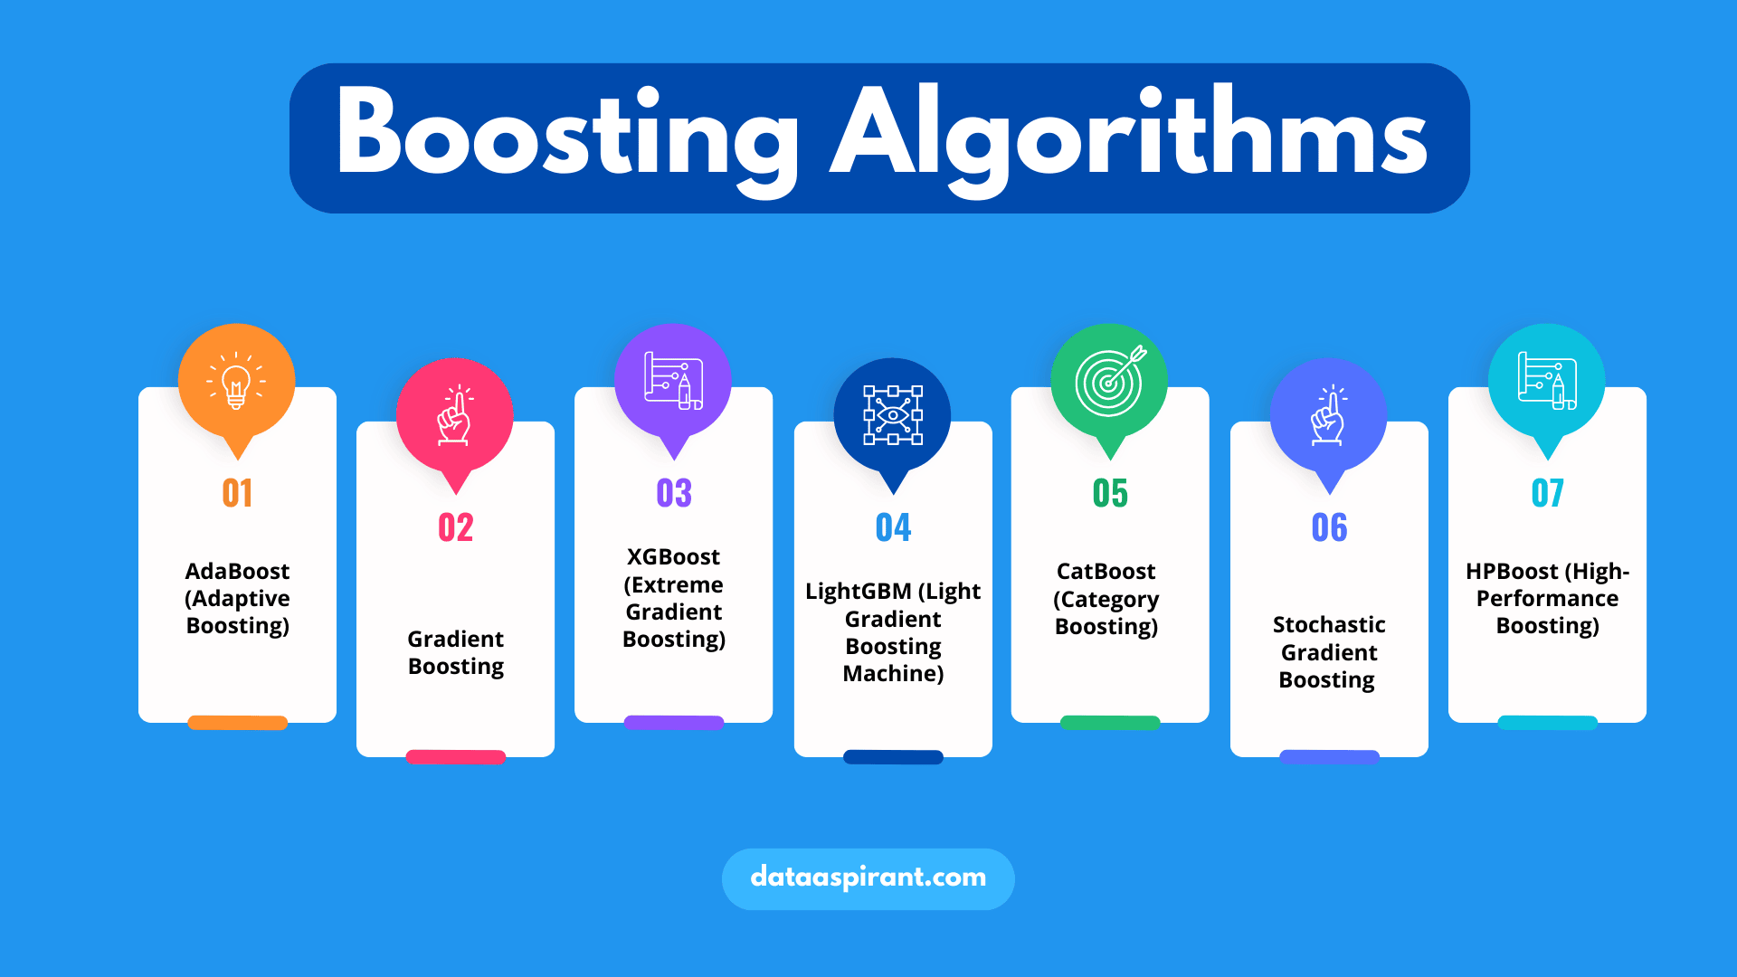

Slide 4
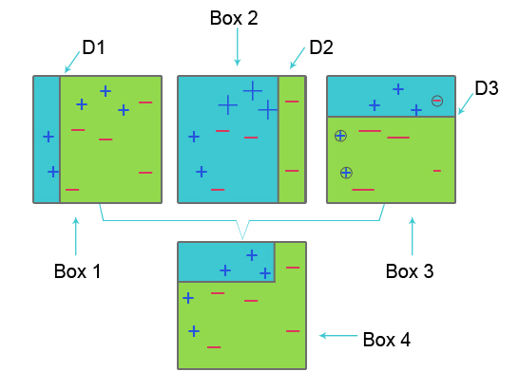
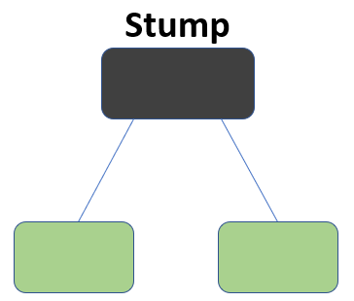
Adaptive Boosting / ADA Boosting
Adaptive Boosting as the weights are re-assigned to each instance, with higher weights assigned to incorrectly classified instances.

Slide 5
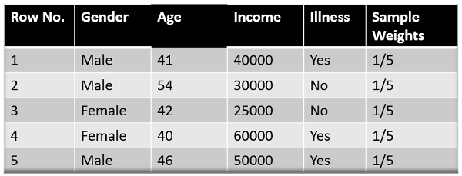
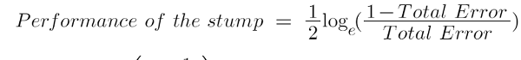

Adaptive Boosting / ADA Boosting
The formula to calculate the sample weights is:

Slide 6
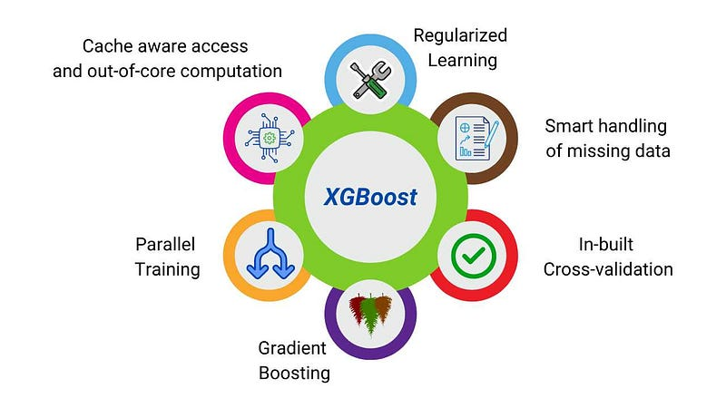
XG Boosting
Features Supported by XG Boosting
XGBoost or the Extreme Gradient boost is a machine learning algorithm that is used for the implementation of gradient boosting decision trees. Why decision trees? When we talk about unstructured data like the images, unstructured text data, etc., the ANN models (Artificial neural network) seems to reside at the top when we try to predict. While when we talk about structured/semi-structured data, decision trees are currently the best. XGBoost was basically designed for improving the speed and performance of machine learning models greatly, and it served the purpose very well.

Slide 7
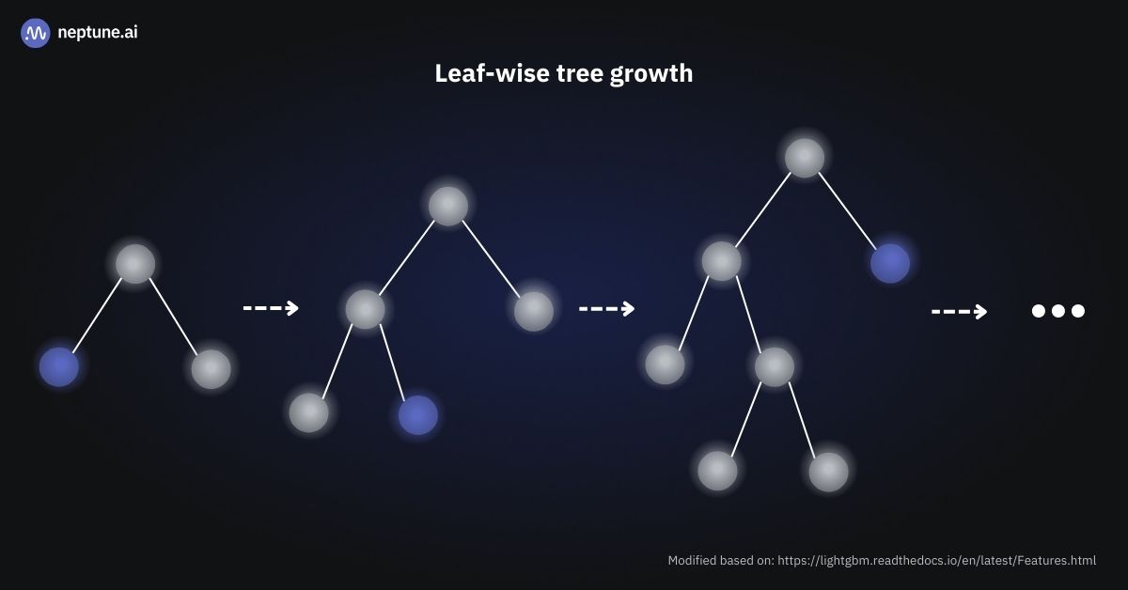
LG Boosting
LightGBM is an ensemble learning framework, specifically a gradient boosting method, which constructs a strong learner by sequentially adding weak learners in a gradient descent manner. It optimizes memory usage and training time with techniques like Gradient-based One-Side Sampling (GOSS).
LightGBM is a distributed high-performance framework that uses decision trees for ranking, classification, and regression tasks.

Slide 8
Advantages of Light GBM
Faster training speed and higher efficiency: Light GBM use histogram based algorithm i.e it buckets continuous feature values into discrete bins which fasten the training procedure.
Lower memory usage: Replaces continuous values to discrete bins which result in lower memory usage.
Better accuracy than any other boosting algorithm: It produces much more complex trees by following leaf wise split approach rather than a level-wise approach which is the main factor in achieving higher accuracy. However, it can sometimes lead to overfitting which can be avoided by setting the max_depth parameter.
Compatibility with Large Datasets: It is capable of performing equally good with large datasets with a significant reduction in training time as compared to XGBOOST.
Parallel learning supported.

