Slide 1
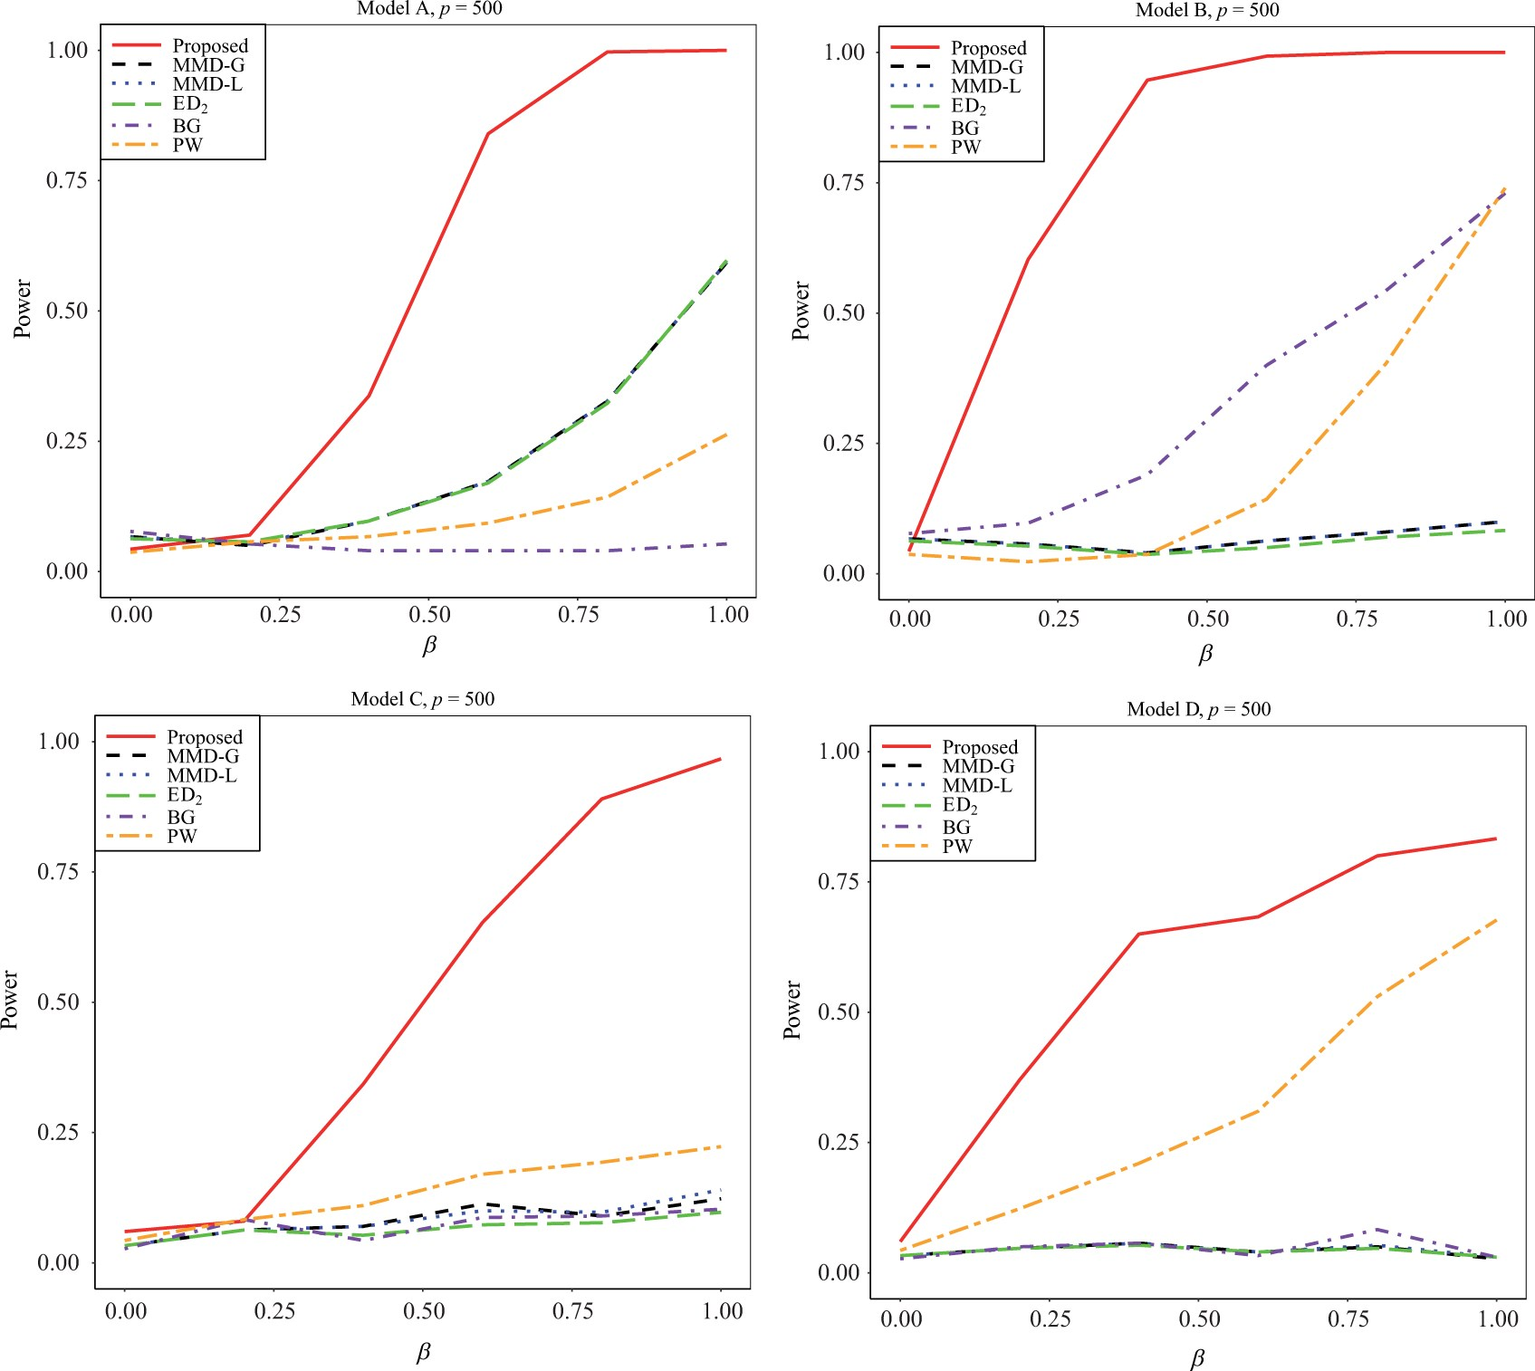

Figure 1: Empirical size ($ \beta=0 $) and power $ (\beta \gt 0) $ of the proposed method (red, solid line), the MMD ...
Notes:
Figure 1: Empirical size ($ \beta=0 $) and power $ (\beta \gt 0) $ of the proposed method (red, solid line), the MMD method (black, dashed line), the $ {\rm ED}_{1} $ method (blue, dotted line), the $ {\rm ED}_{2} $ method (green, long-dash line), the BG method (purple, dash-dot line) and the PW method (orange, long-dash–short-dash line) for different models with $ p=500 $. In Models A and B, MMD-G and MMD-L have almost identical performance and thus the power curve of MMD-L is masked by that of MMD-G.
Unless provided in the caption above, the following copyright applies to the content of this slide: © The Author(s) 2025. Published by Oxford University Press on behalf of Biometrika Trust. All rights reserved. For commercial re-use, please contact reprints@oup.com for reprints and translation rights for reprints. All other permissions can be obtained through our RightsLink service via the Permissions link on the article page on our site—for further information please contact journals.permissions@oup.com.This article is published and distributed under the terms of the Oxford University Press, Standard Journals Publication Model (https://academic.oup.com/pages/standard-publication-reuse-rights)

