Slide 1
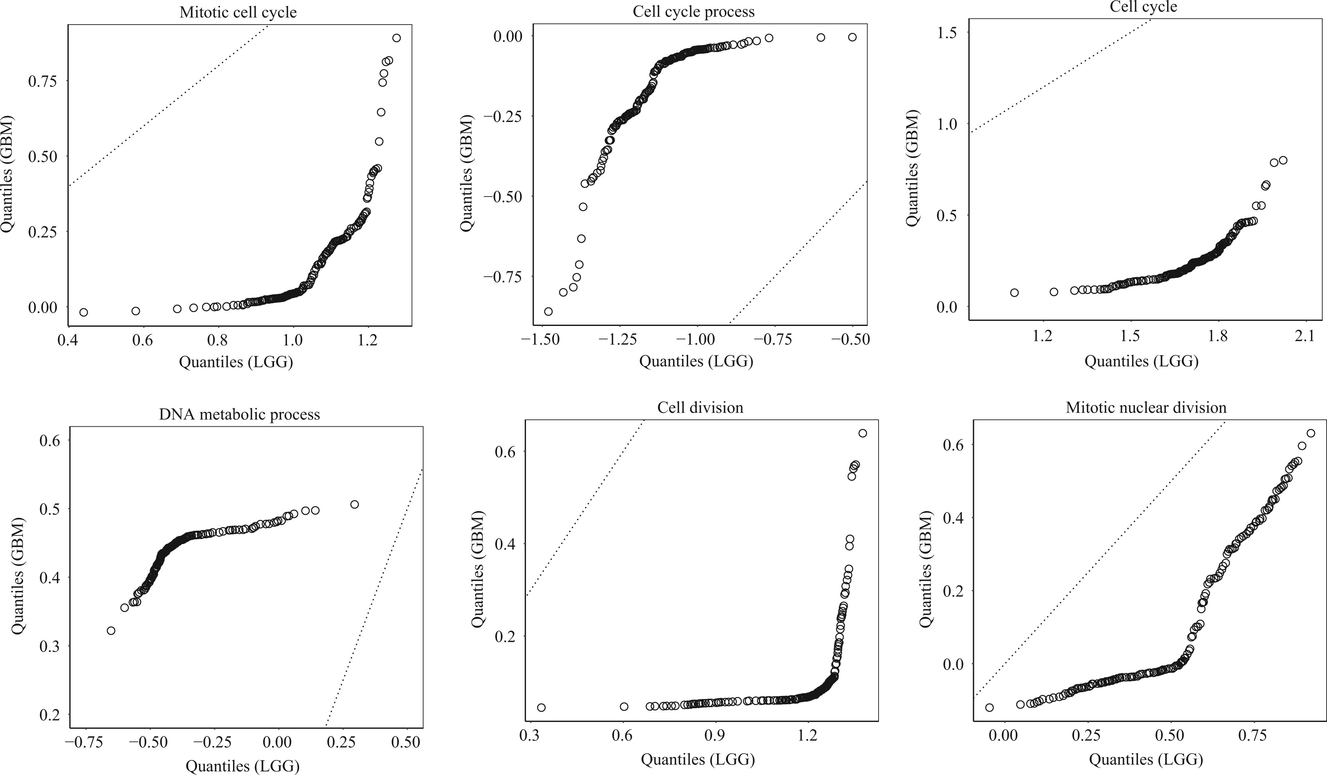

Figure 2: The quantile-quantile plots of the resulting two univariate distributions for different subsets of genes. The ...
Notes:
Figure 2: The quantile-quantile plots of the resulting two univariate distributions for different subsets of genes. The dashed line corresponds to the identity line $ y=x $.
Unless provided in the caption above, the following copyright applies to the content of this slide: © The Author(s) 2025. Published by Oxford University Press on behalf of Biometrika Trust. All rights reserved. For commercial re-use, please contact reprints@oup.com for reprints and translation rights for reprints. All other permissions can be obtained through our RightsLink service via the Permissions link on the article page on our site—for further information please contact journals.permissions@oup.com.This article is published and distributed under the terms of the Oxford University Press, Standard Journals Publication Model (https://academic.oup.com/pages/standard-publication-reuse-rights)

