Slide 1
Flight delay prediction Using Machine Learning techniques
Shiva Teja Chintala

Slide 2
Introduction
Flight delays impact airports, passengers, and airlines. Being able to estimate how long a flight will be delayed will save passengers valuable time as well as inconveniences caused by flight delays or, in worst-case scenarios, cancellations.
Project aim is to develop a solution that can precisely forecast flight delays based on certain flight characteristics
Being able to effectively estimate flight delays can assist travelers understand what delays to expect depending on where they fly from and the airlines they choose to fly with. This allows them to take a buffer and avoid missing connecting flights or meetings.
The project's purpose will be to perform in-depth data analysis and experiment with input features to evaluate how prediction accuracy changes. Because air travel is so complicated, it is challenging to create prediction models that work well.

Slide 3
Problem Statement
The goal is to first predict the arrival delay the flight will incur including the departure delay as one of the features. Then the departure delay feature will be dropped, and its performance will be evaluated by predicting it with the help of the other features.
In addition, the plan is to also run some regression and classification models to see how they does on our data set.

Slide 4
Data Source
In this project, The dataset is taken from Kaggle which is freely available. Flight Delay Prediction uses data from the DOT's Bureau of Transportation statistics.
The data is in CSV format, and it has 31 Features.
This dataset has information about flights from 2015, and it contained the flowing information about the flights Year, Month, Day, Day Of Week, Airline, Flight Number , Tail Number, Origin Airport, Destination Airport, Scheduled Departure, Departure Time, Departure Delay, Taxi Out, Wheels Off, Scheduled Time, Elapsed Time, Air Time, Distance, Wheels On, Taxi In, Scheduled Arrival, Arrival Time, Arrival Delay, Diverted, Cancelled, Cancellation Reason, Air System Delay, Security Delay, Airline Delay, Late Aircraft Delay, Weather Delay.
The dataset has rows 5819079 and 31 columns.

Slide 5
Preprocessing
Importing Libraries: The code starts by importing libraries such as pandas, NumPy, seaborn, matplotlib, and scikit-learn. These libraries are used to manipulate data, visualize data, and perform machine learning.
Loading Data: The code loads flight-related data from CSV files into pandas Data Frames, including information on flights, airports, and carriers.
Handling missing values – The dataset contains small percentage of missing values for certain columns like Departure delay, taxi out and so on. These rows containing missing values are dropped as they make up a very small portion of the dataset.
Formatting times – Initially the times in the dataset are in the form of 4-digit numbers which are not of much use, so these are transformed into HH:MM format. New columns which have the formatted time are created for Departure time, Scheduled arrival, Scheduled departure and arrival time.
Feature selection - Some of the features are not really needed for the prediction of delays so they are dropped.
Label Encoding – Some of the features are in the form of a string these were converted to number values using Label encoder

Slide 6
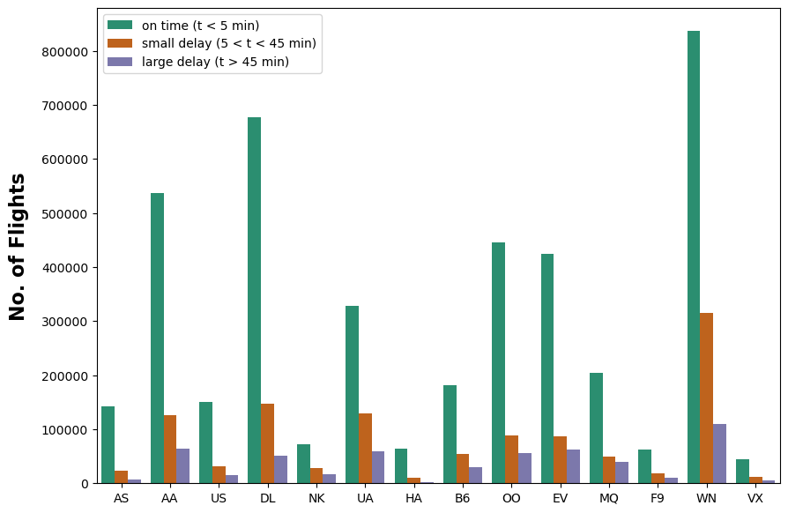
Data visualization
The graph below represents various airline operators and the number of flights that were delayed in comparison to those that were on time.

Slide 7
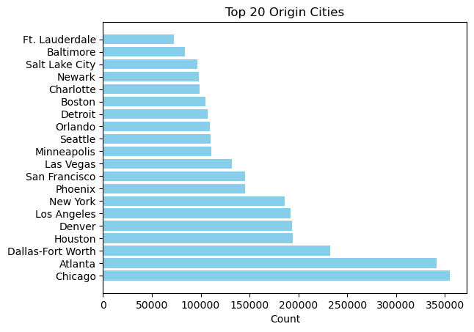
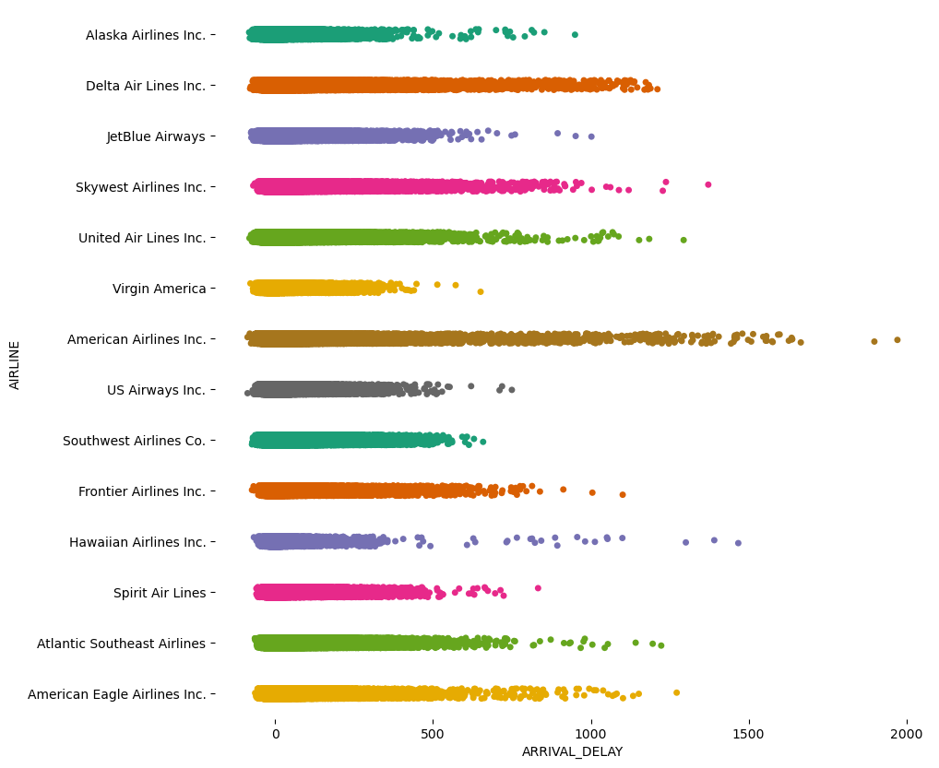
Top 20 cities flight counts
Arrival Delay of the airlines

Slide 8
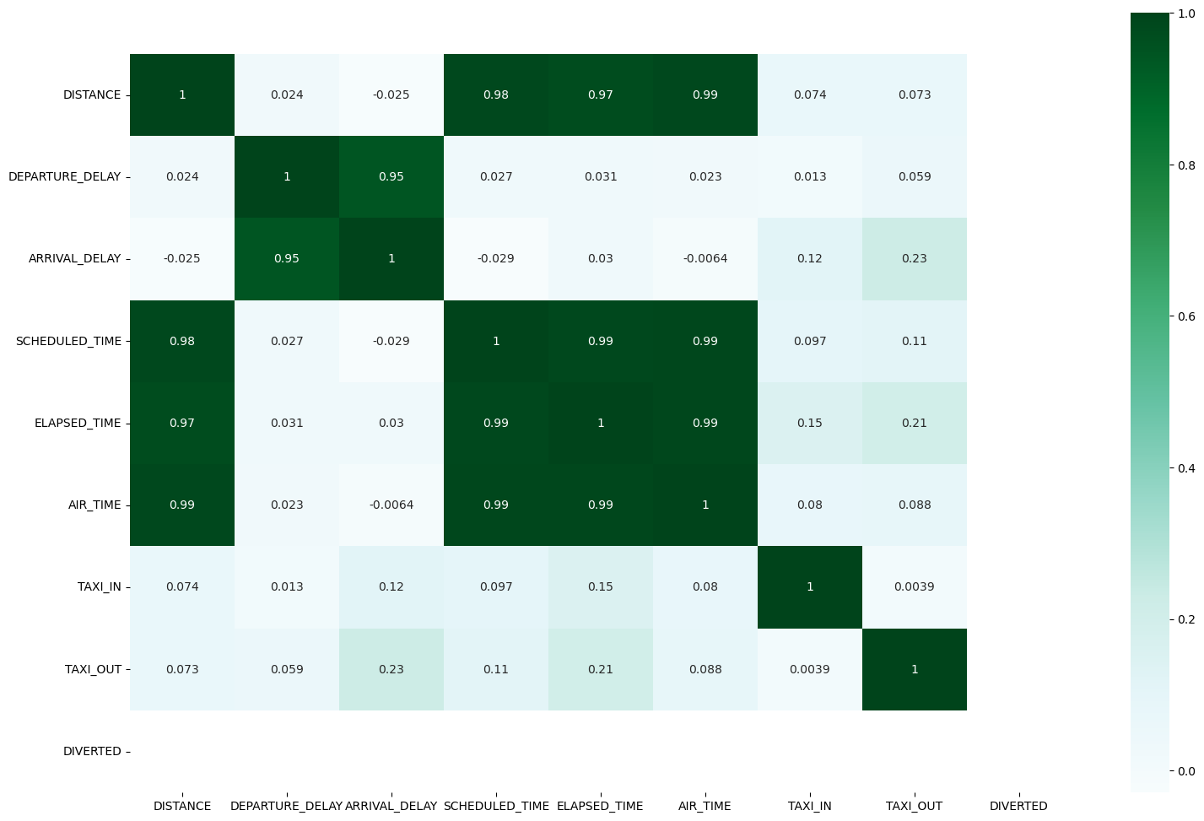
The correlation matrix provides valuable information about which variables are related to one another.
We can clearly see there is a high correlation in between the departure delay and arrival delay.

Slide 9
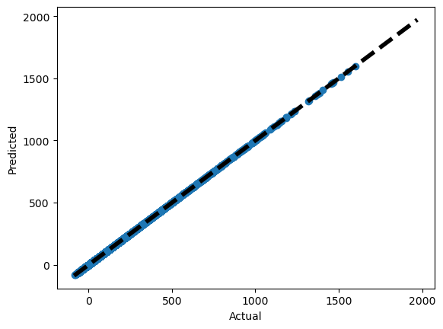
Machine Learning Model Regression analysis
Linear Regression Model: The linear regression model appears to perform exceptionally well, achieving very low values for MAE, MSE, and RMSE. The R2 score is close to 1, indicating a good fit.
MAE: 1.532789208539483e-06
MSE: 3.0655780798900293e-06
RMSE: 0.0017508792305267742
R2: 0.9999999980588673

Slide 10
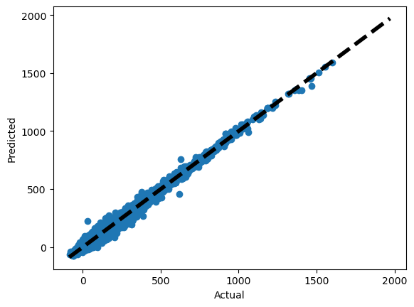
Decision Tree Regression: The decision tree regression model performs well but has higher error metrics compared to linear regression. It may be prone to overfitting.
MAE: 0.4964235356691502
MSE: 3.4596012873128745
RMSE: 1.8600003460518157
R2: 0.997809370634772

Slide 11
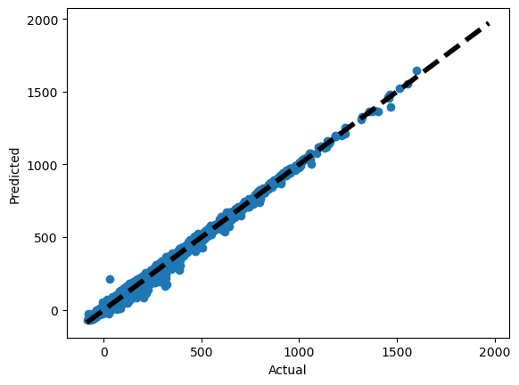
Random Forest Regression: The random forest regression model shows improved performance over a single decision tree, with lower error metrics.
MAE: 0.4964235356691502
MSE: 3.4596012873128745
RMSE: 1.8600003460518157
R2: 0.997809370634772

Slide 12
Boosted Linear Regression: The boosted linear regression model, using AdaBoost, achieves similar results to the linear regression model, indicating that boosting does not significantly improve performance in this case.
MAE: 1.532789634527544e-06
MSE: 3.0655780798915214e-06
RMSE: 0.0017508792305272003
R2: 0.9999999980588673

Slide 13
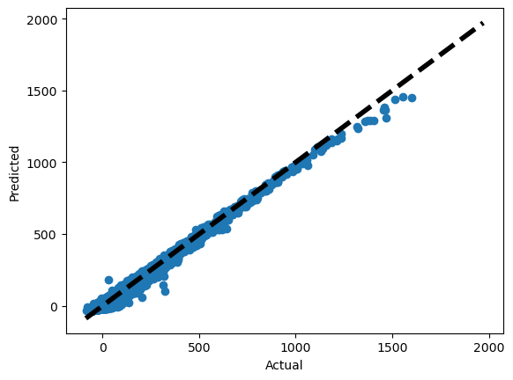
Gradient Boosting Regression: While gradient boosting performs well, it has higher error metrics compared to linear regression. The model might benefit from further tuning or feature engineering.
MAE: 5.507361175576461
MSE: 58.27132462996541
RMSE: 7.633565656360428
R2: 0.9631024316723275

Slide 14
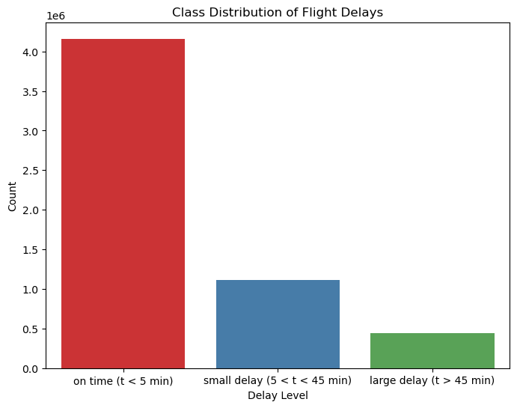
Classification Analysis
The dataset we have is imbalanced, in that it contains approximately 80% of flights that had no delay and only 20% of flights that had a delay. To balance the class, a technique known as Synthetic Minority Over-sampling Technique (SMOTE) was used. This technique over samples from the class in minority, generating 'fake' samples that resemble those of the class in minority. This is essential because our algorithm could simply predict 'no' all the time and still achieve an accuracy of 80%. A representation of the class distribution as seen in the original dataset is shown in the Figure.

Slide 15
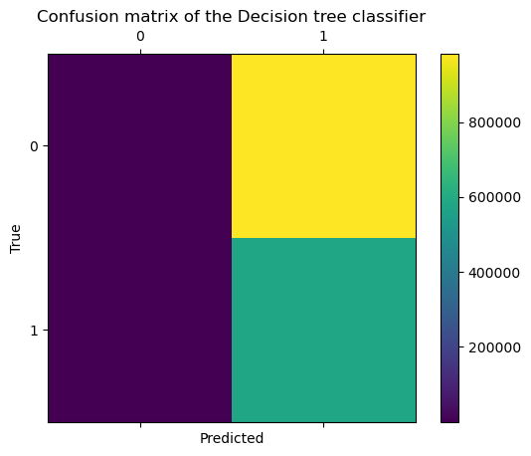
Decision Tree Classifier: The Decision Tree Classifier achieved a high accuracy but shows imbalanced performance in terms of precision, recall, and F1 score. The model seems to be biased towards the majority class
array([[ 1317, 982209],
[ 60, 582188]])
Accuracy Score: 0.9829330414223253
F1 Score: 0.2725455149332318
Precision Score: 0.6642877585986505
Recall Score: 0.5006180053981708

Slide 16
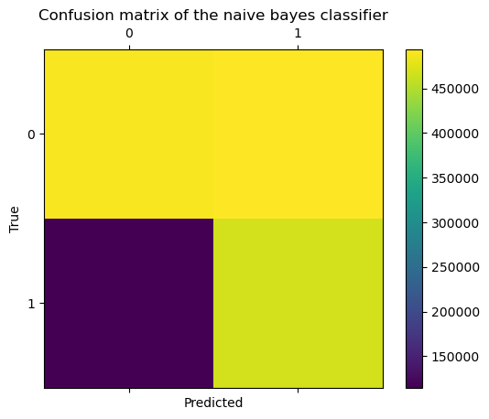
Naive Bayes Classifier: The Naive Bayes Classifier shows decent accuracy and balanced performance in terms of precision, recall, and F1 score. It performs well in capturing patterns in the data.
array([[489939, 493587],
[115066, 467182]])
Accuracy Score: 0.8398344844147367
F1 Score: 0.6111944650038017
Precision Score: 0.6480341198535507
Recall Score: 0.6502608775577009

Slide 17
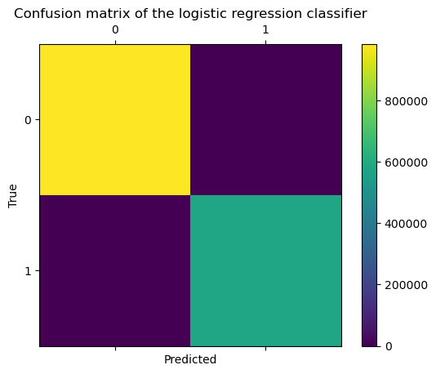
Logistic Regression Classifier: The Logistic Regression Classifier achieves 100% accuracy and an F1 score, indicating a good fit to the data. Nothing has been misclassified, and all the scores are perfect. After SMOTE and preprocessing, this model perfectly fits this dataset. This is a significant improvement over previous methods.
array([[983526, 0],
[ 0, 582248]])
Accuracy Score: 1.0
F1 Score: 1.0
Precision Score: 1.0
Recall Score: 1.0

Slide 18
Model Comparison
Linear Regression and Boosted Linear Regression exhibit nearly identical performance with extremely low error metrics and a near-perfect R2 score.
Depending on the specific requirements, the choice between Linear Regression and Boosted Linear Regression can be made.
Logistic Regression Classifier achieved perfect scores for all metrics, indicating a flawless fit to the data.
Based on this we can to some extent conclude that the variables have a linear relation in between them, as in both classification as well as regression the techniques that aim to find linear relations performed the best.

Slide 19
Challenges and Learnings
The project encountered difficulties in dealing with missing data, transforming features, addressing imbalanced classes, selecting appropriate models.
The importance of carefully examining the data, recognizing important characteristics, and resolving class imbalance using oversampling are among the interesting things to learn.
The project demonstrates the complexity and specifics of developing robust machine learning models for flight delay prediction.

Slide 20
Conclusion and Future Work
The project explored various aspects of flight delay prediction, including data preprocessing, exploratory data analysis, and the application of regression and classification models.
Even with a simple set of input parameters, these simple algorithms could predict delays with high accuracy. Although good results were obtained, there is a lot more work to be done in the future.
If weather and air traffic control information are made available, we can predict arrival delay even if departure delay is not included as an attribute. We can also predict whether a flight will be delayed or cancelled based on weather factors such as snow, rain, storms, and so on.

Slide 21
References
Javier Herbas ,”Using machine learning to predict flight delays” Oct 17, 2020,
https://medium.com/analytics-vidhya/using-machine-learning-to-predict-flight-delays-e8a50b0bb64c
2. M. Lu, P. Wei, M. He and Y. Teng, "Flight delay prediction using gradient boosting machine learning classifiers," Journal of Quantum Computing, vol. 3, no.1, pp. 1–12, 2021.
Data set: https://www.kaggle.com/datasets/usdot/flight-delays/data

Slide 22
THANK YOU

