Slide 1
Evaluating Trading Decisions for EUR/INR: Insights from Technical Indicators
Satya Kowshik
Notes:
Good morning professor and everyone!
Myself, Dharmendra Hingu and she is Harnisha Gevaria, he is Kushal Gevaria.
Today we will demonstrate our project on Foreign currency prediction.

Slide 2
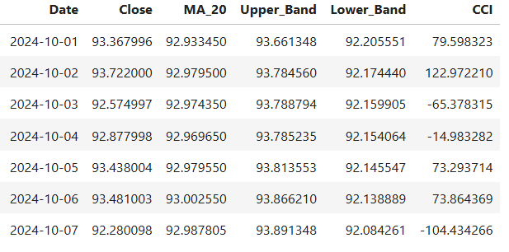
Methodology
Our main objective is to build a model that can predict the exchange rate for future days between two currencies.
Decision Tree Machine learning model is utilized to get the rates for 1 week from sep 30 2024.
Notes:
Now, lets spend little bit time on how we can achieve this?
Our main objective here is to build a system can predict the exchange rate for the next day or any number of future days between the two currencies.
We propose two models,
First using Neural Network and second using a statistical method model namely ARIMA.

Slide 3
Decisions Based on Indicators - MA
Date | Close | Moving_Average | Decision
2024-10-01 | 93.367996 | 92.933450 | Sell
2024-10-02 | 93.722000 | 92.979500 | Sell
2024-10-03 | 92.574997 | 92.974350 | Buy
2024-10-04 | 92.877998 | 92.969650 | Buy
2024-10-05 | 93.438004 | 92.979550 | Sell
2024-10-06 | 93.481003 | 93.002550 | Sell
2024-10-07 | 92.280098 | 92.987805 | Buy

Slide 4
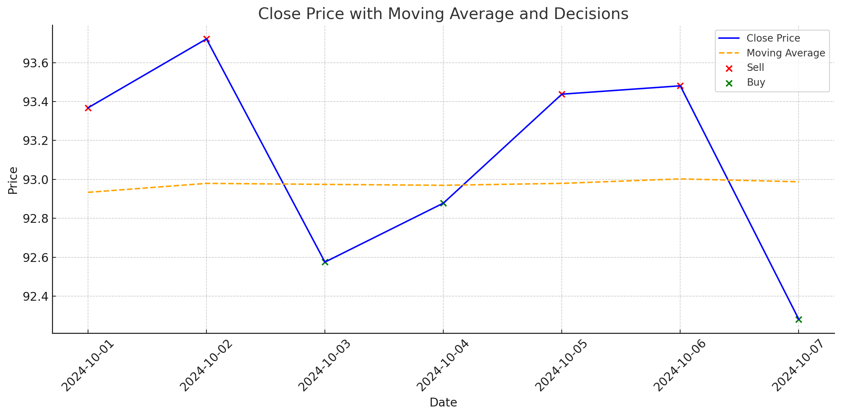

Slide 5
BOLLINGER bANDS
Date | Close | Upper_Band | Lower_Band | Decision
2024-10-01 | 93.367996 | 93.661348 | 92.205551 | Neutral
2024-10-02 | 93.722000 | 93.784560 | 92.174440 | Sell
2024-10-03 | 92.574997 | 93.788794 | 92.159905 | Neutral
2024-10-04 | 92.877998 | 93.785235 | 92.154064 | Neutral
2024-10-05 | 93.438004 | 93.813553 | 92.145547 | Neutral
2024-10-06 | 93.481003 | 93.866210 | 92.138889 | Neutral
2024-10-07 | 92.280098 | 93.891348 | 92.084261 | Neutral

Slide 6
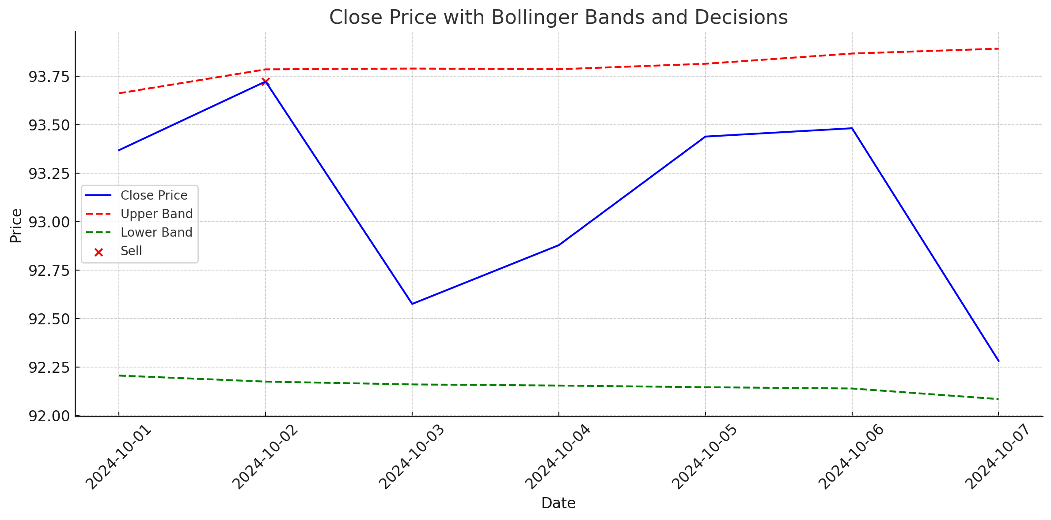

Slide 7
Commodity channel index
Date | Close | CCI | DECISON
2024-10-01 | 93.367996 | 79.598323 | Neutral
2024-10-02 | 93.722000 | 122.972210 | Sell
2024-10-03 | 92.574997 | -65.378315 | Neutral
2024-10-04 | 92.877998 | -14.983282 | Neutral
2024-10-05 | 93.438004 | 73.293714 | Neutral
2024-10-06 | 93.481003 | 73.864369 | Neutral
2024-10-07 | 92.280098 | -104.434266 | Buy

Slide 8
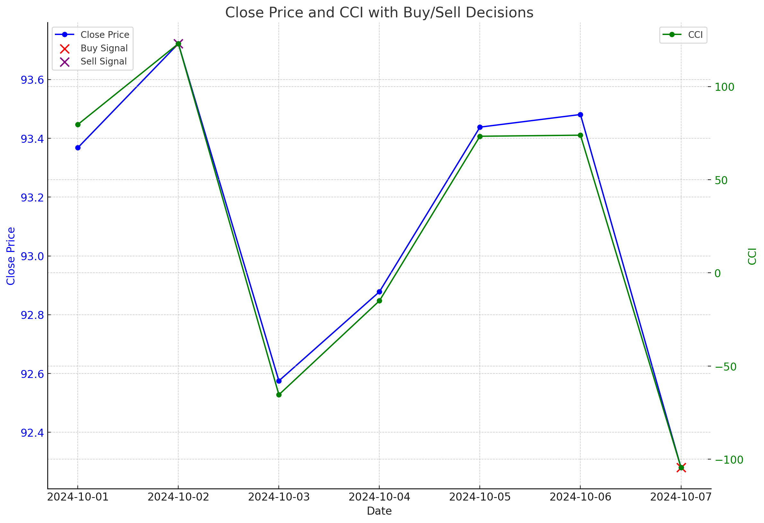

Slide 9
Assumptions and Reasoning
The model was prepared assuming that we do not have access to the data after September 30 2024
While calculating CCI Closing price was assumed as typical price.
Reasons for the decisions
Moving Average
Buy: If the "Close" price is below the "Moving_Average,“.
Sell: If the "Close" price is above the "Moving_Average,".
Neutral: If the "Close" price is very close to the "Moving_Average“.

Slide 10
Assumptions and Reasoning
BOLLINGER BANDS
Buy: If the "Close" price is near or below the "Lower_Band,“.
Sell: If the "Close" price is near or above the "Upper_Band,“.
Neutral: If the "Close" price is between the bands.
Commodity channel index
CCI > 100: Indicates a potential overbought condition; a Sell signal.
CCI < -100: Indicates a potential oversold condition; a Buy signal.
100>=CCI>=-100: Neutral signal.

