Slide 1
MongoDB
Amit Fegade
601.01.13

Slide 2
What is NoSQL?
Generic term …
… for various non-relational database alternatives

Slide 3
Modern Applications Require…
Storage and handling of huge volumes of data
Twitter (March 2013): 200 million active users, 400 million tweets per day
Facebook (April 2014): 300 PB of data as on that date; >600 TB of data per day
Wal-Mart: 1 million customer transactions per hour
And the grand-daddy of all: Google
RDBMS: Big challenge
RDBMS: Scalability beyond to a point is not practical or economical

Slide 4
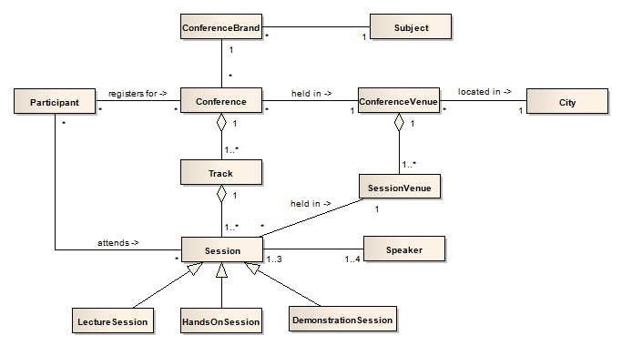
Modern Applications Require…
Storage and handling of huge volumes of data
Very high level of performance
RDBMS: Lack of linear performance
Normalized tables lead to many joins => drop in performance

Slide 5
Modern Applications Require…
Storage and handling of huge volumes of data
Very high level of performance
100% uptime with no single point of failure
RDBMS: single point of failure
Typically master-slave architecture
Not designed for multi-DC, geo-clusters, cloud

Slide 6
Modern Applications Require…
Storage and handling of huge volumes of data
Very high level of performance
100% uptime with no single point of failure
Ease of managing the database
RDBMS: complex to manage
Complex, old architecture, often requiring lot of administration and tuning work

Slide 7
Modern Applications Require…
Storage and handling of huge volumes of data
Very high level of performance
100% uptime with no single point of failure
Ease of managing the database
Flexibility in schema design
RDBMS: Not easy to change schema online
Limited support for new data type needs

Slide 8
What is NoSQL?
Architected from ground-up, with considerations for
High performance
Huge data volumes => high, linear scalability
High availability
High flexibility of database structure
Don’t use the relational model at all, or use very little of it
Compromise on various features of RDBMS (including joins, normalization, ACID transactions in most cases)
Schema-less, or flexible schemas
Mostly open source
Mostly distributed systems, run on clusters

Slide 9
Types of NoSQL Databases
Column family (Apache Cassandra, HBase)
Document (MongoDB, CouchDB)
Graph (Neo4J, Titan)
Key value (Riak, DynamoDB)

Slide 10

A Document database
Developed by MongoDB Inc.
Latest version (as on May 15, 2017) is 3.4.4, released on April 21, 2017.
Runs on most platforms such as Red Hat Enterprise, CentOS, Fedora Linux, Ubuntu, Debian, Linux, OS X, Windows
Supports 32 and 64 bit architectures.
Clients supply data to MongoDB in JSON format
MongoDB is written in C++
Language drivers and client libraries avaialble for: Java, C, C++, C#, Erlang, JavaScript, Groovy, Clojure, Perl, PHP, Python, Ruby, Scala.

Slide 11
MongoDB Terminology
RDBMS
Mongo DB
Database
Database
Employees
Table
ID | Name | Gender | Dept
1 | Ahmad | M | Fin
2 | Bajrang | M | Sales
3 | Catherine | F | HR
4 | Dostoyevski | M | Prod
Collection
Row / Record
Document
Products
ID | Name | Unit
1 | Pens | NO
2 | Biscuits | KG

Slide 12
JSON Documents
{ _id:1, name: 'Ahmad', gender: 'M', dept: 'Fin'}
{ _id:2, name: 'Bajrang', gender: 'M', dept: 'Sales'}
{ _id:3, name: 'Catherine', gender: 'F', dept: 'HR'}
{ _id:4, name: 'Dostoyevski', gender: 'M', dept: 'Prod'}

Slide 13
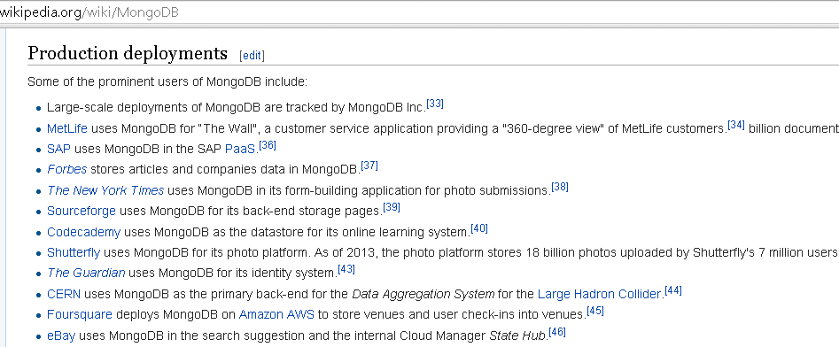
MongoDB Users
Aadhaar project of UIDAI
MTV Networks
Craigslist
Go to http://www.mongodb.com/customers for more information

Slide 14
Installing MongoDB
Download from www.mongodb.org.
Simple installation, takes about a minute. There are no system dependencies.
In Windows, the default location for installation is: C:\Program Files\MongoDB\Server\3.4
Create the following folder for storing data:
C:\data\db
Alternatively, you may specify the path for data while starting mongodb: bin\mongod --dbpath d:\mymongodb\data

Slide 15
Getting Started
Starting MongoDB server mongod
Starting MongoDB shell mongo
Viewing the name of the current database db
Viewing the list of databases show dbs
Creating a new database / using an existing database use pragati
Others help
db.dropDatabase()

Slide 16
Inserting Simple Documents
db.friends.insert ( {
name: 'Narayan Subramanian',
gender: 'M',
currentCity: 'Jaipur'
} )
db.friends.insert ( {
name: 'Pushpa Maheshwari',
gender: 'F',
email: 'pushpa@example.com',
worksAt: 'Indian Railways'
} )

Slide 17
Persons Collection

Slide 18
Persons Documents
db.persons.insert ( {
name: {
first: 'Harish',
last: 'Chandra'},
gender: 'M',
yearOfBirth: 1962,
livesIn: 'Mumbai',
countriesVisited: [
'India', 'Singapore', 'Thailand',
'United Kingdom', 'Spain', 'Denmark',
'United States of America'],
languages: [
{name: 'Hindi', proficiency: 'Fluent'},
{name: 'English', proficiency: 'Fluent'},
{name: 'Sanskrit', proficiency:
'Intermediate'} ]
} )

Slide 19
More with Collections
show collections
db.persons.find()
db.persons.findOne()
db.persons.count()
db.persons.renameCollection('friends')
db.friends.drop()

Slide 20
Query Operations

Slide 21
Persons Collection
Drop and re-create the persons collection using MongoDB commands supplied in persons.txt file.

Slide 22
Querying Data
db.persons.find({gender: 'F'})
db.persons.find({gender: 'F'}).pretty()

Slide 23
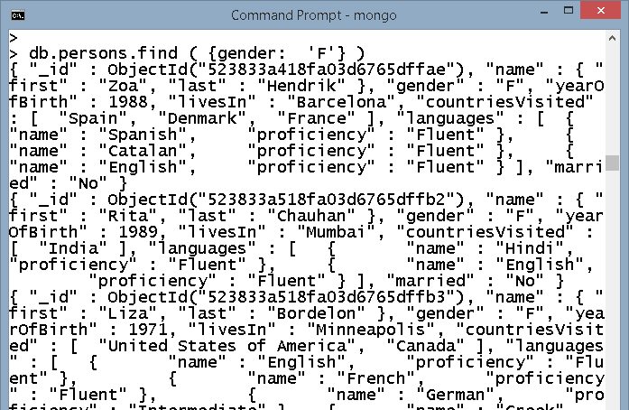
Querying Data
db.persons.find( {gender: 'F'} )

Slide 24
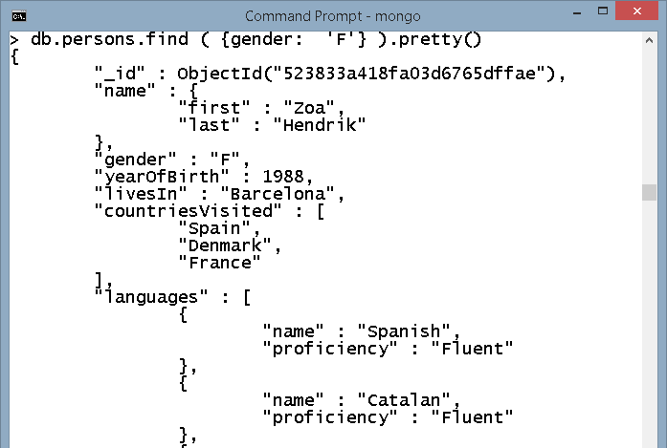
Querying Data
db.persons.find( {gender: 'F'} )
db.persons.find( {gender: 'F'} ).pretty()

Slide 25
Querying Data
db.persons.find( {gender: 'F'} ).count()
db.persons.find( {gender: 'F'}, {name: 1} )
db.persons.find( {gender: 'F'},
{name: 1, _id: 0} )
db.persons.find( {gender: 'F'},
{name: 1, yearOfBirth: 1} )
db.persons.find( {gender: 'F'},
{name: 1, yearOfBirth: 1, _id: 0} )
db.persons.find( {gender: 'F'},
{name: 1, yearOfBirth: 1,
_id: 0, married: 0} )
// why the error in the previous command?

Slide 26
The $in Operator
Find all people living in Mumbai
db.persons.find (
{livesIn: 'Mumbai'}
)
Find all people living in Mumbai or Jaipur
db.persons.find (
{livesIn: {$in: ['Mumbai', 'Jaipur'] } }
)

Slide 27
Some Other Query Operators
$all, $gt, $gte, $in, $lt, $lte, $ne, $nin
All people born before 1980
db.persons.find (
{yearOfBirth: {$lt: 1980} },
{name: 1, yearOfBirth: 1, _id: 0}
)
All persons not living in Jaipur
db.persons.find (
{livesIn: {$ne: 'Jaipur'} },
{name: 1, livesIn: 1}
)

Slide 28
The $all Operator
All persons who have visited India, United States of America and Singapore
db.persons.find (
{countriesVisited: {$all:
['India', 'United States of America',
'Singapore'] } },
{name: 1, countriesVisited: 1, _id: 0}
)

Slide 29
Querying on Subdocument Fields
Find all persons with first name as 'Sapna'
db.persons.find (
{'name.first': 'Sapna'},
{name: 1, _id: 0}
)
Find all persons whose 'name' subdocument has exactly the same fields, with the given values, in the same order; finds one record
db.persons.find (
{name: {first: 'Jenny', last: 'Jones'} },
{name: 1, _id: 0}
)

Slide 30
Querying on Subdocument Fields
Find all persons with 'Jenny' as first name and 'Jones' as last name; finds two records
db.persons.find (
{'name.first': 'Jenny', 'name.last': 'Jones'},
{name: 1, _id: 0}
)

Slide 31
Querying on an Array
Find all persons who have visited India
db.persons.find (
{countriesVisited: 'India'},
{name: 1, countriesVisited: 1, _id: 0}
)
Find all persons who have visited Canada and United States of America. But the following query returns only those documents where the data is exactly as given below and in the same order.
db.persons.find (
{countriesVisited:
['Canada', 'United States of America'] },
{name: 1, countriesVisited: 1, _id: 0}
)

Slide 32
Querying on an Array
This is the correct query. Though if you were looking for those people who have visited only these two countries and no other country, this will not work.
db.persons.find (
{countriesVisited: {$all:
['Canada', 'United States of America'] } },
{name: 1, _id: 0}
)

Slide 33
Querying on an Array
Find all persons whose first country visited is India
db.persons.find (
{'countriesVisited.0': 'India'},
{name: 1, countriesVisited: 1, _id: 0}
)
Find all persons whose first language is 'English'
db.persons.find (
{'languages.0.name': 'English'},
{name: 1, languages: 1, _id: 0}
)
Find all persons who know English
db.persons.find (
{'languages.name': 'English'},
{name: 1, languages: 1, _id: 0}
)

Slide 34
The $or Operator
Find all persons who either live in Mumbai or have visited India
db.persons.find (
{$or: [
{livesIn: 'Mumbai'},
{countriesVisited: 'India'}
] },
{name: 1, livesIn: 1, countriesVisited: 1, _id: 0}
)
Find all persons who have visited India or know Hindi
db.persons.find (
{$or: [
{countriesVisited: 'India'},
{'languages.name': 'Hindi'} ] },
{name: 1, countriesVisited: 1, languages: 1, _id: 0}
).pretty()

Slide 35
The $and Operator
Find all persons who have visited India and know Hindi
db.persons.find (
{$and: [
{countriesVisited: 'India'},
{'languages.name': 'Hindi'}
] },
{name: 1, countriesVisited: 1, languages: 1, _id: 0}
).pretty()

Slide 36
Querying Multiple Fields on an Array
Find all persons who are fluent in English.
The following is incorrect: it will find all persons who know English and are fluent in any one language.
db.persons.find (
{$and: [
{'languages.name': 'English'},
{'languages.proficiency': 'Fluent'} ] },
{name: 1, languages: 1, _id: 0}
).pretty()

Slide 37
Querying Multiple Fields on an Array
What we need is to compare language name and proficiency level within the same array element. This is the right query:
db.persons.find (
{languages:
{$elemMatch:
{name: 'English', proficiency: 'Fluent'} } },
{name: 1, languages: 1, _id: 0}
).pretty()

Slide 38
Querying Multiple Fields on an Array
Find all persons with fluency in English or Hindi
db.persons.find (
{languages: {$elemMatch: {
name: {$in: ['English', 'Hindi'] },
proficiency: 'Fluent'
} } },
{name: 1, languages: 1, _id: 0}
).pretty()

Slide 39
Querying Multiple Fields on an Array
Find all persons who have visited India and are fluent in Hindi
db.persons.find (
{countriesVisited: 'India',
languages: {$elemMatch:
{name: 'Hindi', proficiency: 'Fluent'} } },
{name: 1, countriesVisited: 1, languages: 1, _id: 0}
)

Slide 40
Another Query Example
All males born before 1970 and all females born before 1980.
db.persons.find (
{$or: [
{gender: 'M', yearOfBirth: {$lt: 1970} },
{gender: 'F', yearOfBirth: {$lt: 1980} }
] },
{name: 1, gender: 1, yearOfBirth: 1, _id: 0}
)

Slide 41
Expression Matching
Find people whose first name contains the letter “a” db.persons.find ( {'name.first': /a/}, {name: true, _id: false})
Where first name begins with ‘A’ db.persons.find ( {'name.first': /^A/}, {name: true, _id: false})

Slide 42
Using the “$regex” operator
Where name begins 'Na' db.persons.find ({'name.first': {$regex: /^na/i}}, {name: 1, _id: 0})
Alternatively db.persons.find ({'name.first': {$regex: /^na/, $options: 'i'}}, {name: true, _id: false})
Where name ends with 'sh' db.persons.find ({'name.first': {$regex: /sh$/}}, {name: true, _id: false})
More details: http://docs.mongodb.org/manual/reference/operator/query/regex/

Slide 43
Limiting Array Elements to Return
For all females, return their name and three countries visited by them
db.persons.find (
{gender: 'F'},
{name: 1, countriesVisited: {$slice: 3},
_id: 0} )

Slide 44
Sorting the Documents
Show all persons, sorted in ascending order of their year of birth
db.persons.find().sort ( {yearOfBirth: 1} )
db.persons.find( {}, {yearOfBirth: 1, name: 1, _id: 0} ).sort ( {yearOfBirth: 1} )
Show all persons, sorted in ascending order of their year of birth; suppress people with no yearOfBirth available.
db.persons.find(
{yearOfBirth: {$exists: true} }, {yearOfBirth: 1, name: 1, _id: 0}
).sort ( {yearOfBirth: 1} )

Slide 45
Sorting the Documents
Show all persons, sorted in descending order of their year of birth
db.persons.find ({}).sort ({yearOfBirth: -1})
Show all persons, sorted by last name and then first name
db.persons.find (
{},
{name: 1, _id: 0}
).sort ( {'name.last': 1, 'name.first': 1} )

Slide 46
Limiting the Number of Documents
Show persons, sorted by last name and then first name, limiting to first five people
db.persons.find ( {} ).sort (
{'name.last': 1, 'name.first': 1}
).limit(5)
The following also gives the same output even though limit is written before sort. MongoDB shell always applies limit clause after sort clause.
db.persons.find ( {} ).limit (5).sort (
{'name.last': 1, 'name.first': 1}
)

Slide 47
Limiting the Number of Documents
Show persons, sorted by last name and then first name, limiting to 6-10th persons only
db.persons.find (
{}, {name: 1, _id: 0}
).sort ( {'name.last': 1, 'name.first': 1}
).skip(5).limit(5)

Slide 48
Returning Only One Document
Find and return only one document for a condition
db.persons.findOne (
{gender: 'F'},
{name: 1, _id: 0} )
The following, however, is an error: sort, limit, skip are not applicable with findOne.
db.persons.findOne (
{gender: 'F'},
{name: 1, _id: 0}
).sort ( {'yearOfBirth': 1} )

Slide 49
Exercise
Find all females whose first country visited is either India or Singapore.

Slide 50
Insert, Update, Delete Operations

Slide 51
The _id Field
Reserved for use as a primary key
Value can be specified by you. Example:
db.persons.insert ( {_id: 101, name: {first: 'Robinson', last: 'Crusoe'} } )
If a value is not specified by you, the insert () method adds it to the document with a unique ObjectId for its value
ObjectId is a 12-byte unique identifier.
Value must be unique in a collection
Is immutable

Slide 52
The _id Field
May be of any type other an array
db.persons.insert (
{_id: 101,
name: {first: 'Robinson', last: 'Crusoe'} }
)
db.persons.insert (
{_id:
{name: {first: 'Mary', last: 'Kym'} },
gender: 'F'} )

Slide 53
Insert Operations
If a collection object does not exist, the insert () method creates the collection during the first insert.
Field names:
Cannot start with the $ character
Cannot contain the . character
Maximum BSON document size is 16MB
To store documents large than the maximum size, MongoDB provides the GridFS API.

Slide 54
Update
Update. The following is bad as after this command the document only has the "married" field.
db.persons.update (
{name: {first: 'Nancy', last: 'Karin'} },
{married: 'Y'}
)

Slide 55
The Correct Update Statement
db.persons.update (
{name: {first: 'Nancy', last: 'Karin'} },
{name: {first: 'Nancy', last: 'Karin'},
gender: 'F', yearOfBirth: 1992,
livesIn: 'Montreal',
countriesVisited:
['Canada', 'United States of America'],
languages: [
{name: 'English', proficiency: 'Fluent'} ],
married: 'Y'
}
)

Slide 56
A Better Update Statement
db.persons.update (
{name: {first: 'Nancy', last: 'Karin'} },
{$set: {married: 'N'} }
)

Slide 57
Update
When performing update operations that increase the document size beyond the allocated space for that document, the update operation relocates the document on disk and may reorder the document fields depending on the type of update.

Slide 58
Upsert
There is no such record, so collections remains unaffected, no error is returned either.
db.persons.update (
{name: {first: 'Merilyn', last: 'Holmes'} },
{$set:{gender: 'F', yearOfBirth: 1997, married: 'N'}}
)
This illustrates upsert operation
db.persons.update (
{name: {first: 'Merilyn', last: 'Holmes'} },
{$set:{gender: 'F', yearOfBirth: 1997, married:'N'}},
{upsert: true}
)

Slide 59
Updates Based on an Array Value
Single record update
db.persons.update (
{'countriesVisited.0': 'India'},
{$set: {nationality: 'Indian'} }
)
Multiple records update
db.persons.update (
{'countriesVisited.0': 'India'},
{$set: {nationality: 'Indian'} },
{multi: true}
)

Slide 60
Removing a Field From a Document
Remove a field from a document
db.persons.update (
{name: {first: 'Nancy', last: 'Karin'} },
{$unset: {married: 1} }
)

Slide 61
Updating an Array Element at a Specific Position
Set the first language of Nancy Karin to Portuguese
db.persons.update (
{name: {first: 'Nancy', last: 'Karin'} },
{$set: {'languages.0.name': 'Portuguese'} }
)

Slide 62
Updating an Array Element Without Specifying Its Position
Change Nancy Karin's language from German to Italian
db.persons.update (
{'name.first': 'Nancy', 'name.last':
'Karin', 'languages.name': 'German'},
{$set: {'languages.$.name': 'Italian'} }
)
Change Italian back to German, and make her expert in German
db.persons.update (
{name: {first: 'Nancy', last: 'Karin'},
'languages.name': 'Italian'},
{$set: {'languages.$': {name: 'German', proficiency:
'Expert'} }
} )

Slide 63
Adding an Element to an Array
Adding Beginner level proficiency in Spanish for Rita Chauhan
db.persons.update (
{'name.first': 'Rita',
'name.last': 'Chauhan'},
{$push: {languages:
{name: 'Spanish',
proficiency: 'Beginner' } } }
)

Slide 64
Incrementing / Setting a Field Value
db.persons.update (
{'name.first': 'Rita',
'name.last': 'Chauhan'},
{$inc: {children: 1} }
)

Slide 65
Renaming a Field
db.persons.find ( {livesIn: 'Gangtok'} )
The above does not find a record. Reason: wrongly spelt field name as 'lievsIn' for one record. Let's fix that
db.persons.update (
{},
{$rename: {'lievsIn': 'livesIn'}},
{multi: true}
)

Slide 66
Renaming Subdocument Field Names
db.persons.update (
{},
{$rename: {'name.first': 'name.fname'} },
{multi: true}
)
Now reverse the change.

Slide 67
Renaming Multiple Field Names
db.persons.update (
{},
{$rename: {
'name.first': 'name.fname',
'name.last': 'name.lname',
yearOfBirth: 'birthYear'} },
{multi: true}
)
Roll it back

Slide 68
Renaming Fields, Dropping Arrays
db.persons.update (
{},
{$rename: {'name.first': 'firstname',
'name.last': 'lastname'} },
{multi: true}
)
Drop the empty "name" subdocument.
db.persons.update (
{},
{$unset: {name: 'doesnotmatter'} },
{multi: true}
)
Roll back everything.

Slide 69
Adding Values to an Array
Narayan Sundaram, Rita Chauhan and Liza Bordelon have enrolled for Sanskrit classes, so they should all be marked as having beginner level proficiency in Sanskrit. Out of these Liza Bordelon already has this, so should not be duplicated.
db.persons.update (
{name: {$in: [
{first: 'Narayan', last: 'Sundaram'},
{first: 'Rita', last: 'Chauhan'},
{first: 'Liza', last: 'Bordelon'}
] } },
{$addToSet: {languages: {name: 'Sanskrit',
proficiency: 'Beginner'} } },
{multi: true}
)

Slide 70
Add Multiple Elements to an Array
Add multiple languages to Neeharika Chauhan
db.persons.update (
{'name.first': 'Neeharika', 'name.last': 'Chauhan'},
{$push:
{languages:
{$each: [
{name: 'Marathi', proficiency: 'Fluent'},
{name: 'Gujrati'},
{name: 'Punjabi',
proficiency: 'Intermediate'}
] } } } )

Slide 71
Remove an Element from an Array
Remove the last language for Nancy Karin
db.persons.update (
{'name.first': 'Nancy',
'name.last': 'Karin'},
{$pop: {languages: 1}})
Remove the first language for Nancy Karin
db.persons.update (
{'name.first': 'Nancy',
'name.last': 'Karin'},
{$pop: {languages: -1}})

Slide 72
Explore Yourself: $pull
db.collection.update(
{ field: value },
{ $pull: { field1: value1 } } );
removes all occurrences of value1 from the array in field1, in the document that matches the query statement {field: value}

Slide 73
The save() Method
db.persons.save ( {name: {first: 'Jonathan', middle: 'Livingstone', last: 'Seagull'} } )
db.persons.save ( {_id: 102, name: {first: 'Vishnudutt', last: 'Sharma'} } )
db.persons.save ( {_id: 102, gender: 'M'} )
db.persons.save ( {_id: 102, name: {first: 'Vishnudutt', last: 'Sharma'}, gender: 'M'} )
If the document does not contain an _id field, it is equivalent to insert() method.
If the document contains an _id field, then it performs an upsert.

Slide 74
findAndModify
Finds and modifies the document in a single atomic operation.
db.collection.findAndModify({
query: <document>,
sort: <document>,
remove: <boolean>,
update: <document>,
new: <boolean>,
fields: <document>,
upsert: <boolean>
});

Slide 75
findAndModify
db.persons.findAndModify ( {
query: {$and: [
{'name.first': 'Zoa'},
{'name.last': 'Hendrik'}]},
update: {$set: {livesIn: 'Madrid'} },
new: true
} )

Slide 76
Updates
Updates are made in-place.
If an update increases the size of the document beyond allocation, MongoDB relocates the document on disk. Negative impact on performance.
MongoDB allocates padding to reduce the likelihood of such relocation.
Pre-allocation strategies may work in some cases.
Example: to track page hits per minute.
Create one document per day.
Have 60 * 24 fields pre-allocated in the document with zero values.
Upsert such documents the previous day, spreading the workload during the day.

Slide 77
Deleting Data
Remove all males
db.persons.remove ( {gender: 'M'} )
Remove just one male
db.persons.remove ( {gender: 'M'}, 1)
Remove all documents
db.persons.remove( { } )
Drop the collection
db.persons.drop()

Slide 78
Dropping a collection
Removing all documents: one by one they are removed.
Drop collection: in one go. So faster.
However, removing all documents preserves metadata, such as indexes. So choose appropriately.

