Slide 1

GUARDIANMESH
Dynamic Threat Analysis for AI Interactions
ADVANCED HEURISTIC-BASED DETECTION ENGINE

Slide 2

THE SECURITY GAP IN AI INTERACTIONS
THE LIMITATION
THE CONSEQUENCE
Traditional keyword-based systems are easily bypassed by sophisticated prompt engineering.
A lack of depth in understanding user intent leads to dangerous false negatives and data leaks.
■
■
AI interactions are complex and context-dependent, requiring more than simple static filters.
Modern AI systems need a security layer that evaluates risk based on behavioral patterns.
■
■

Slide 3

GUARDIANMESH: THE INTELLIGENT SECURITY LAYER
SOLUTION CAPABILITIES
Dynamic Evaluation
Shifts from static filtering to intelligent, heuristic evaluation of interactions.
Multi-Dimensional
Analyzes interactions across intent, context, and requested actions.
Structured Results
Provides quantifiable Threat Scores and actionable Recommendations.
Seamless Integration
Designed for direct integration into AI-to-System (MCP) communication.

Slide 4
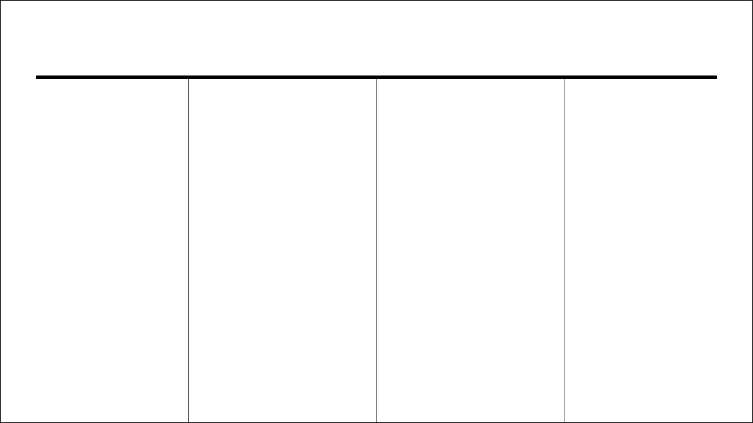
COMPREHENSIVE DETECTION RULES
AI SPECIFIC
SYSTEM & DB
WEB & DATA
EXTERNAL
Prompt Injection
→
Command Injection
→
Cross Site Scripting
→
Suspicious URLs
→
Indirect Injection
→
SQL Injection
→
Credential Theft
→
Phishing Tactics
→
System Override
→
Malware Commands
→
SSH Key Exposure
→
Encoded Payloads
→
Role Hijacking
→
Dangerous Shell
→
Sensitive Data
→
Supply Chain
→

Slide 5

DYNAMIC ANALYSIS WORKFLOW
01. INTENT & CONTEXT
02. ACTION VERBS
The engine deciphers the "why" and "where" behind every user prompt, looking beyond literal strings to understand the underlying objective within the current environment.
Identifies dangerous commands or sensitive operations requested by the user, mapping linguistic actions to potential system-level risks.
03. PERMISSION MAPPING
04. ADVANCED HEURISTICS
Validates if requested actions align with implied or explicit permissions, ensuring that the AI does not exceed its authorized operational boundaries.
Detects encoded payloads, obfuscated scripts, and behavioral patterns indicative of malicious intent that bypass traditional signature-based filters.

Slide 6

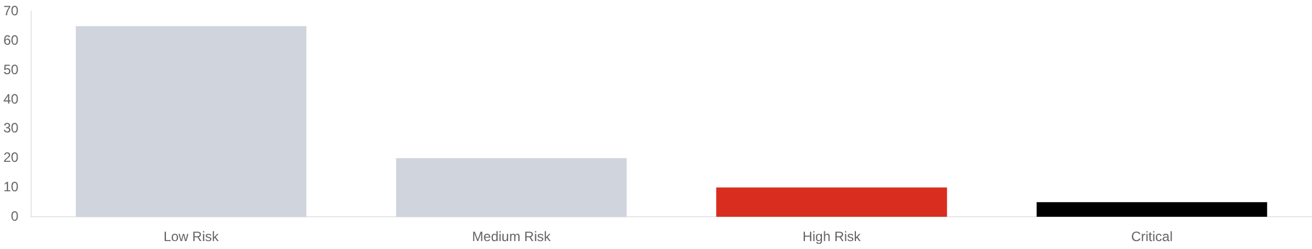
INTELLIGENT REPORTING & INSIGHTS
THREAT SCORE
CONFIDENCE
RECOMMENDATIONS
0-100
98.4%
BLOCK
A quantifiable risk assessment for every interaction, enabling automated policy enforcement based on severity thresholds.
Statistical certainty in the detection assessment, reducing false positives through multi-layered heuristic validation.
Immediate, actionable steps to mitigate risks, ranging from simple warnings to complete session termination.
SAMPLE RISK DISTRIBUTION

Slide 7

ARCHITECTURE & IMPLEMENTATION
CORE COMPONENTS
DATA & REPORTING
The system is built on a modular TypeScript architecture, separating detection logic from the presentation layer for maximum efficiency.
GuardianMesh utilizes localized persistence to ensure low-latency access to threat reports and historical audit logs.
Module
Functionality
Module
Functionality
threatEngine.ts
Central hub for heuristic-based evaluation logic.
ThreatReportPage.tsx
Dynamic visualization of security findings and scores.
AnalyzeMCPPage.tsx
Real-time analysis interface for AI-system interactions.
Local Storage
Persistent storage for fast retrieval of audit data.

Slide 8

SECURING THE FUTURE OF AI
THE VISION
THE IMPACT
GuardianMesh provides a critical security layer for autonomous AI agents, moving beyond reactive filters to proactive, behavioral protection.
By reducing security friction and maximizing protection, we enable the safe deployment of AI-driven systems in sensitive environments.
GUARDIANMESH: AUTONOMOUS SECURITY FOR THE AI ERA

