Slide 1


Linux Storage Monitoring System
Linux System Administration (E1ITA307) | Infrastructure Deployment Project
Storage status
Normal
A web dashboard for disk and inode monitoring on Linux
Warning (80%)
SUBMITTED BY
SUPERVISOR
Koushik K T (2411021060147)
Nehaa Mahesh (2411021060103)
Shauryaman Singh (2411021060077)
Prof. Kusuma J
Critical (90%)
B.Tech in Information Technology | Oct 2026
Alliance School of Advanced Computing, Alliance University, Bengaluru
Notes:
Good morning everyone. Our project is the Linux Storage Monitoring System. We built it for the Linux System Administration course (E1ITA307) under Prof. Kusuma J. It is a web dashboard that shows disk space and inode usage on a Linux machine, so storage problems are easy to see. The three coloured bars on the right show the idea: normal, warning at 80 percent, and critical at 90 percent. The bars are only an illustration.

Slide 2


Introduction and Background
Linux is everywhere
Servers, development setups, virtual machines and cloud systems all run on Linux.
Linux tools used to check storage
df
df -i
Free space matters
Filesystems need enough free space so that applications keep working.
Filesystem usage and capacity
Inode usage
lsblk
findmnt
Our idea
Put the Linux storage tools behind one simple web dashboard.
Block devices
Mounted filesystems
Reading raw terminal output by hand is slow. Our dashboard shows disk space, inodes and alerts in one place.
Notes:
Linux runs most servers, virtual machines and cloud systems. These systems need enough free disk space, or applications can fail. Linux already has tools to check storage: df for usage, df -i for inodes, lsblk for block devices and findmnt for mounted filesystems. But you must run them one by one and read the raw output yourself. Our idea is to bring them together in one web dashboard.

Slide 3





Problem Statement
Administrators must watch disk space and inode availability to avoid storage problems.
When storage gets full
Why the command line is hard
Applications cannot create new files
Many commands must be run
Logs may stop updating
Each output is read separately
System operations can be affected
Harder for beginners
THE NEED A simple web interface that collects storage data from Linux, shows it clearly, flags threshold violations, and supports reports and log checks.
Notes:
The problem is simple. If disk space or inodes run out, applications cannot create files, logs can stop updating, and the system can misbehave. Checking this from the command line means running several commands and reading each output separately, which is not easy for beginners. So we need one simple web interface that collects the data, shows it clearly, warns when thresholds are crossed, and supports reports and logs.

Slide 4
Objectives and Proposed Solution
Solution: a Flask web dashboard that runs approved Linux commands and shows the results clearly.
1
2
3
Scope
Build a web dashboard for storage monitoring
Show capacity, used and free space, and usage %
Watch inode usage and spot high use
Monitors existing filesystems on the Linux system it runs on
For local, educational and demo use
4
5
6
Connect Linux storage commands to the web page
Set warning and critical thresholds
Simulate alerts without changing the disk
Not included yet
Automatic disk cleanup
Partition creation
Filesystem resizing
Scheduled monitoring
7
8
9
Record activity in log files
Create downloadable storage reports
Show Linux commands and Python web development
Notes:
Our aim is a web dashboard for Linux storage monitoring. It should show capacity, used and free space, and usage percentage. It should also watch inodes, connect Linux commands to the web page, let users set warning and critical thresholds, simulate alerts safely, write logs, and create downloadable reports. The scope is local, educational use on the Linux system where it runs. It does not yet clean disks, create partitions, resize filesystems or run scheduled checks. Those are left for future work.

Slide 5


System Design and Methodology
Kali Linux VM | Oracle VirtualBox on a Windows host
Development process
1
Requirement analysis
2
Environment setup
Browser
Flask backend
Linux tools
HTML, CSS, JavaScript dashboard
Python 3 runs approved commands, returns JSON
df, df -i, lsblk, findmnt
3
Backend development
4
Frontend development
5
Integration
config.json
Log file
Report files
6
Testing
Thresholds
App activity
Text reports
7
Documentation
Kali Linux
Python 3
Flask
HTML + CSS
JavaScript
JSON
Oracle VirtualBox
Notes:
This is how the system works. The user opens the dashboard in a browser, built with HTML, CSS and JavaScript. The browser talks to a Python Flask backend using HTTP requests. The backend runs only approved Linux commands such as df, df -i, lsblk and findmnt, and sends the result back as JSON. The backend also saves thresholds in config.json, writes a log file and creates report files. Everything runs inside a Kali Linux virtual machine on Oracle VirtualBox on a Windows computer. We built it in seven steps: requirement analysis, environment setup, backend, frontend, integration, testing and documentation. Requirements in short: a laptop or desktop that can run VirtualBox with enough RAM and storage, Windows as host, Kali Linux as guest, Python 3 with a virtual environment, Flask, and a browser such as Firefox. Internet is only needed to install packages and load Google Fonts.

Slide 6



Key Features and Implementation
Threshold-based alerts
Filesystem monitoring
Inode monitoring
Disk and inode usage is compared with two limits. The defaults can be changed in the dashboard and are saved in config.json.
Type, capacity, used and free space, mount point and usage %
Uses df -i. A disk can run out of inodes even when space is free
80%
90%
Command console
Alerts and logs
Only five approved commands can run, such as df, lsblk and findmnt
Test any % without changing the disk. Activity is logged
Normal: below the warning level
Warning: 80% threshold (default)
Storage reports
Security
Critical: 90% threshold (default)
Download a text snapshot of host, time, thresholds and usage
Local only (127.0.0.1), approved commands only, no admin rights needed. No login yet
Notes:
These are the main features. The core one is filesystem monitoring, using df, lsblk and findmnt to show type, capacity, used and free space, mount point and usage percentage. Inode monitoring uses df -i, because a disk can run out of inodes even when space is still free. Usage is checked against two limits: the default warning level is 80 percent and critical is 90 percent. You can change them in the dashboard and they are saved in config.json. The command console runs only five approved commands. Alert simulation lets you enter a test percentage; it does not fill the disk, and the event is written to the log. The log also records commands, threshold changes and reports. Reports are text files with host, time, thresholds, filesystem and inode details. For security, the server binds to 127.0.0.1, uses an allowlist and needs no admin commands. It is for learning and is not production ready: there is no login, role-based access control or full security audit yet.

Slide 7
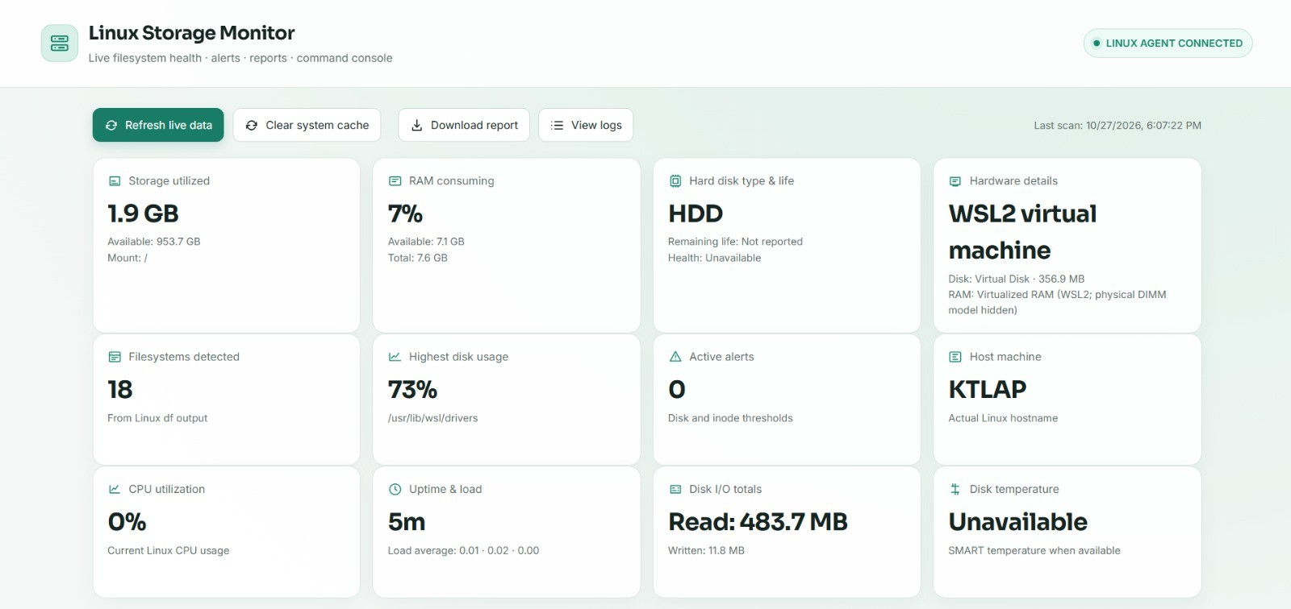

Results and Testing
Dashboard summary cards
Detected filesystems
Highest disk usage
Active threshold alerts
Hostname
Testing: 9 of 9 test cases matched
Dashboard launch
Alert simulation
Filesystem data
Log viewing
Dashboard from the running application
Inode data
Report download
Alert simulation shows how thresholds work without changing real disk contents.
Command output
Bad input rejected
Threshold update
Notes:
Here are the results. The dashboard works as planned. Its summary cards show the number of filesystems found, the highest disk usage, the number of active alerts, and the hostname. Below them are tables for capacity, used and free space, mount points, inode data and status. We tested nine cases: dashboard launch, filesystem data, inode data, command output, threshold update, alert simulation, log viewing, report download, and rejection of a wrong simulation input. In all nine, the actual result matched what we expected. The report itself says final results should be backed by screenshots and test outputs from the running Kali Linux application.

Slide 8


Conclusion and Future Scope
Conclusion
Current limits
Future enhancements
Links Linux commands with a web dashboard to make storage checks simple
One place for disk space, inodes, alerts, command output, logs and reports
Applies Linux administration, backend development and basic security
A base for a fuller storage administration platform
No automatic delete, resize, create or cleanup actions
Simulation shows threshold logic, not real disk pressure
No scheduled checks, history graphs, email alerts or multi-user login
Disk health and temperature may be unavailable in a virtual machine
Automated monitoring: Cron or background checks
History graphs: usage trends over time
Notifications: email alerts at critical levels
Storage analysis: top space users with du
Backups: create and verify
Authentication: login and role-based access
Multi-system: monitor many Linux machines
Better reports: CSV export, graphs, period comparison
References: Linux man-pages (df, lsblk, findmnt) | Flask Documentation | Python 3 Documentation | Kali Linux Documentation | Oracle VirtualBox Documentation
Notes:
To conclude: our project shows how Linux commands can be joined with a web interface to make storage monitoring easier. It gives one dashboard for disk space, inode use, alerts, command output, logs and reports. It uses real ideas from Linux administration, backend development, configuration and basic security. It has limits: it does not clean or resize disks, the simulation does not create real disk pressure, and there are no scheduled checks, history graphs, email alerts or multi-user login. In the future we can add Cron-based monitoring, usage graphs, email notifications, du-based storage analysis, backup tools, login with roles, multi-machine monitoring and better reports. References are the Linux man-pages for df, lsblk and findmnt, plus the Flask, Python 3, Kali Linux and VirtualBox documentation. Thank you. We are happy to take questions.

