Slide 1
A Seminar on DESIGNING A WEB BASED CHAT INTERFACE SERVER
Team Details
Kodidala Koushik Kumar (20EG105125)
Sai Spandana Echambadi (20EG105142)
Shaik Mohammed Kaif (20EG105145)
Marri Nithin Reddy (20EG105153)
Project Supervisor
Mr.D. Ramana Kumar
Assistant Professor

Slide 2
Abstract
A chat application is a type of software or technology that allows users to communicate with one other in real time over the internet. The article outlines an idea for a messaging software that emphasizes security and usability above all else, with the goal of being adaptable across several platforms. The proposed method is starting with Node.js and building a server with the Express.js framework. Furthermore, the programme makes use of the Socket.io module to provide efficient user communication. MongoDB is used by the system for database administration. The solution uses bcrypt.js for password hashing and JSON Web Token to improve security measures.
Keywords: Socket.io, Node.js, Express.js, Bcrypt.js Hashing, Json Web Token

Slide 3
Introduction
Chatting Apps: Chat applications allow you to stay connected with other people who may be using the application even on the other side of the world. In customer service, such applications are one of the most important communication channels.
Working of Chat Applications: Chat applications typically run on centralized networks that are served by platform operator servers as opposed to peer-to-peer protocols such as XMPP. This allows two people to talk to each other in real time
Introduced Keywords:
Socket.io :Socket.IO is an event-driven library for real-time web applications. It enables real-time, bi-directional communication between web clients and servers. It consists of two components: a client, and a server.

Slide 4
Node js Node.js is a cross-platform, open-source JavaScript runtime environment that can run on Windows, Linux, Unix, macOS, and more. Node.js runs on the V8 JavaScript engine, and executes JavaScript code outside a web browser. Node.js lets developers use JavaScript to write command line tools and for server-side scripting
Express js: Express.js, or simply Express, is a back end web application framework for building RESTful APIs with Node.js, released as free and open-source software under the MIT License.
Json web token: Express.js, or simply Express, is a back end web application framework for building RESTful APIs with Node.js, released as free and open-source software under the MIT License.
Bcrypt js hashing: To avoid the sensitive data being visible to anyone, Node. js uses “bcryptjs”. This module enables storing passwords as hashed passwords instead of plaintext.

Slide 5
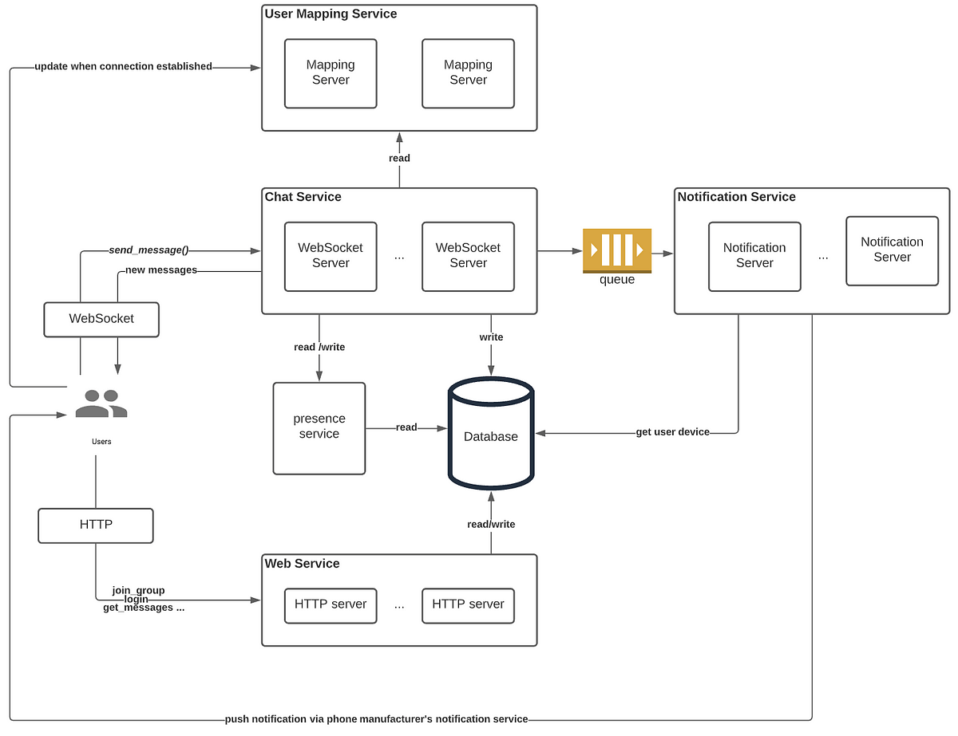
Concept Tree

Slide 6
Literature
Author(s) | Methods | Advantages | Disadvantages
[1] Croucher, T. H., & Wilson, M. (2012). Node: Up and Running. United States. | Creates twitter app using Express and Node JS and includes fundamental parts like: Event Loop: The fundamental part of the node, and the base for all API is Event API I/O: It is one of the core pieces that makes Node different from other frameworks. Blocking and Non-blocking operation | It offers easy scalability: Node.js isn’t more scalable than PHP or Ruby, but it is way easier to scale than other backend technologies. Understand nodejs event-loop architecture, non-blocking I/O and event driven programming | Its performance is reduced with heavy computational tasks: Node.js is unable to process heavy CPU-bound tasks, and this is arguably one of the biggest drawbacks of Node.js. It has an unstable API: Node.Js implements changes frequently connected to its API. The issue is that those changes are generally backward-incompatible with previous versions.

Slide 7
Literature
Author(s) | Methods | Advantages | Disadvantages
[3]Kiessling, Manuel. 2012. The Node Beginner Book. lulu.com, United Stated. | Creates a basic chatting app using the following : 1.MongoDB 2.NodeJS 3.AngularJS 4.EventEmitter | Data binding, the code disappears, helping the developer concentrate on the actual application. The driver automatically maps JavaScript objects to BSON documents, meaning that developers can easily work with their data. Supports DOM manipulation. As AngularJS supports MVC architecture, it eliminates the need to manipulate the DOM directly from code inside the controller. | Not very in-depth: while including the basics of node js, it sacrifices the installation and details of some main elements. Less Secure: Anyone can breach ones network by just entering the localhost details, hence is prone to network breach.

Slide 8
Literature
Author(s) | Methods | Advantages | Disadvantages
[2] Sidik, B. (2011). JavaScipt. Bandung: Informatika. | JavaScript library for building user interfaces React can be used as a base in creating a chat interface | Quick and live updation because of react js and focuses on Native app development Focus on the language: It is designed in a way that helps one chat in different languages. Code runs seamlessly on various operating systems | Node.js relies heavily on callbacks. It is a function that runs after a task in the queue is finished, allowing other code to run in the meantime. However, with a number of tasks in the queue — each with its own callback — it can lead to callback overloading. Single-threaded nature Does not encourage creating an application for a specific entity rather focuses on generalized features.

Slide 9
Literature
Author(s) | Methods | Advantages | Disadvantages
[6]Teixeira, Pedro. 2012. Hands-on Node.js. Wrox. | Used Bash scripts and Jade template engine and Express Js. Bash script allows you to perform a series of actions, such as navigating to a specific directory, creating a folder, and launching a process using the command line. | Provides module-by-module code with clear explanation Analysis the different proposals to server side solutions | It does not cover complete details of Node API like fetching service schemes or creating middleware to keep the node active and solid. It does not use any node frameworks like network traffic collection tools.

Slide 10
Literature
Author(s) | Methods | Advantages | Disadvantages
[4]Mardan, Azat. 2012. Practical Node.js: Building Real-World Scalable Web Apps. Appress. | It is a comprehensive study on Node Js and explains it by creating a Chat application. 1.NPM modules 2.Hapi.js frameworks 3.Mongoose object-relational mapping(ORM) library 4.OAuth and Everyauth libraries for secure integration and jade template engine | Robust ecosystem through npm Maintains high secure Is highly scalable and the frameworks installed are reliable to use at the clients place | Does not support multiple user interfaces. Cannot be used in multiple devices and cannot save the data Lacks Library support :There is no monitoring system for accessing and removing the files from the Library.

Slide 11
Problem Statement
To create a specialized mobile chat application for the web that can be used in real time to share data and facilitate quicker and simpler communication.

Slide 12
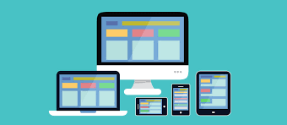


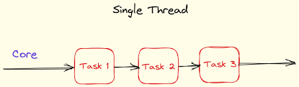
Problem Illustration
“Many Problems one solution”
Chat Interface

Slide 13
Proposed Method
A software application that operates on the internet, accessible through various platforms, designed to provide users with an easy-to-use interface. This proposed application utilizes socket.io and express js as server modules, while employing mongodb for the database management aspect. For enhanced security measures, this software incorporates methods such as jwt (JSON Web Tokens) and password hashing.
A web-based software is created using Node.js to convert large image formats into smaller ones. This software is user-friendly and faster than other Node.js modules. It has features like text messaging, expressive emojis and stickers, group chats, notifications, and security measures.

Slide 14
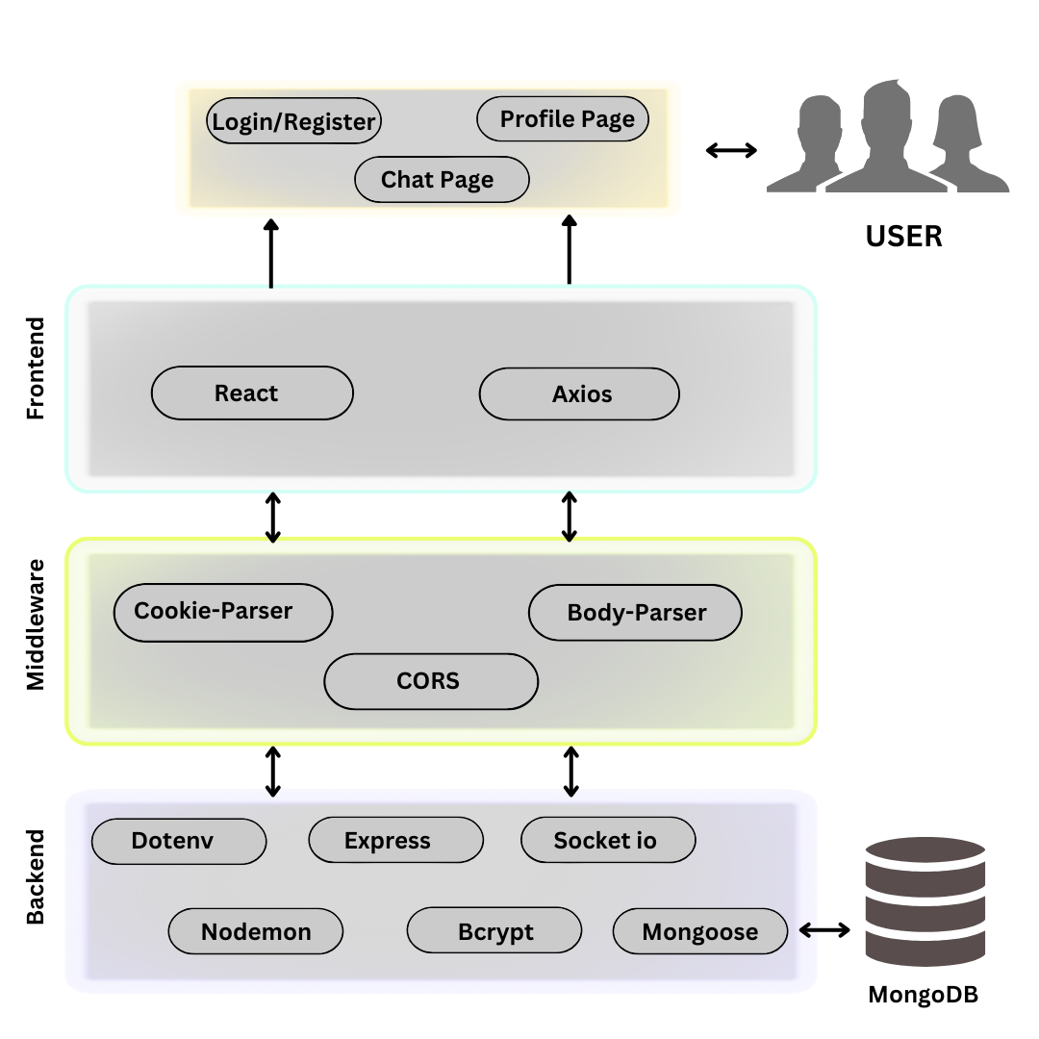
Proposed Method Illustration

Slide 15
Explanation
The above architecture is a complete structure design of the system. It consists of of 3 main layers Frontend, Middleware and Backend. The Backend The Middleware includes CORS, cookie parser and Body Parser which helps in smooth integration of frontend with Backend. The Frontend is the user interface where the users interact with the system and use it for its functionality. The main functions that the user can access is Login/ Register Page, Chat Page, Profile Page.

Slide 16
Activity Diagram
Login to Chat Application System
Start
Check User Level and permission
Manage Chat
Manage Profile
Manage Group Chats
Activity
Logout from the system
Stop

Slide 17
Experiment Environment
Software:
Coding Environment:
VSCode
Execution Environment(output):
Google Chrome
Hardware:
RAM: 2GB
Processor: i3 and higher versions

Slide 18
Project status
S.No | Functionality | Status (Completed /in-progress/Not started)
1 | Requirement Gathering | Completed
2 | Analysis, Design and Planning | In-progress
3 | Development | In-progress
4 | Testing and Feedback | Not Started

Slide 19
References
[1]Croucher, T. H., & Wilson, M. (2012). Node: Up and Running. United States.
[2]Sidik, B. (2011). JavaScipt. Bandung: Informatika.
[3]Kiessling, Manuel. 2012. The Node Beginner Book. lulu.com, United Stated.
[4] Mardan, Azat. 2012. Practical Node.js: Building Real-World Scalable Web Apps. Appress.
[5] Teixeira, Pedro. 2012. Professional Node.js: Building Javascript Based Scalable Software Kindle Edition. Wrox.
[6] Teixeira, Pedro. 2012. Hands-on Node.js. Wrox.

Slide 20
Thank You!

Slide 21
Project seminar–I Evaluation
S.No | Rubrics | Marks
1 | Concept Introduction | 4
2 | Literature and Parameter | 5
3 | Problem and Problem Illustration | 8
4 | Proposed Method and Illustration | 8
Total |  | 25

