Slide 1
A Seminar on DESIGNING A WEB BASED CHAT INTERFACE SERVER USING MERN STACK
Team Details
Kodidala Koushik Kumar (20EG105125)
Sai Spandana Echambadi (20EG105142)
Shaik Mohammed Kaif (20EG105145)
Marri Nithin Reddy (20EG105153)
Project Supervisor
Mr.D. Ramana Kumar
Assistant Professor

Slide 2
Abstract
A chat application is a type of software or technology that allows users to communicate with one other in real time over the internet. The article outlines an idea for a messaging software that emphasizes security and usability above all else, with the goal of being adaptable across several platforms. The proposed method is starting with Node.js and building a server with the Express.js framework. Furthermore, the programme makes use of the Socket.io module to provide efficient user communication. MongoDB is used by the system for database administration. The solution uses bcrypt.js for password hashing and JSON Web Token to improve security measures.
Keywords: Socket.io, Node.js, Express.js, Bcrypt.js Hashing, Json Web Token

Slide 3
Introduction
Chatting Apps: Chat applications allow you to stay connected with other people who may be using the application even on the other side of the world. In customer service, such applications are one of the most important communication channels.
Working of Chat Applications: Chat applications typically run on centralized networks that are served by platform operator servers as opposed to peer-to-peer protocols such as XMPP. This allows two people to talk to each other in real time
Introduced Keywords:
Socket.io :Socket.IO is an event-driven library for real-time web applications. It enables real-time, bi-directional communication between web clients and servers. It consists of two components: a client, and a server.

Slide 4
Node js Node.js is a cross-platform, open-source JavaScript runtime environment that can run on Windows, Linux, Unix, macOS, and more. Node.js runs on the V8 JavaScript engine, and executes JavaScript code outside a web browser. Node.js lets developers use JavaScript to write command line tools and for server-side scripting
Express js: Express.js, or simply Express, is a back-end web application framework for building RESTful APIs with Node.js, released as free and open-source software under the MIT License.
Json web token: JSON Web Token is an open standard for securely transferring data within parties using a JSON object. JWT is used for stateless authentication mechanisms for users and providers, this means maintaining sessions on the client side instead of storing sessions on the server.
Bcrypt js hashing: To avoid the sensitive data being visible to anyone, Node. js uses “bcryptjs”. This module enables storing passwords as hashed passwords instead of plaintext.

Slide 5
Problem Statement
To create a specialized mobile chat application for the web that can be used in real time to share data and facilitate quicker and simpler communication.

Slide 6
Proposed Method
A software application that operates on the internet, accessible through various platforms, designed to provide users with an easy-to-use interface. This proposed application utilizes socket.io and express js as server modules, while employing MongoDB for the database management aspect. For enhanced security measures, this software incorporates methods such as jwt (JSON Web Tokens) and password hashing.
A web-based software is created using Node.js to convert large image formats into smaller ones. This software is user-friendly and faster than other Node.js modules. It has features like text messaging, expressive emojis and stickers, group chats, notifications, and security measures.

Slide 7
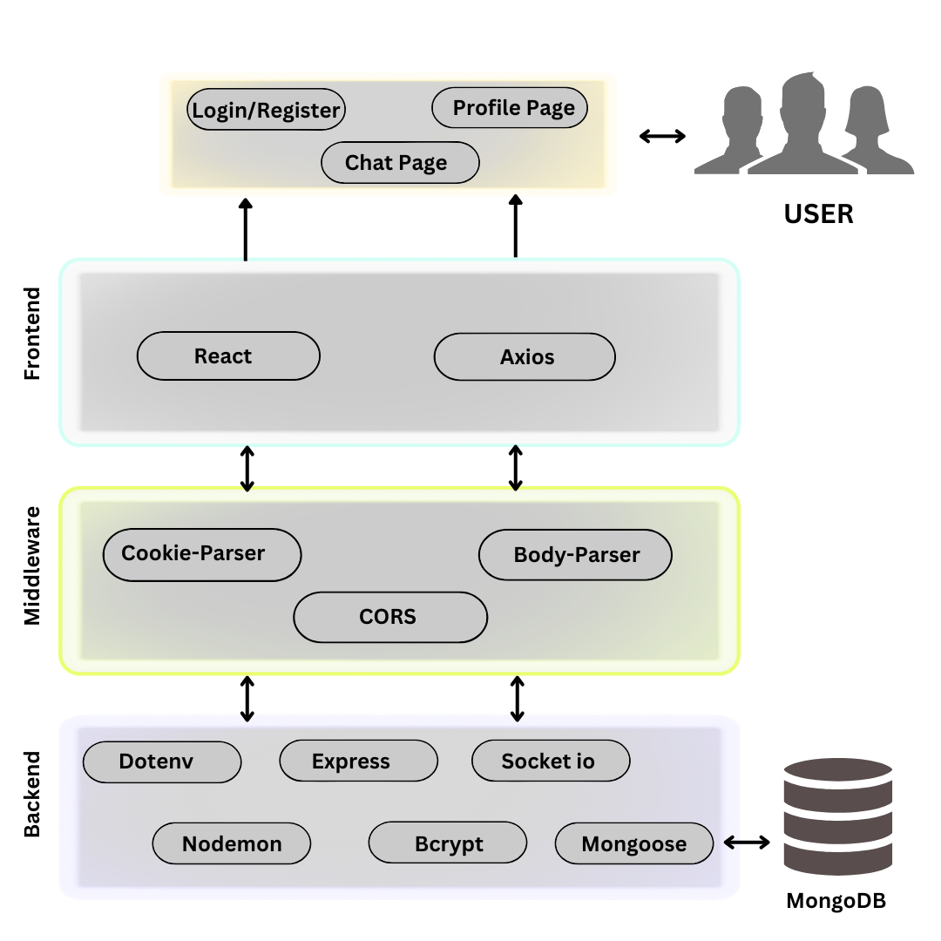
Proposed Method Illustration

Slide 8
Experiment Environment
Software Requirements:
Operating System : Windows Family
Technology : JavaScript
Front-End : Node.js
Back-End : Express.js, Socket.io, MongoDB
IDE : VSCode
Hardware Requirements:
Processor : Any updated processor
RAM : Minimum 4GB
Hard Disk : Minimum 100GB

Slide 9
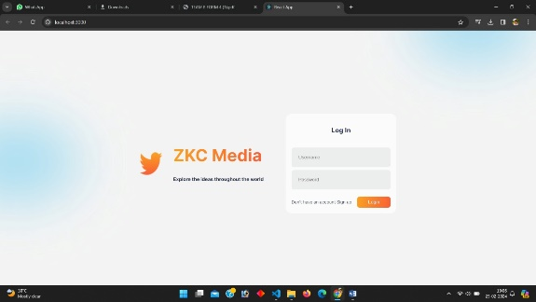
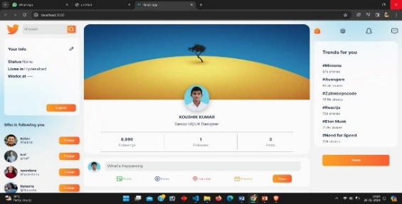
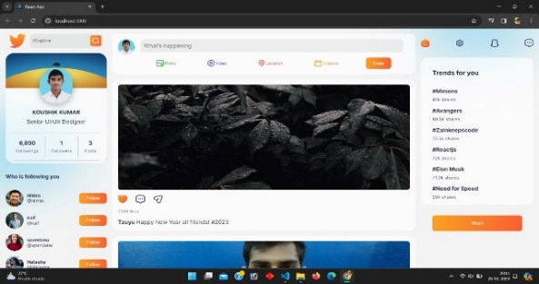
Experiment Screenshots
Figure : Login Page
Figure : Profile Page
Figure : Home Page

Slide 10
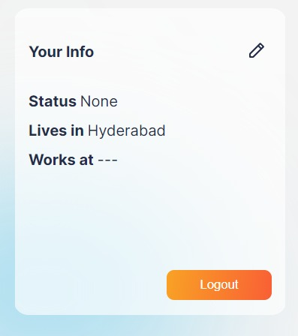
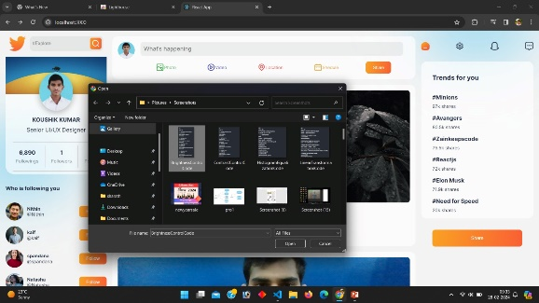
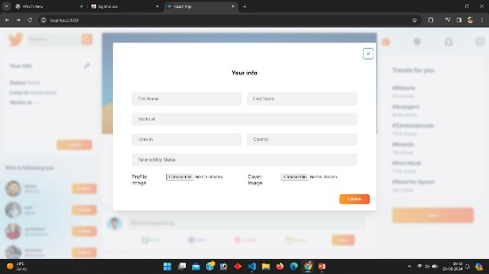
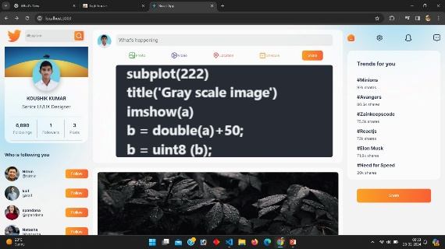
Experiment Screenshots
Figure : Info Card
Figure : Post Selection
Figure : Info Editing Card
Figure : Post Sharing

Slide 11
Experiment Results
S.No | Metrics/Parameters | Chat Application using PHP | Proposed Chat Application using MERN Stack | Metrics Description
1 | First Contentful Paint | 2.1 s | 0.4 s | First Contentful Paint marks the time at which the first text or image is painted.
2 | Largest Contentful Paint | 22.5 s | 1.7 s | Largest Contentful Paint marks the time at which the largest text or image is painted.
3 | Total Blocking Time | 370 ms | 200 ms | Sum of all time periods between FCP and Time to Interactive, when task length exceeded 50ms, expressed in milliseconds.
4 | Cumulative Layout Shift | 0.004 | 0 | Cumulative Layout Shift measures the movement of visible elements within the viewport.
5 | Speed Index | 4.2 s | 0.9 s | Speed index shows how quickly the contents of a page are visibly populated

Slide 12
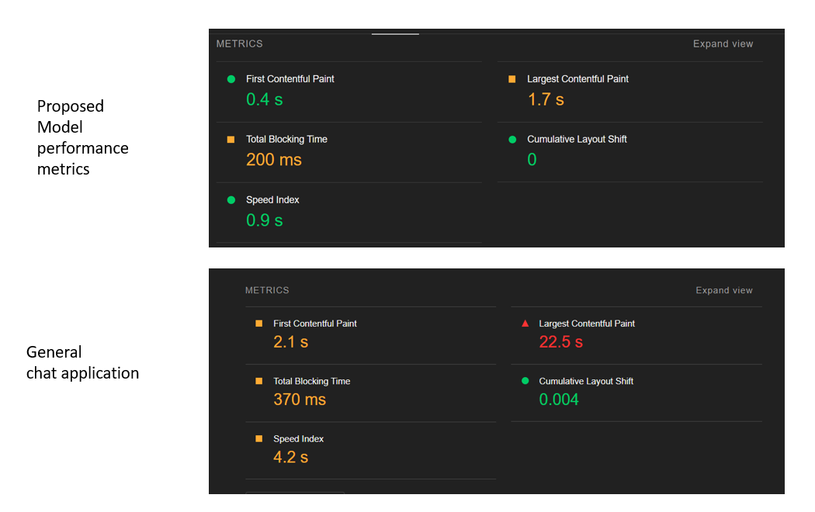
Experiment Results
Proposed Model Chat Application Performance Index
Chat Application using PHP Performance Index

Slide 13

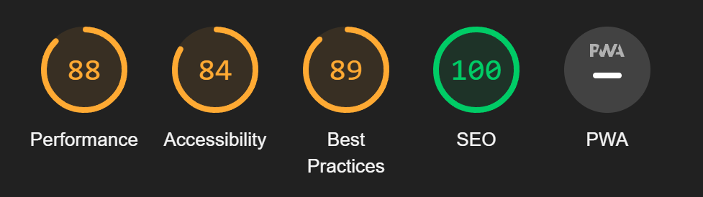
Finding
Chat Application using PHP Performance Index
Performance Index Parameters
Proposed Model Chat Application Performance Index

Slide 14
Justification
Based on the results of tests performed, it can produce a conclusion that:
The overall response time of the system is 4 times better than the application created using PHP.
Though the performance indexes like SEO and Best Practices are the same and the accessibility of the general application is better than that of proposed, the overall performance and efficiency is higher by 26% which proves that the proposed model is accurate and efficient than other models.
In summary, the MERN stack provides a comprehensive solution for developing modern chat applications, empowering developers to create engaging and efficient communication platforms tailored to the needs of users than the other applications.

Slide 15
Thank You !!

