Slide 1

Tutor Finder
Presented by:Abu Ashraf
Mahir Ahmed
Aurnab Das
Mozammel Hossain
Arman Shanto
Probal Shutradhar

Slide 2

introduction
Tutor finder is a Web App which will provide easy and affordable platform for tutors and students to seek preferable match according to their requirements .

Slide 3

purpose
The purpose is to deliver competent podium both for students and tutors.
Rich collection of eligible and resourceful tutors for student which is difficult to find .
Help student-tutor relation and tutors to get job easily.

Slide 4
Project scope
Everyone use the conventional way to find tutor or student, now competently through this service search is easy and efficient.
Guardians will be able to evaluate tutor’s academic and their performance.
Location will help to customize search between student and teacher.

Slide 5
Overall description
Student’s detail
Stores information of a student. Student can communicate with desired tutor.
Tutor’s detail
It contains tutors academic excellence and experience and detail. Communicate is easily done with tutor .

Slide 6
requirements
User interface
Front End: HTML, CSS, Javascript
Back End: Mysql, Php
Laravel framework
Hardware interface
Mobile
Browser

Slide 7
System feature (contd.)
Home page
Two options to choose from “Teacher” or “Student”
Sign in
User signs in using email and password
Sign up
A signup option is also available if the user is new or don’t have an account.

Slide 8
System feature(contd.)
Profile
In the profile, all the information given by the user will be shown.
Status
In this panel, how many students the teacher is teaching is shown.
Search option
User sets a list of option which then is searched in the database.

Slide 9

System feature(contd.)
Search result
After matching the database, the most eligible students are displayed.
Settings
User can edit personal information and reset password.

Slide 10
Other non-functional features
Performance Requirements
Safety Requirements
Security Requirements
Software Quality Attributes
Business Rules

Slide 11
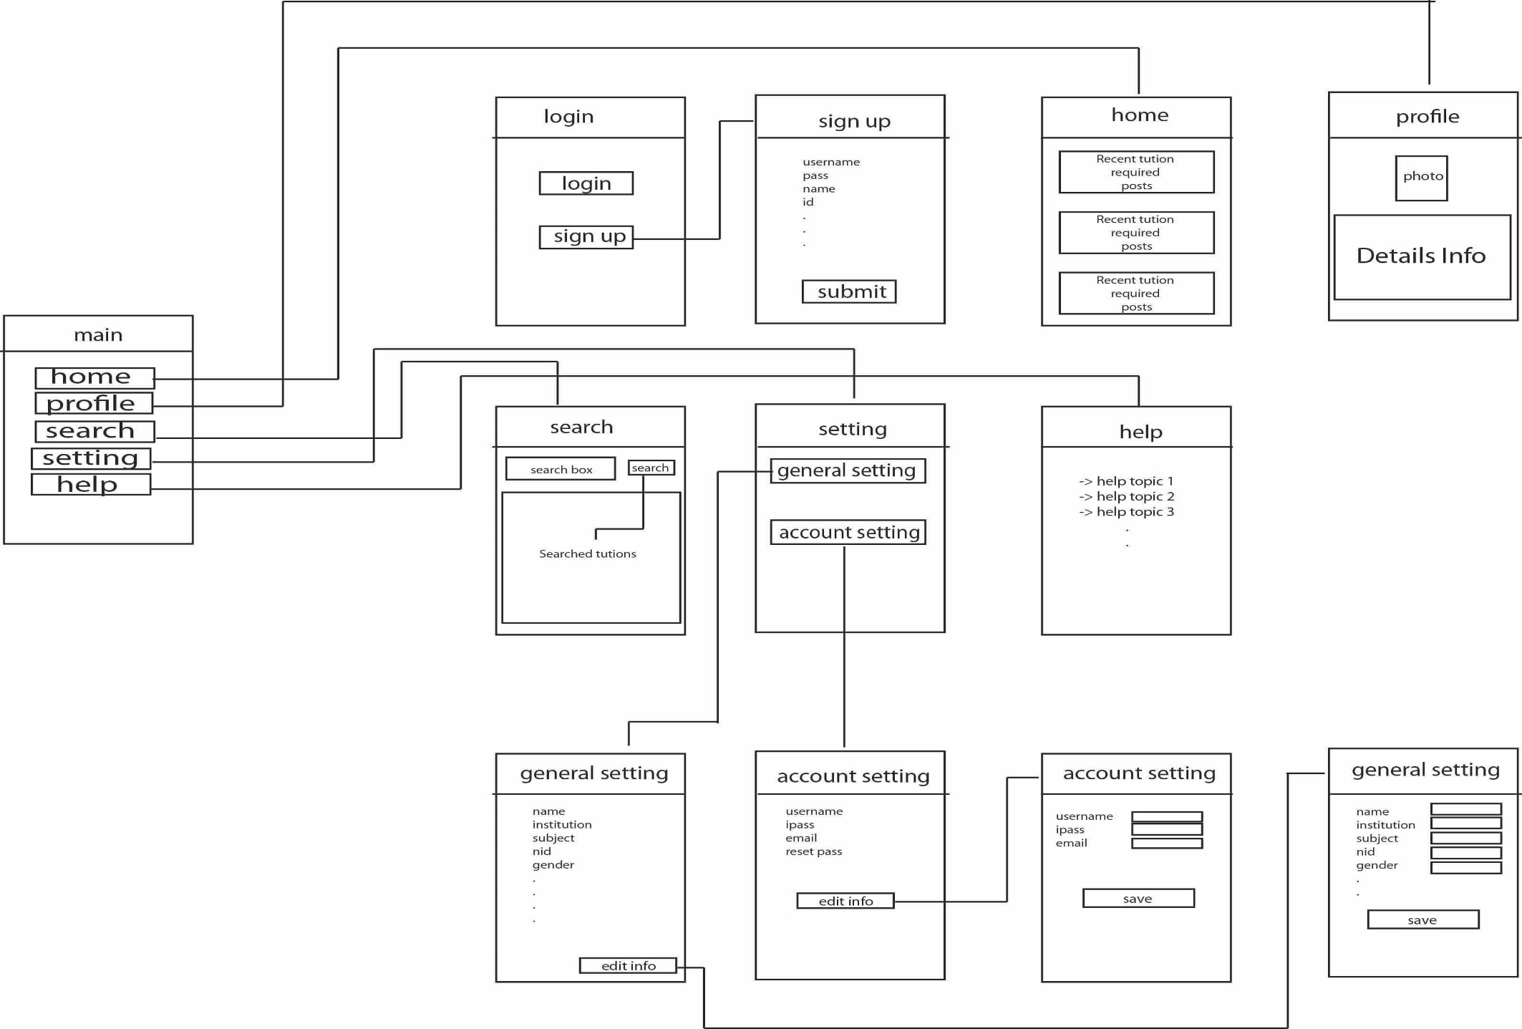
UI Diagram

Slide 12
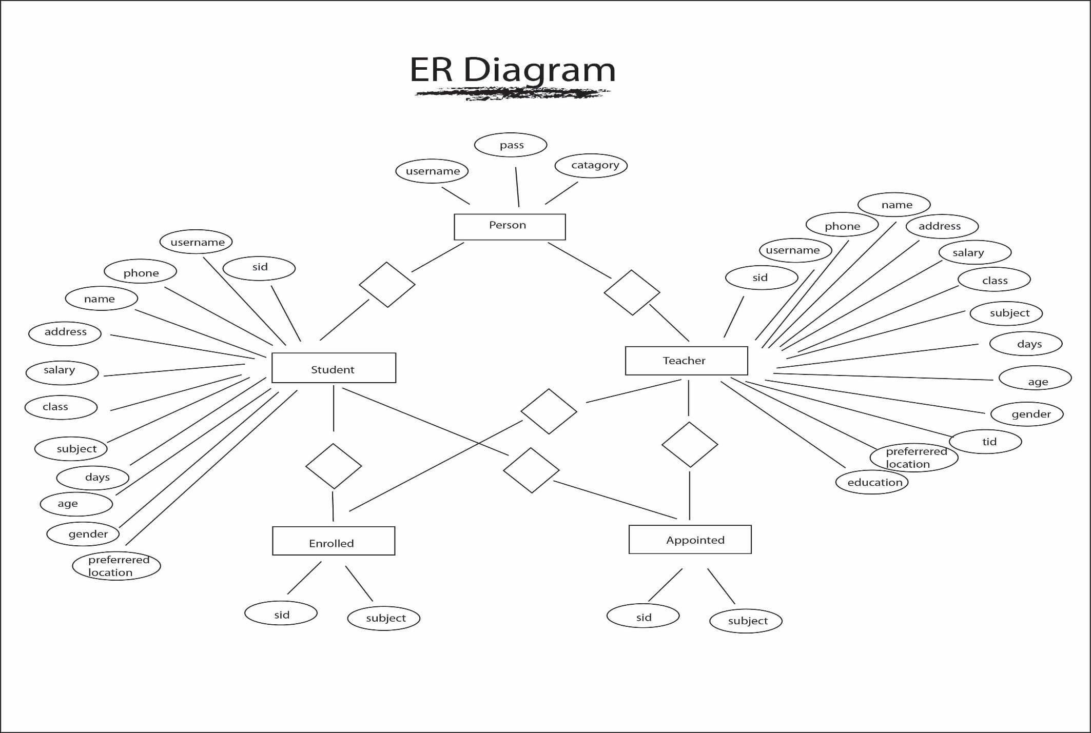
ER Diagram

Slide 13
conclusion
Making easy inroads for students and tutors to fulfill their requirements regarding all possible scenarios.
Easily accessible and user friendly in terms of service.
Easiest way possible to take initial to find the collaboration.

Slide 14
Thank You

