Slide 1
Team Name : SUST_CodeSmell
App Name: ISkool
Team members :
1. Koushik Sarker Seemanto
2. Badrudduza Ahmed Fahim
3. Partha Protim Paul
4. Jarin Tasnim Rafa

Slide 2
Challenge
The challenge is to build a system to provide real-time information on students’ attendance and performance, information that is critical for the management to design interventions to ensure quality and effective use of time.
Have to maintain consistent flow of data.
Have to create an efficient attendance system.

Slide 3
Features
Cross Platform for different management (Web, Android)
Face recognition system for students’ attendance
All level of data management and data consistency
Continuous flow of real time data through different level management
Dashboard system for all level of management.
Performance analysis of a school.
Performance analysis of individual students.
Problem identification from different level of management

Slide 4
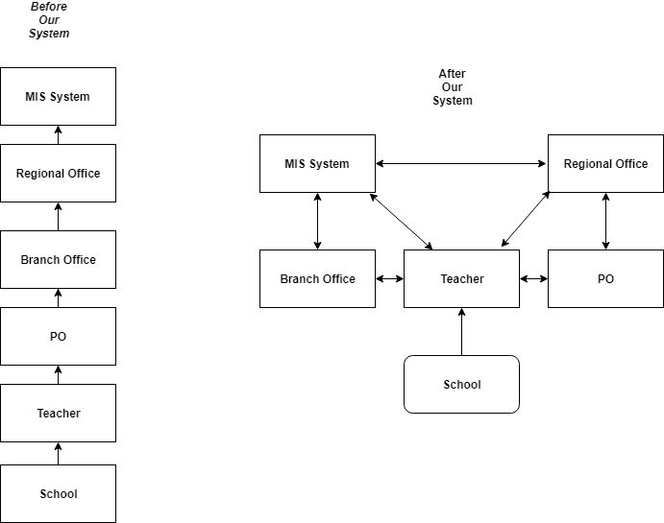
DATA FLOW

Slide 5
Features to be implemented
Offline face recognition and attendance generation through message service.
An AI system will be implemented for teachers which will mark problem of school and grade school according to various parameter & provide a decision by talking to the teachers.

Slide 6
THANK YOU

