Slide 1
Digital Logic Design I
Boolean Algebra and Logic Gate
Mustafa Kemal Uyguroğlu
EASTERN MEDITERRANEAN UNIVERSITY

Slide 2
Algebras
What is an algebra?
  Mathematical system consisting of
    Set of elements
    Set of operators
    Axioms or postulates
Why is it important?
  Defines rules of “calculations”
Example: arithmetic on natural numbers
  Set of elements: N = {1,2,3,4,…}
  Operator: +, –, *
  Axioms: associativity, distributivity, closure, identity elements, etc.
Note: operators with two inputs are called binary
  Does not mean they are restricted to binary numbers!
  Operator(s) with one input are called unary

Slide 3
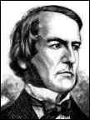
George Boole
Father of Boolean algebra
He came up with a type of linguistic algebra, the three most basic operations of which were (and still are) AND, OR and NOT. It was these three functions that formed the basis of his premise, and were the only operations necessary to perform comparisons or basic mathematical functions.
Boole’s system (detailed in his 'An Investigation of the Laws of Thought, on Which Are Founded the Mathematical Theories of Logic and Probabilities', 1854) was based on a binary approach, processing only two objects - the yes-no, true-false, on-off, zero-one approach.
Surprisingly, given his standing in the academic community, Boole's idea was either criticized or completely ignored by the majority of his peers.
Eventually, one bright student, Claude Shannon (1916-2001), picked up the idea and ran with it
George Boole (1815 - 1864)

Slide 4
Boolean Algebra
Terminology:
  Literal: A variable or its complement
  Product term: literals connected by •
  Sum term: literals connected by +

Slide 5
Postulates of Two-Valued Boolean Algebra
B = {0, 1} and two binary operations, + and．
The rules of operations: AND、OR and NOT.
Closure (+ and‧)
The identity elements
  (1) +: 0
  (2)．: 1
AND
OR
NOT
x | y | x．y
0 | 0 | 0
0 | 1 | 0
1 | 0 | 0
1 | 1 | 1
x | y | x+y
0 | 0 | 0
0 | 1 | 1
1 | 0 | 1
1 | 1 | 1
x | x'
0 | 1
1 | 0

Slide 6
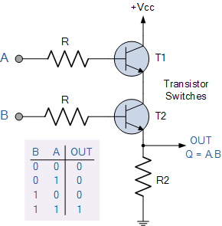
How is the behavior implemented

Slide 7
Postulates of Two-Valued Boolean Algebra
The commutative laws
The distributive laws
x | y | z | y+z | x．(y+z) | x．y | x．z | (x．y)+(x．z)
0 | 0 | 0 | 0 | 0 | 0 | 0 | 0
0 | 0 | 1 | 1 | 0 | 0 | 0 | 0
0 | 1 | 0 | 1 | 0 | 0 | 0 | 0
0 | 1 | 1 | 1 | 0 | 0 | 0 | 0
1 | 0 | 0 | 0 | 0 | 0 | 0 | 0
1 | 0 | 1 | 1 | 1 | 0 | 1 | 1
1 | 1 | 0 | 1 | 1 | 1 | 0 | 1
1 | 1 | 1 | 1 | 1 | 1 | 1 | 1

Slide 8
Postulates of Two-Valued Boolean Algebra
Complement
  x+x'=1 → 0+0'=0+1=1; 1+1'=1+0=1
  x．x'=0 → 0．0'=0．1=0; 1．1'=1．0=0
Has two distinct elements 1 and 0, with 0 ≠ 1
Note
  A set of two elements
  + : OR operation; ．: AND operation
  A complement operator: NOT operation
  Binary logic is a two-valued Boolean algebra

Slide 9
Duality
The principle of duality is an important concept. This says that if an expression is valid in Boolean algebra, the dual of that expression is also valid.
To form the dual of an expression, replace all + operators with . operators, all . operators with + operators, all ones with zeros, and all zeros with ones.
Form the dual of the expression
  a + (bc) = (a + b)(a + c)
Following the replacement rules…
  a(b + c) = ab + ac
Take care not to alter the location of the parentheses if they are present.

Slide 10
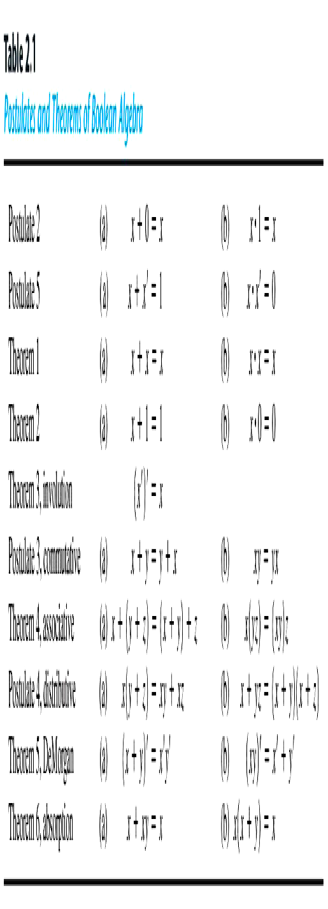
Basic Theorems

Slide 11
Proof of x+x=x
We can only use
Huntington postulates:
Show that x+x=x.
  x+x = (x+x)·1 by 2(b)
  = (x+x)(x+x’) by 5(a)
  = x+xx’ by 4(b)
  = x+0 by 5(b)
  = x by 2(a)
  Q.E.D.
We can now use Theorem 1(a) in future proofs
Huntington postulates:
Post. 2: (a) x+0=x, (b) x·1=x
Post. 3: (a) x+y=y+x, (b) x·y=y·x
Post. 4: (a) x(y+z) = xy+xz,
(b) x+yz = (x+y)(x+z)
Post. 5: (a) x+x’=1, (b) x·x’=0

Slide 12
Proof of x·x=x
Similar to previous
proof
Show that x·x = x.
  x·x = xx+0 by 2(a)
  = xx+xx’ by 5(b)
  = x(x+x’) by 4(a)
  = x·1 by 5(a)
  = x by 2(b)
  Q.E.D.
Huntington postulates:
Post. 2: (a) x+0=x, (b) x·1=x
Post. 3: (a) x+y=y+x, (b) x·y=y·x
Post. 4: (a) x(y+z) = xy+xz,
(b) x+yz = (x+y)(x+z)
Post. 5: (a) x+x’=1, (b) x·x’=0
Th. 1: (a) x+x=x

Slide 13
Proof of x+1=1
Theorem 2(a): x + 1 = 1
x + 1 = 1．(x + 1) by 2(b)
  =(x + x')(x + 1) 5(a)
  = x + x' 1 4(b)
  = x + x' 2(b)
  = 1 5(a)
Theorem 2(b): x．0 = 0 by duality
Theorem 3: (x')' = x
  Postulate 5 defines the complement of x, x + x' = 1 and x x' = 0
  The complement of x' is x is also (x')'
Huntington postulates:
Post. 2: (a) x+0=x, (b) x·1=x
Post. 3: (a) x+y=y+x, (b) x·y=y·x
Post. 4: (a) x(y+z) = xy+xz,
(b) x+yz = (x+y)(x+z)
Post. 5: (a) x+x’=1, (b) x·x’=0
Th. 1: (a) x+x=x

Slide 14
Absorption Property (Covering)
Huntington postulates:
Post. 2: (a) x+0=x, (b) x·1=x
Post. 3: (a) x+y=y+x, (b) x·y=y·x
Post. 4: (a) x(y+z) = xy+xz,
(b) x+yz = (x+y)(x+z)
Post. 5: (a) x+x’=1, (b) x·x’=0
Th. 1: (a) x+x=x
Theorem 6(a): x + xy = x
  x + xy = x．1 + xy by 2(b)
  = x (1 + y) 4(a)
  = x (y + 1) 3(a)
  = x．1 Th 2(a)
  = x 2(b)
Theorem 6(b): x (x + y) = x by duality
By means of truth table (another way to proof )
x | y | xy | x+xy
0 | 0 | 0 | 0
0 | 1 | 0 | 0
1 | 0 | 0 | 1
1 | 1 | 1 | 1

Slide 15
DeMorgan’s Theorem
Theorem 5(a): (x + y)’ = x’y’
Theorem 5(b): (xy)’ = x’ + y’
By means of truth table
x | y | x’ | y’ | x+y | (x+y)’ | x’y’ | xy | x’+y' | (xy)’
0 | 0 | 1 | 1 | 0 | 1 | 1 | 0 | 1 | 1
0 | 1 | 1 | 0 | 1 | 0 | 0 | 0 | 1 | 1
1 | 0 | 0 | 1 | 1 | 0 | 0 | 0 | 1 | 1
1 | 1 | 0 | 0 | 1 | 0 | 0 | 1 | 0 | 0

Slide 16
Consensus Theorem
xy + x’z + yz = xy + x’z
(x+y)•(x’+z)•(y+z) = (x+y)•(x’+z) -- (dual)
Proof:
xy + x’z + yz = xy + x’z + (x+x’)yz
= xy + x’z + xyz + x’yz
= (xy + xyz) + (x’z + x’zy)
= xy + x’z
QED (2 true by duality).

Slide 17
Operator Precedence
The operator precedence for evaluating Boolean Expression is
  Parentheses
  NOT
  AND
  OR
Examples
  x y' + z
  (x y + z)'

Slide 18
Boolean Functions
A Boolean function
  Binary variables
  Binary operators OR and AND
  Unary operator NOT
  Parentheses
Examples
  F₁= x y z'
  F₂ = x + y'z
  F₃ = x' y' z + x' y z + x y'
  F₄ = x y' + x' z

Slide 19
Boolean Functions
  The truth table of 2^{n} entries
Two Boolean expressions may specify the same function
  F₃ = F₄
x | y | z | F₁ | F₂ | F₃ | F₄
0 | 0 | 0 | 0 | 0 | 0 | 0
0 | 0 | 1 | 0 | 1 | 1 | 1
0 | 1 | 0 | 0 | 0 | 0 | 0
0 | 1 | 1 | 0 | 0 | 1 | 1
1 | 0 | 0 | 0 | 1 | 1 | 1
1 | 0 | 1 | 0 | 1 | 1 | 1
1 | 1 | 0 | 1 | 1 | 0 | 0
1 | 1 | 1 | 0 | 1 | 0 | 0

Slide 20
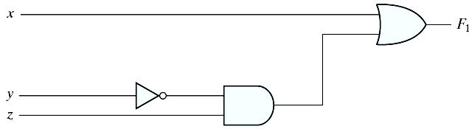
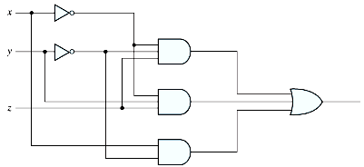
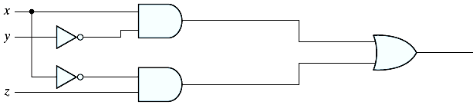
Boolean Functions
Implementation with logic gates
  F₄ is more economical
  F₂ = x + y'z
  F₃ = x' y' z + x' y z + x y'
  F₄ = x y' + x' z

Slide 21
Algebraic Manipulation
To minimize Boolean expressions
  Literal: a primed or unprimed variable (an input to a gate)
  Term: an implementation with a gate
  The minimization of the number of literals and the number of terms → a circuit with less equipment
  It is a hard problem (no specific rules to follow)
Example 2.1
  x(x'+y) = xx' + xy = 0+xy = xy
  x+x'y = (x+x')(x+y) = 1 (x+y) = x+y
  (x+y)(x+y') = x+xy+xy'+yy' = x(1+y+y') = x
  xy + x'z + yz = xy + x'z + yz(x+x') = xy + x'z + yzx + yzx' = xy(1+z) + x'z(1+y) = xy +x'z
  (x+y)(x'+z)(y+z) = (x+y)(x'+z), by duality from function 4. (consensus theorem with duality)

Slide 22
Complement of a Function
An interchange of 0's for 1's and 1's for 0's in the value of F
  By DeMorgan's theorem
  (A+B+C)' = (A+X)' let B+C = X
  = A'X' by theorem 5(a) (DeMorgan's)
  = A'(B+C)' substitute B+C = X
  = A'(B'C') by theorem 5(a) (DeMorgan's)
  = A'B'C' by theorem 4(b) (associative)
Generalizations: a function is obtained by interchanging AND and OR operators and complementing each literal.
  (A+B+C+D+ ... +F)' = A'B'C'D'... F'
  (ABCD ... F)' = A'+ B'+C'+D' ... +F'

Slide 23
Examples
Example 2.2
  F₁' = (x'yz' + x'y'z)' = (x'yz')' (x'y'z)' = (x+y'+z) (x+y+z')
  F₂' = [x(y'z'+yz)]' = x' + (y'z'+yz)' = x' + (y'z')' (yz)‘
  = x' + (y+z) (y'+z')
  = x' + yz‘+y'z
Example 2.3: a simpler procedure
  Take the dual of the function and complement each literal
  F₁ = x'yz' + x'y'z.
  The dual of F₁ is (x'+y+z') (x'+y'+z).
  Complement each literal: (x+y'+z)(x+y+z') = F₁'
  F₂ = x(y' z' + yz).
  The dual of F₂ is x+(y'+z') (y+z).
  Complement each literal: x'+(y+z)(y' +z') = F₂'

Slide 24
2.6 Canonical and Standard Forms
Minterms and Maxterms
A minterm (standard product): an AND term consists of all literals in their normal form or in their complement form.
  For example, two binary variables x and y,
    xy, xy', x'y, x'y'
  It is also called a standard product.
  n variables con be combined to form 2^{n} minterms.
A maxterm (standard sums): an OR term
  It is also call a standard sum.
  2^{n} maxterms.

Slide 25
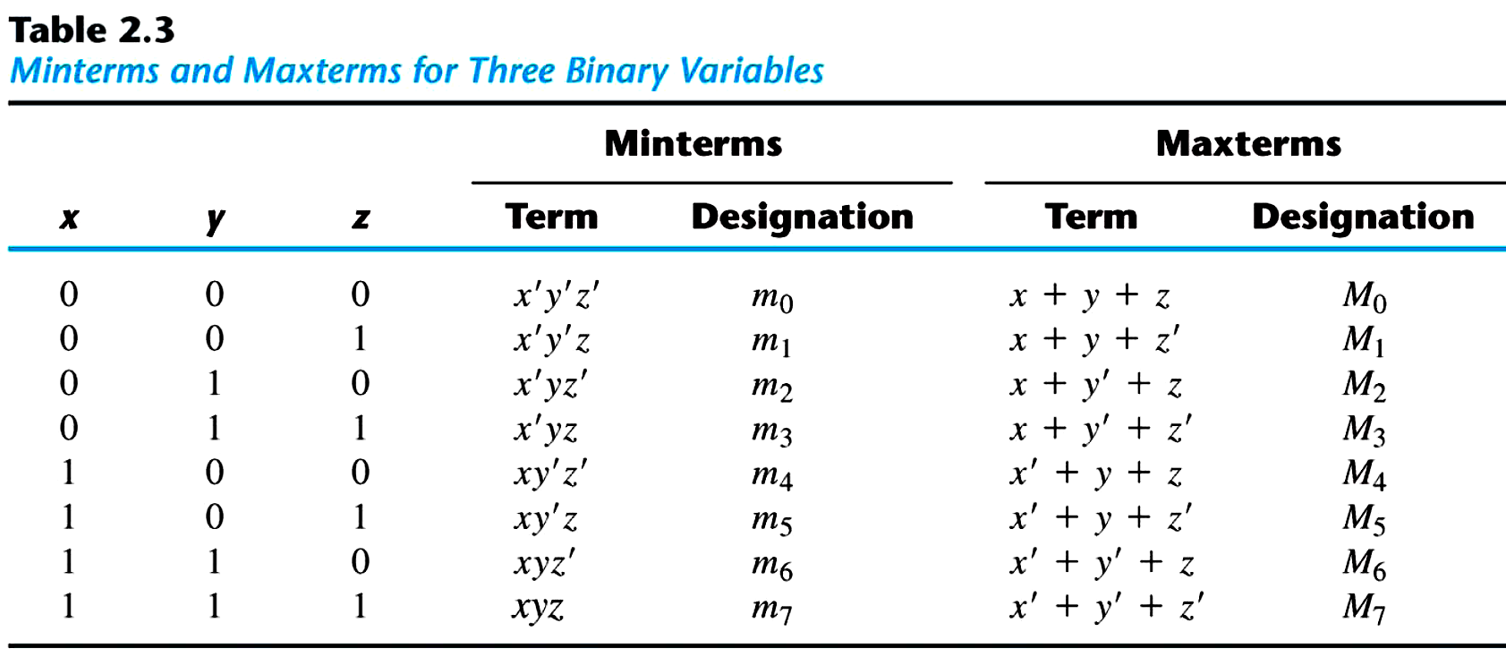
Minterms and Maxterms
  Each maxterm is the complement of its corresponding minterm, and vice versa.

Slide 26
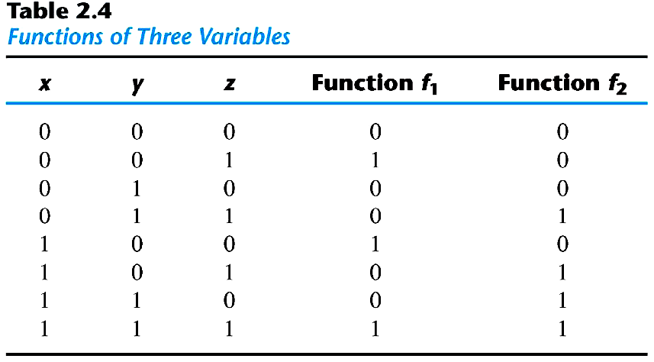
Minterms and Maxterms
An Boolean function can be expressed by
  A truth table
  Sum of minterms
  f₁ = x'y'z + xy'z' + xyz = m₁ + m₄ +m₇ (Minterms)
  f₂ = x'yz+ xy'z + xyz'+xyz = m₃ + m₅ +m₆ + m₇ (Minterms)

Slide 27
Minterms and Maxterms
The complement of a Boolean function
  The minterms that produce a 0
  f₁' = m₀ + m₂ +m₃ + m₅ + m₆ = x'y'z'+x'yz'+x'yz+xy'z+xyz'
  f₁ = (f₁')' = (x+y+z)(x+y'+z) (x+y'+z') (x'+y+z')(x'+y'+z) = M₀ M₂ M₃ M₅ M₆
  f₂ = (x+y+z)(x+y+z')(x+y'+z)(x'+y+z)=M₀M₁M₂M₄
Any Boolean function can be expressed as
  A sum of minterms (“sum” meaning the ORing of terms).
  A product of maxterms (“product” meaning the ANDing of terms).
  Both boolean functions are said to be in Canonical form.

Slide 28
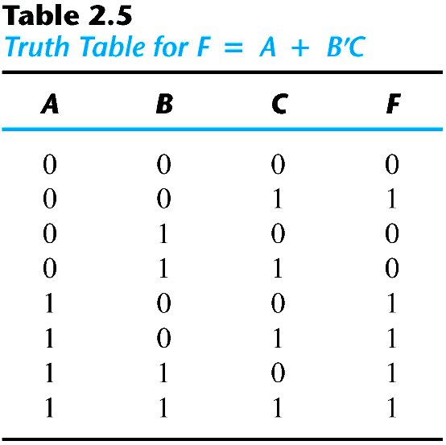
Sum of Minterms
Sum of minterms: there are 2^{n} minterms and 2^{2n} combinations of function with n Boolean variables.
Example 2.4: express F = A+BC' as a sum of minterms.
  F = A+B'C = A (B+B') + B'C = AB +AB' + B'C = AB(C+C') + AB'(C+C') + (A+A')B'C = ABC+ABC'+AB'C+AB'C'+A'B'C
  F = A'B'C +AB'C' +AB'C+ABC'+ ABC = m₁ + m₄ +m₅ + m₆ + m₇
  F(A, B, C) = Σ(1, 4, 5, 6, 7)
  or, built the truth table first

Slide 29
Product of Maxterms
Product of maxterms: using distributive law to expand.
  x + yz = (x + y)(x + z) = (x+y+zz')(x+z+yy') = (x+y+z)(x+y+z')(x+y'+z)
Example 2.5: express F = xy + x'z as a product of maxterms.
  F = xy + x'z = (xy + x')(xy +z) = (x+x')(y+x')(x+z)(y+z) = (x'+y)(x+z)(y+z)
  x'+y = x' + y + zz' = (x'+y+z)(x'+y+z')
  F = (x+y+z)(x+y'+z)(x'+y+z)(x'+y+z') = M₀M₂M₄M₅
  F(x, y, z) = Π(0, 2, 4, 5)

Slide 30
Conversion between Canonical Forms
The complement of a function expressed as the sum of minterms equals the sum of minterms missing from the original function.
  F(A, B, C) = Σ(1, 4, 5, 6, 7)
  Thus, F'(A, B, C) = Σ(0, 2, 3)
  By DeMorgan's theorem
  F(A, B, C) = Π(0, 2, 3)
  F'(A, B, C) =Π (1, 4, 5, 6, 7)
  m_{j}' = M_{j}
  Sum of minterms = product of maxterms
  Interchange the symbols Σ and Π and list those numbers missing from the original form
    Σ of 1's
    Π of 0's

Slide 31
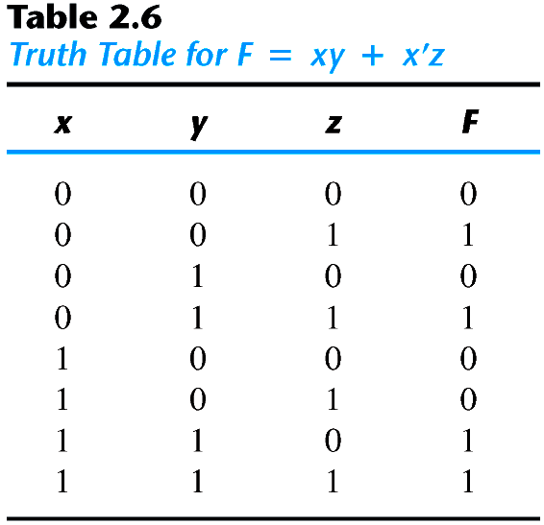
Example
  F = xy + x′z
  F(x, y, z) = Σ(1, 3, 6, 7)
  F(x, y, z) = Π (0, 2, 4, 6)

Slide 32
Standard Forms
Canonical forms are very seldom the ones with the least number of literals.
Standard forms: the terms that form the function may obtain one, two, or any number of literals.
  Sum of products: F₁ = y' + xy+ x'yz'
  Product of sums: F₂ = x(y'+z)(x'+y+z')
  F₃ = A'B'CD+ABC'D'

Slide 33
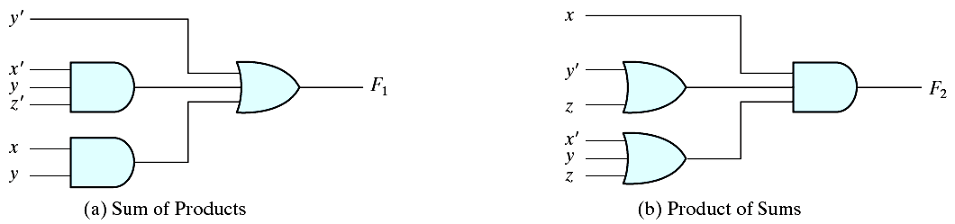
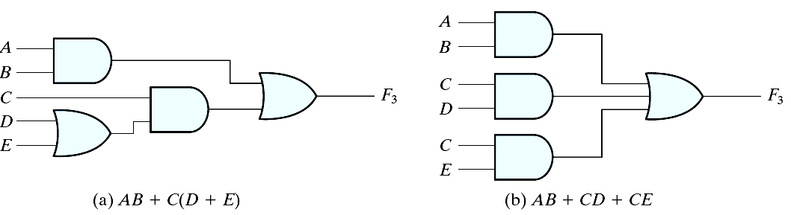
Implementation
Two-level implementation
Multi-level implementation
F₁ = y' + xy+ x'yz'
F₂ = x(y'+z)(x'+y+z')

