Slide 1
Digital Logic Design I
Gate-Level Minimization
Mustafa Kemal Uyguroğlu
EASTERN MEDITERRANEAN UNIVERSITY

Slide 2
3-1 Introduction
Gate-level minimization refers to the design task of finding an optimal gate-level implementation of Boolean functions describing a digital circuit.

Slide 3
3-2 The Map Method
The complexity of the digital logic gates
  The complexity of the algebraic expression
Logic minimization
  Algebraic approaches: lack specific rules
  The Karnaugh map
    A simple straight forward procedure
    A pictorial form of a truth table
    Applicable if the # of variables < 7
A diagram made up of squares
  Each square represents one minterm

Slide 4
Review of Boolean Function
Boolean function
  Sum of minterms
  Sum of products (or product of sum) in the simplest form
  A minimum number of terms
  A minimum number of literals
  The simplified expression may not be unique

Slide 5
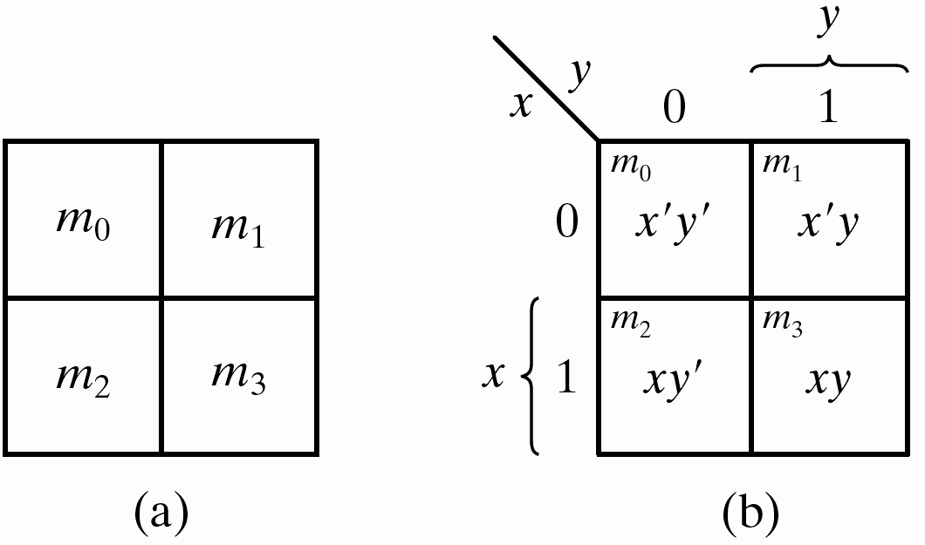
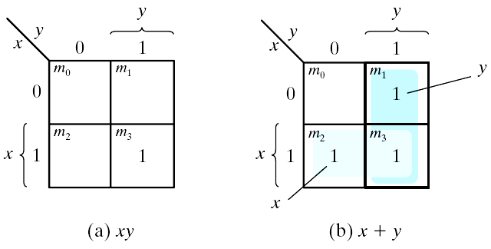
Two-Variable Map
A two-variable map
  Four minterms
  x' = row 0; x = row 1
  y' = column 0; y = column 1
  A truth table in square diagram
  Fig. 3.2(a): xy = m₃
  Fig. 3.2(b): x+y = x'y+xy' +xy = m₁+m₂+m₃
Figure 3.1 Two-variable Map
Figure 3.2 Representation of functions in the map

Slide 6
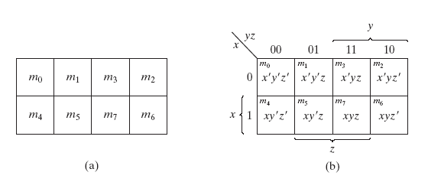
A Three-variable Map
A three-variable map
  Eight minterms
  The Gray code sequence
  Any two adjacent squares in the map differ by only on variable
    Primed in one square and unprimed in the other
    e.g., m₅ and m₇ can be simplified
    m₅+ m₇ = xy'z + xyz = xz (y'+y) = xz
Figure 3.3 Three-variable Map

Slide 7
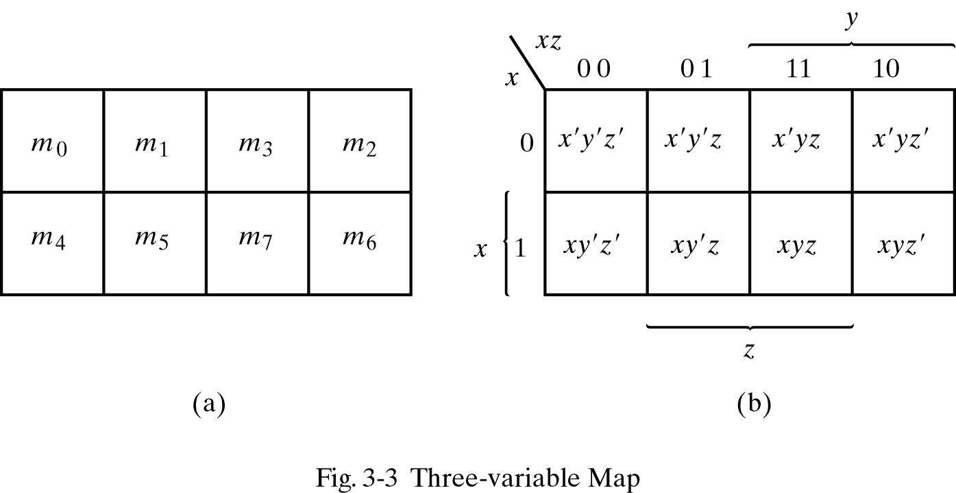
A Three-variable Map
  m₀ and m₂ (m₄ and m₆) are adjacent
  m₀+ m₂ = x'y'z' + x'yz' = x'z' (y'+y) = x'z'
  m₄+ m₆ = xy'z' + xyz' = xz' (y'+y) = xz'

Slide 8
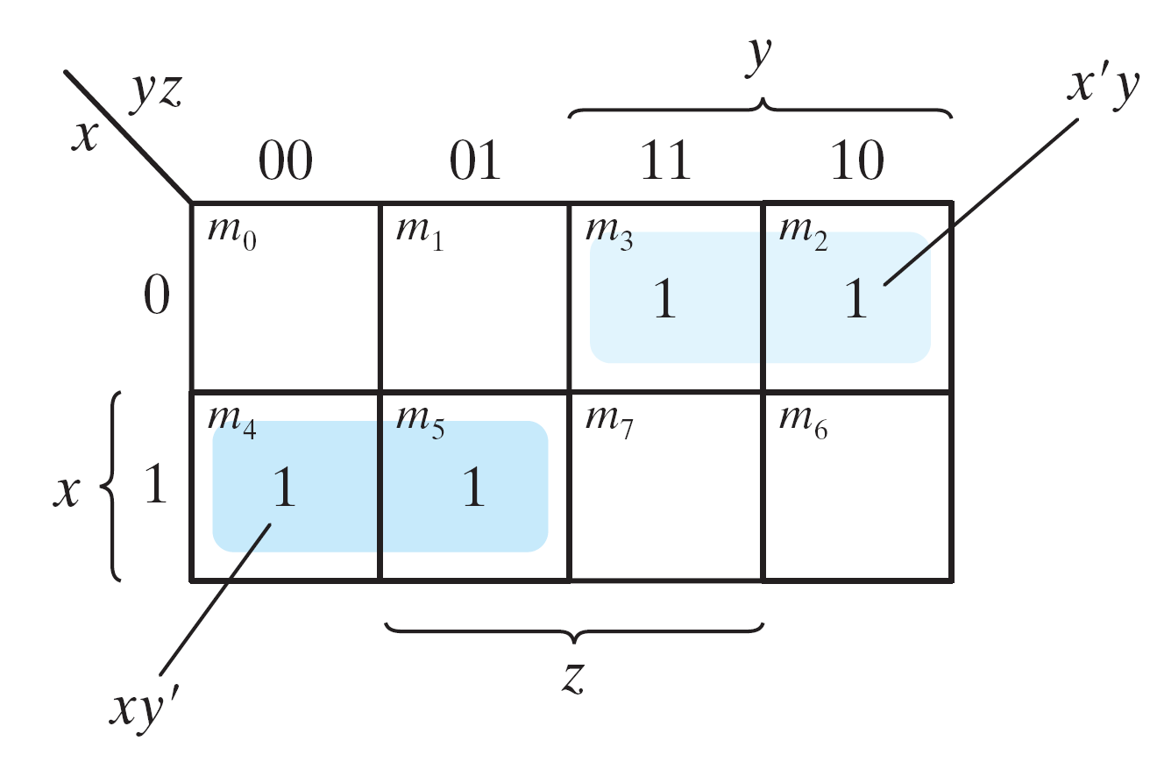
Example 3.1
Example 3.1: simplify the Boolean function F(x, y, z) = Σ(2, 3, 4, 5)
  F(x, y, z) = Σ(2, 3, 4, 5) = x'y + xy'
Figure 3.4 Map for Example 3.1, F(x, y, z) = Σ(2, 3, 4, 5) = x'y + xy'

Slide 9
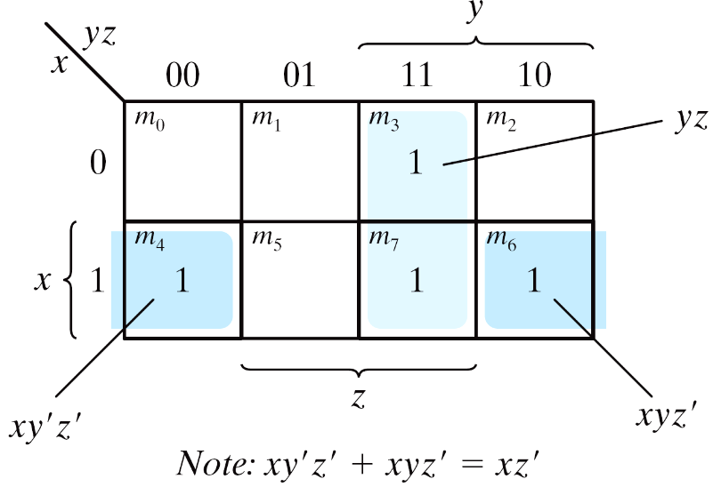
Example 3.2
Example 3.2: simplify F(x, y, z) = Σ(3, 4, 6, 7)
  F(x, y, z) = Σ(3, 4, 6, 7) = yz+ xz'
Figure 3.5 Map for Example 3-2; F(x, y, z) = Σ(3, 4, 6, 7) = yz + xz'

Slide 10
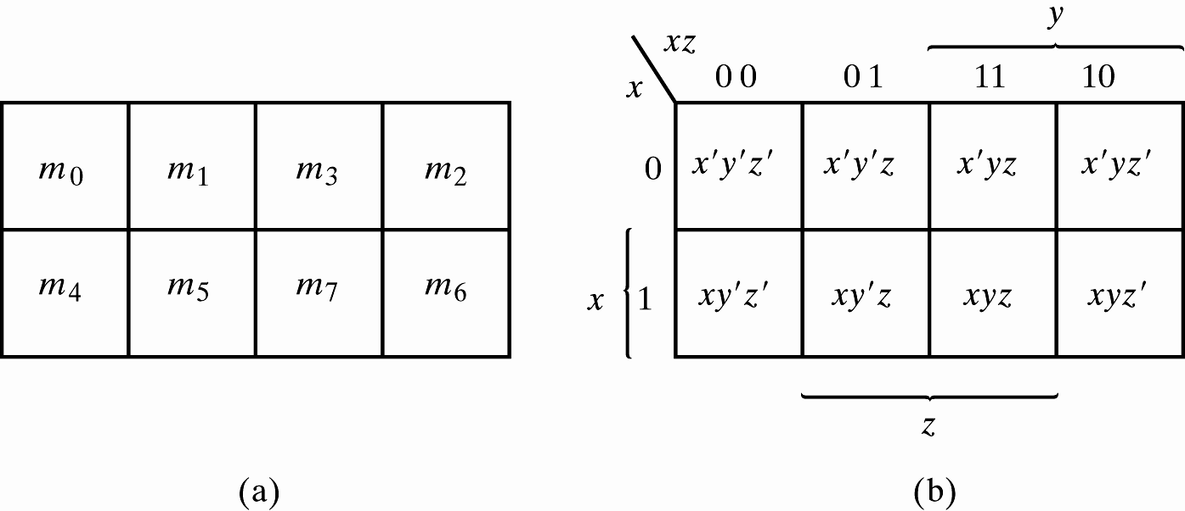
Four adjacent Squares
Consider four adjacent squares
  2, 4, and 8 squares
  m₀+m₂+m₄+m₆ = x'y'z'+x'yz'+xy'z'+xyz' = x'z'(y'+y) +xz'(y'+y) = x'z' + xz‘ = z'
  m₁+m₃+m₅+m₇ = x'y'z+x'yz+xy'z+xyz =x'z(y'+y) + xz(y'+y) =x'z + xz = z
Figure 3.3 Three-variable Map

Slide 11
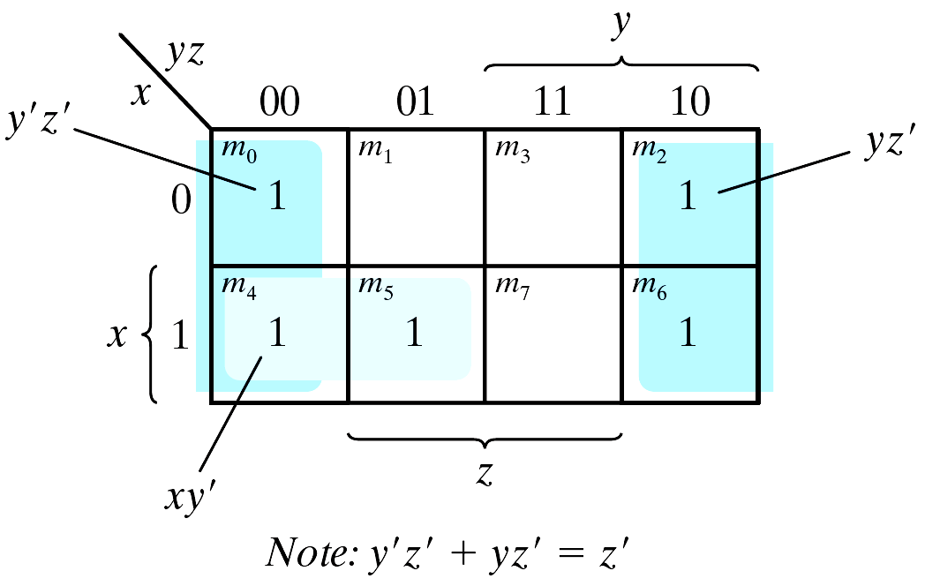
Example 3.3
  Example 3.3: simplify F(x, y, z) = Σ(0, 2, 4, 5, 6)
  F(x, y, z) = Σ(0, 2, 4, 5, 6) = z'+ xy'
Figure 3.6 Map for Example 3-3, F(x, y, z) = Σ(0, 2, 4, 5, 6) = z' +xy'

Slide 12
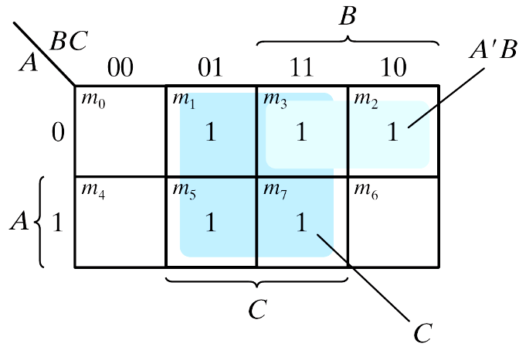
Example 3.4
Example 3.4: let F = A'C + A'B + AB'C + BC
  Express it in sum of minterms.
  Find the minimal sum of products expression.
  Ans:
  F(A, B, C) = Σ(1, 2, 3, 5, 7) = C + A'B
Figure 3.7 Map for Example 3.4, A'C + A'B + AB'C + BC = C + A'B

Slide 13
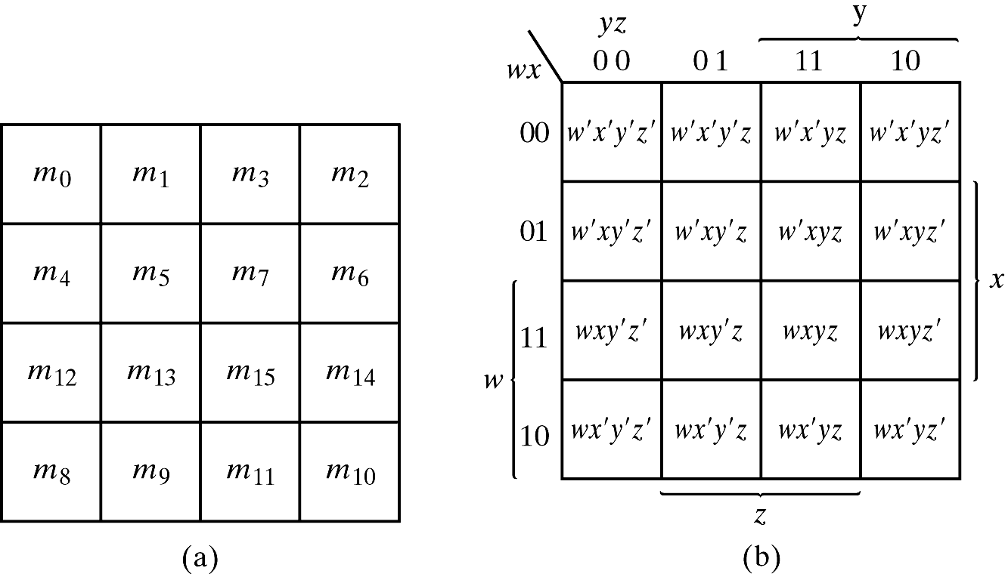
3.3 Four-Variable Map
The map
  16 minterms
  Combinations of 2, 4, 8, and 16 adjacent squares
Figure 3.8 Four-variable Map

Slide 14
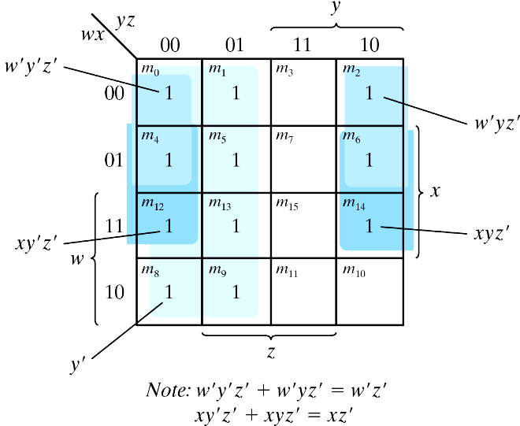
Example 3.5
Example 3.5: simplify F(w, x, y, z) = Σ(0, 1, 2, 4, 5, 6, 8, 9, 12, 13, 14)
  F = y'+w'z'+xz'
Figure 3.9 Map for Example 3-5; F(w, x, y, z) = Σ(0, 1, 2, 4, 5, 6, 8, 9, 12, 13, 14) = y' + w' z' +xz'

Slide 15
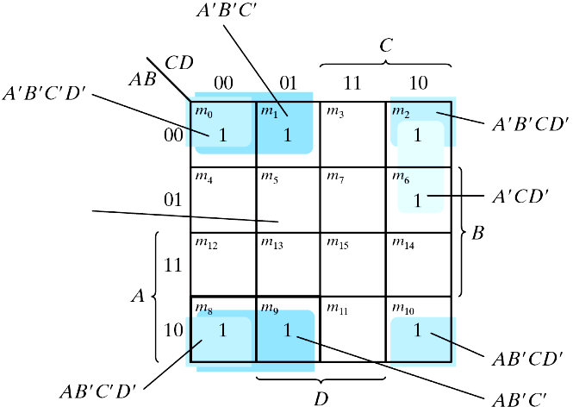
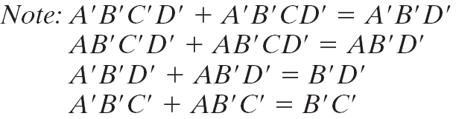
Example 3.6
Example 3-6: simplify F = A′B′C′ + B′CD′ + A ′ BCD ′ + AB′C′
Figure 3.9 Map for Example 3-6; A′B′C′ + B′CD′ + A′B′C′D′ + AB′C′= B′D′ + B′C′ +A′CD′

Slide 16
Prime Implicants
Prime Implicants
  All the minterms are covered.
  Minimize the number of terms.
  A prime implicant: a product term obtained by combining the maximum possible number of adjacent squares (combining all possible maximum numbers of squares).
  Essential P.I.: a minterm is covered by only one prime implicant.
  The essential P.I. must be included.

Slide 17
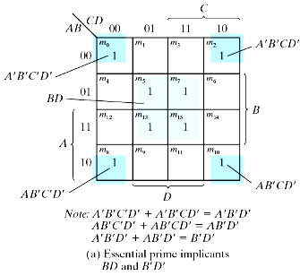
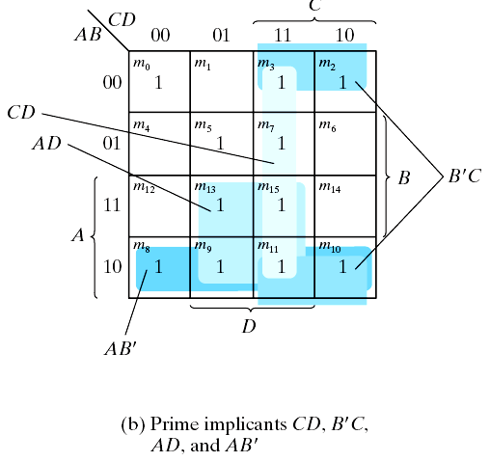
Prime Implicants
Consider F(A, B, C, D) = Σ(0, 2, 3, 5, 7, 8, 9, 10, 11, 13, 15)
  The simplified expression may not be unique
  F = BD+B'D'+CD+AD = BD+B'D'+CD+AB'
  = BD+B'D'+B'C+AD = BD+B'D'+B'C+AB'
Figure 3.11 Simplification Using Prime Implicants

Slide 18
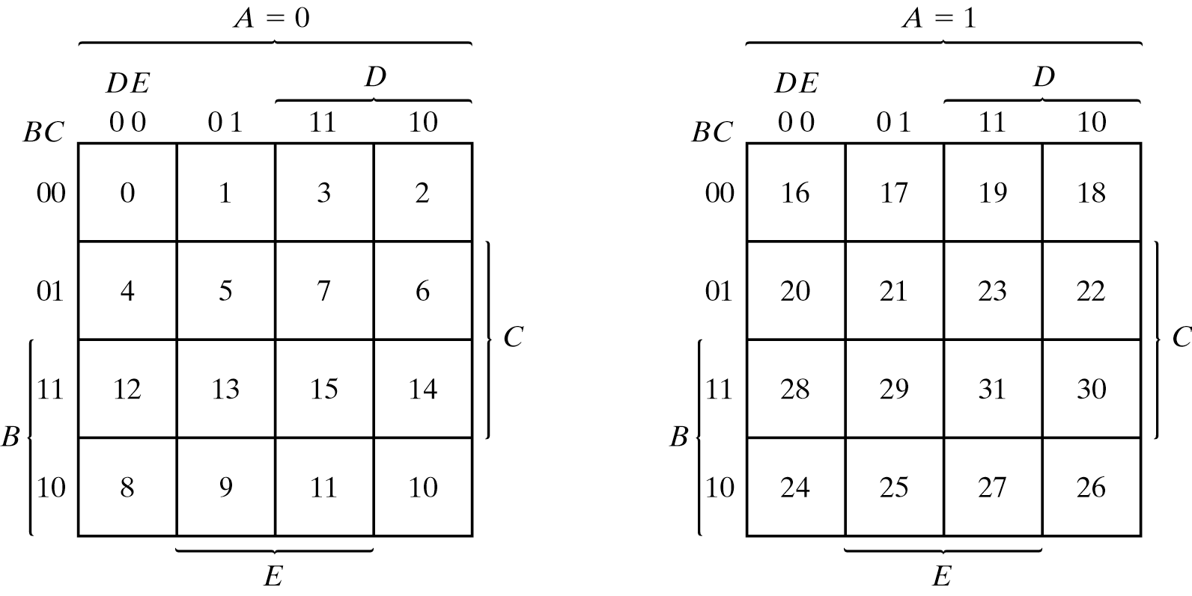
3.4 Five-Variable Map
Map for more than four variables becomes complicated
  Five-variable map: two four-variable map (one on the top of the other).
Figure 3.12 Five-variable Map

Slide 19
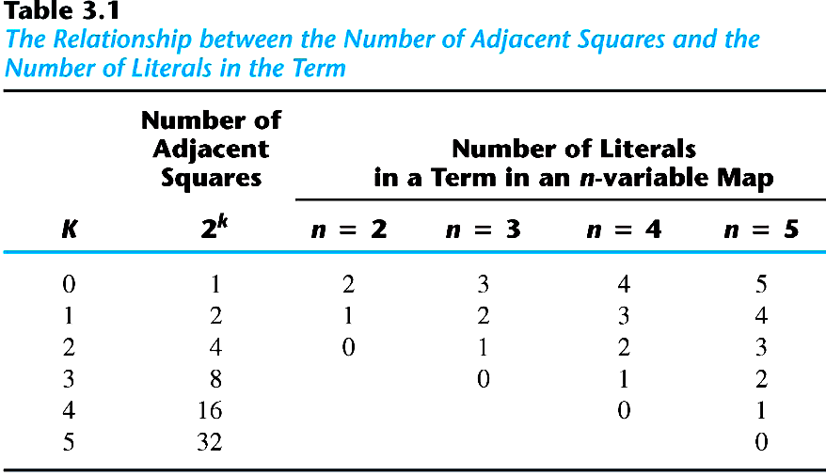
Table 3.1 shows the relationship between the number of adjacent squares and the number of literals in the term.

Slide 20
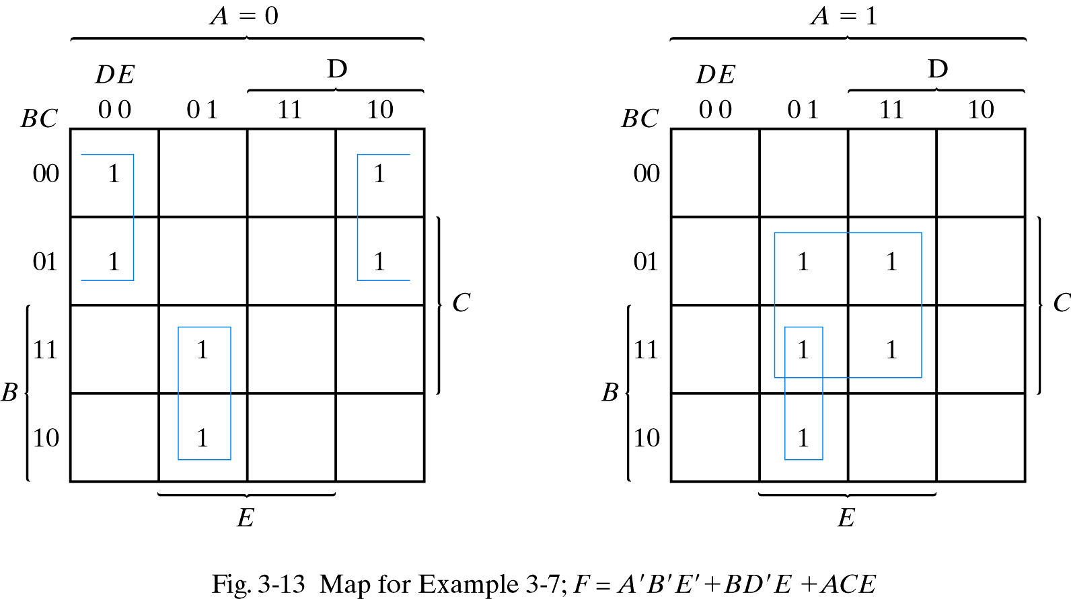
Example 3.7
Example 3.7: simplify F = Σ(0, 2, 4, 6, 9, 13, 21, 23, 25, 29, 31)
F = A'B'E'+BD'E+ACE

Slide 21
3-5 Product of Sums Simplification
Approach #1
  Simplified F' in the form of sum of products
  Apply DeMorgan's theorem F = (F')'
  F': sum of products → F: product of sums
Approach #2: duality
  Combinations of maxterms (it was minterms)
  M₀M₁ = (A+B+C+D)(A+B+C+D') = (A+B+C)+(DD') = A+B+C
CD
AB
00
01
11
10
00
M₀ | M₁ | M₃ | M₂
M₄ | M₅ | M₇ | M₆
M₁₂ | M₁₃ | M₁₅ | M₁₄
M₈ | M₉ | M₁₁ | M₁₀
01
11
10

Slide 22
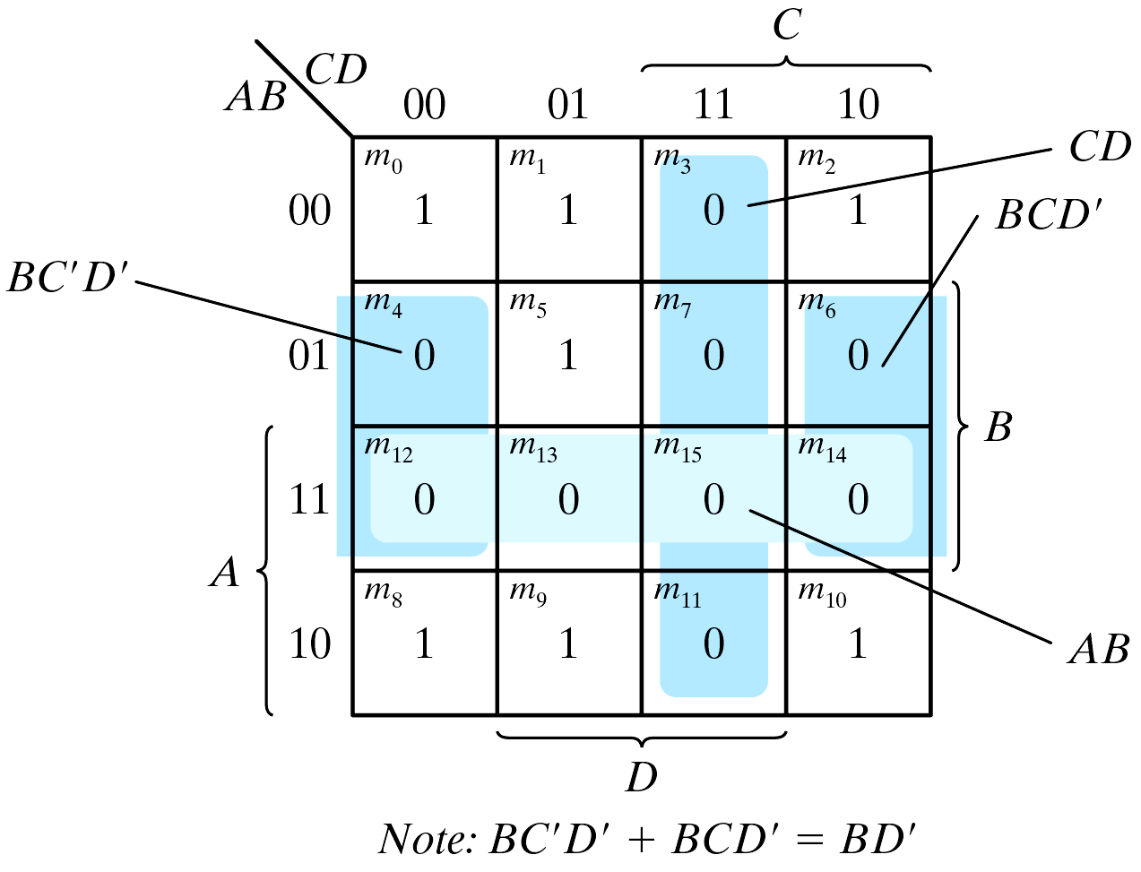
Example 3.8
  Example 3.8: simplify F = Σ(0, 1, 2, 5, 8, 9, 10) into (a) sum-of-products form, and (b) product-of-sums form:
  F(A, B, C, D)= Σ(0, 1, 2, 5, 8, 9, 10) = B'D'+B'C'+A'C'D
  F' = AB+CD+BD'
    Apply DeMorgan's theorem; F=(A'+B')(C'+D')(B'+D)
    Or think in terms of maxterms
Figure 3.14 Map for Example 3.8, F(A, B, C, D)= Σ(0, 1, 2, 5, 8, 9, 10) = B'D'+B'C'+A'C'D

Slide 23
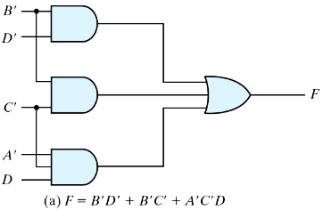
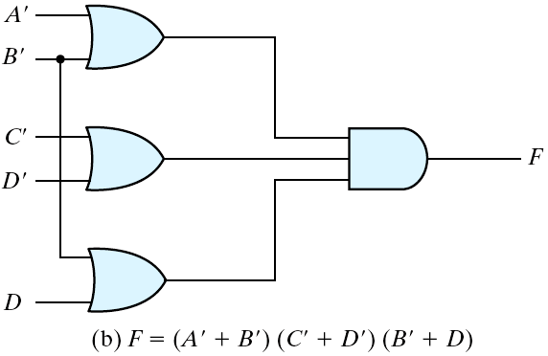
Example 3.8 (cont.)
Gate implementation of the function of Example 3.8
Sum-of products form
Product-of sums form
Figure 3.15 Gate Implementation of the Function of Example 3.8

Slide 24
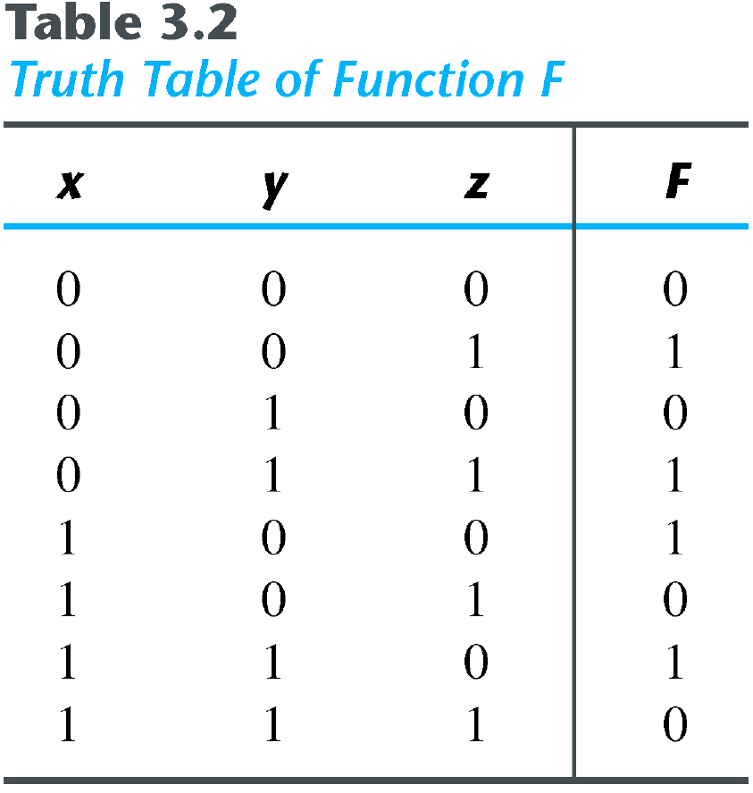
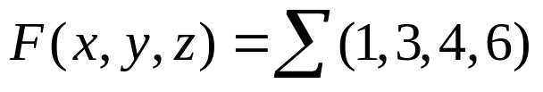


Sum-of-Minterm Procedure
Consider the function defined in Table 3.2.
  In sum-of-minterm:
  In sum-of-maxterm:
  Taking the complement of F′

Slide 25
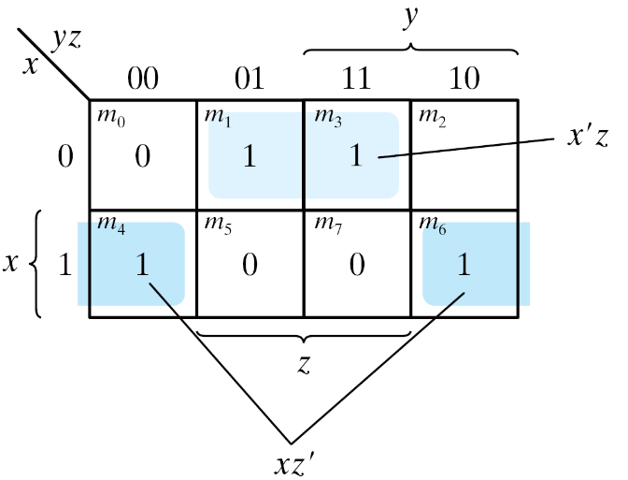


Sum-of-Minterm Procedure
Consider the function defined in Table 3.2.
  Combine the 1’s:
  Combine the 0’s :
'
Figure 3.16 Map for the function of Table 3.2

Slide 26
3-6 Don't-Care Conditions
The value of a function is not specified for certain combinations of variables
  BCD; 1010-1111: don't care
The don't-care conditions can be utilized in logic minimization
  Can be implemented as 0 or 1
Example 3.9: simplify F(w, x, y, z) = Σ(1, 3, 7, 11, 15) which has the don't-care conditions d(w, x, y, z) = Σ(0, 2, 5).

Slide 27
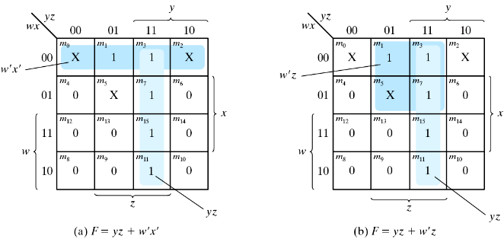
Example 3.9 (cont.)
  F = yz + w'x'; F = yz + w'z
  F = Σ(0, 1, 2, 3, 7, 11, 15) ; F = Σ(1, 3, 5, 7, 11, 15)
  Either expression is acceptable
Figure 3.17 Example with don't-care Conditions

Slide 28
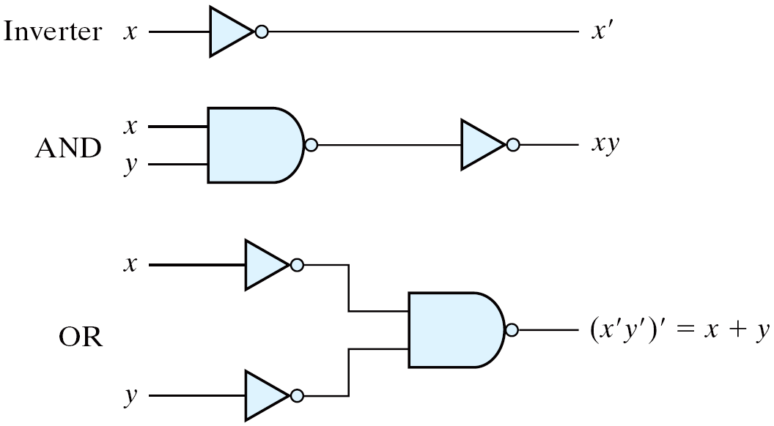
3-7 NAND and NOR Implementation
NAND gate is a universal gate
  Can implement any digital system
Figure 3.18 Logic Operations with NAND Gates

Slide 29

NAND Gate
Two graphic symbols for a NAND gate
Figure 3.19 Two Graphic Symbols for NAND Gate

Slide 30
Two-level Implementation
Two-level logic
  NAND-NAND = sum of products
  Example: F = AB+CD
  F = ((AB)' (CD)' )' =AB+CD
Figure 3.20 Three ways to implement F = AB + CD

Slide 31


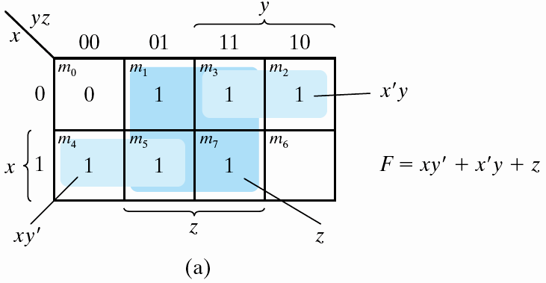
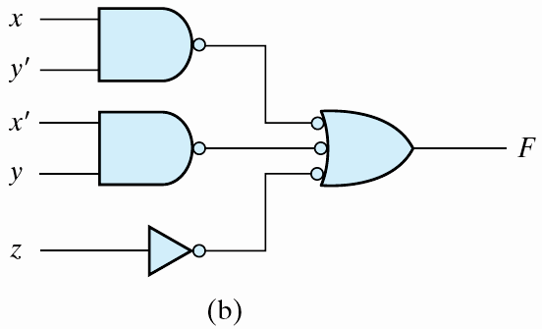
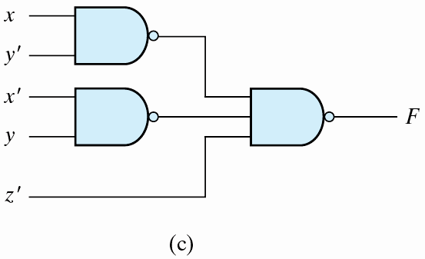
Example 3.10
Example 3-10: implement F(x, y, z) =
Figure 3.21 Solution to Example 3-10

Slide 32
Procedure with Two Levels NAND
The procedure
  Simplified in the form of sum of products;
  A NAND gate for each product term; the inputs to each NAND gate are the literals of the term (the first level);
  A single NAND gate for the second sum term (the second level);
  A term with a single literal requires an inverter in the first level.

Slide 33
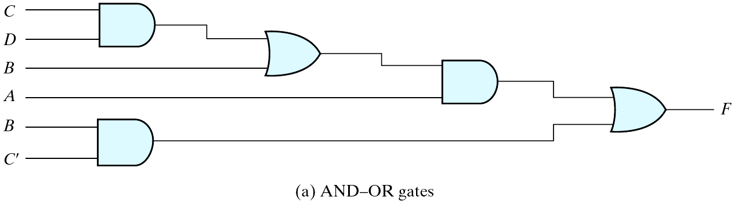
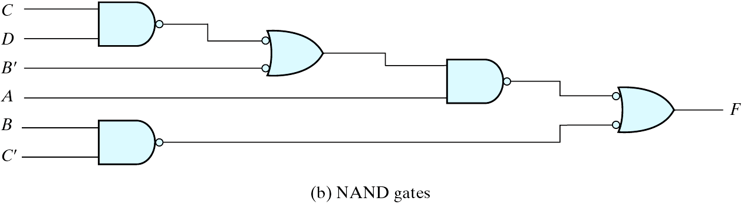
Multilevel NAND Circuits
Boolean function implementation
  AND-OR logic → NAND-NAND logic
    AND → AND + inverter
    OR: inverter + OR = NAND
    For every bubble that is not compensated by another small circle along the same line, insert an inverter.
Figure 3.22 Implementing F = A(CD + B) + BC′

Slide 34
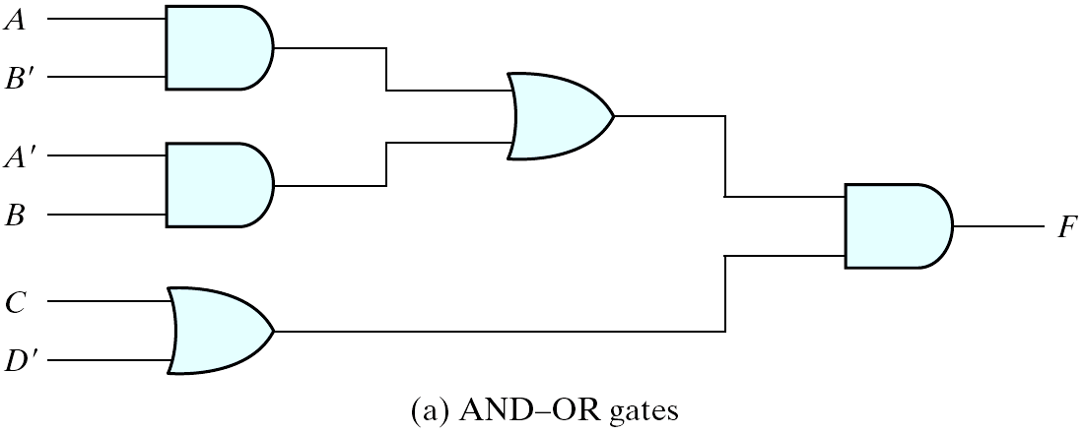
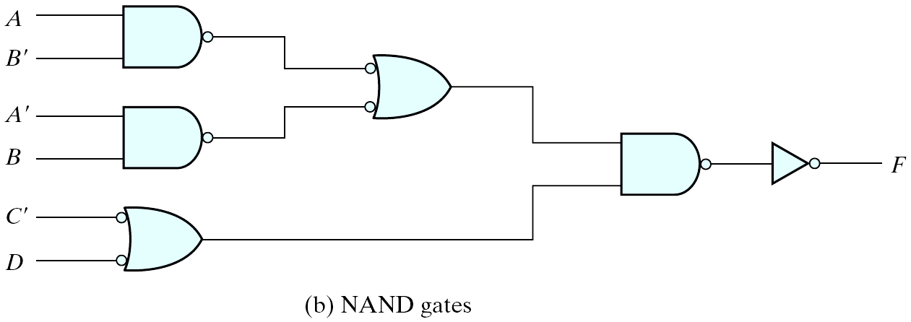
NAND Implementation
Figure 3.23 Implementing F = (AB′ +A′B)(C+ D′)

Slide 35
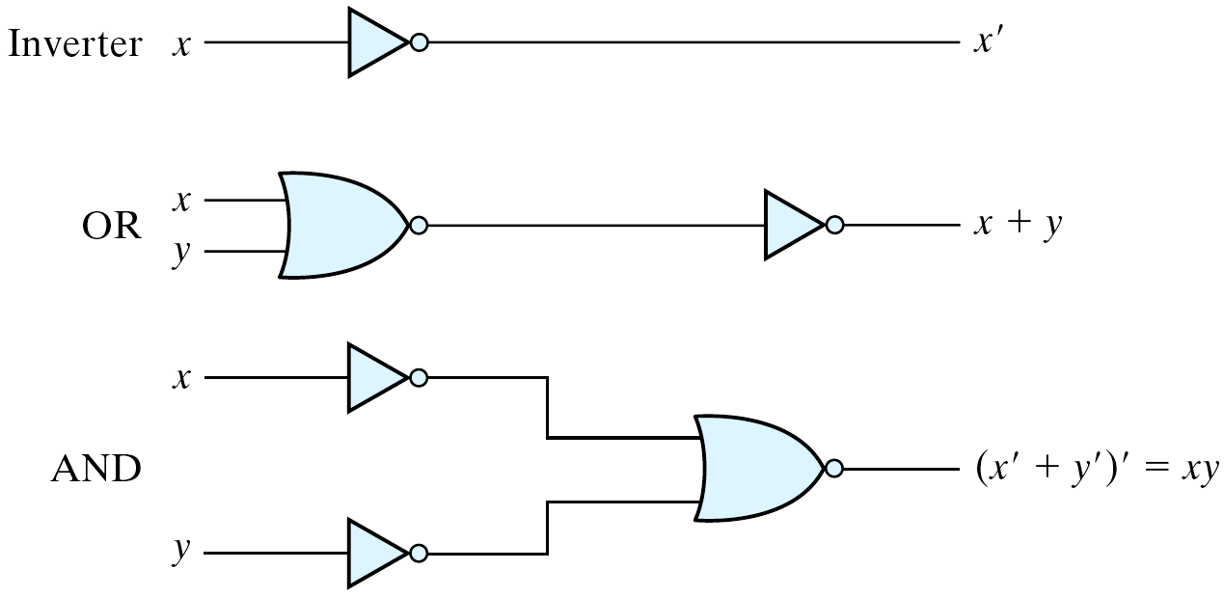
NOR Implementation
NOR function is the dual of NAND function.
The NOR gate is also universal.
Figure 3.24 Logic Operation with NOR Gates

Slide 36
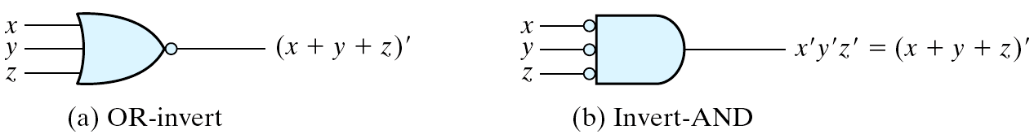
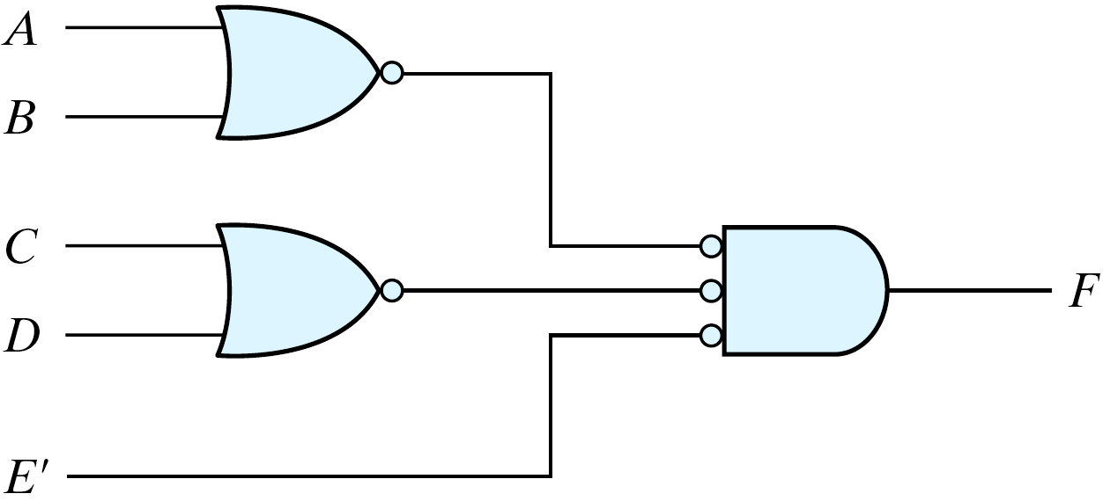
Two Graphic Symbols for a NOR Gate
Figure 3.25 Two Graphic Symbols for NOR Gate
Example: F = (A + B)(C + D)E
Figure 3.26 Implementing F = (A + B)(C + D)E

Slide 37
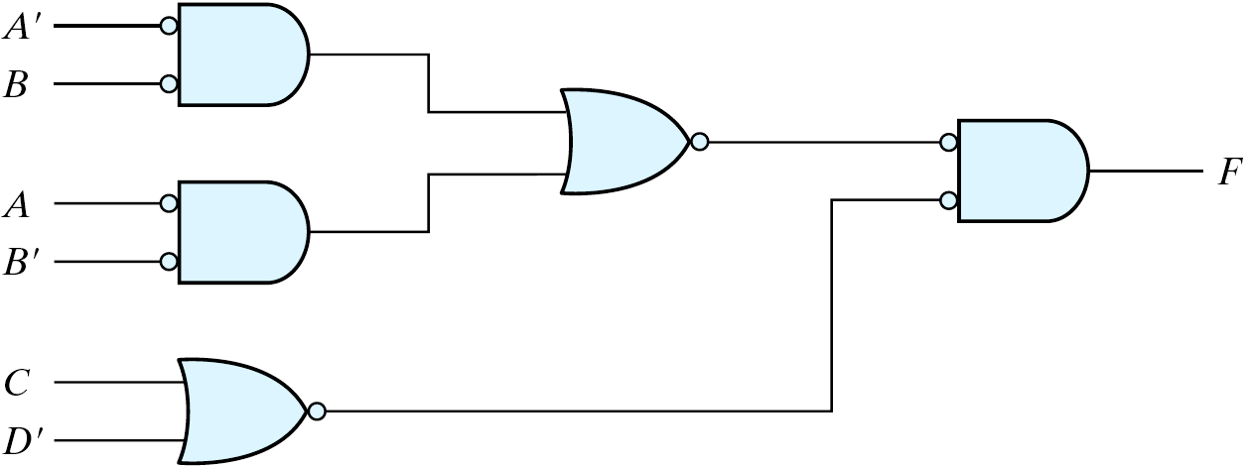
Example
Example: F = (AB′ +A′B)(C + D′)
Figure 3.27 Implementing F = (AB′ +A′B)(C + D′) with NOR gates

Slide 38
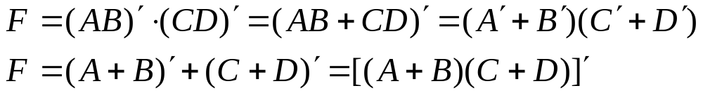
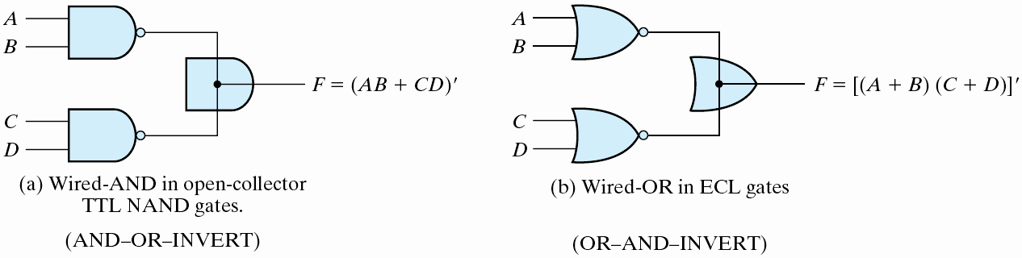
3-8 Other Two-level Implementations (
Wired logic
  A wire connection between the outputs of two gates
  Open-collector TTL NAND gates: wired-AND logic
  The NOR output of ECL gates: wired-OR logic
AND-OR-INVERT function
OR-AND-INVERT function
Figure 3.28 Wired Logic

Slide 39
Non-degenerate Forms
16 possible combinations of two-level forms
  Eight of them: degenerate forms = a single operation
    AND-AND, AND-NAND, OR-OR, OR-NOR, NAND-OR, NAND-NOR, NOR-AND, NOR-NAND.
  The eight non-degenerate forms
    AND-OR, OR-AND, NAND-NAND, NOR-NOR, NOR-OR, NAND-AND, OR-NAND, AND-NOR.
    AND-OR and NAND-NAND = sum of products.
    OR-AND and NOR-NOR = product of sums.
    NOR-OR, NAND-AND, OR-NAND, AND-NOR = ?

Slide 40
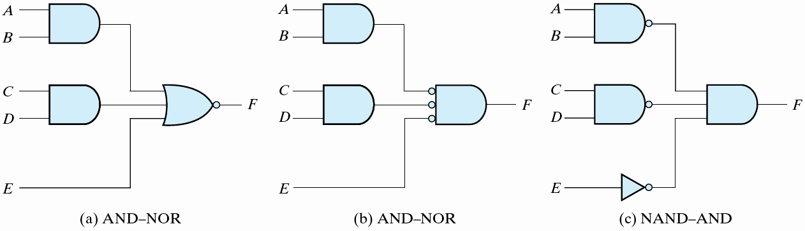
AND-OR-Invert Implementation
AND-OR-INVERT (AOI) Implementation
  NAND-AND = AND-NOR = AOI
  F = (AB+CD+E)'
  F' = AB+CD+E (sum of products)
Figure 3.29 AND-OR-INVERT circuits, F = (AB +CD +E)′

Slide 41
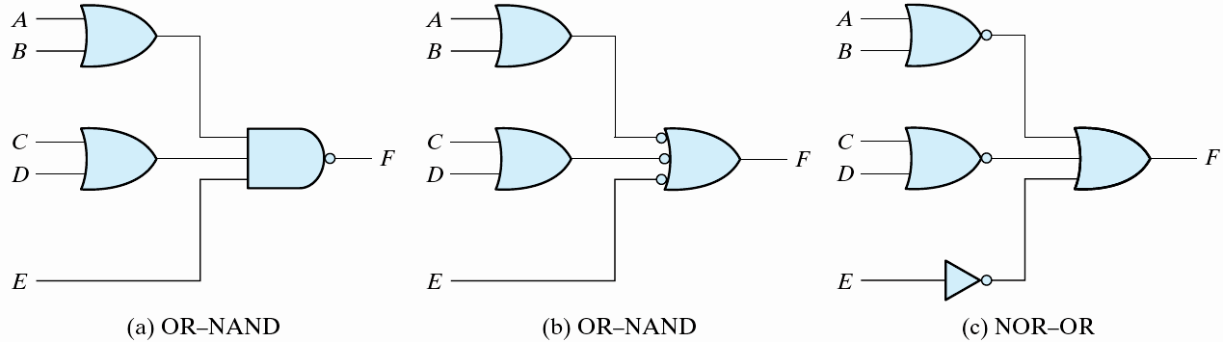
OR-AND-Invert Implementation
OR-AND-INVERT (OAI) Implementation
  OR-NAND = NOR-OR = OAI
  F = ((A+B)(C+D)E)'
  F' = (A+B)(C+D)E (product of sums)
  Figure 3.30 OR-AND-INVERT circuits, F = ((A+B)(C+D)E)'

Slide 42
Tabular Summary and Examples
Example 3-11: F = x'y'z'+xyz'
  F' = x'y+xy'+z (F': sum of products)
  F = (x'y+xy'+z)' (F: AOI implementation)
  F = x'y'z' + xyz' (F: sum of products)
  F' = (x+y+z)(x'+y'+z) (F': product of sums)
  F = ((x+y+z)(x'+y'+z))' (F: OAI)

Slide 43
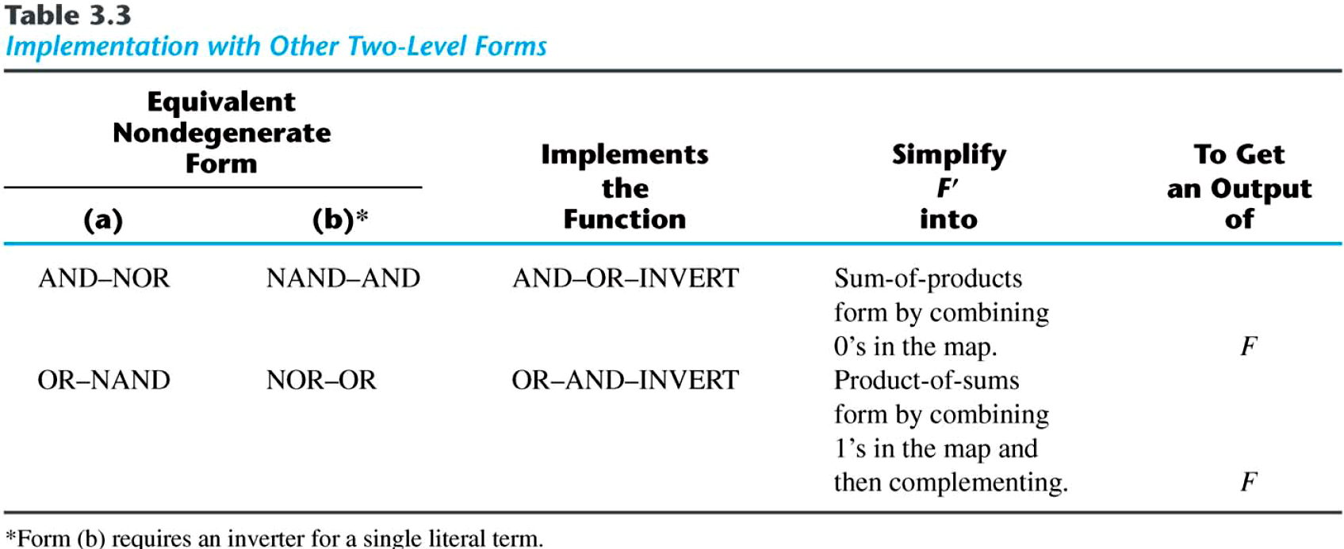
Tabular Summary and Examples

Slide 44
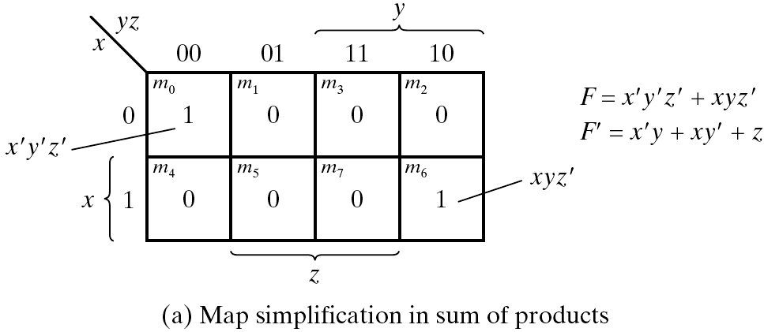
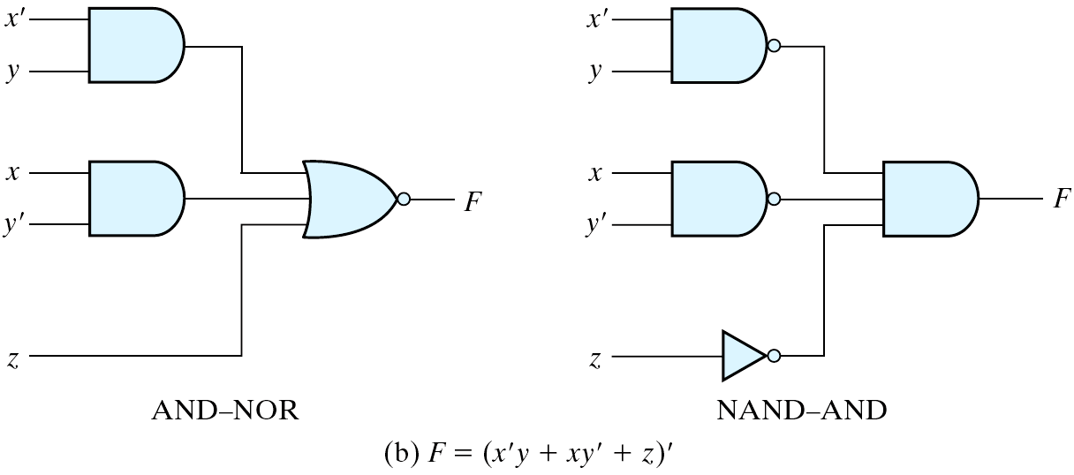
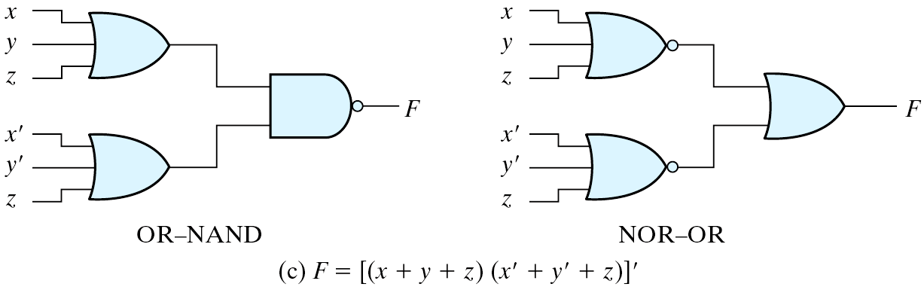
  Figure 3.31 Other Two-level Implementations

Slide 45
3-9 Exclusive-OR Function
Exclusive-OR (XOR)
  x⊕y = xy'+x'y
Exclusive-NOR (XNOR)
  (x⊕y)' = xy + x'y'
Some identities
  x⊕0 = x
  x⊕1 = x'
  x⊕x = 0
  x⊕x' = 1
  x⊕y' = (x⊕y)'
  x'⊕y = (x⊕y)'
Commutative and associative
  A⊕B = B⊕A
  (A⊕B) ⊕C = A⊕ (B⊕C) = A⊕B⊕C

Slide 46
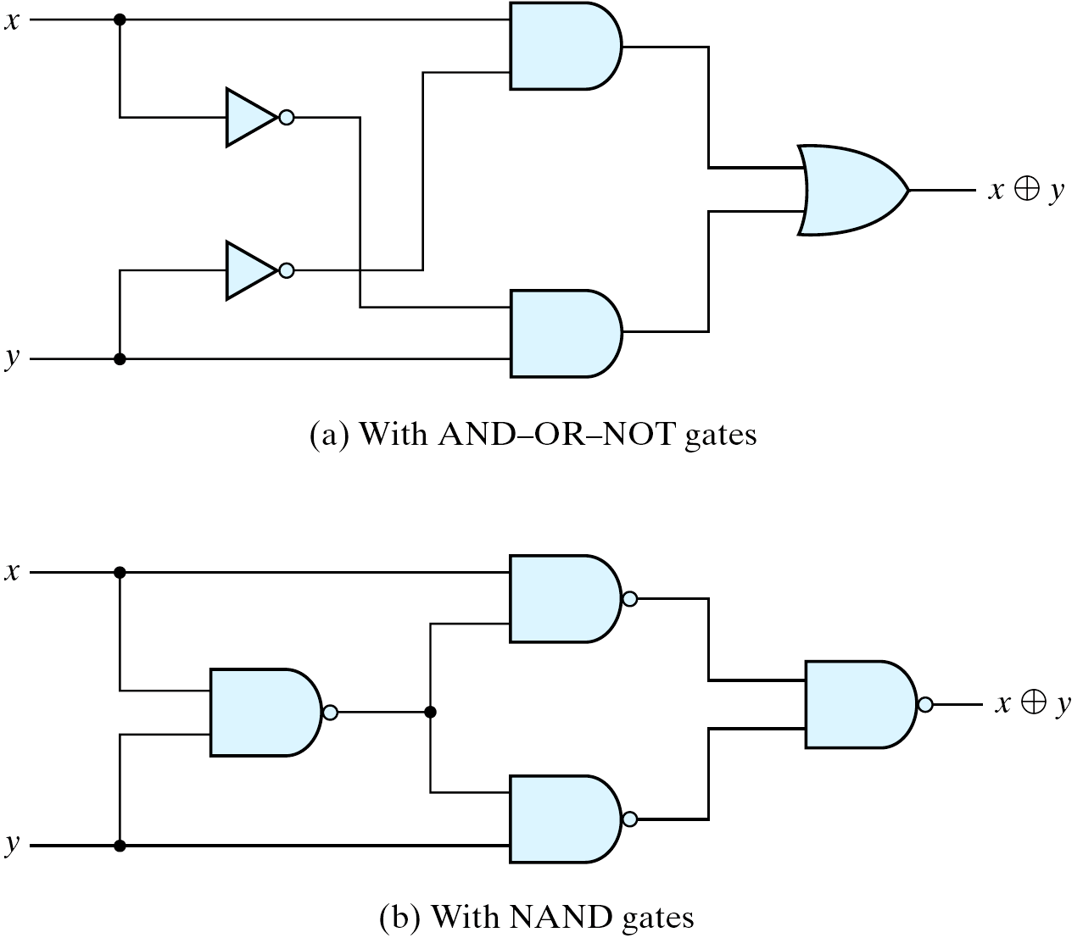
Exclusive-OR Implementations
Implementations
  (x'+y')x + (x'+y')y = xy'+x'y = x⊕y
Figure 3.32 Exclusive-OR Implementations

Slide 47
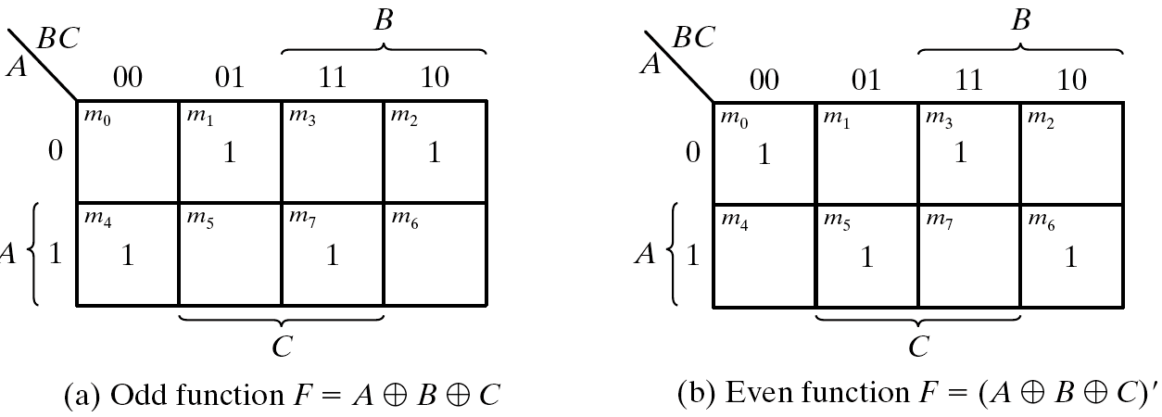
Odd Function
  A⊕B⊕C = (AB'+A'B)C' +(AB+A'B')C = AB'C'+A'BC'+ABC+A'B'C = Σ(1, 2, 4, 7)
  XOR is a odd function → an odd number of 1's, then F = 1.
  XNOR is a even function → an even number of 1's, then F = 1.
Figure 3.33 Map for a Three-variable Exclusive-OR Function

Slide 48
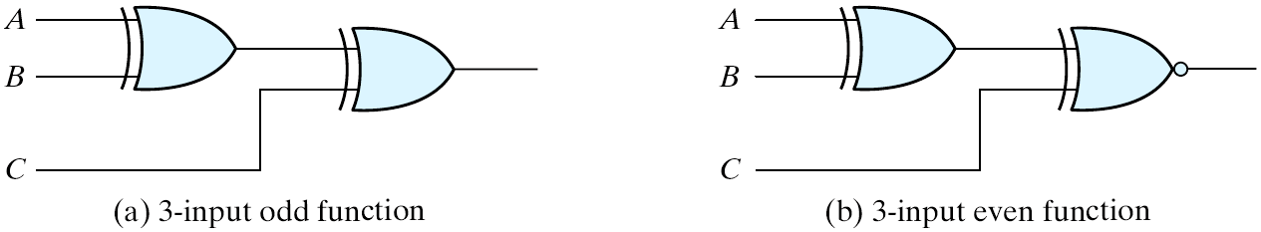
XOR and XNOR
Logic diagram of odd and even functions
Figure 3.34 Logic Diagram of Odd and Even Functions

Slide 49
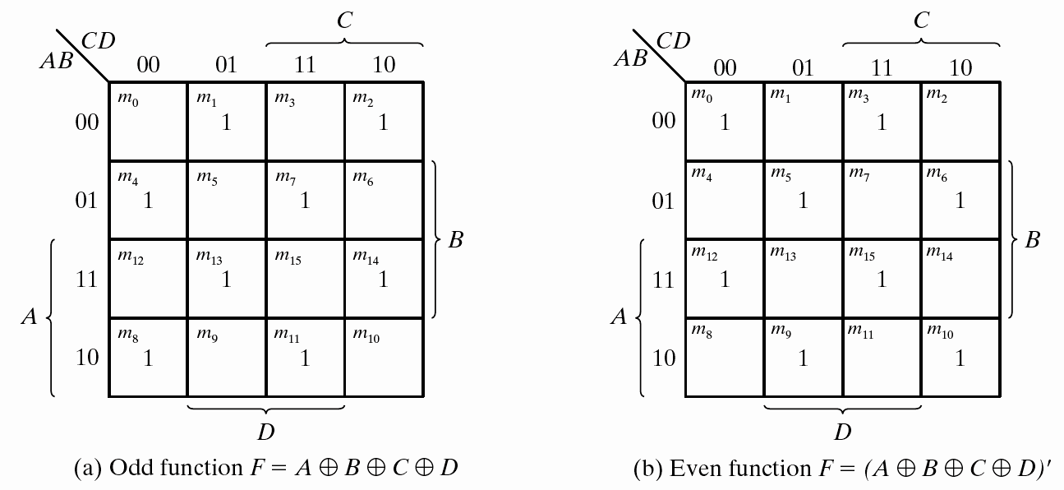
Four-variable Exclusive-OR function
Four-variable Exclusive-OR function
  A⊕B⊕C⊕D = (AB'+A'B)⊕(CD'+C'D) = (AB'+A'B)(CD+C'D')+(AB+A'B')(CD'+C'D)
Figure 3.35 Map for a Four-variable Exclusive-OR Function

Slide 50
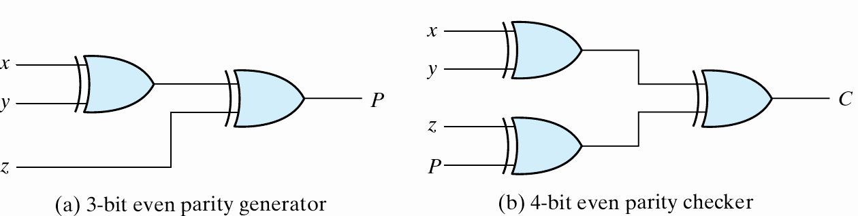
Parity Generation and Checking
Parity Generation and Checking
  A parity bit: P = x⊕y⊕z
  Parity check: C = x⊕y⊕z⊕P
    C=1: one bit error or an odd number of data bit error
    C=0: correct or an even # of data bit error
Figure 3.36 Logic Diagram of a Parity Generator and Checker

Slide 51

Parity Generation and Checking

Slide 52

Parity Generation and Checking

