Slide 1
Notes:
Princess Sumaya University
4241 - Digital Logic Design
Dr. Bassam Kahhaleh

Slide 2
Binary Adder
Carry Propagate Adder
x₇ x₆ x₅ x₄
x₃ x₂ x₁ x₀
y₇ y₆ y₅ y₄
y₃ y₂ y₁ y₀
CPA
CPA
A₃ A₂ A₁ A₀
B₃ B₂ B₁ B₀
A₃ A₂ A₁ A₀
B₃ B₂ B₁ B₀
C_{y}
C₀
C_{y}
C₀
0
S₃ S₂ S₁ S₀
S₃ S₂ S₁ S₀
S₇ S₆ S₅ S₄
S₃ S₂ S₁ S₀
Eastern Mediterranean University
<number> / 65
Notes:
Princess Sumaya University
4241 - Digital Logic Design
Dr. Bassam Kahhaleh

Slide 3
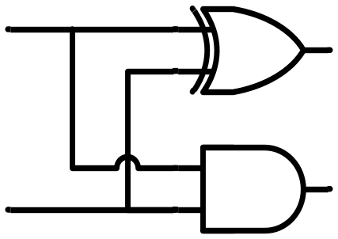
Binary Adder
Half Adder
  Adds 1-bit plus 1-bit
  Produces Sum and Carry
x
y
S
C
HA
x
+ y
───
C S
x y | C S
0 0 | 0 0
0 1 | 0 1
1 0 | 0 1
1 1 | 1 0
x
y
S
C
Eastern Mediterranean University
<number> / 65
Notes:
Princess Sumaya University
4241 - Digital Logic Design
Dr. Bassam Kahhaleh

Slide 4

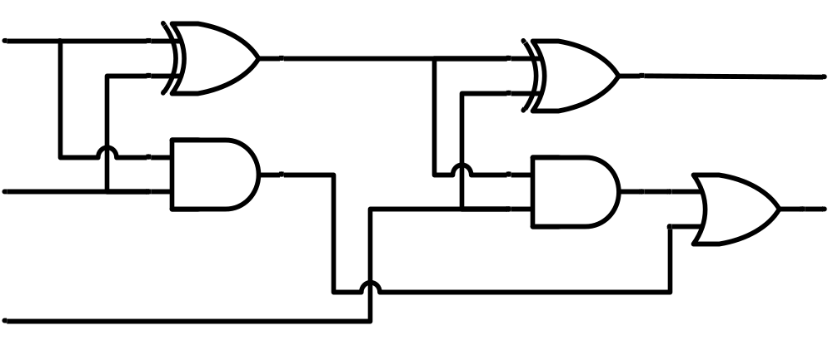
Binary Adder
Full Adder
HA
HA
x
y
z
S
C
x
y
z
S
C
Eastern Mediterranean University
<number> / 65
Notes:
Princess Sumaya University
4241 - Digital Logic Design
Dr. Bassam Kahhaleh

Slide 5
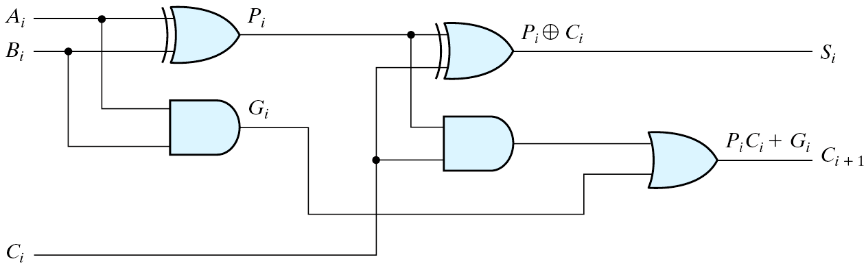
Carry propagation
  When the correct outputs are available
  The critical path counts (the worst case)
  (A₁, B₁, C₁) → C₂ → C₃ → C₄ → (C₅, S₄)
  When 4-bits full-adder → 8 gate levels (n-bits: 2n gate levels)
Figure 4.10 Full Adder with P and G Shown
Eastern Mediterranean University
<number> / 65
Notes:
Princess Sumaya University
4241 - Digital Logic Design
Dr. Bassam Kahhaleh

Slide 6
Parallel Adders
Reduce the carry propagation delay
  Employ faster gates
  Look-ahead carry (more complex mechanism, yet faster)
  Carry propagate: P_{i} = A_{i}⊕B_{i}
  Carry generate: G_{i} = A_{i}B_{i}
  Sum: S_{i} = P_{i}⊕C_{i}
  Carry: C_{i+1} = G_{i}+P_{i}C_{i}
  C₀ = Input carry
  C₁ = G₀+P₀C₀
  C₂ = G₁+P₁C₁ = G₁+P₁(G₀+P₀C₀) = G₁+P₁G₀+P₁P₀C₀
  C₃ = G₂+P₂C₂ = G₂+P₂G₁+P₂P₁G₀+ P₂P₁P₀C₀
Eastern Mediterranean University
<number> / 65
Notes:
Princess Sumaya University
4241 - Digital Logic Design
Dr. Bassam Kahhaleh

Slide 7
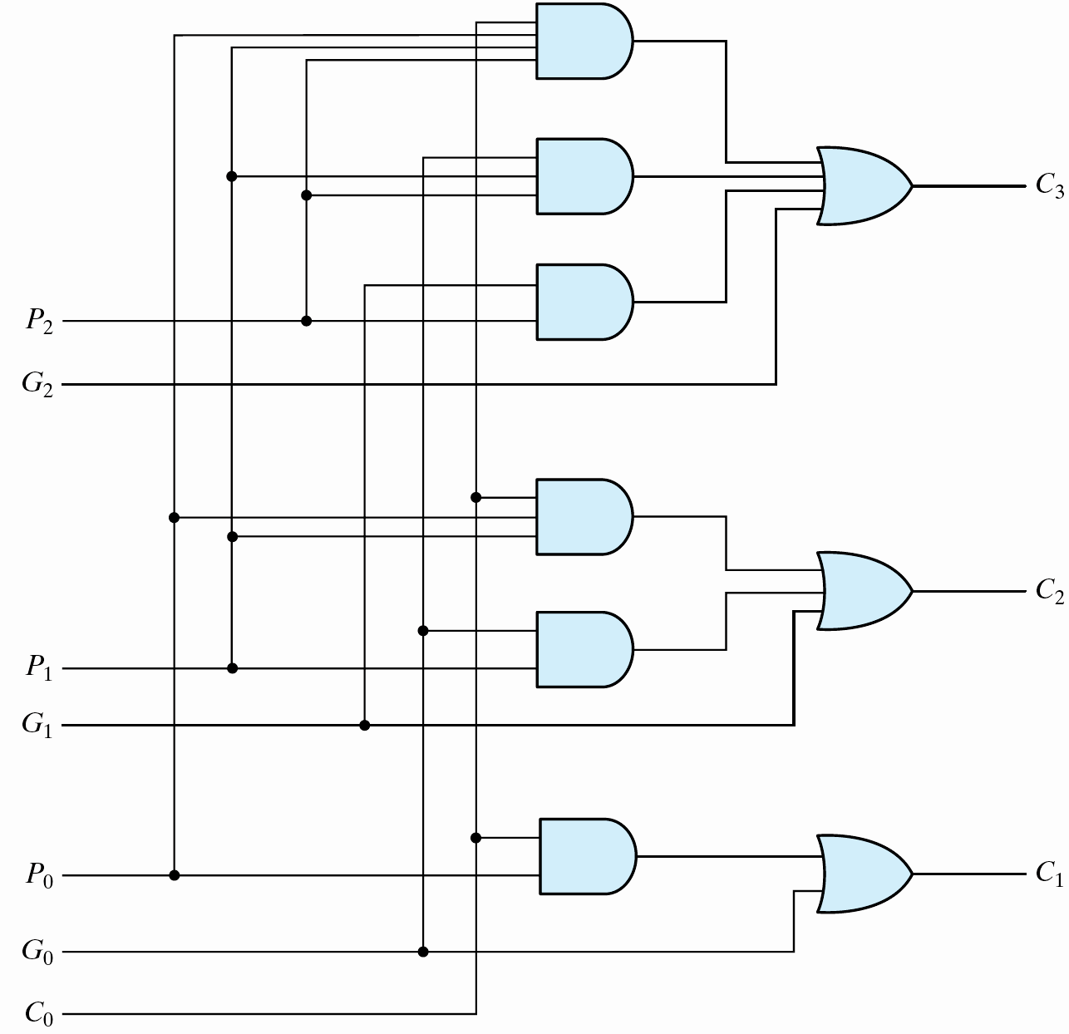
Carry Look-ahead Adder (1/2)
Logic diagram
Fig. 4.11 Logic Diagram of Carry Look-ahead Generator
Eastern Mediterranean University
<number> / 65
Notes:
Princess Sumaya University
4241 - Digital Logic Design
Dr. Bassam Kahhaleh

Slide 8
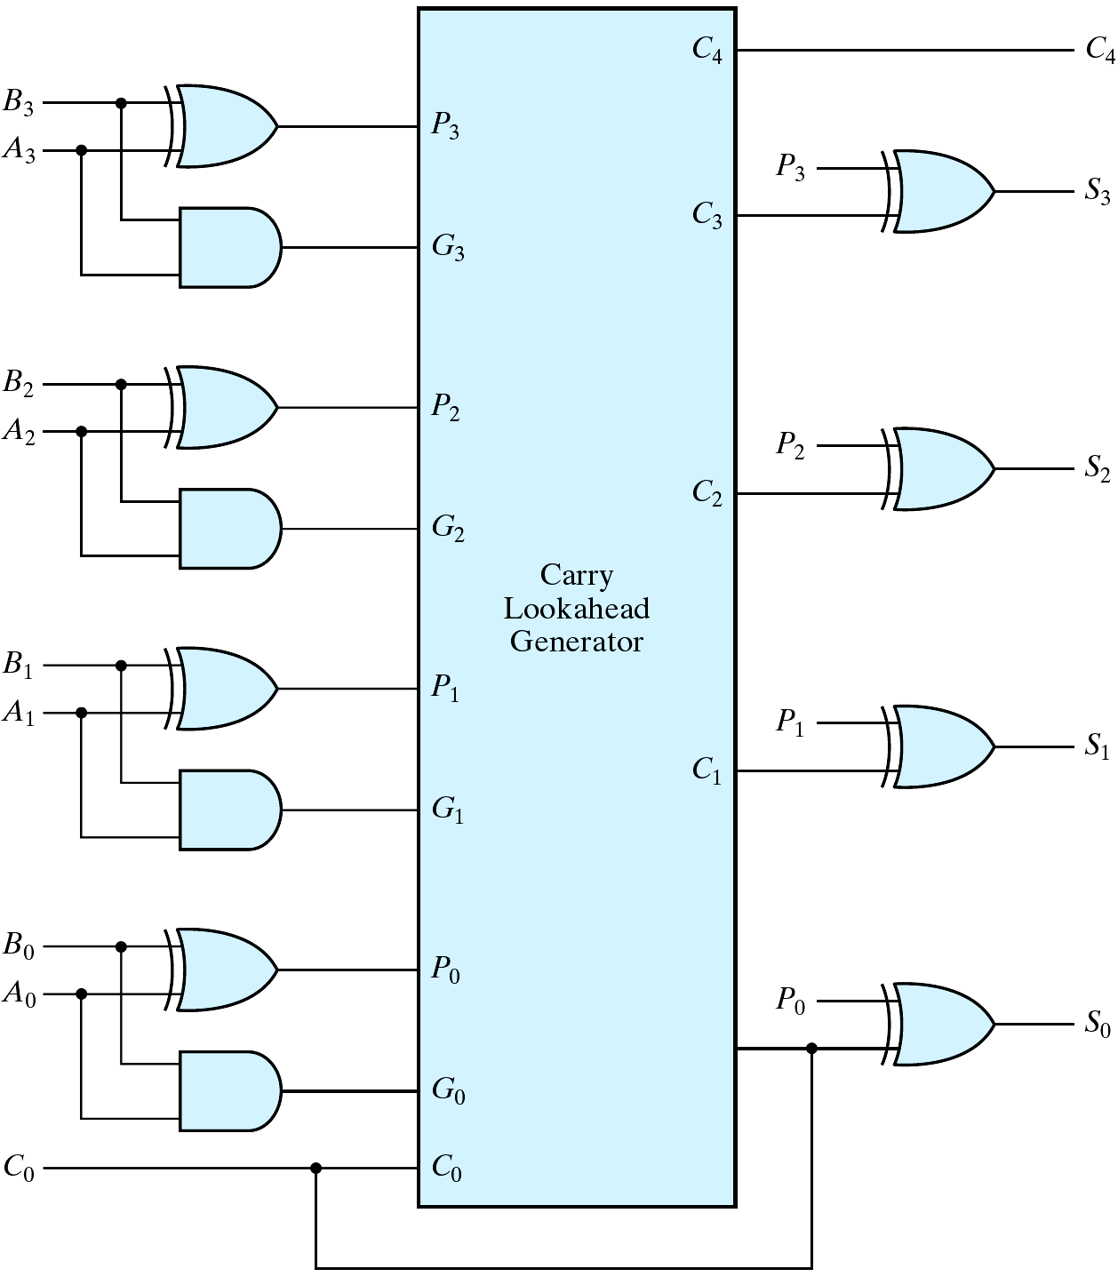
Carry Look-ahead Adder (2/2)
4-bit carry-look ahead adder
  Propagation delay of C₃, C₂ and C₁ are equal.
Fig. 4.12 4-Bit Adder with Carry Look-ahead
Eastern Mediterranean University
<number> / 65
Notes:
Princess Sumaya University
4241 - Digital Logic Design
Dr. Bassam Kahhaleh

Slide 9
Decoders
Extract “Information” from the code
Binary Decoder
  Example: 2-bit Binary Number
Only one lamp will turn on
0
1
2
3
Binary
Decoder
1
0
0
0
x₁
x₀
0
0
Eastern Mediterranean University
<number> / 65
Notes:
Princess Sumaya University
4241 - Digital Logic Design
Dr. Bassam Kahhaleh

Slide 10
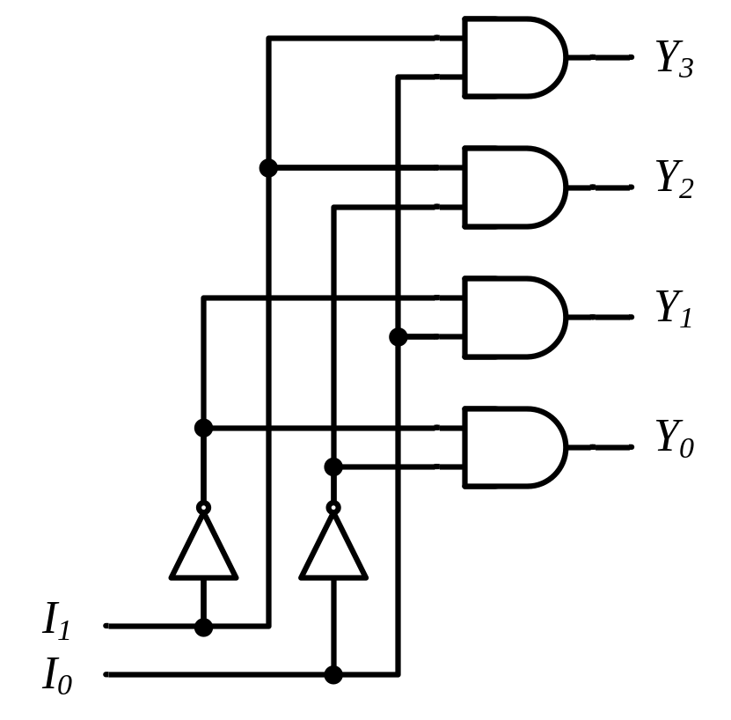
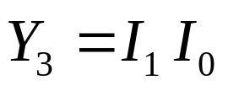
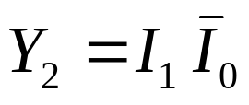
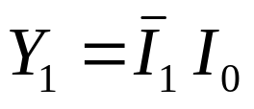
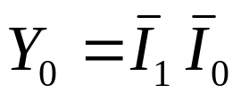
Decoders
2-to-4 Line Decoder
Binary
Decoder
y₃
y₂
y₁
y₀
I₁
I₀
I₁ I₀ | Y₃ Y₂ Y₁ Y₀
0 0 | 0 0 0 1
0 1 | 0 0 1 0
1 0 | 0 1 0 0
1 1 | 1 0 0 0
Eastern Mediterranean University
<number> / 65
Notes:
Princess Sumaya University
4241 - Digital Logic Design
Dr. Bassam Kahhaleh

Slide 11
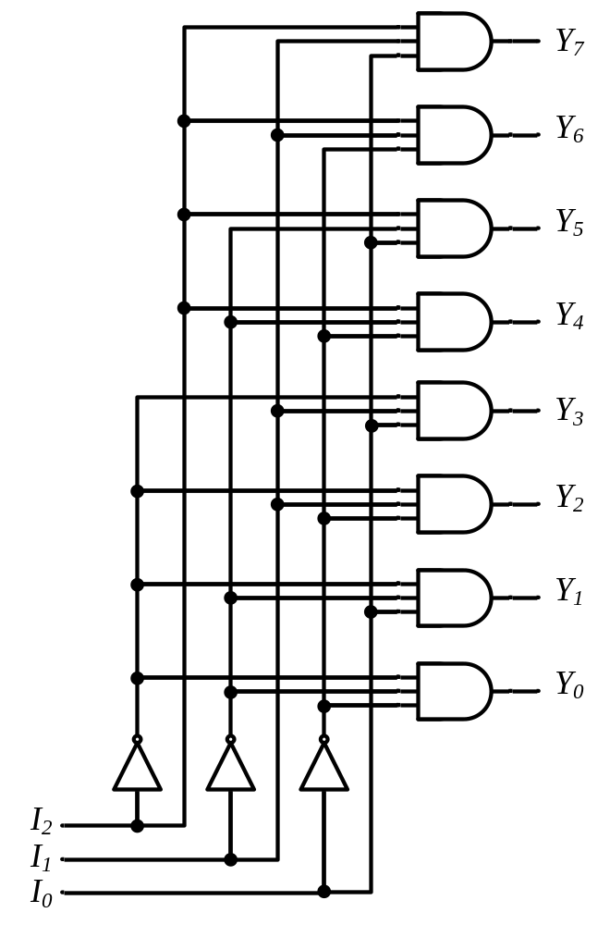








Decoders
3-to-8 Line Decoder
Binary
Decoder
Y₇
Y₆
Y₅
Y₄ Y₃
Y₂
Y₁
Y₀
I₂
I₁
I₀
Eastern Mediterranean University
<number> / 65
Notes:
Princess Sumaya University
4241 - Digital Logic Design
Dr. Bassam Kahhaleh

Slide 12
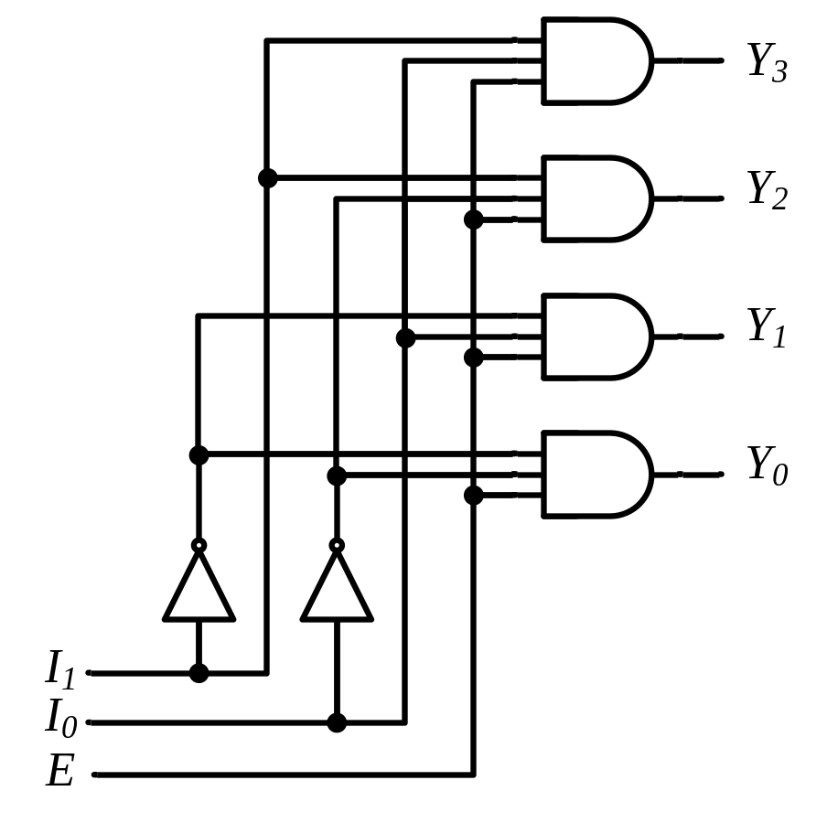
Decoders
“Enable” Control
Binary
Decoder
Y₃
Y₂
Y₁
Y₀
I₁
I₀
E
E | I₁ I₀ | Y₃ Y₂ Y₁ Y₀
0 | x x | 0 0 0 0
1 | 0 0 | 0 0 0 1
1 | 0 1 | 0 0 1 0
1 | 1 0 | 0 1 0 0
1 | 1 1 | 1 0 0 0
Eastern Mediterranean University
<number> / 65
Notes:
Princess Sumaya University
4241 - Digital Logic Design
Dr. Bassam Kahhaleh

Slide 13

Decoders
Expansion
I₂ I₁ I₀
I₂ I₁ I₀ | Y₇ Y₆ Y₅ Y₄ Y₃ Y₂ Y₁ Y₀
0 0 0 | 0 0 0 0 0 0 0 1
0 0 1 | 0 0 0 0 0 0 1 0
0 1 0 | 0 0 0 0 0 1 0 0
0 1 1 | 0 0 0 0 1 0 0 0
1 0 0 | 0 0 0 1 0 0 0 0
1 0 1 | 0 0 1 0 0 0 0 0
1 1 0 | 0 1 0 0 0 0 0 0
1 1 1 | 1 0 0 0 0 0 0 0
Binary
Decoder
Y₇
Y₆
Y₅
Y₄
Y₃
Y₂
Y₁
Y₀
Y₃
Y₂
Y₁
Y₀
I₀
I₁
E
Binary
Decoder
Y₃
Y₂
Y₁
Y₀
I₀
I₁
E
Eastern Mediterranean University
<number> / 65
Notes:
Princess Sumaya University
4241 - Digital Logic Design
Dr. Bassam Kahhaleh

Slide 14

Implementation Using Decoders
Each output is a minterm
All minterms are produced
Sum the required minterms
Example: Full Adder
S(x, y, z) = ∑(1, 2, 4, 7)
C(x, y, z) = ∑(3, 5, 6, 7)
Binary
Decoder
Y₇
Y₆
Y₅
Y₄ Y₃
Y₂
Y₁
Y₀
x
y
z
I₂
I₁
I₀
S C
Eastern Mediterranean University
<number> / 65
Notes:
Princess Sumaya University
4241 - Digital Logic Design
Dr. Bassam Kahhaleh

Slide 15

Encoders
Put “Information” into code
Binary Encoder
  Example: 4-to-2 Binary Encoder
Only one switch should be activated at a time
1
x₁
x₂
x₃
Binary
Encoder
x₃ x₂ x₁ | y₁ y₀
0 0 0 | 0 0
0 0 1 | 0 1
0 1 0 | 1 0
1 0 0 | 1 1
y₁
y₀
2
3
Eastern Mediterranean University
<number> / 65
Notes:
Princess Sumaya University
4241 - Digital Logic Design
Dr. Bassam Kahhaleh

Slide 16
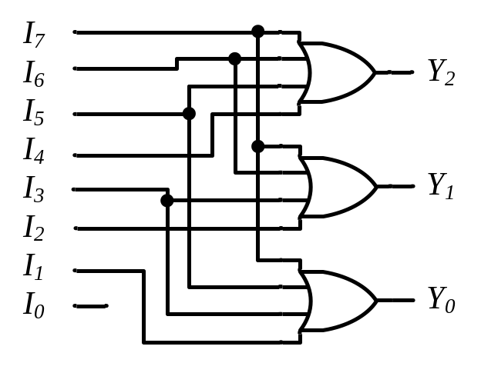
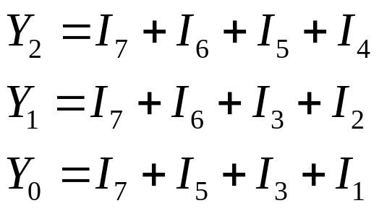
Encoders
Binary
Encoder
Octal-to-Binary Encoder (8-to-3)
I₇
I₆
I₅
I₄ I₃
I₂
I₁
I₀
I₇ I₆ I₅ I₄ I₃ I₂ I₁ I₀ | Y₂ Y₁ Y₀
0 0 0 0 0 0 0 1 | 0 0 0
0 0 0 0 0 0 1 0 | 0 0 1
0 0 0 0 0 1 0 0 | 0 1 0
0 0 0 0 1 0 0 0 | 0 1 1
0 0 0 1 0 0 0 0 | 1 0 0
0 0 1 0 0 0 0 0 | 1 0 1
0 1 0 0 0 0 0 0 | 1 1 0
1 0 0 0 0 0 0 0 | 1 1 1
Y₂
Y₁
Y₀
Eastern Mediterranean University
<number> / 65
Notes:
Princess Sumaya University
4241 - Digital Logic Design
Dr. Bassam Kahhaleh

Slide 17
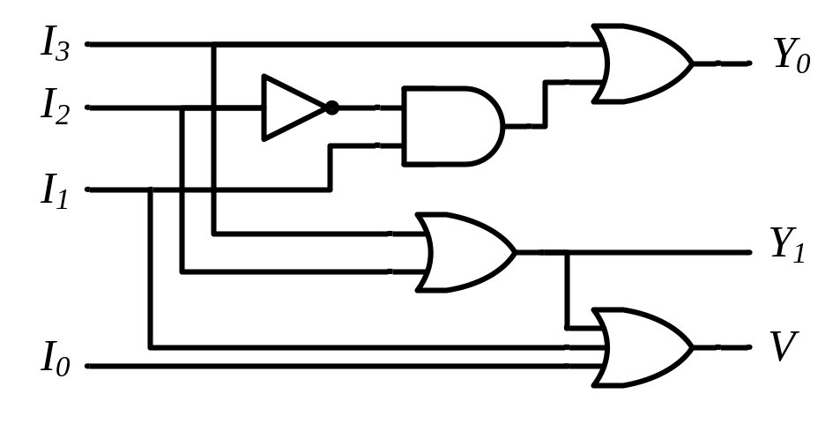
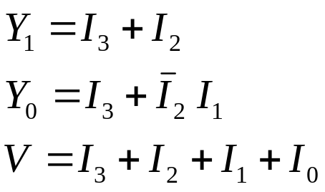
Priority Encoders
4-Input Priority Encoder
Priority
Encoder
I₃
I₂
I₁
I₀
V
Y₁
Y₀
I₃ I₂ I₁ I₀ | Y₁ Y₀ | V
0 0 0 0 | 0 0 | 0
0 0 0 1 | 0 0 | 1
0 0 1 x | 0 1 | 1
0 1 x x | 1 0 | 1
1 x x x | 1 1 | 1
Y₁ |  |  |  | I₁
 |  | 1 | 1 | 1 | 1 | I₂
I₃ |  | 1 | 1 | 1 | 1
 |  | 1 | 1 | 1 | 1
 |  |  | I₀
Eastern Mediterranean University
<number> / 65
Notes:
Princess Sumaya University
4241 - Digital Logic Design
Dr. Bassam Kahhaleh

Slide 18
Encoder / Decoder Pairs
Binary
Encoder
Binary
Decoder
Y₇
Y₆
Y₅
Y₄ Y₃
Y₂
Y₁
Y₀
7
7
I₇
I₆
I₅
I₄ I₃
I₂
I₁
I₀
6
6
5
5
Y₂
Y₁
Y₀
I₂
I₁
I₀
4
4
3
3
2
2
1
1
0
0
Eastern Mediterranean University
<number> / 65
Notes:
Princess Sumaya University
4241 - Digital Logic Design
Dr. Bassam Kahhaleh

Slide 19
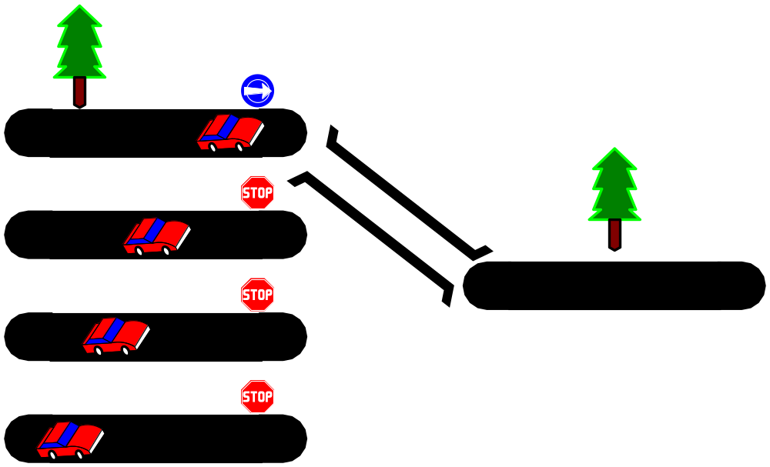
Multiplexers
S₁ S₀ | Y
0 0 | I₀
0 1 | I₁
1 0 | I₂
1 1 | I₃
MUX
I₀
I₁
I₂
I₃
Y
S₁ S₀
Eastern Mediterranean University
<number> / 65
Notes:
Princess Sumaya University
4241 - Digital Logic Design
Dr. Bassam Kahhaleh

Slide 20
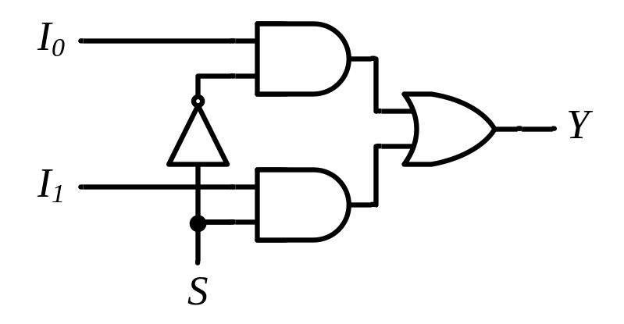
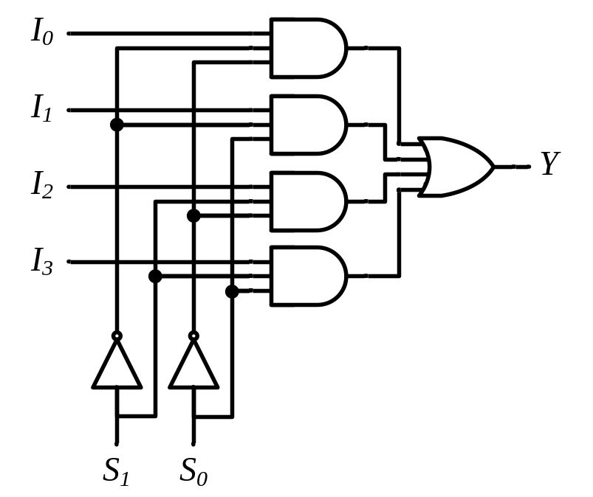
Multiplexers
2-to-1 MUX
4-to-1 MUX
MUX
I₀
I₁
Y
S
MUX
I₀
I₁
I₂
I₃
Y
S₁ S₀
Eastern Mediterranean University
<number> / 65
Notes:
Princess Sumaya University
4241 - Digital Logic Design
Dr. Bassam Kahhaleh

Slide 21
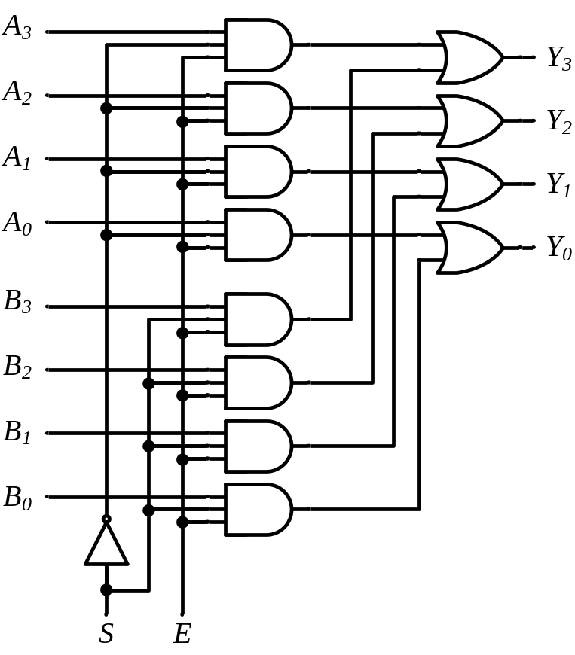
Multiplexers
Quad 2-to-1 MUX
x₃
x₂
x₁
x₀
MUX
I₀
I₁
y₃
y₂
y₁
y₀
Y
S
MUX
I₀
I₁
Y
S
MUX
A₃
A₂
A₁
A₀
MUX
I₀
I₁
Y₃
Y₂
Y₁
Y₀
Y
S
B₃
B₂
B₁
B₀
MUX
I₀
I₁
Y
S
S E
S
Eastern Mediterranean University
<number> / 65
Notes:
Princess Sumaya University
4241 - Digital Logic Design
Dr. Bassam Kahhaleh

Slide 22
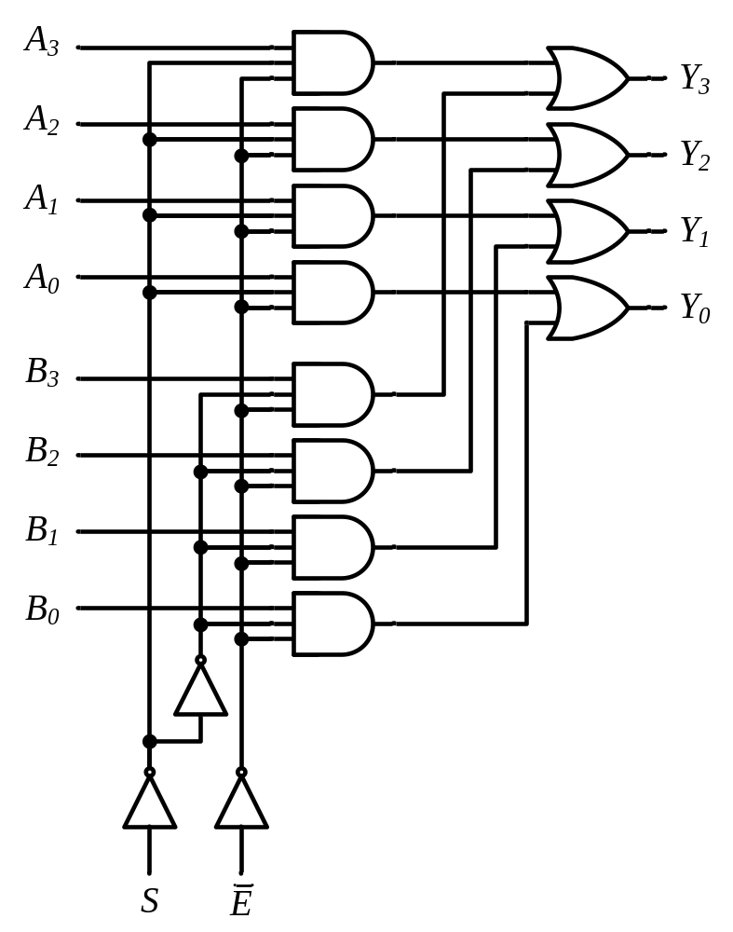

Multiplexers
Quad 2-to-1 MUX
MUX
A₃
A₂
A₁
A₀
Y₃
Y₂
Y₁
Y₀
B₃
B₂
B₁
B₀
S E
Extra Buffers
Eastern Mediterranean University
<number> / 65
Notes:
Princess Sumaya University
4241 - Digital Logic Design
Dr. Bassam Kahhaleh

Slide 23
Implementation Using Multiplexers
Example
F(x, y) = ∑(0, 1, 3)
x y | F
0 0 | 1
0 1 | 1
1 0 | 0
1 1 | 1
MUX
1
1
0
1
I₀
I₁
I₂
I₃
Y
F
S₁ S₀
x y
Eastern Mediterranean University
<number> / 65
Notes:
Princess Sumaya University
4241 - Digital Logic Design
Dr. Bassam Kahhaleh

Slide 24
Implementation Using Multiplexers
Example
F(x, y, z) = ∑(1, 2, 6, 7)
MUX
0
1
1
0
0
0
1
1
I₀
I₁
I₂
I₃ I₄
I₅
I₆
I₇
x y z | F
0 0 0 | 0
0 0 1 | 1
0 1 0 | 1
0 1 1 | 0
1 0 0 | 0
1 0 1 | 0
1 1 0 | 1
1 1 1 | 1
Y
F
S₂ S₁ S₀
x y z
Eastern Mediterranean University
<number> / 65
Notes:
Princess Sumaya University
4241 - Digital Logic Design
Dr. Bassam Kahhaleh

Slide 25
Implementation Using Multiplexers
Example
F(x, y, z) = ∑(1, 2, 6, 7)
x y z | F
0 0 0 | 0
0 0 1 | 1
0 1 0 | 1
0 1 1 | 0
1 0 0 | 0
1 0 1 | 0
1 1 0 | 1
1 1 1 | 1
z
MUX
I₀
I₁
I₂
I₃
F = z
F
z
0
Y
F = z
1
S₁ S₀
F = 0
x y
F = 1
Eastern Mediterranean University
<number> / 65
Notes:
Princess Sumaya University
4241 - Digital Logic Design
Dr. Bassam Kahhaleh

Slide 26
Implementation Using Multiplexers
Example
F(A, B, C, D) = ∑(1, 3, 4, 11, 12, 13, 14, 15)
A B C D | F
0 0 0 0 | 0
0 0 0 1 | 1
0 0 1 0 | 0
0 0 1 1 | 1
0 1 0 0 | 1
0 1 0 1 | 0
0 1 1 0 | 0
0 1 1 1 | 0
1 0 0 0 | 0
1 0 0 1 | 0
1 0 1 0 | 0
1 0 1 1 | 1
1 1 0 0 | 1
1 1 0 1 | 1
1 1 1 0 | 1
1 1 1 1 | 1
MUX
D
I₀
I₁
I₂
I₃ I₄
I₅
I₆
I₇
F = D
D
F = D
D
F = D
0
Y
F
0
F = 0
D
F = 0
1
F = D
1
S₂ S₁ S₀
F = 1
F = 1
A B C
Eastern Mediterranean University
<number> / 65
Notes:
Princess Sumaya University
4241 - Digital Logic Design
Dr. Bassam Kahhaleh

Slide 27
Multiplexer Expansion
8-to-1 MUX using Dual 4-to-1 MUX
MUX
I₀
I₁
I₂
I₃
I₄
I₅
I₆
I₇
I₀
I₁
I₂
I₃
Y
S₁ S₀
MUX
I₀
I₁
Y
Y
MUX
S
I₀
I₁
I₂
I₃
Y
S₁ S₀
1
0 0
S₂ S₁ S₀
Eastern Mediterranean University
<number> / 65
Notes:
Princess Sumaya University
4241 - Digital Logic Design
Dr. Bassam Kahhaleh

Slide 28
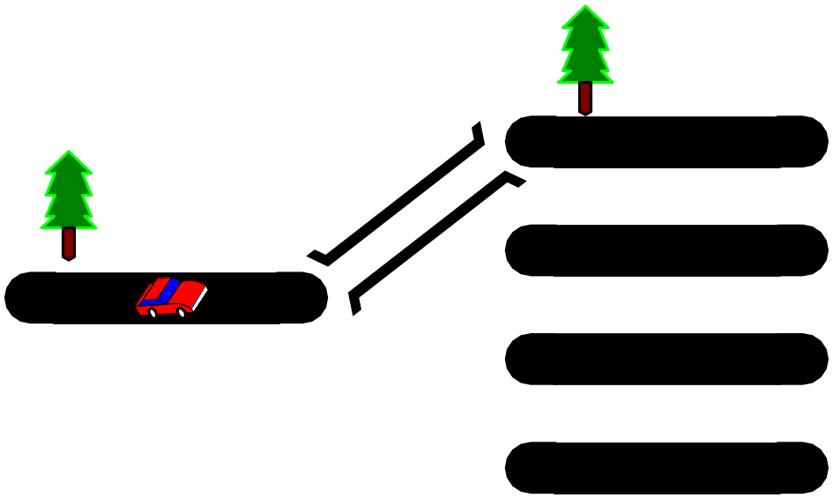
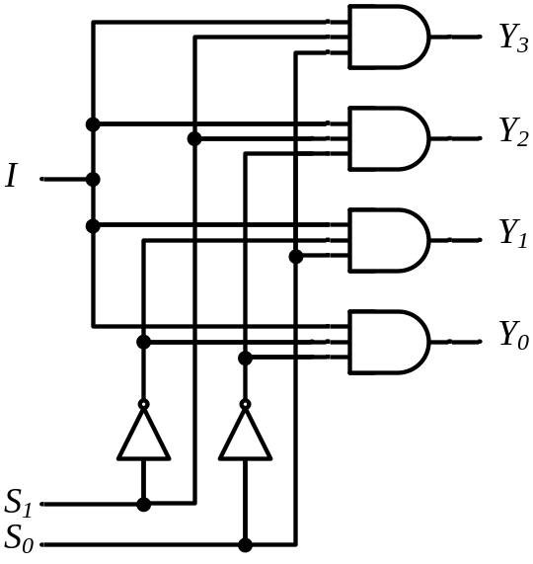
DeMultiplexers
DeMUX
Y₃
Y₂
Y₁
Y₀
I
S₁ S₀
S₁ S₀ | Y₃ | Y₂ | Y₁ | Y₀
0 0 | 0 | 0 | 0 | I
0 1 | 0 | 0 | I | 0
1 0 | 0 | I | 0 | 0
1 1 | I | 0 | 0 | 0
Eastern Mediterranean University
<number> / 65
Notes:
Princess Sumaya University
4241 - Digital Logic Design
Dr. Bassam Kahhaleh

Slide 29
Multiplexer / DeMultiplexer Pairs
MUX
DeMUX
Y₇
Y₆
Y₅
Y₄ Y₃
Y₂
Y₁
Y₀
7
7
I₇
I₆
I₅
I₄ I₃
I₂
I₁
I₀
6
6
5
5
4
4
Y
I
3
3
2
2
1
1
0
0
S₂ S₁ S₀
S₂ S₁ S₀
Synchronize
x₂ x₁ x₀
y₂ y₁ y₀
Eastern Mediterranean University
<number> / 65
Notes:
Princess Sumaya University
4241 - Digital Logic Design
Dr. Bassam Kahhaleh

Slide 30
DeMultiplexers / Decoders
DeMUX
Binary
Decoder
Y₃
Y₂
Y₁
Y₀
Y₃
Y₂
Y₁
Y₀
I₁
I₀
E
I
S₁ S₀
E | I₁ I₀ | Y₃ Y₂ Y₁ Y₀
0 | x x | 0 0 0 0
1 | 0 0 | 0 0 0 1
1 | 0 1 | 0 0 1 0
1 | 1 0 | 0 1 0 0
1 | 1 1 | 1 0 0 0
S₁ S₀ | Y₃ | Y₂ | Y₁ | Y₀
0 0 | 0 | 0 | 0 | I
0 1 | 0 | 0 | I | 0
1 0 | 0 | I | 0 | 0
1 1 | I | 0 | 0 | 0
Eastern Mediterranean University
<number> / 65
Notes:
Princess Sumaya University
4241 - Digital Logic Design
Dr. Bassam Kahhaleh

Slide 31
Three-State Gates
Tri-State Buffer
Tri-State Inverter
C A | Y
0 x | Hi-Z
1 0 | 0
1 1 | 1
A
Y
C
A
Y
C
Eastern Mediterranean University
<number> / 65
Notes:
Princess Sumaya University
4241 - Digital Logic Design
Dr. Bassam Kahhaleh

Slide 32
Three-State Gates
C D | Y
0 0 | Hi-Z
0 1 | B
1 0 | A
1 1 | ?
A
Y
C
B
Not Allowed
D
A
C
A if C = 1
B if C = 0
Y=
B
Eastern Mediterranean University
<number> / 65
Notes:
Princess Sumaya University
4241 - Digital Logic Design
Dr. Bassam Kahhaleh

Slide 33
Three-State Gates
I₃
I₂
Y
I₁
I₀
Binary
Decoder
Y₃
Y₂
Y₁
Y₀
S₁
I₁
I₀
E
S₀
E
Eastern Mediterranean University
<number> / 65
Notes:
Princess Sumaya University
4241 - Digital Logic Design
Dr. Bassam Kahhaleh

