Slide 1
Welcome to
Total Quality Management
(19MEE347)
Unit 2
Name: Dr. Sunil Kumar
Department of Mechanical Engineering

Slide 2
CUSTOMER SATISFACTION
“An organization’s success depends on how many customers it has, how much they buy, and how often they buy”.
“Manufacturing and service organizations are using customer satisfaction as the measure of quality.”

Slide 3
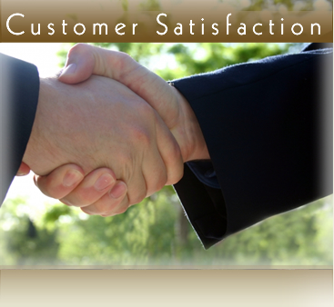
Introduction
Customer satisfaction is a part of qualitative pillar of TQM. It is dynamic in nature and is subjective concept because it varies from person to person.
Customer satisfaction has become one of the most integral or essential part of any business. In today's market, companies look at it as their business strategies or as their business requirement.

Slide 4
Customer satisfaction
Who is the customer?
One who uses the product or service, the one who purchases the product or service or the one who influences the product or service.
Two types of customers:
Internal customers
The customers inside the company are called internal customers.
(eg). Every department persons
External customers
The customers outside the company are called external customers.
(eg). End user, Purchaser, Merchants, Suppliers
TQM is commitment to customer-focus - internal and external customers.
https://youtu.be/XK3cNcuvuMs

Slide 5
Customer satisfaction model
Teboul Model
Customer needs
Company offer
(product or service)
Customer satisfaction
Needs not fulfilled
Total satisfaction is achieved when offer matches the need i.e. circle is superimposed on the square.

Slide 6
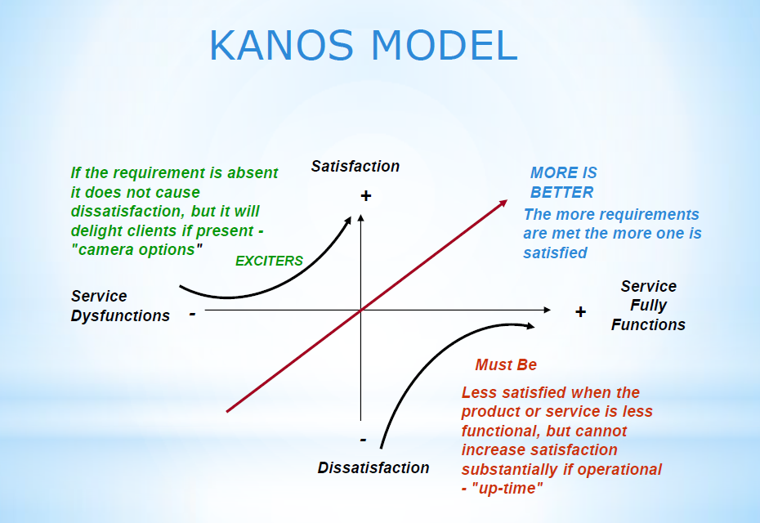
Customer satisfaction model
Kano’s Model
Understand, Integrate, and Priorities the things to attract the customers:
Improve performances
Differentiate from competitors
Ensure Success.
Bus Service
Must be: Clean seats, blanket (for AC)
More is better: Free wifie, surprise like birthday
Exciters: Free Netflix/A-prime, drink

Slide 7
Customer satisfaction
Customer is the Boss or ’King’
Customer dictates the market trends and direction
Customer not only has needs to be supplied (basic performance functions)
Also he wants what he needs (additional features satisfy him and influence his purchase decision)
Hence the Suppliers and Manufacturers have to closely follow at the heel of the customer.

Slide 8
Customer satisfaction organizational diagram
CUSTOMERS
Front-line Staff
Functional
Department Staff
Sr. Mgrs
CEO

Slide 9
What is Customer satisfaction?
Is it due to Product quality?
Is it due to pricing?
Is it due to good customer service ?
Is it due to company reputation?
Is it something more?

Slide 10
Integrated Quality
Customer
Customer
Requirements
Selling Price
Customer
Schedule
Quality
Cost
Delivery
Process Capability
Production Cost
Process Speed
Supplier

Slide 11
Internal / External Customer
Improvements
Improvements
External Suppliers
Internal Suppliers
Internal Suppliers
External Customer
Requirements
Requirements

Slide 12
Internal customer / Supplier relationships
Questions asked by people to their internal customers
  What do you need from me?
  What do you do with my output?
  Are there any gaps between what you need and what you get?
Good team-work and inter - departmental harmony is required. Also the leaders role in supervising the internal customer-supplier chain.

Slide 13
Service organizations and customer satisfaction
Difficult but not impossible
Determine key performance indicators
Set Targets – SMART goals
Make teams
Analyze them on a weekly basis
Standardize
Sustain

Slide 14
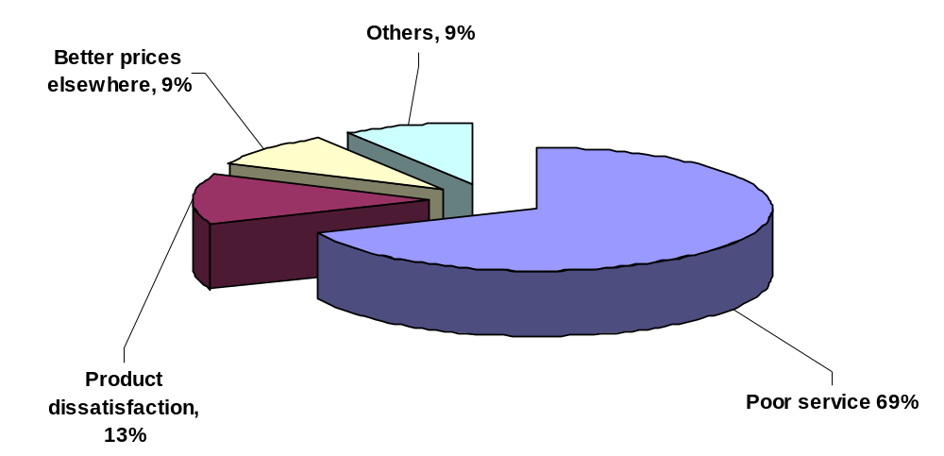
Why Customers leave?

Slide 15



Difference between…..
Good service
Bad service
Excellent service

Slide 16


Good Customer Service
Good service is when the customer gets
treatment that meets his/her expectations.
Customer
Expectation
What Customer receives

Slide 17

Bad Customer Service
Bad Service is when customer gets treatment
which is less than his/her expectations
Customer
Expectation
What Customer receives

Slide 18

Excellent Customer Service
When the customer gets a little more than what
he/she expected, Good Service becomes
Excellent Service
+
Customer
Expectation
What Customer receives

Slide 19
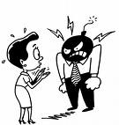
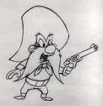

Categories of Customer
unreasonable requests and demand
Ex. Deadline, Price, 1+1
Angry customers
Stay calm.
Be an active listener.
Personalize the interaction.
Acknowledge your customer's emotions.
Use positive language.
Restate what they told you.
Build trust.
Thank them.
They think their needs and demands are superior to everybody else's. They scream, complain, abuse and may often get physical to get what they want
Demanding customers
do not feel any loyalty towards your organization and are happy to switch brands or products as soon as a better option comes along.
Passive customers

Slide 20
Customer perception of quality
American Society for Quality Survey shows that important factors that influence purchasing are
PERFORMANCE – Fitness for use
FEATURES – Secondary characteristics
SERVICE – Good service at right time
WARRANTY – Organizations public promise of a quality product
PRICE – High quality products at lower prices
REPUTATION – willing to buy from reputed organization

Slide 21
Identifying customer needs
Customer surveys, Market research programs and studies
Tracking customer complaints by letters and telephone
Customer meetings
Information on competitors products
Personal visits to customer locations
Employees with special knowledge of the customer

Slide 22
Customer Complaints
A customer complaint may be defined as an expression of dissatisfaction with a product or service, either orally or in writing, from an internal or external customer.
Why is it necessary?
To discover customer dissatisfaction,
To identify customer needs,
To discover relative priorities of quality,
To compare performance with the competition and
To determine opportunities, for improvement.

Slide 23
Various tools for collecting customer feedback or customer complaint
1. Customer cards or comment cards – question and answer type, normally attached to the warranty card.
2. Customer questionnaire – survey through website, E-mail, telephone.
3. Post–transaction surveys – conducted immediately after a customer service interaction.
4. Reports or Feedback cards – physical paper cards or forms with one or more survey questions designed to collect customer feedback.

Slide 24
Various tools for collecting customer feedback or customer complaint
5. Social media – social networks, online communities, blogs, and discussion boards can be used to collect customer feedback.
6. Toll-free telephone numbers – Effective tool for receiving customer feedback.
7. Customer visits – visit the customer's place to gather information and feedback on the product.

Slide 25
Customer satisfaction / dissatisfaction feedback
Customer feedback has to be continuously sought and monitored - not one-time only! (Pro-active! Complaints are a reactive method of finding out there is a problem)
Customer feedback can be related to Manufacturer
Performance comparison with competitors can be known
Customers needs can be identified
Relative priorities of quality can be obtained from the feedback
Areas for improvement can be noted.

Slide 26
Customers - Handle with care
Employers don’t pay wages but it is the customer who pays the wages!
So take good care of your customers.
Customer-care centers not just profit-centers!
The entire organization must in effect revolve around the customer – whether the customer is being well served and if he is really pleased, contented and satisfied with the service you have to offer.

Slide 27
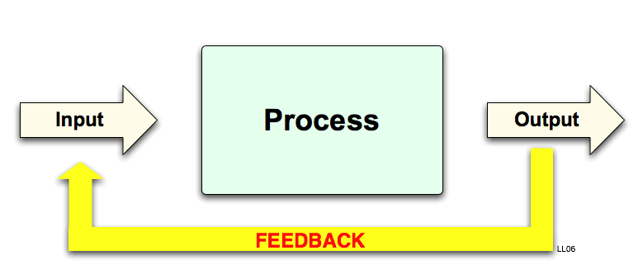
Continuous Process Improvement
Create a system for constant and continuous improvement

Slide 28
Continuous Process Improvement
Understand the Process: Variations are Major Enemies
Detecting mode (heavy dependence on inspection/testing/control):
Fire fighting is not effective
Preventive mode (emphasis on “do it right the first time and all the time):
Use FEEDBACK to take corrective actions so that the process can be continuously improved.

Slide 29
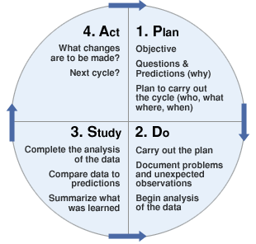
Continuous Process Improvement
Deming’s PDSA Cycle: Embedded in the Continuing System

Slide 30
Continuous Process Improvement
Reasons for Collecting Data
Provide objective information
Increase info about the change (Positive/negative)
Give some expectation of the change impact
Show if the gains are retained
Involve the staff in the changes
Provide economic impacts

Slide 31
Continuous Process Improvement
Model for Improvement
What are we trying to accomplish?
How will we know that a change is an improvement?
What change can we make that will result in improvement?
Act Plan
Study Do

Slide 32
Continuous Process Improvement
Problem Solving: A Continuous Effort
Identify problems as an opportunity
Analyze the problem: to find root causes
Develop optimal and cost effective solutions
Implement changes: system wide
Study the results: worked or not? Need adjustment?
Standardize solution: Keep problems from reoccurring.

Slide 33
Continuous Process Improvement
Process Improvement Strategy: Finding Cost Effective Solution
Control existing process: i.e., statistical process control (SPC)
Optimize the process: i.e., design of experiment (DOE)
Change the system: hardware, software and brainware
New system: machine, human, materials, method

Slide 34
Continuous Process Improvement
Process Improvement Strategy: Finding Cost Effective Solution
Build a quality (continuous improvement) culture. Positive and Constructive.
Drive out fear.
Provide organization-structural assurance for continuing feedback system.
Respond to customers needs and solve problems timely.
Standardize the procedure and continuously improve it.

