Slide 1
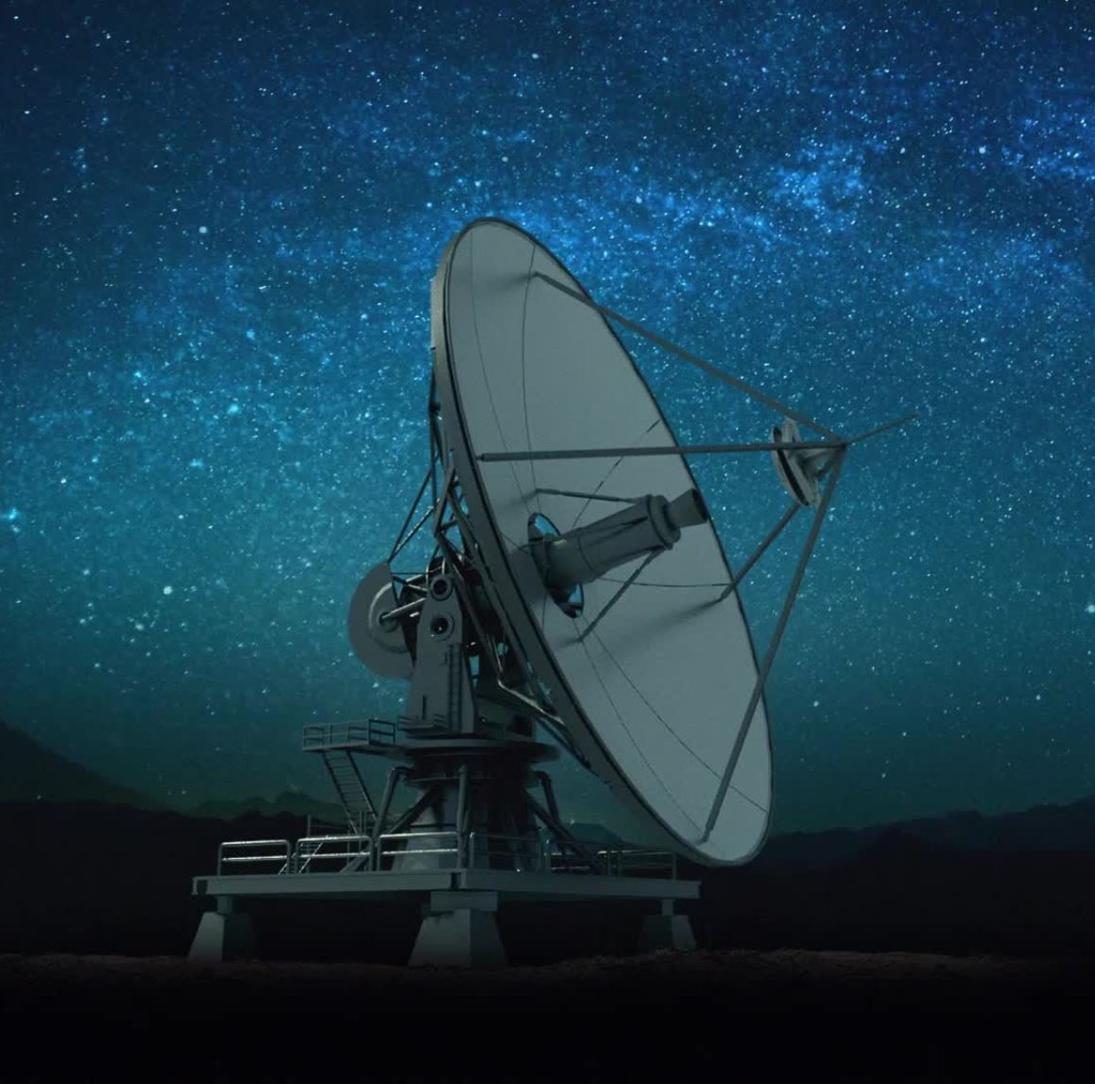
Satellite Image Classification using CNN architectures
Satellite Imagery Analysis through simple cnn models

Slide 2
Motivation
Satellite imagery is a valuable resource across various fields including agriculture, urban planning, disaster management, and environmental monitoring.
Manual analysis of satellite images is time-consuming and resource-intensive.
Automating the classification process can expedite analysis and decision-making, leading to more efficient and informed actions.
Simple CNN architectures offer a promising approach for accurate and scalable classification of satellite images.

Slide 3
Applications
Agriculture: Monitoring crop health, yield estimation, and pest detection.
Urban Planning: Land use classification, infrastructure development planning.
Disaster Management: Damage assessment, emergency response planning.
Environmental Monitoring: Deforestation detection, water body classification, and habitat mapping.

Slide 4
Objectives
Implement Convolutional Neural Network (CNN) architectures for satellite image classification.
Fine-tune CNN models to optimize performance for satellite imagery analysis.
Gain insights into the workings of CNN architectures.
Understand the impact of different CNN architectures on classification accuracy and efficiency in satellite imagery analysis.

Slide 5
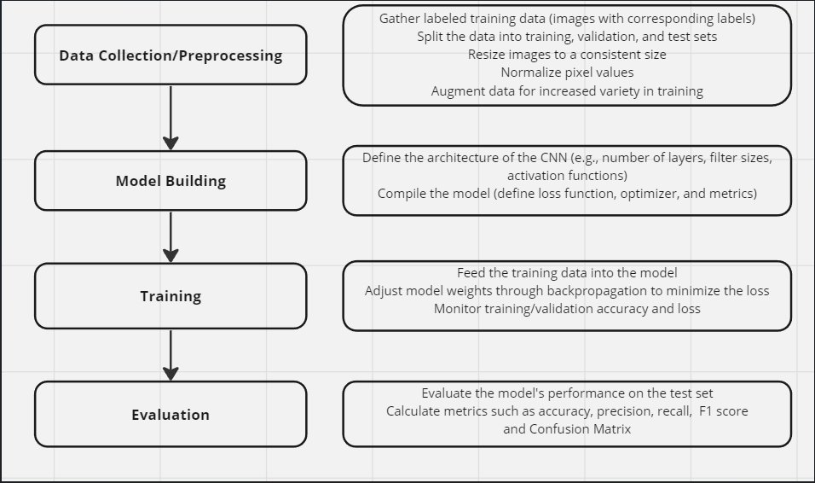
Methodology

Slide 6
Data
Source-Satellite image Classification Dataset-RSI-CB256
This dataset has 4 different classes mixed from Sensors and google map snapshot
Image augmentation has been done , like horizontal flip.
The dataset was divided into three subsets: training, validation, and testing. Split taken was 0.8,0.1,0.1.
The training set was used to train the CNN models, the validation set was used to fine-tune hyperparameters, and the test set was used to evaluate model performance.

Slide 7
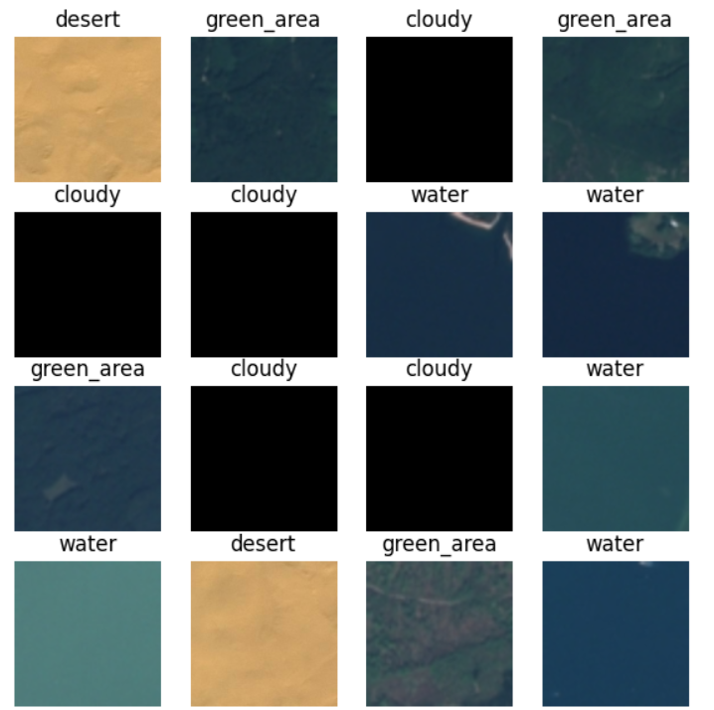
Sample data points

Slide 8
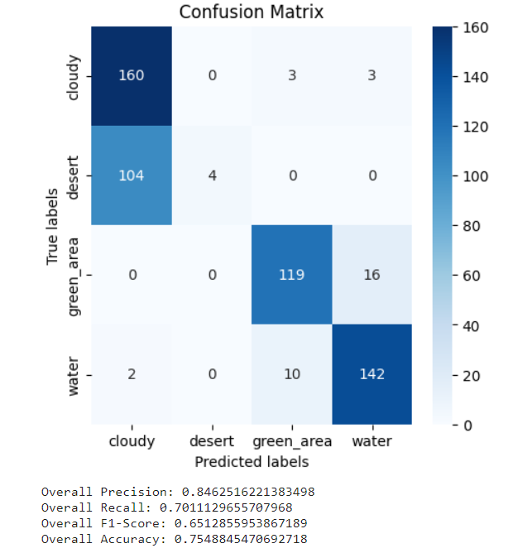
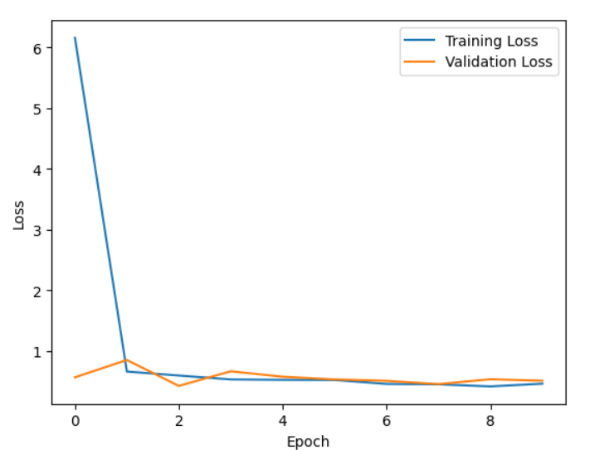
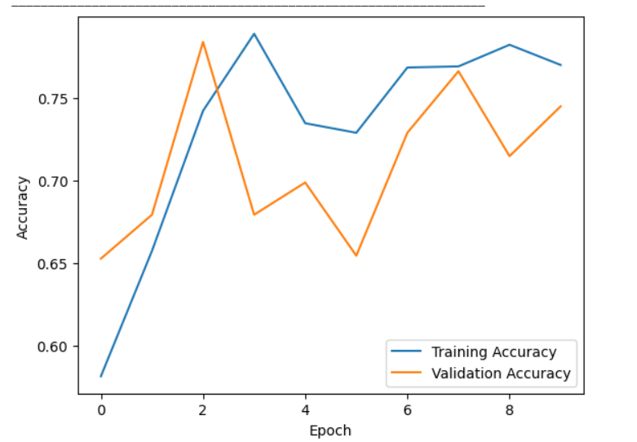
Results
LeNet-5.
It achieved accuracy of 0.75.

Slide 9
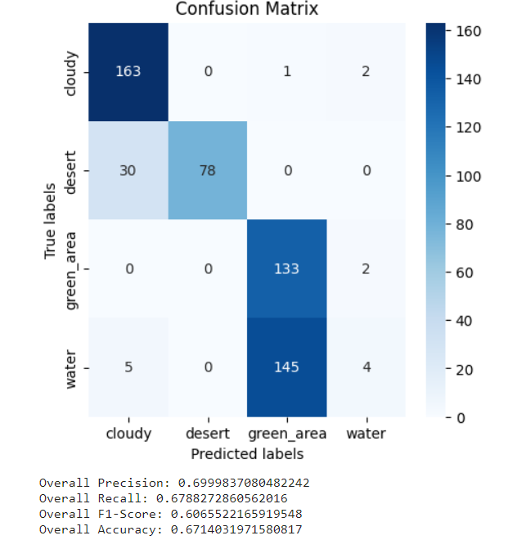
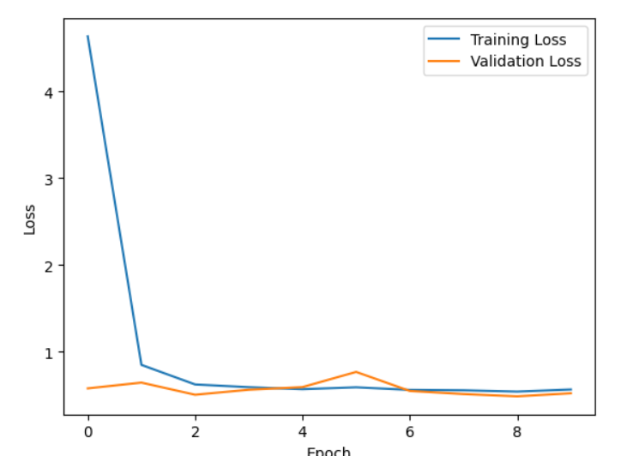
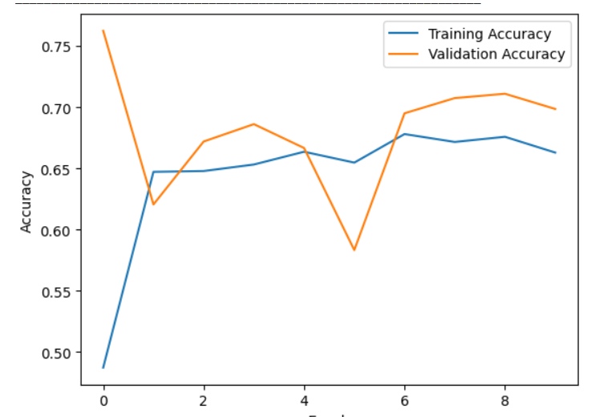
Results
Alex Net( with drop out)
It achieved accuracy of 0.67.

Slide 10
Transfer Learning with Pre-trained Models:
Utilizing pre-trained models (VGG, ResNet50, DenseNet) from ImageNet.
Fine-tuning these models on our satellite image dataset.
Leveraging pre-trained weights to expedite convergence and improve classification accuracy.
Accuracies obtained for VGG,ResNet50 and DenseNet are 99,98,99 respectively.

Slide 11
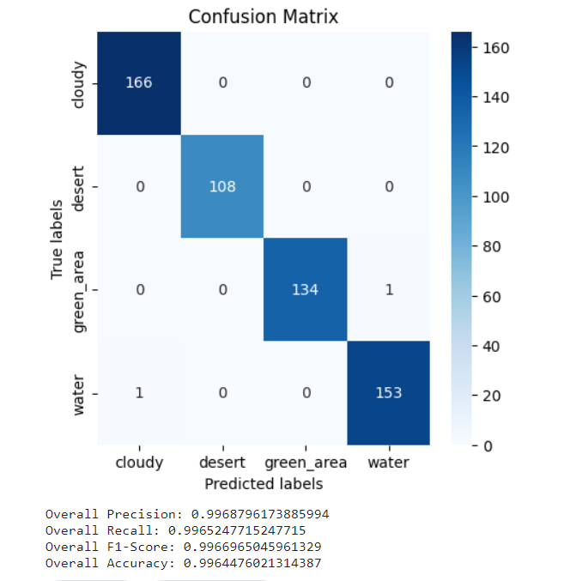
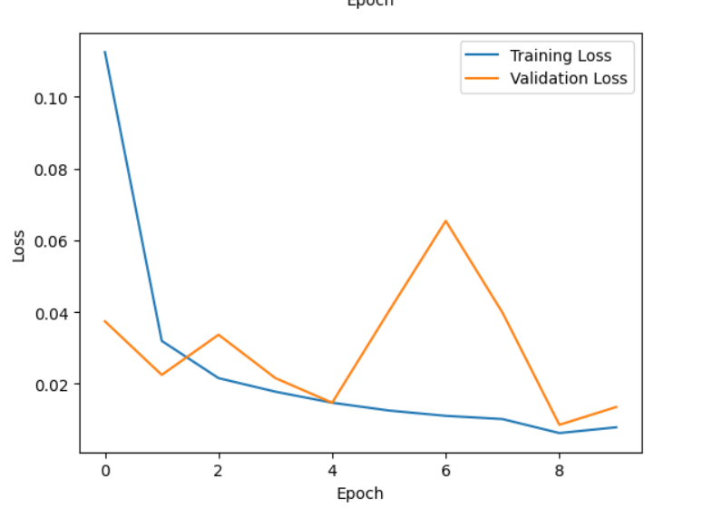
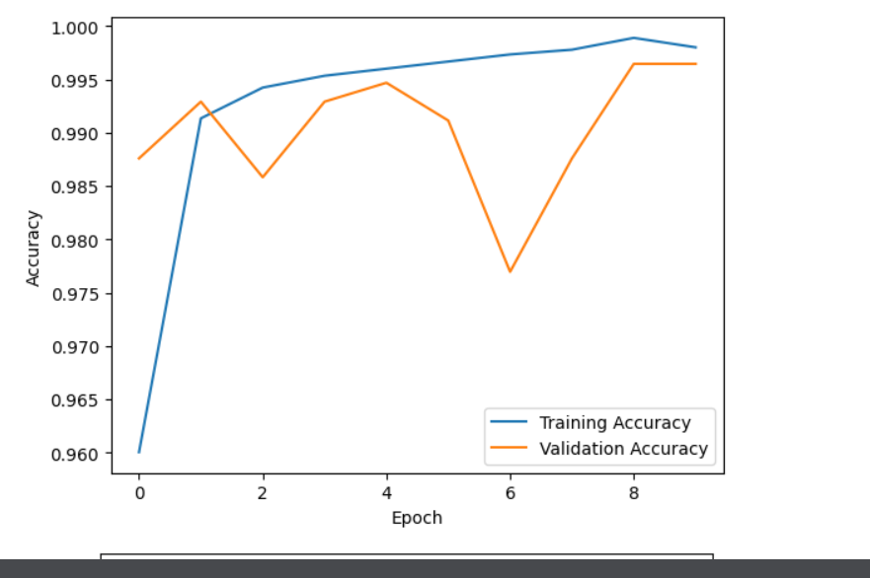
Results
Transfer Learning with Pre-trained Models
It achieved accuracy of 0.67.

Slide 12
Summary
VGG, ResNet, and DenseNet achieved high accuracy, indicating their effectiveness in feature extraction and classification.
LeNet and AlexNet, while showing decent performance, were outperformed by deeper architectures.
Custom CNN model built with dropout, resulted in decreased test accuracy, this indicates, hence it doesnot overfit the dataset.
For more data

Slide 13
Literature
Satellite Image Classification with Deep Learning (Authors: Mark Pritt, Gary Chern)
Satellite image classification using deep learning approach ( Authors: Divakar Yadav, Kritarth Kapoor)
Satellite Image Categorization Using Scalable Deep Learning( Authors: Samabia Tehsin,Sumaia Kausar)

